Slide 1

Readmission Risk
Prediction
Predicting 30-Day Hospital Readmission for Diabetic Patients
INSY 674 · Enterprise Data Science · Group Project

Slide 2






Our Team
Feroz Khan
Matthieu Lafont
Henry Wolcott
Mustafa Yousaf
github.com/Stafa7/readmission-risk-prediction

Slide 3

Why Hospital Readmission Matters
Business Goal
$26B+
Reduce avoidable 30-day readmissions and allocate follow-up resources efficiently.
DS Goal
Annual cost of avoidable
30-day readmissions in the U.S.
Build an end-to-end PoV pipeline that predicts readmission risk with measurable lift over a heuristic baseline.
Limited Resources
Transition-of-care nurses, social workers, and follow-up capacity are finite. Targeting matters.
Hypothesis
Using routinely available encounter-level data, we can predict 30-day readmission risk better than simple heuristics, with interpretable explanations suitable for operational adoption.

Slide 4

Data Overview
Diabetes 130-US Hospitals (1999–2008) · UCI Repository
101,766
50+
130
10 yrs
Encounters
Features
U.S. Hospitals
Clinical Data
Target Definition
Key Feature Groups
1 = Readmitted ≤ 30 days
0 = Not readmitted ≤ 30 days
After leakage removal: 99,343 rows
11.4% positive rate (heavily imbalanced)
Demographics: age, gender, race (for auditing)
Utilization: labs, meds, OP/ER/IP visit counts
Encounter: admission type, discharge, LOS
Clinical: ICD-9 groups, A1C flag, med changes
Class Imbalance: Only ~11% positive — PR-AUC matters more than accuracy.

Slide 5
End-to-End Pipeline
Data Cleaning
& Leakage
Prevention
Feature
Engineering
(ICD-9, meds)
Feature
Selection
(MI, PCA)
Train/Test
Grouped
Split
SOTA Models
(LR, RF, XGB,
LGBM, Stack)
Calibration
& SHAP
Explainability
Fairness
Audit &
Outputs
→
→
→
→
→
→
Course Concepts Applied
Module II
End-to-end DS lifecycle, best practices, patient-level splits
Module III
Feature engineering (ICD-9 grouping, polynomial & derived features), MI, PCA
Module IV
SOTA Classification: LR, RF, XGBoost, LightGBM, Stacking Ensemble
Module V
PCA for dimensionality reduction and exploration

Slide 6
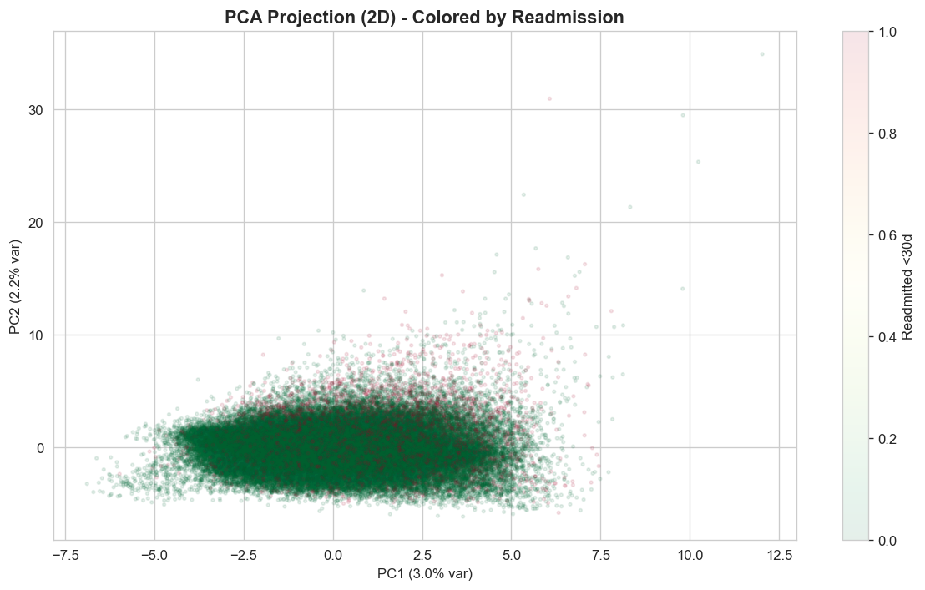
Feature Engineering & Selection
Feature Selection
ICD-9 Grouping
500+ raw codes → 18 clinical categories
Zero-variance removal
Correlation filtering (|r| > 0.85)
Mutual Information scoring
PCA 2D visualization
Medication Aggregation
23 med columns → active count + change indicators
Derived Features
total_visits, high_utilizer, many_meds, poly_visits
Encoding
One-hot for categoricals, ordinal for age bands

Slide 7

Modeling Approach
Binary classification producing risk probabilities, risk tiers, and a top-K outreach list.
BASELINE
ROBUST
PRIMARY
PRIMARY
ADVANCED
Logistic
Regression
Random
Forest
XGBoost
LightGBM
Stacking
Ensemble
Fast, stable,
interpretable
Handles
nonlinearities
Top tabular
performer
Fast gradient
boosting
Multi-model
combination
Selection Criteria
ROC-AUC + PR-AUC
Top-K Recall/Precision
Calibration (Brier)
Fold Stability
SHAP Explanations
Maintainability

Slide 8
5-Fold Cross-Validation Results
StratifiedGroupKFold — no patient leakage between folds
Model | PR-AUC | ROC-AUC | Brier
Logistic Regression | 0.2113 ± 0.015 | 0.6614 ± 0.009 | 0.2264 ± 0.002
Random Forest | 0.2114 ± 0.016 | 0.6631 ± 0.011 | 0.2164 ± 0.002
XGBoost | 0.2205 ± 0.013 | 0.6583 ± 0.009 | 0.1946 ± 0.002
LightGBM | 0.2255 ± 0.013 | 0.6643 ± 0.010 | 0.2036 ± 0.002
LightGBM leads on PR-AUC (0.2255) and ROC-AUC (0.6643) with stable folds. XGBoost has the best calibration (Brier: 0.1946).

Slide 9
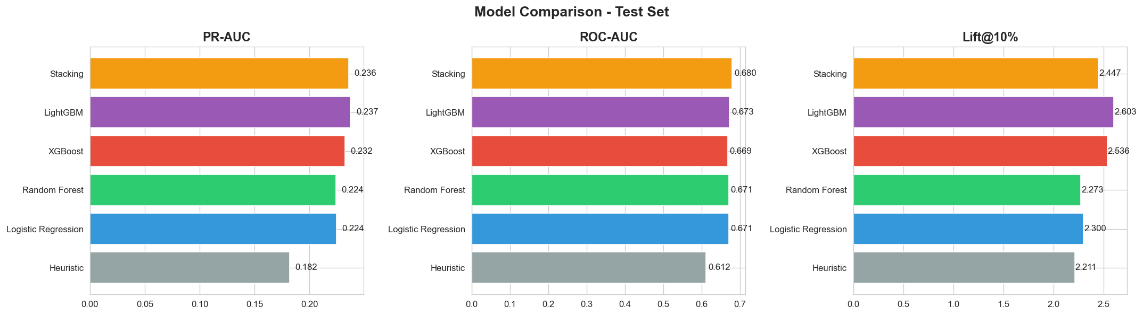
Test Set Model Comparison
Model | PR-AUC | ROC-AUC | Brier | Recall@10% | Lift@10%
Heuristic | 0.1817 | 0.6122 | 0.1041 | 22.1% | 2.21x
Logistic Reg. | 0.2243 | 0.6710 | 0.2250 | 23.0% | 2.30x
Random Forest | 0.2240 | 0.6707 | 0.2158 | 22.7% | 2.27x
XGBoost | 0.2323 | 0.6686 | 0.1963 | 25.4% | 2.54x
LightGBM ★ | 0.2373 | 0.6731 | 0.2043 | 26.0% | 2.60x
Stacking | 0.2358 | 0.6802 | 0.0955 | 24.5% | 2.45x

Slide 10
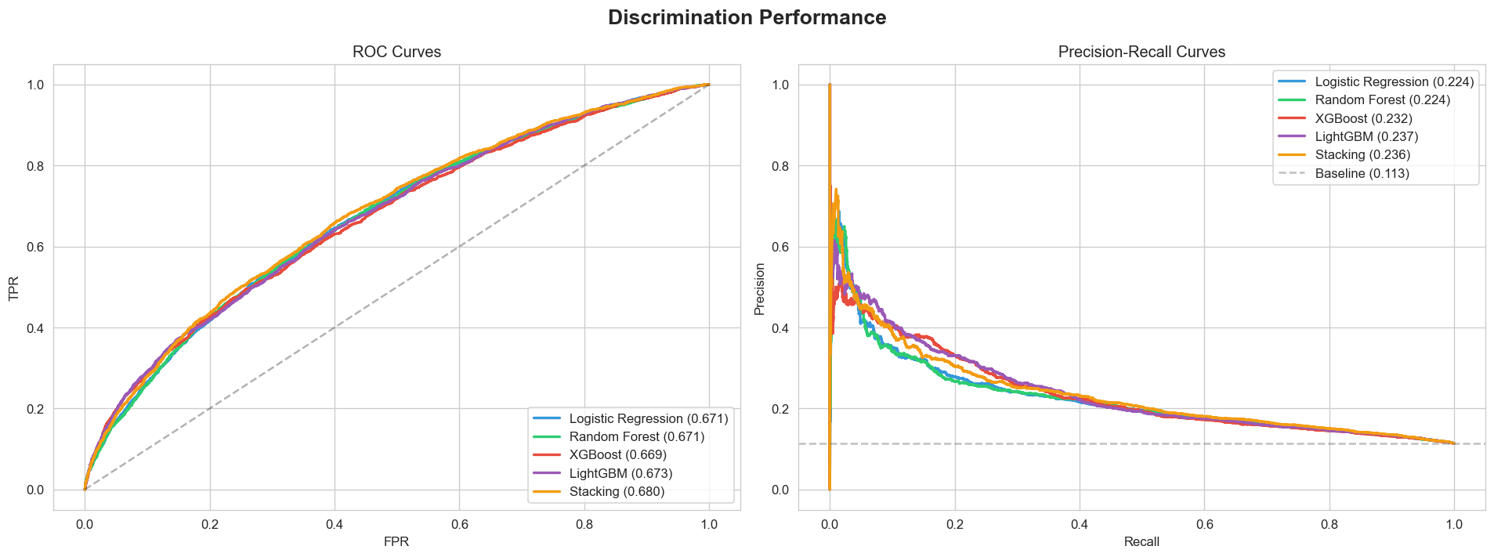
ROC & Precision-Recall Curves
LightGBM achieves the best PR-AUC (0.2373), which is critical under 11% class imbalance. ROC-AUC of 0.6731 confirms meaningful discrimination above baseline.

Slide 11
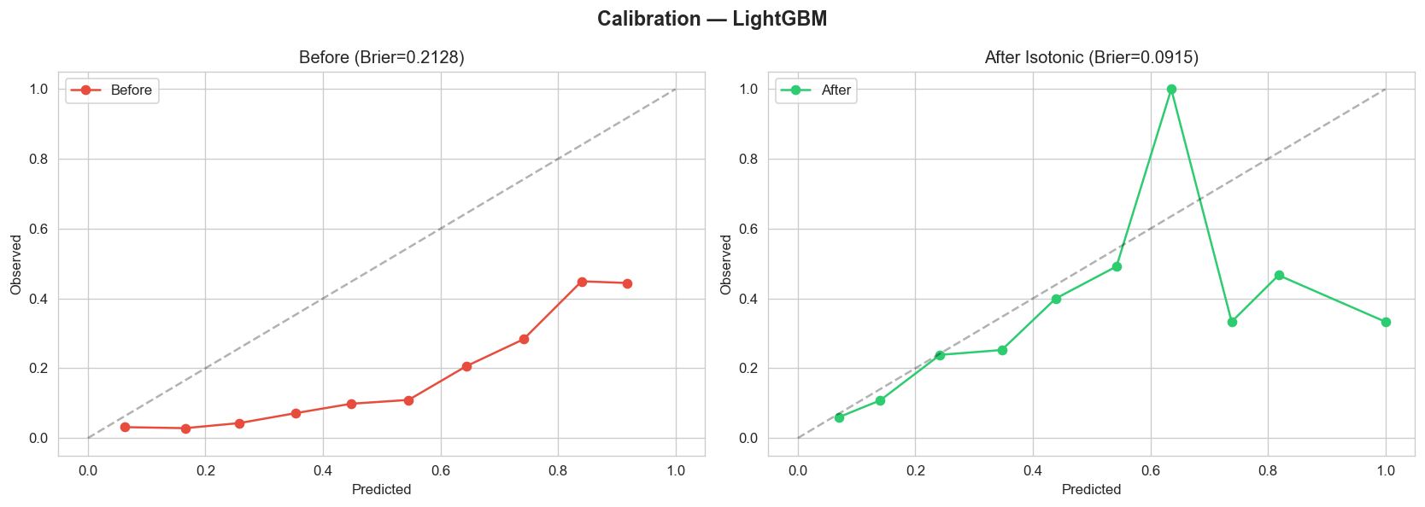
Probability Calibration
Before
→
After (Isotonic)
Brier Score: 0.2128
Brier Score: 0.0915

Slide 12
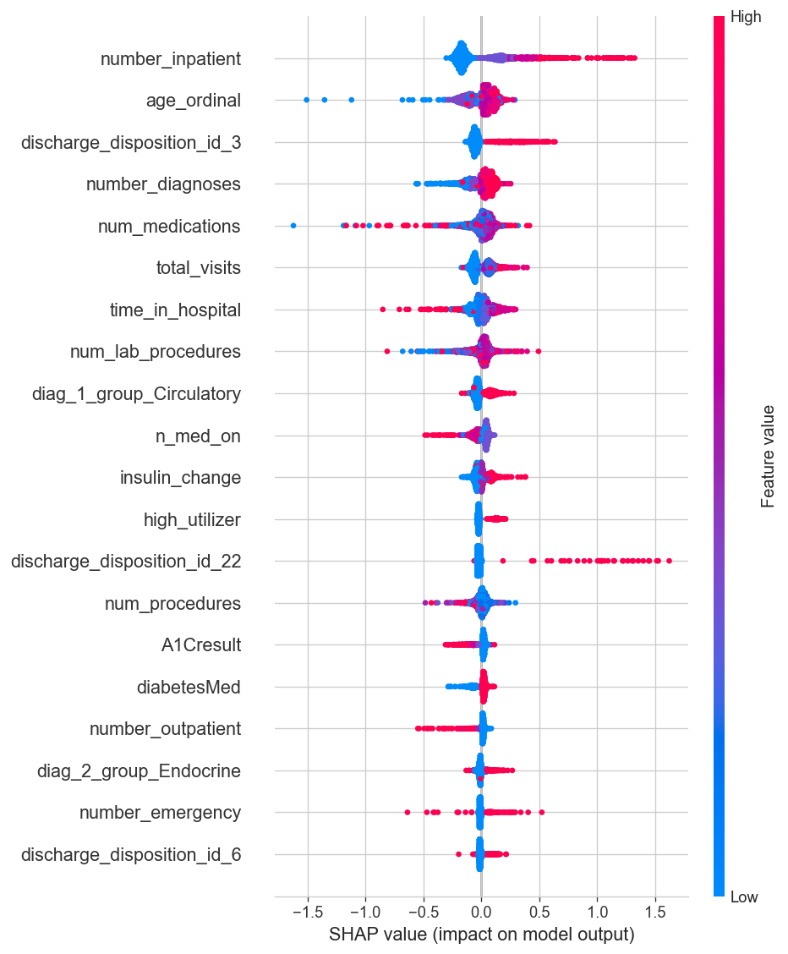
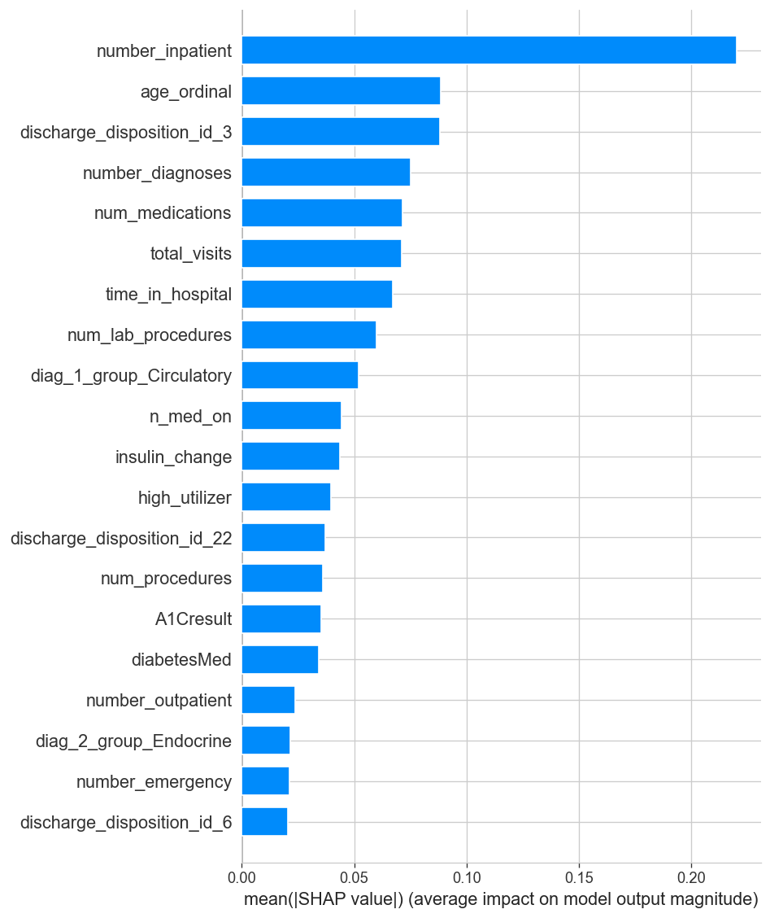
Explainability — SHAP Analysis
Global feature importance (left: beeswarm, right: mean |SHAP|)

Slide 13
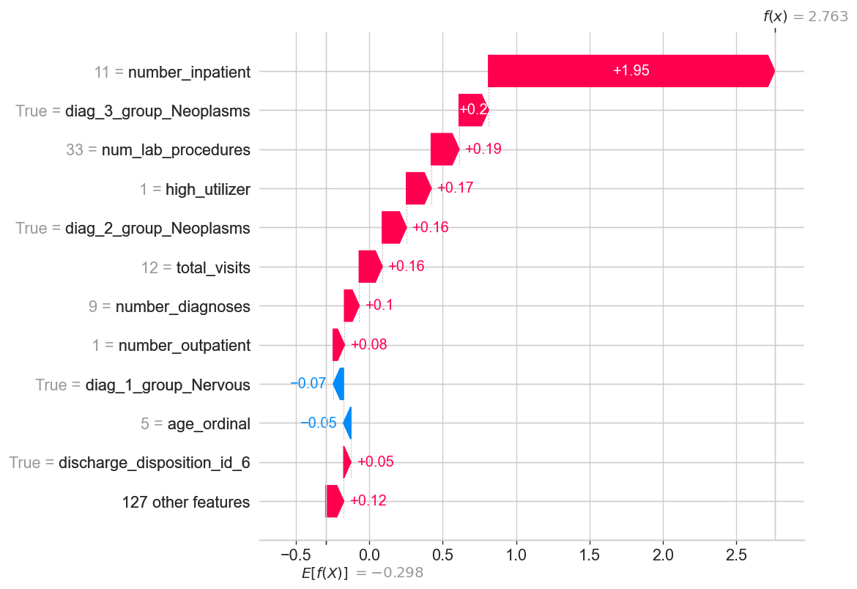
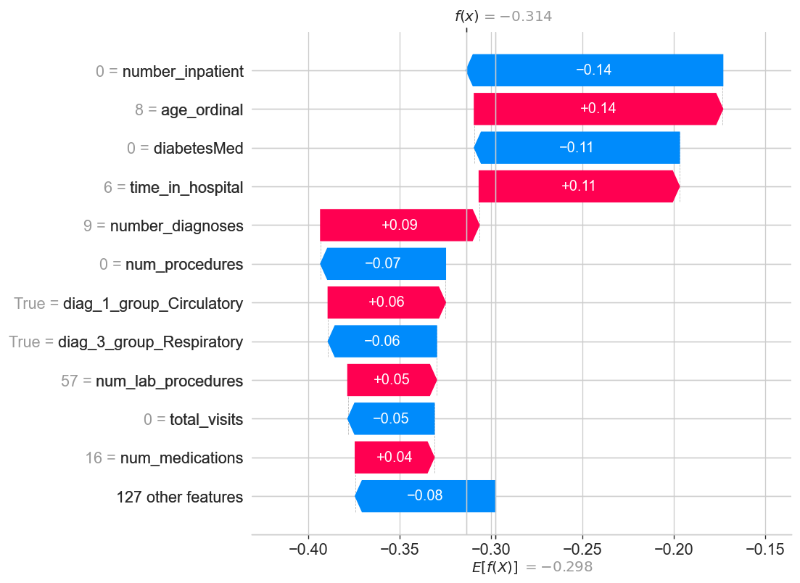
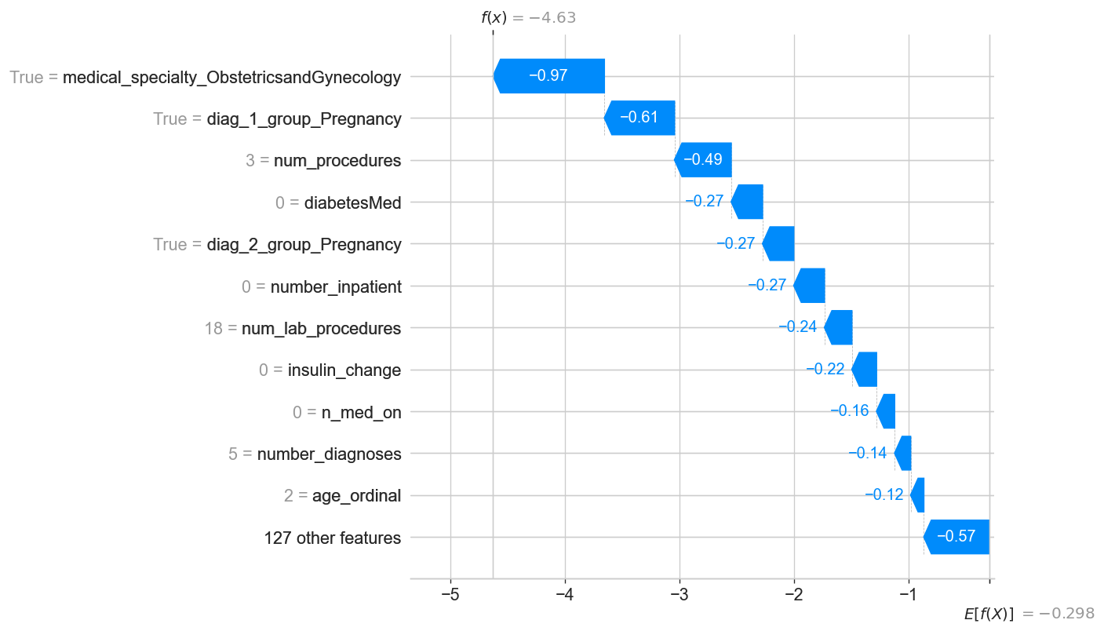
Per-Patient Explanations
High Risk
Medium Risk
Low Risk
SHAP waterfall plots show per-patient feature contributions — enabling clinicians to understand why a patient was flagged.

Slide 14
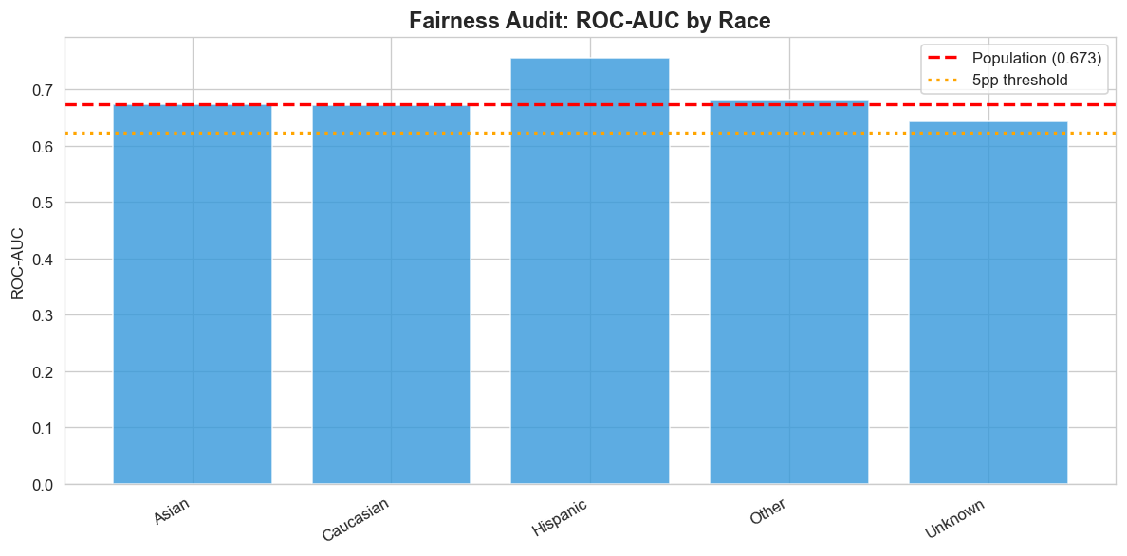
Fairness Audit
Race Group | N | Base Rate | ROC-AUC
Caucasian | 18,510 | 11.5% | 0.671
Hispanic | 398 | 9.0% | 0.755
Other | 302 | 10.3% | 0.680
Asian | 116 | 8.6% | 0.674
Unknown | 447 | 7.2% | 0.644
Max subgroup ROC-AUC gap: −0.029 ✓ — No significant fairness concerns detected. Model performance is consistent across racial subgroups.

Slide 15



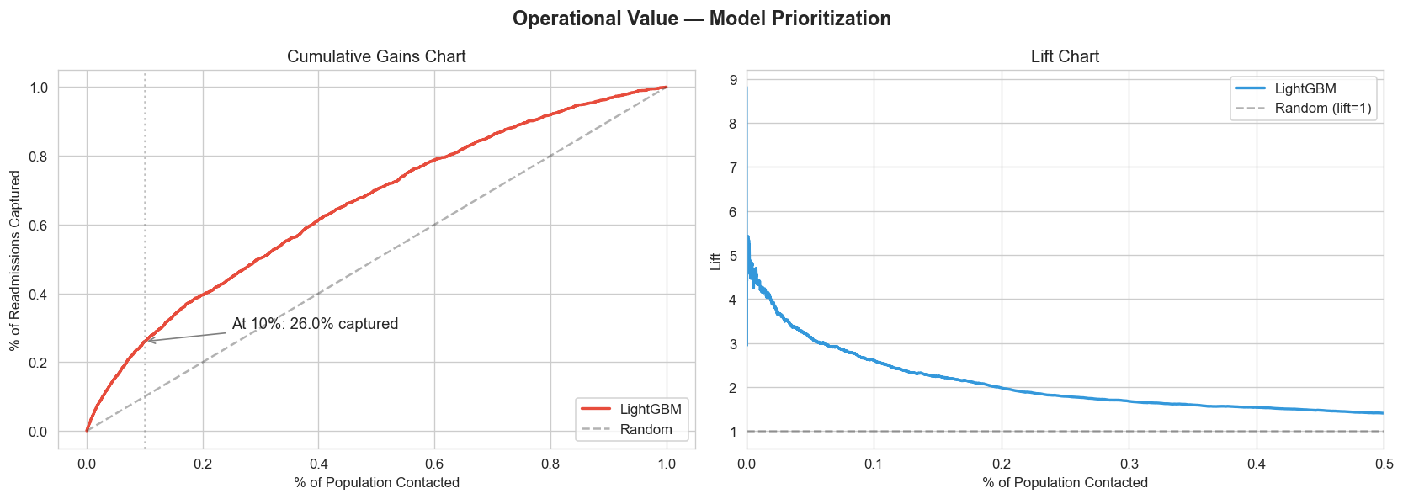

Operational Outputs
Risk Probability
Risk Tiers
Top-K Outreach List
0–1 score for each patient at discharge
Low / Medium / High based on percentile thresholds (15th, 85th)
Prioritized list for care-management with SHAP explanations per patient
Key Result
By contacting the top 10% of patients by risk score, we capture 26% of all 30-day readmissions — a 2.6x lift over random selection.

Slide 16
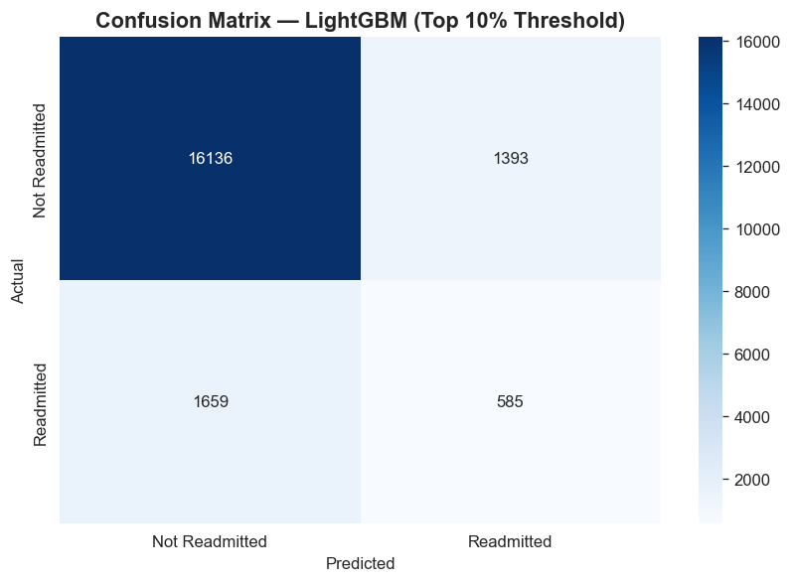
Classification at Top-10% Threshold
Classification Report (top 10%)
Precision (readmitted): 30%
Recall (readmitted): 26%
Overall accuracy: 85%
At the top-10% threshold, nearly 1 in 3 flagged patients is a true readmission — meaningful for targeted outreach.

Slide 17
Key Takeaways
LightGBM is the winning model — best PR-AUC (0.237) with strong operational lift (2.6x at top 10%)
Isotonic calibration reduced Brier score from 0.213 to 0.092 — risk scores are now actionable
SHAP provides global and per-patient explanations — clinicians can see why each patient was flagged
Fairness audit shows no significant subgroup disparities (max gap: −0.03 ROC-AUC)
Patient-level grouped split prevents data leakage — results reflect real-world deployment

Slide 18

Limitations & Next Steps
Limitations
Next Steps
Dataset is from 1999–2008 — clinical practices have evolved
Hyperparameter tuning (Bayesian optimization)
~11% positive rate limits absolute precision at any threshold
External validation on a different hospital dataset
Missing weight (97%) and payer code — potential signals lost
A/B test integration with EHR workflow
No external validation on a separate hospital system
Model monitoring & drift detection in production

Slide 19
Thank You
Questions & Discussion
Feroz Khan · Matthieu Lafont · Henry Wolcott · Mustafa Yousaf
github.com/Stafa7/readmission-risk-prediction
INSY 674 · Enterprise Data Science · February 2026

