Slide 1

Readmission Risk
Prediction
Predicting 30-Day Hospital Readmission for Diabetic Patients
INSY 674 · Enterprise Data Science · Group Project
Notes:
Hello - We're presenting our end-to-end ML pipeline for predicting 30-day hospital readmission risk in diabetic patients.

Slide 2






Our Team
ferozobaid
Mlaf27
henrytwolcott-sudo
Stafa7
Feroz Khan
Matthieu Lafont
Henry Wolcott
Mustafa Yousaf
github.com/Stafa7/readmission-risk-prediction
Notes:
This is our team

Slide 3

Why Hospital Readmission Matters
Business Goal
$26B+
Reduce avoidable 30-day readmissions and allocate follow-up resources efficiently.
DS Goal
Annual cost of avoidable
30-day readmissions in the U.S.
Build an end-to-end PoV pipeline that predicts readmission risk with measurable lift over a heuristic baseline.
Limited Resources
Transition-of-care nurses, social workers, and follow-up capacity are finite. Targeting matters.
Hypothesis
Using routinely available encounter-level data, we can predict 30-day readmission risk better than simple heuristics, with interpretable explanations suitable for operational adoption.
Notes:
"Hospital readmissions within 30 days cost the U.S. healthcare system over $26 billion every year. That's not just a financial burden—CMS penalizes hospitals with excess readmission rates, and more importantly, each avoidable readmission disrupts patient recovery.
The challenge is resource allocation. Transition-of-care nurses, social workers, and follow-up scheduling capacity are all finite. Hospitals can't call every discharged patient—they need a principled way to decide who to prioritize.
Our business goal is simple: reduce avoidable readmissions by enabling risk-stratified follow-up.
Our data science goal is to build a proof-of-value pipeline that predicts readmission risk with measurable lift over heuristic baselines, and produces outputs that are actionable, explainable, and audited for fairness.
Our hypothesis: Using routinely available encounter-level data—demographics, utilization history, clinical proxies—we can beat simple heuristics like 'high prior utilization equals high risk,' while maintaining interpretability suitable for clinical adoption."
”Mustafa will show you the data we worked with..."

Slide 4

Data Overview
Diabetes 130-US Hospitals (1999–2008) · UCI Repository
101,766
50+
130
10 yrs
Encounters
Features
U.S. Hospitals
Clinical Data
Target Definition
Key Feature Groups
1 = Readmitted ≤ 30 days
0 = Not readmitted ≤ 30 days
After leakage removal: 99,343 rows
11.4% positive rate (heavily imbalanced)
Demographics: age, gender, race (for auditing)
Utilization: labs, meds, OP/ER/IP visit counts
Encounter: admission type, discharge, LOS
Clinical: ICD-9 groups, A1C flag, med changes
Class Imbalance: Only ~11% positive — PR-AUC matters more than accuracy.
Notes:
[0:30] We used the UCI Diabetes 130-US Hospitals dataset: 101,000 encounters, 50+ features, 130 hospitals, 10 years of data.
Target: binary—readmitted within 30 days or not. After removing leakage cases like deaths, we have 99,340 rows with 11% positive rate.
This severe imbalance means PR-AUC is our primary metric—accuracy would be meaningless here.

Slide 5
End-to-End Pipeline
Data Cleaning
& Leakage
Prevention
Feature
Engineering
(ICD-9, meds)
Feature
Selection
(MI, PCA)
Train/Test
Grouped
Split
SOTA Models
(LR, RF, XGB,
LGBM, Stack)
Calibration
& SHAP
Explainability
Fairness
Audit &
Outputs
→
→
→
→
→
→
Notes:
[0:35] Our pipeline maps to course modules:
Module II: Data cleaning, leakage prevention, GroupShuffleSplit for zero patient overlap.
Module III: ICD-9 grouping from 500+ codes to 18 categories, medication aggregation, mutual information scoring, PCA.
Module IV: Five SOTA models—Logistic Regression, Random Forest, XGBoost, LightGBM, and Stacking.
Finally: calibration, SHAP explainability, and fairness auditing.

Slide 6
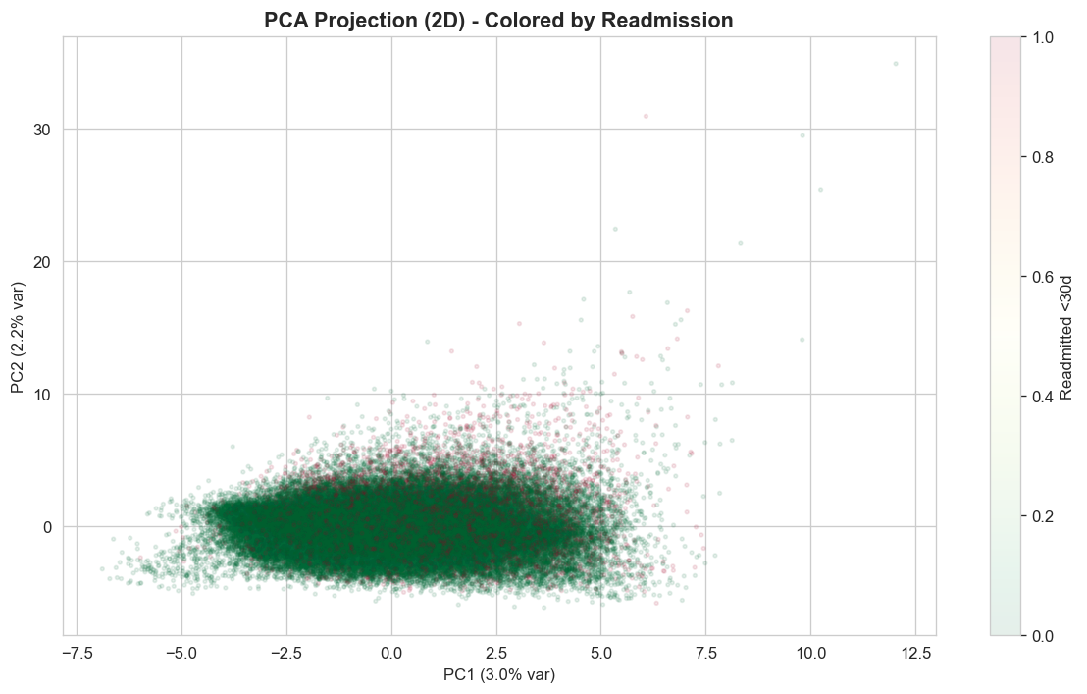
Feature Engineering & Selection
Feature Selection
ICD-9 Grouping
500+ raw codes → 18 clinical categories
Zero-variance removal
Correlation filtering (|r| > 0.85)
Mutual Information scoring
PCA 2D visualization
Medication Aggregation
23 med columns → active count + change indicators
Derived Features
total_visits, high_utilizer, many_meds, poly_visits
Encoding
One-hot for categoricals, ordinal for age bands
Notes:
[0:25] Feature engineering highlights:
ICD-9 Grouping: 500+ codes mapped to 18 clinical categories—preserving meaning, reducing dimensionality.
Medication Aggregation: 23 columns condensed to change counts and insulin indicators.
Derived Features: total_visits, high_utilizer, many_meds flags.
Feature Selection: correlation filtering, mutual information ranking, PCA visualization confirmed no clean class separation.

Slide 7

Modeling Approach
Binary classification producing risk probabilities, risk tiers, and a top-K outreach list.
BASELINE
ROBUST
PRIMARY
PRIMARY
ADVANCED
Logistic
Regression
Random
Forest
XGBoost
LightGBM
Stacking
Ensemble
Fast, stable,
interpretable
Handles
nonlinearities
Top tabular
performer
Fast gradient
boosting
Multi-model
combination
Selection Criteria
ROC-AUC + PR-AUC
Top-K Recall/Precision
Calibration (Brier)
Fold Stability
SHAP Explanations
Maintainability
Notes:
For the modelling approach we trained Five candidate models, each serving a different purpose:
Logistic Regression—interpretable baseline.
Random Forest—nonlinear robustness.
XGBoost and LightGBM—SOTA gradient boosting.
Stacking for multi-model combination.
And then our Selection criteria is PR-AUC, top-K recall, calibration, fold stability, SHAP compatibility, and maintainability.

Slide 8
5-Fold Cross-Validation Results
StratifiedGroupKFold — no patient leakage between folds
Model | PR-AUC | ROC-AUC | Brier
Logistic Regression | 0.2113 ± 0.015 | 0.6614 ± 0.009 | 0.2264 ± 0.002
Random Forest | 0.2114 ± 0.016 | 0.6631 ± 0.011 | 0.2164 ± 0.002
XGBoost | 0.2205 ± 0.013 | 0.6583 ± 0.009 | 0.1946 ± 0.002
LightGBM | 0.2255 ± 0.013 | 0.6643 ± 0.010 | 0.2036 ± 0.002
LightGBM leads on PR-AUC (0.2255) and ROC-AUC (0.6643) with stable folds. XGBoost has the best calibration (Brier: 0.1946).
Notes:
"We used StratifiedGroupKFold cross-validation to prevent patient leakage between folds—the same patient never appears in both training and validation within a fold.
Looking at PR-AUC, our primary metric, LightGBM leads at 0.2255 with low variance across folds. ROC-AUC tells the same story which is LightGBM at 0.6643.
XGBoost shows the best Brier score at 0.1946, indicating strong probability calibration. However, since we apply post-hoc calibration anyway, PR-AUC discrimination matters more for model selection.
The tight confidence intervals—plus-or-minus 0.01 to 0.015—indicate stable performance across different patient cohorts."
"Let's see how these translate to held-out test performance..."

Slide 9
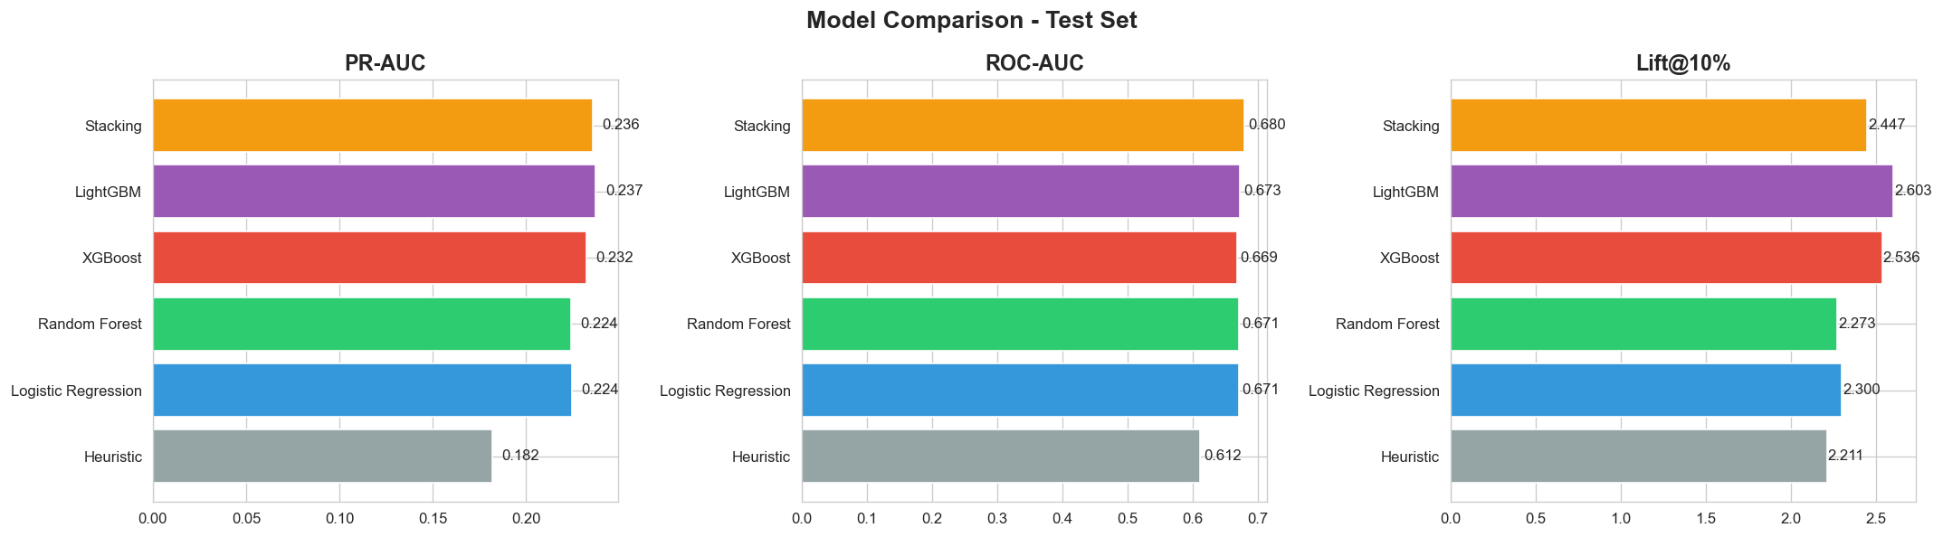
Test Set Model Comparison
Model | PR-AUC | ROC-AUC | Brier | Recall@10% | Lift@10%
Heuristic | 0.1817 | 0.6122 | 0.1041 | 22.1% | 2.21x
Logistic Reg. | 0.2243 | 0.6710 | 0.2250 | 23.0% | 2.30x
Random Forest | 0.2240 | 0.6707 | 0.2158 | 22.7% | 2.27x
XGBoost | 0.2323 | 0.6686 | 0.1963 | 25.4% | 2.54x
LightGBM ★ | 0.2373 | 0.6731 | 0.2043 | 26.0% | 2.60x
Stacking | 0.2358 | 0.6802 | 0.0955 | 24.5% | 2.45x
Notes:
"This table shows final performance on the held-out test set—patients never seen during training or cross-validation.
Key comparisons: Our heuristic baseline—ranking by prior visit counts—achieves 0.182 PR-AUC and 2.2× lift. All ML models beat this substantially.
LightGBM wins on PR-AUC at 0.237, with 26% recall at the top 10% threshold—meaning by contacting just 10% of discharged patients, we capture 26% of all eventual readmissions. That's a 2.6× lift over random selection.
Stacking achieves the highest ROC-AUC at 0.680 and best Brier score, but LightGBM's PR-AUC advantage makes it our choice. Under severe class imbalance, PR-AUC directly measures our ability to identify the minority class that matters.
Additionally, LightGBM is simpler than Stacking—a single model is easier to deploy, monitor, and maintain in production. It's also SHAP-compatible for efficient TreeExplainer explanations.
The star next to LightGBM indicates our winning model."
"Let's visualize these metrics..."

Slide 10
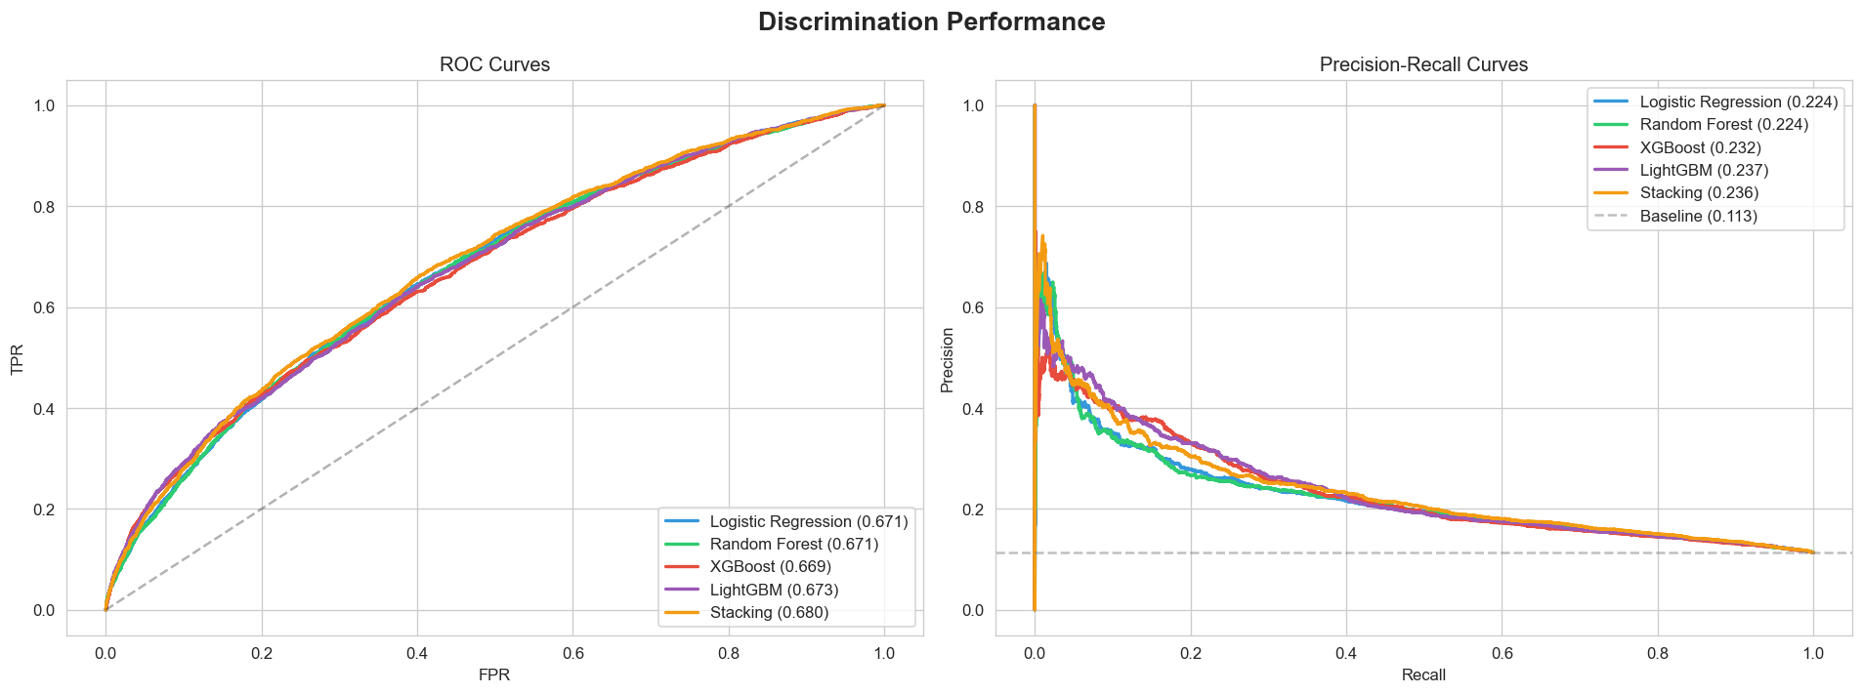
ROC & Precision-Recall Curves
LightGBM achieves the best PR-AUC (0.2373), which is critical under 11% class imbalance. ROC-AUC of 0.6731 confirms meaningful discrimination above baseline.
Notes:
The curves visualize our results.
ROC shows LightGBM above other models. PR curve—more important under imbalance—shows meaningful lift above the 11% baseline.
LightGBM dominates at higher recall values.

Slide 11
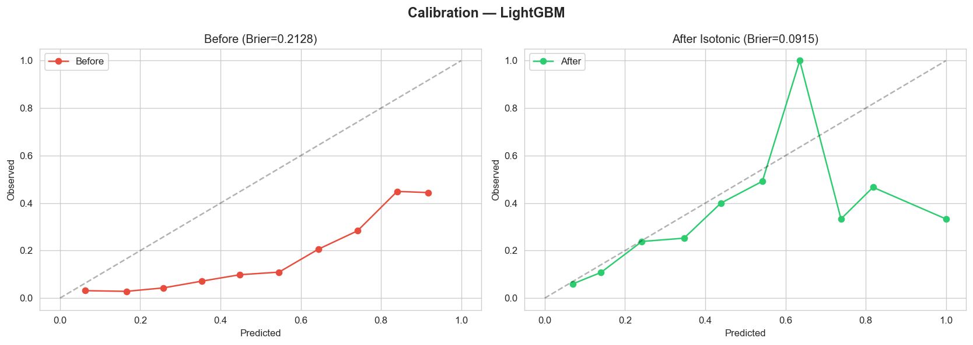
Probability Calibration
Before
→
After (Isotonic)
Brier Score: 0.2128
Brier Score: 0.0915
Notes:
[0:20] Calibration makes scores actionable. Before isotonic calibration: Brier 0.213, reliability curve deviates from diagonal. After: Brier drops to 0.092—57% improvement. Now a 20% score means roughly 1-in-5 actually get readmitted.

Slide 12
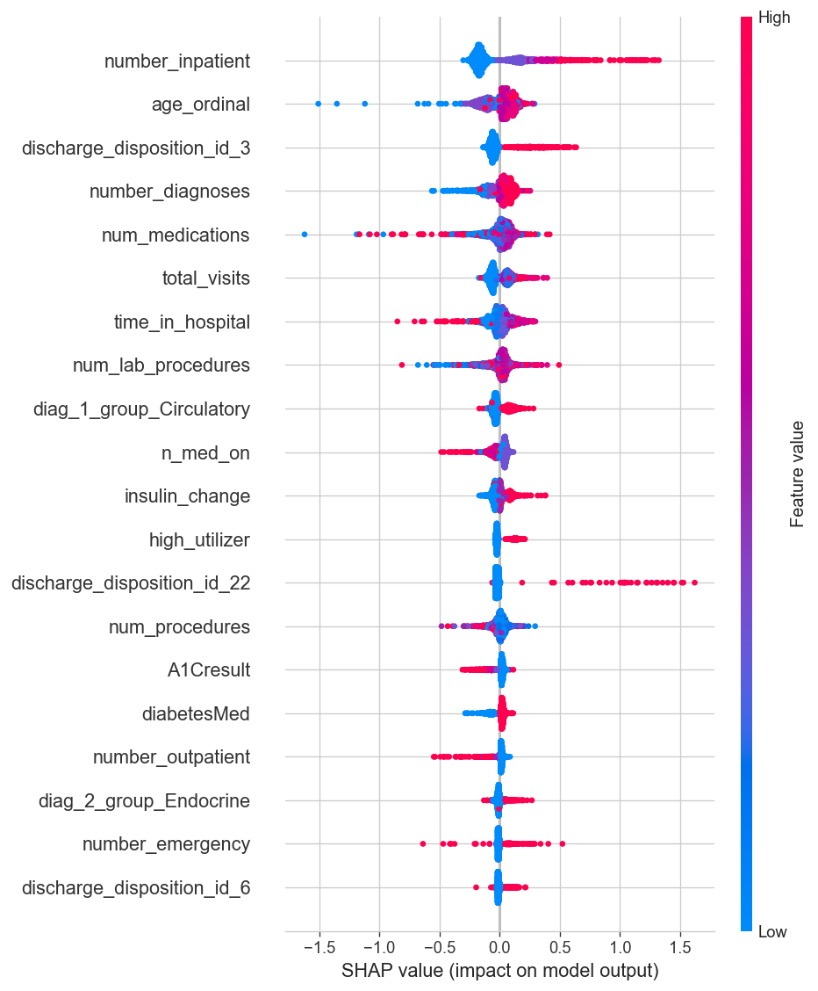
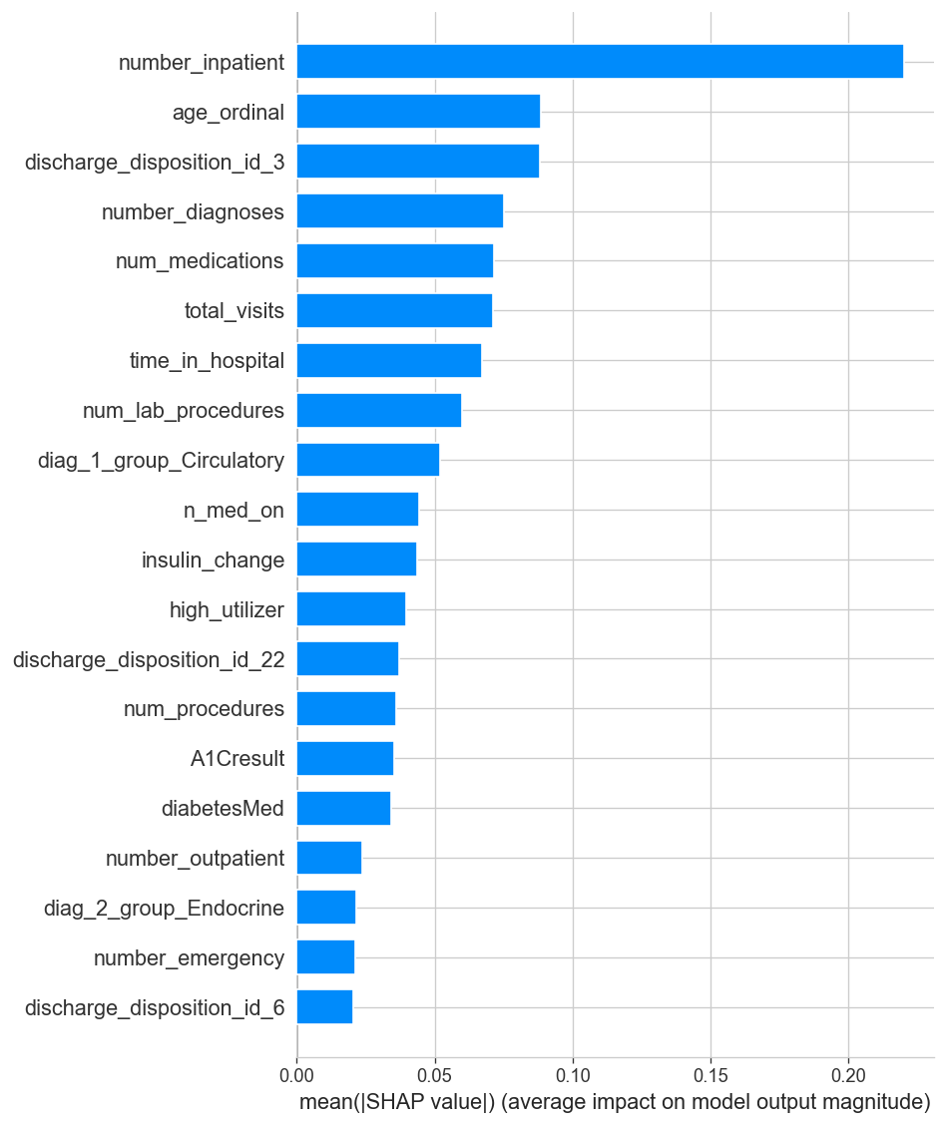
Explainability — SHAP Analysis
Global feature importance (left: beeswarm, right: mean |SHAP|)
Notes:
[0:25] SHAP provides explainability—essential for clinical trust.
Beeswarm plot shows global feature importance. Bar chart summarizes mean SHAP values.
Top drivers: number_inpatient, discharge_disposition, number_diagnoses, total_visits.
These align with clinical intuition: sicker patients with complex pathways and prior admissions are higher risk.

Slide 13
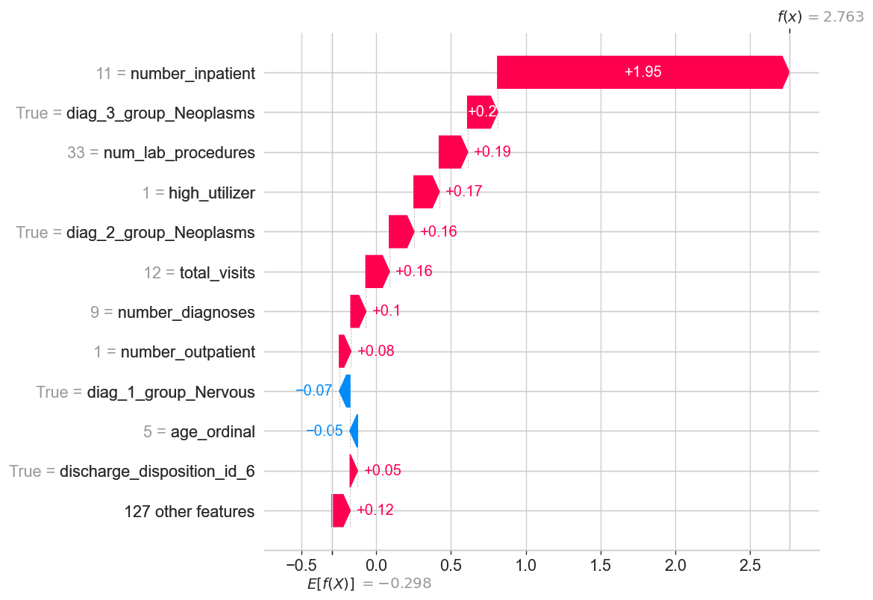
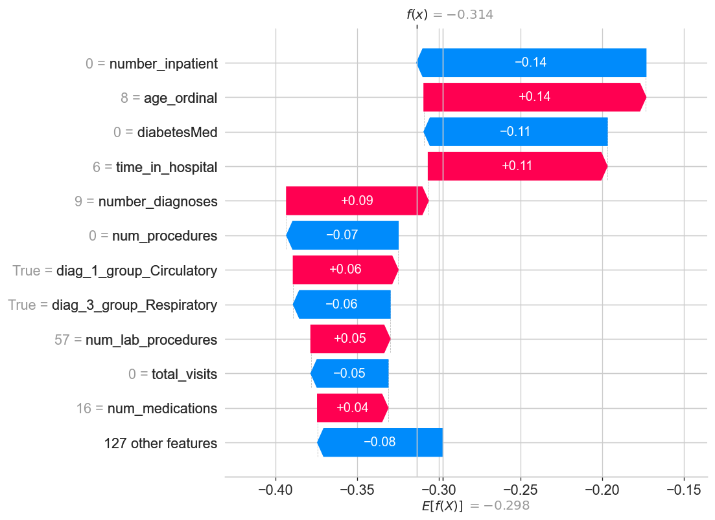
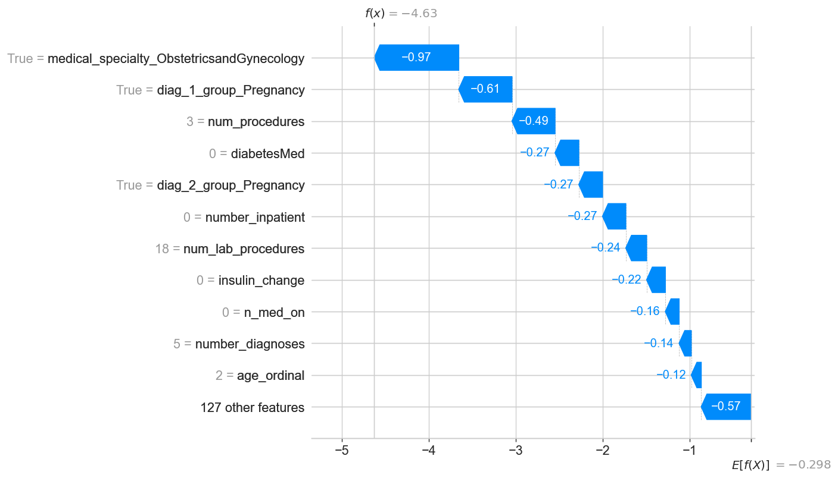
Per-Patient Explanations
High Risk
Medium Risk
Low Risk
SHAP waterfall plots show per-patient feature contributions — enabling clinicians to understand why a patient was flagged.
Notes:
[0:20] Per-patient waterfall plots show WHY each patient was flagged.
High-risk patient: driven by prior inpatient visits and complex discharge. Medium-risk: mixed contributions balancing out. Low-risk: protective factors like fewer admissions.
These explanations attach to care workflows—nurses see the reasoning, not just a score.

Slide 14
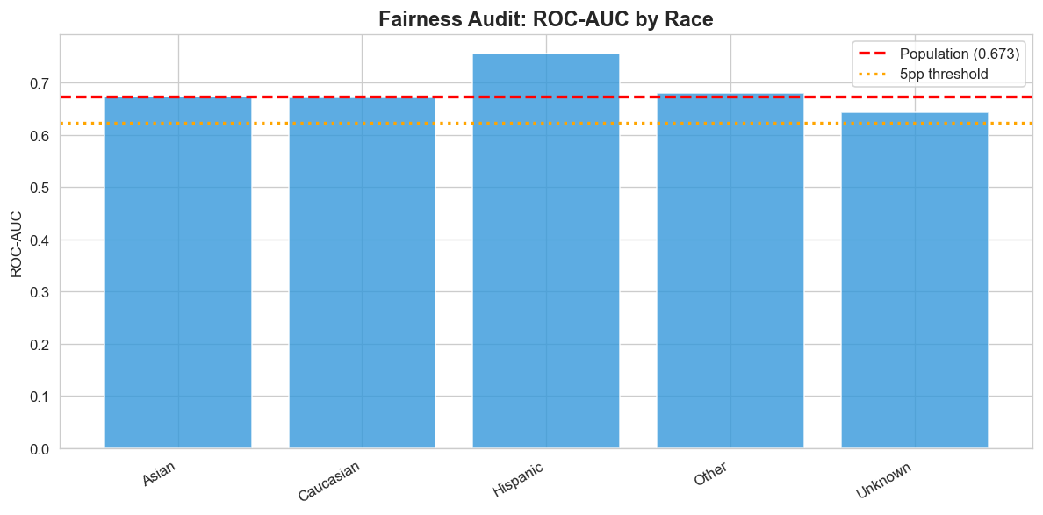
Fairness Audit
Race Group | N | Base Rate | ROC-AUC
Caucasian | 18,510 | 11.5% | 0.671
Hispanic | 398 | 9.0% | 0.755
Other | 302 | 10.3% | 0.680
Asian | 116 | 8.6% | 0.674
Unknown | 447 | 7.2% | 0.644
Max subgroup ROC-AUC gap: −0.029 ✓ — No significant fairness concerns detected. Model performance is consistent across racial subgroups.
Notes:
[0:20] Fairness audit across racial subgroups.
Caucasian: 0.671 ROC-AUC. Hispanic: 0.755. Asian, Other, Unknown range 0.644-0.680.
Maximum gap from population average: -0.029—within acceptable bounds. No significant disparities detected. Caveat: smaller subgroups warrant continued monitoring.

Slide 15



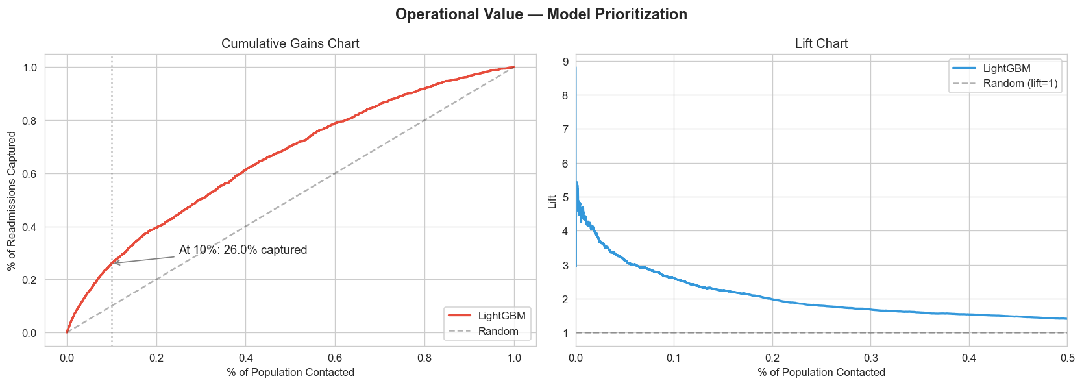

Operational Outputs
Risk Probability
Risk Tiers
Top-K Outreach List
0–1 score for each patient at discharge
Low / Medium / High based on percentile thresholds (15th, 85th)
Prioritized list for care-management with SHAP explanations per patient
Key Result
By contacting the top 10% of patients by risk score, we capture 26% of all 30-day readmissions — a 2.6x lift over random selection.
Notes:
[0:25] Three operational outputs:
Risk Probability: 0-1 calibrated score per patient. Risk Tiers: Low/Medium/High based on percentiles. Top-K Outreach List: prioritized CSV with SHAP explanations.
Key result: contacting top 10% captures 26% of readmissions—2.6x lift. Dramatically better resource allocation.

Slide 16
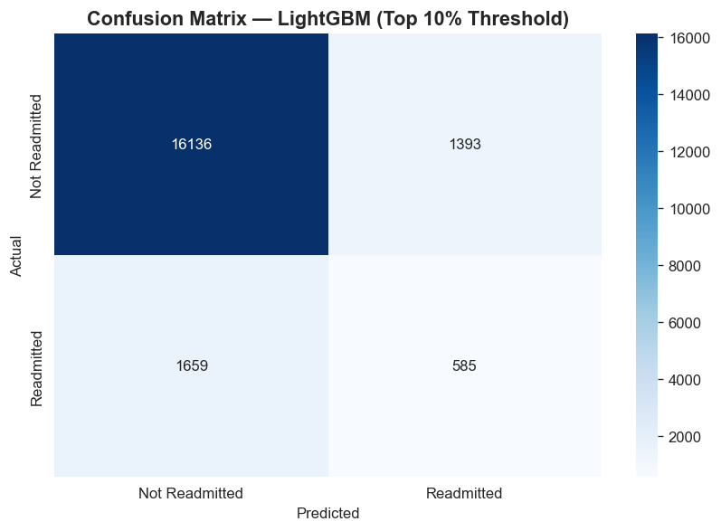
Classification at Top-10% Threshold
Classification Report (top 10%)
Precision (readmitted): 30%
Recall (readmitted): 26%
Overall accuracy: 85%
At the top-10% threshold, nearly 1 in 3 flagged patients is a true readmission — meaningful for targeted outreach.
Notes:
This confusion matrix shows what happens operationally when we flag the top 10% highest-risk patients.
Of patients flagged as high-risk, nearly 30% precision—almost 1 in 3—are true readmissions. That's far better than the 11% base rate.
We achieve 26% recall on readmissions—capturing a quarter of all eventual readmissions by contacting just 10% of discharges.
Overall accuracy is 85%, but remember—accuracy isn't our goal under this imbalance. What matters is that our targeted outreach reaches patients who actually need it, not that we correctly classify the majority who wouldn't be readmitted anyway."
Transition: "Let me summarize our key findings..."

Slide 17
Key Takeaways
LightGBM is the winning model — best PR-AUC (0.237) with strong operational lift (2.6x at top 10%)
Isotonic calibration reduced Brier score from 0.213 to 0.092 — risk scores are now actionable
SHAP provides global and per-patient explanations — clinicians can see why each patient was flagged
Fairness audit shows no significant subgroup disparities (max gap: −0.03 ROC-AUC)
Patient-level grouped split prevents data leakage — results reflect real-world deployment
Notes:
"Five key takeaways from our project:
One: LightGBM is our winning model—best PR-AUC at 0.237 with 2.6× operational lift at top 10%.
Two: Isotonic calibration reduced Brier score from 0.213 to 0.092—risk scores are now actionable probabilities, not just rankings.
Three: SHAP provides both global insights and per-patient explanations—clinicians can see why each patient was flagged, enabling trusted adoption.
Four: Our fairness audit shows no significant subgroup disparities—maximum ROC-AUC gap of -0.03. The model performs consistently across racial groups.
Five: Patient-level grouped splitting prevented data leakage throughout—our results reflect realistic deployment performance on truly unseen patients.
This pipeline demonstrates the complete enterprise data science lifecycle, from raw data through deployable, explainable, fair risk scores."
Transition: "Of course, there are limitations..."

Slide 18

Limitations & Next Steps
Limitations
Next Steps
Dataset is from 1999–2008 — clinical practices have evolved
Hyperparameter tuning (Bayesian optimization)
~11% positive rate limits absolute precision at any threshold
External validation on a different hospital dataset
Missing weight (97%) and payer code — potential signals lost
A/B test integration with EHR workflow
No external validation on a separate hospital system
Model monitoring & drift detection in production
Notes:
"We acknowledge several limitations:
The dataset spans 1999-2008 since then clinical practices have significantly evolved. And performance on contemporary data may differ.
Also, with only 11% positive rate, absolute precision at any threshold is bounded, we can prioritize well, but can't eliminate all false positives.
Missing data like weight has 97% missing values and payer code has 40% which means potential signals were lost.
On top of that we also lack external validation on a separate hospital system.
Our Next steps would include:
Hyperparameter tuning via Bayesian optimization—we used informed defaults but didn't exhaustively search.
Then we’d use external validation on different hospital populations.
Another next step is A/B testing integration with actual EHR workflows to measure real-world impact.
And production monitoring for model drift over time."

Slide 19
Thank You
Questions & Discussion
Feroz Khan · Matthieu Lafont · Henry Wolcott · Mustafa Yousaf
github.com/Stafa7/readmission-risk-prediction
INSY 674 · Enterprise Data Science
Notes:
[ Thank you. Code and notebooks on GitHub. Happy to take questions on any aspect—feature engineering, model selection, or fairness considerations.

