Slide 1

Butler Cheat Sheet

Slide 2
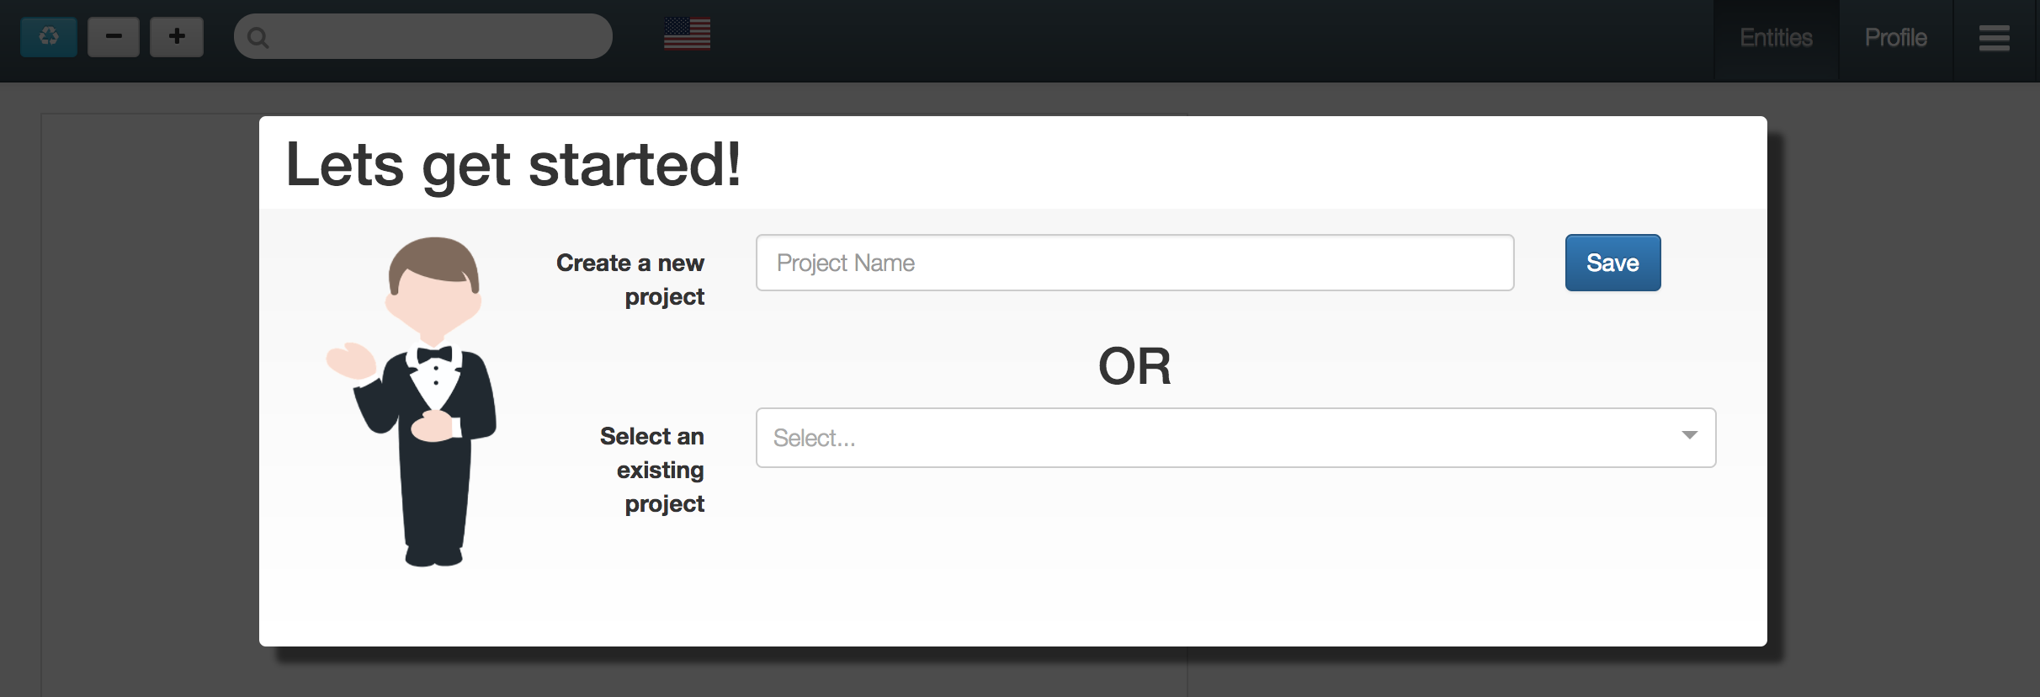
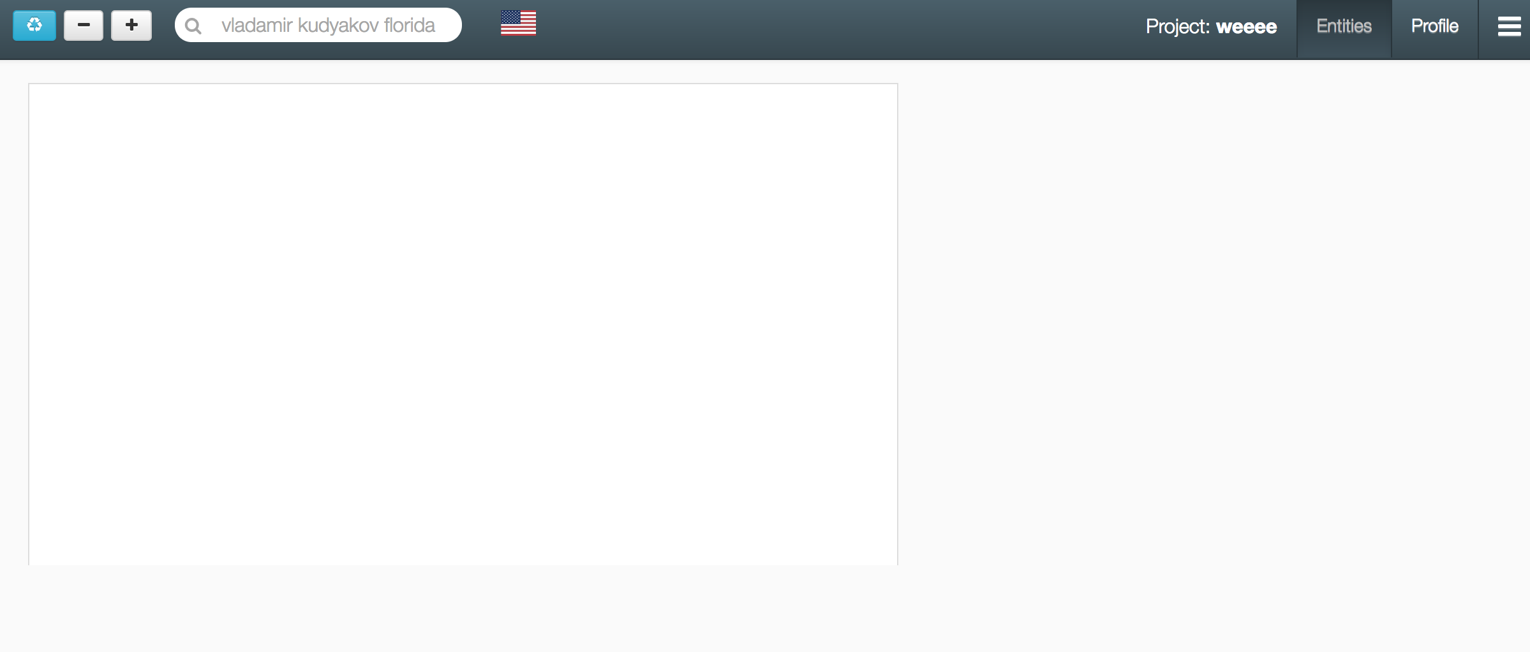
Butler Cheat Sheets
Butler is a KYC application meant to assist in slot-filling an entity profile via human-in-the-loop feedback and open/dark web search results.
Using the tool begins with creating a project or opening a project you’ve already started.
We are looking to populate a profile for a person we know as Vladamir Kudyakov that has an association with Florida.
Type in ‘vladamir kudyakov florida’ and hit ‘enter’.
You can choose the language you expect to see results come back in if desired.

Slide 3
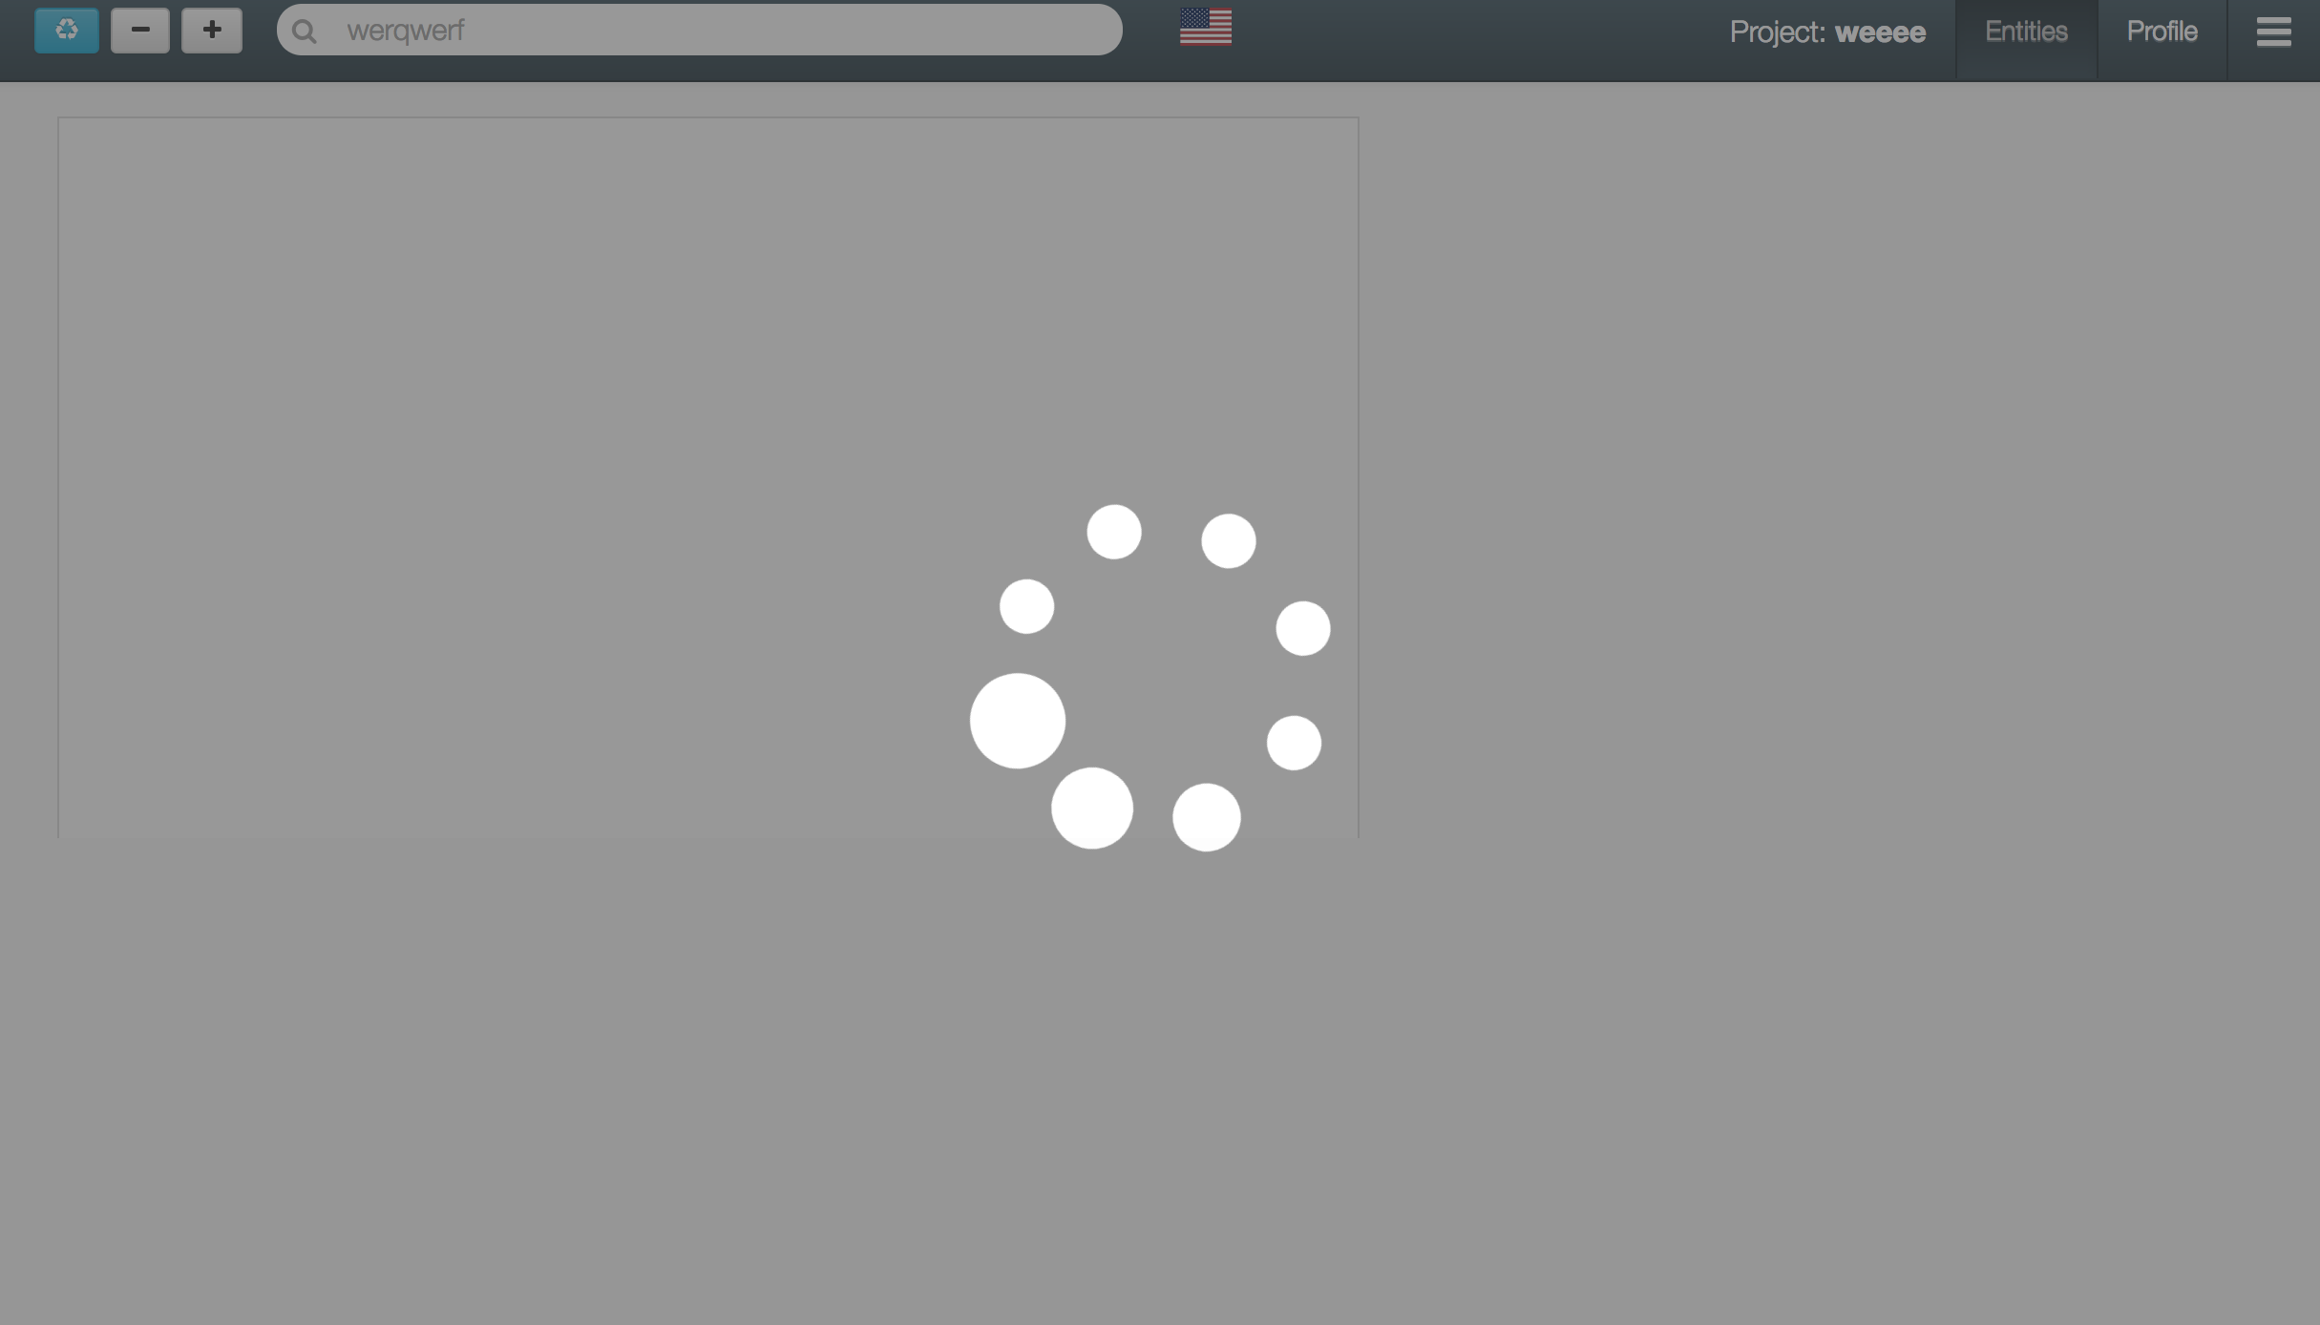
Open, dark web, and various data silos are being searched using your query and the result pages are being stored and analyzed. It may take 1-2 minutes before results are returned.
Please be patient and refrain from closing the window and/or conducting another search. If for some reason you don’t receive results back, you can refresh the page and open your project to see the results.

Slide 4
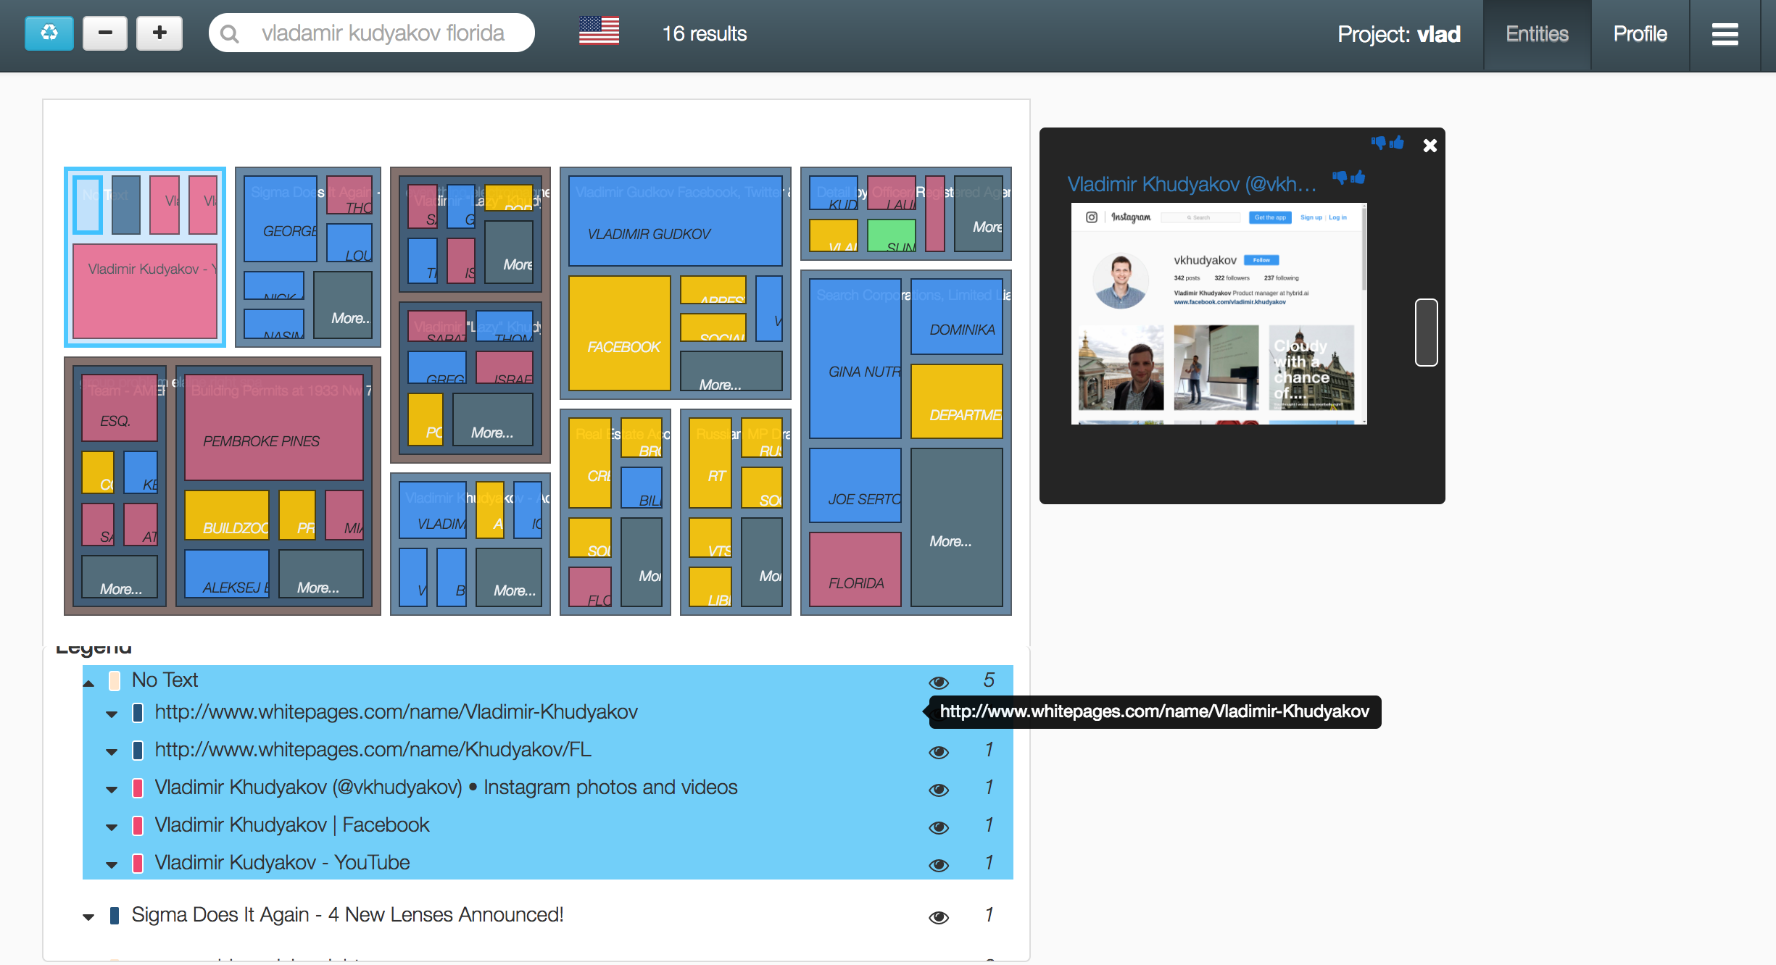
Once results are returned you should see a screen that looks like below and the top pane should tell you how many pages were returned (16 in this case). This is called the Entities View. The 16 pages have been organized in two different ways below. The treemap shows groups of pages with similar content and the entities (people, places, etc.) extracted from pages. The legend below the treemap corresponds to the page groupings in the treemap. The purpose of this view is to allow the user to mark relevant and irrelevant pages and groupings to help the system build a profile.
Page grouping pop up from clicking “eye” icon.
Within the treemap, brown boxes are groupings with multiple pages (red outline in lower left). This example has two open web pages as denoted by the two blue boxes inside.
Blue boxes are a single open web page grouping (red outline in lower right).
Red boxes are social media pages (red outline in upper left).
Green boxes are dark web pages (none in this example).
Boxes with CAPITAL LETTERS represent the prominent entities within a given page and are meant to give a quick feel for page relevance.
Within the legend, hovering over a line will highlight the corresponding group in the treemap above. To unfold page information (title, url, or associated terms) with a grouping or the entities associated with a page, click the arrow to the left. To view screenshots, content summaries, and to be able to go to the actual result pages, click on the “eye” icon for a grouping to bring up a pop up. To examine a page grouping more in depth, click the text for a grouping. This will change the view to what’s on the next page!

Slide 5
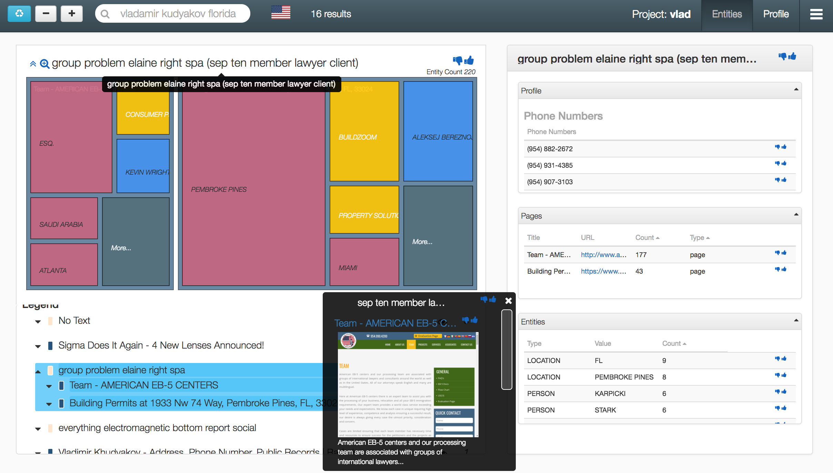
When the user select a page grouping via the legend or from clicking a group on the treemap, the treemap will morph such that the user can see more detailed entity information for the group and well as the topics associated to the cluster. The user can mark the grouping or pages as relevant or irrelevant using the thumb up/down buttons. The user can navigate back up the treemap by clicking another line in the legend or the arrow at the top of the treemap.
Additionally the user can now see a profile view on the right which shows the parts of the profile populated from the page grouping selected.
User can mark profile information as relevant or irrelevant using the thumb up/down buttons.

Slide 6
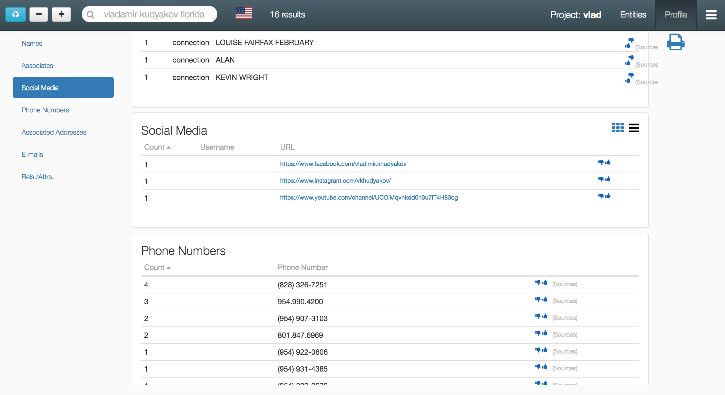
To view the complete profile for the project, click the ‘Profile’ tab in the upper right. Pivot between the information slots using the links on the left.
Within this view you can mark information as relevant/irrelevant, view the page sources for each piece of information and print the profile (using the printer icon).
You can always go back to the Entities view by clicking ‘Entities’.

Slide 7
Butler is not perfect and is not meant to build a profile on it’s own without some help from the user. Sometimes the relevant information takes more pages to get to. The three buttons in the upper left are meant to help provide you the best page results possible from which to pull information. These can be pressed at any time to cause the system to reprocess the results and a profile.
If you’d like to conduct another search to augment your results, enter your query and hit enter to gather more pages and reprocess.
From right to left:
+ Button: System will go get more results for you based on what you’ve marked irrelevant and relevant. This button means you need to see more pages to build a profile.
Button: System will remove some results based on what you’ve marked – relevant items will not go away however.
Blue Refresh Button: System will reprocess results and build a new profile and may provide a few extra pages for you based on markings.
Using these buttons will cause more Open, dark web, and various data silos to be searched using your data and it may take 1-2 minutes before results are returned.
Please be patient and refrain from closing the window and/or conducting another search. If for some reason you don’t receive results back, you can refresh the page and open your project to see the results.

Slide 8
Thank You!
Feedback and questions are welcome.
Please send to Justin Gawrilow (justin.gawrilow@gmail.com)

