Slide 1
Homework TCO
Daniele ferrarelli

Slide 2
Enviroment and NFR
Every CC transaction has to be approved by checking the CC is valid, the POS is valid, the money amount is valid (for single transaction and for other limits such as monthly or daily limits), check if suspect, if the POS type requires a second identification step, to run that step and check complete successfully, issue OK or abort storing the attempt.
NFR-1 The average number of transactions per second (TPS) is 500. 90% of the time the peak is below double of the average. The maximum peak that the system must handle is the double of the 90% peak.
NFR-2 The system must ensure a HA at 99.999%.
NFR-3 In case of a disaster, such as Earthquake or flooding in the Data Center site area, the system functionality must be restored and be able to provide Production and Non-Production capabilities and at least 50% of the Dev and Test Capabilities.
NFR-4 The Development team has available an environment that is half the size of the full Production environment.
NFR-5 Before putting in production any new release of software a complete round of functional test must be completed. The Test environment is the same size of the development environment.
NFR-6 Before putting in production any new release of software a complete round of performance test must be completed stressing the system at TPS peaks.
NFR-7 The Software is written in Java and run on the selected Application Server.
NFR-8 The DB used by the system is the selected DB.

Slide 3
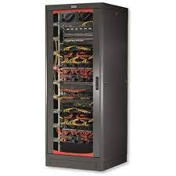
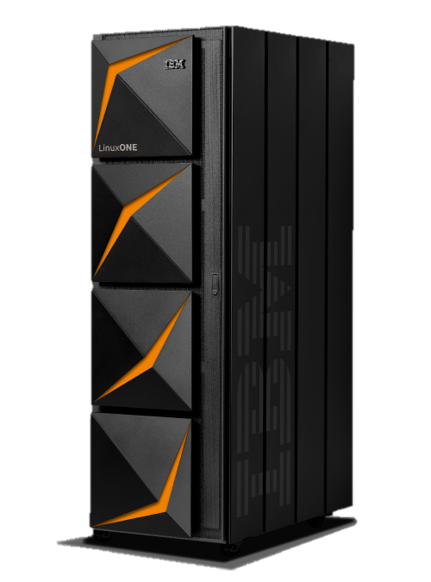
Sizing
 |  | Workload (TPS) | Core per Server | Max Server Faults | HA Ratio
 |  | 2,000 | 72 | 1 | 72%
 | Typical core Ratio | TPS by Core | # of Cores for workload TPS | HA cores | Prod cores |  | Dev % of Workload | Dev cores | Test % of Workload | Test cores | PreProd % of Workload | PreProd cores | DR active cores % of Prod+PreProd | DR cores | DR CBU (spare) cores |  | Tot # of Active cores | x86 to z Active Core ratio | Tot # of Active cores no DR | x86 to z Core ratio no DR | Tot # of cores | x86 to z Core ratio
x86 | 10 | 20 | 100 | 72 | 172 |  | 50% | 50 | 50% | 50 | 100% | 100 | 136% | 370 |  |  | 742 | 24,7 | 372 | 12.4 | 742 | 14,8
LinuxONE | 1 | 200 | 10 |  | 10 |  | 50% | 5.0 | 50% | 5.0 | 100% | 10 |  |  | 20 |  | 30 |  | 30 |  | 50
The input provided is that the system must support up to 500 average TPS, the workload is 90% the times under the 2,000 TPS peak. The TCO analysis is done for the peak TPS the ensure the system is not overloaded.
Other values for peak TPS are considered (25 TPS to 10,000 TPS) to see how the cost changes based on the TPS.
Active, passive
For 2,000 TPS
Active, Active
For 2,000 TPS
Site 1
Prod 172 Cores Dev 50 Cores
Test 50 Cores PreProd 100 Cores
Site 2
Disaster Recovery 408 Cores
(172 Prod, 100 PreProd, 98 Dev+Test)
Site 1
Prod 10 Cores, Dev 5 Cores, 10 CBU
Site 2
Test 5 Cores, PreProd 10 Cores, 10 CBU

Slide 4
TCO 5 year comparison for 2,000 TPS
 | x86 | Environments |  |  |  |  |  |  |  | LinuxONE | Environments
Dell R940 3U w Xeon Gold 6254 18C 3.1Ghz (4 Chips, 18 Cores) 24 * 64GB RDIMM 3200MT/s |  | Prod | Dev | Test | PreProd/QA | DR | Tot by Comp |  |  |  | Prod | Dev | Test | PreProd/QA | DR | Tot by Comp
Components | Hardware | 200,861 | 66,954 | 66,954 | 133,907 | 334,768 | 803,443 |  | Components | Hardware | 588,000 | 294,000 | 294,000 | 588,000 | 84,000 | 1,848,000
 | Software | 819,359 | 240,981 | 240,981 | 481,962 | 1,739,099 | 3,522,382 |  |  | Software | 377,153 | 188,577 | 188,577 | 377,153 | - | 1,131,460
 | People | 200,000 |  |  |  |  | 200,000 |  |  | People | 100,000 |  |  |  |  | 100,000
 | Network | 20,580 | 6,860 | 6,860 | 13,720 | 34,300 | 82,320 |  |  | Network | 9,147 | 4,573 | 4,573 | 9,147 | - | 27,440
 | Space | 13,000 | 3,380 | 3,380 | 6,760 | 26,000 | 52,520 |  |  | Space | 24,267 | 12,133 | 12,133 | 24,267 | - | 72,800
 | Electricity | 21,024 | 7,008 | 7,008 | 14,016 | 35,040 | 84,096 |  |  | Electricity | 3,458 | 1,729 | 1,729 | 3,458 | - | 10,374
 | Total by Env | 1,274,823 | 325,183 | 325,183 | 650,365 | 2,169,207 | 4,744,761 |  |  | Total by Env | 1,102,025 | 501,012 | 501,012 | 1,002,025 | 84,000 | 3,190,074
 |  |  |  |  |  |  |  |  |  |  |  |  |  |  | Savings = | 33%

Slide 5
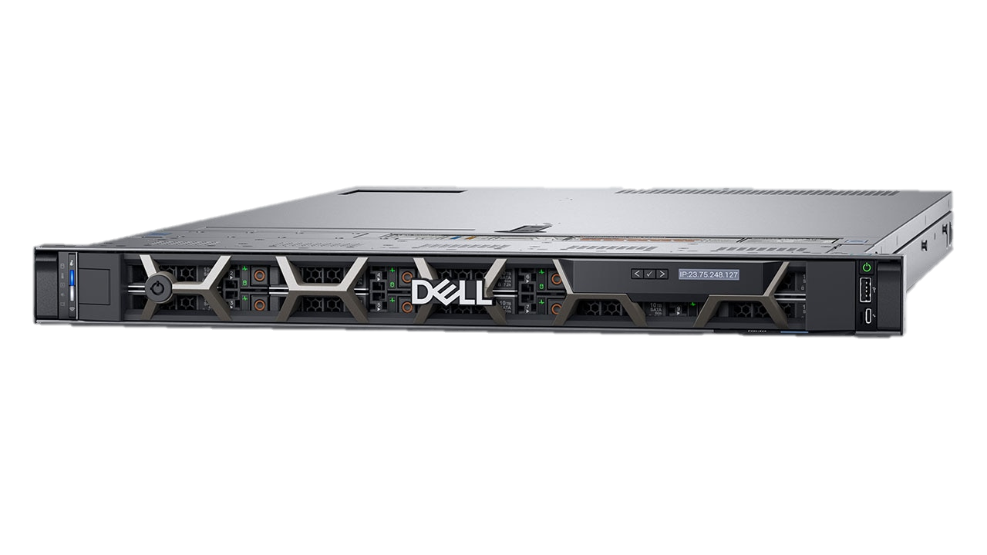
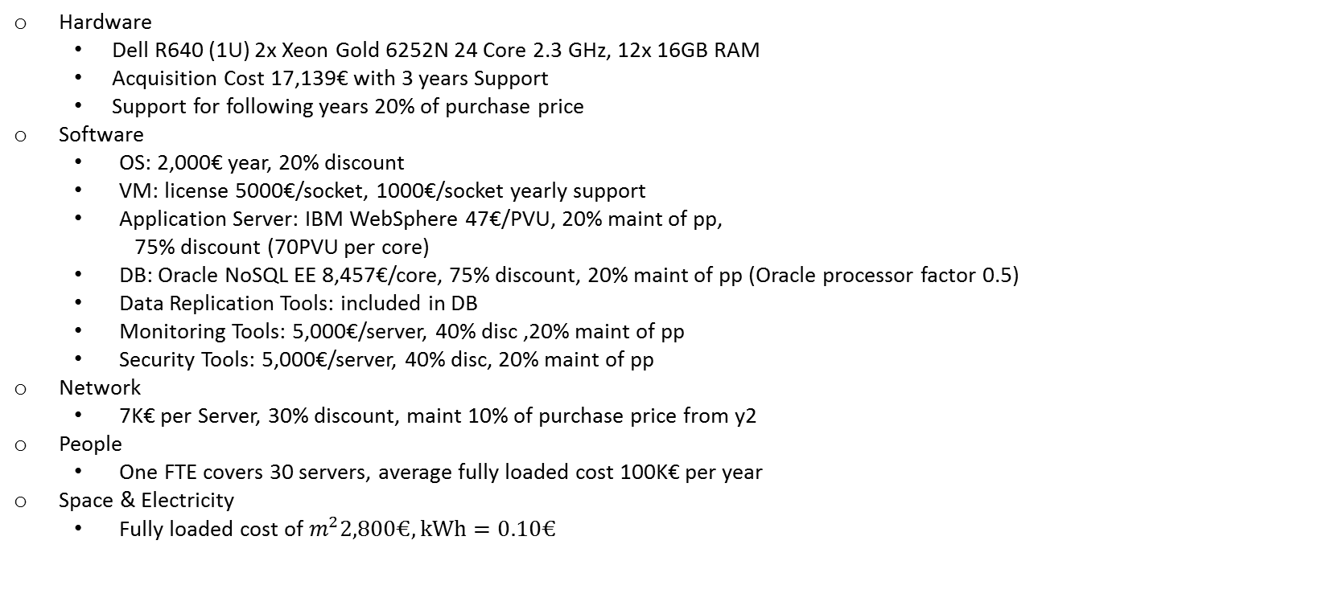
X86 TCO Assumptions
Hardware
Dell R640 (1U) 2x Xeon Gold 6252N 24 Core 2.3 GHz, 12x 16GB RAM
Acquisition Cost 17,139€ with 3 years Support
Support for following years 20% of purchase price
Software
OS: 2,000€ year, 20% discount
VM: license 5000€/socket, 1000€/socket yearly support
Application Server: IBM WebSphere 47€/PVU, 20% maint of pp,
75% discount (70PVU per core)
DB: Oracle NoSQL EE 8,457€/core, 75% discount, 20% maint of pp (Oracle processor factor 0.5)
Data Replication Tools: included in DB
Monitoring Tools: 5,000€/server, 40% disc ,20% maint of pp
Security Tools: 5,000€/server, 40% disc, 20% maint of pp
Network
7K€ per Server, 30% discount, maint 10% of purchase price from y2
People
One FTE covers 30 servers, average fully loaded cost 100K€ per year
Space & Electricity
Fully loaded cost of $m^{2}2,800€, kWh=0.10€$

Slide 6
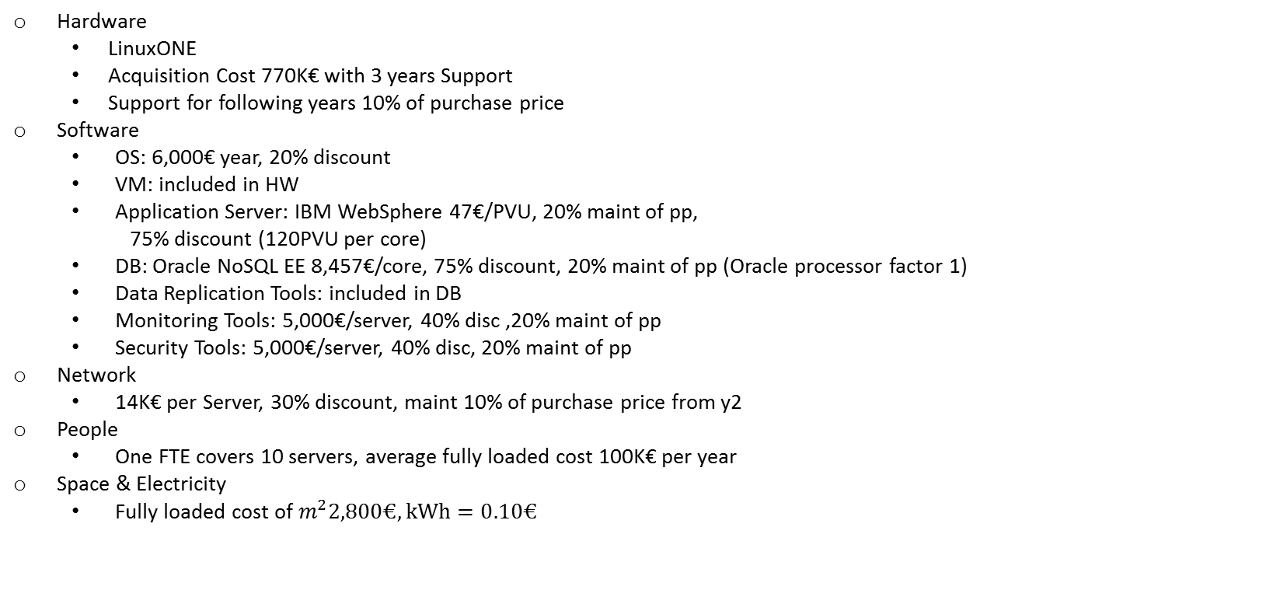
LinuxONE TCO Assumptions
Hardware
LinuxONE
Acquisition Cost 770K€ with 3 years Support
Support for following years 10% of purchase price
Software
OS: 6,000€ year, 20% discount
VM: included in HW
Application Server: IBM WebSphere 47€/PVU, 20% maint of pp,
75% discount (120PVU per core)
DB: Oracle NoSQL EE 8,457€/core, 75% discount, 20% maint of pp (Oracle processor factor 1)
Data Replication Tools: included in DB
Monitoring Tools: 5,000€/server, 40% disc ,20% maint of pp
Security Tools: 5,000€/server, 40% disc, 20% maint of pp
Network
14K€ per Server, 30% discount, maint 10% of purchase price from y2
People
One FTE covers 10 servers, average fully loaded cost 100K€ per year
Space & Electricity
Fully loaded cost of $m^{2}2,800€, kWh=0.10€$

Slide 7
X86 vs LinuxONE with varing TPS
If the system is subject to a low workload (TPS < 500 TPS) the LinuxONE architecture is less convinient than x86 due to the high acquisition costs.
If the system is subject to a higher workload (TPS >= 500 TPS) the LinuxONE architecture has lower costs, due to the use of CBU and the lower amount of cores. The x86 needs a higher amount of servers for the Disaster Recovery enviroment, driving up the costs.

Slide 8
Main costs
For the x86 architecture the most impacting cost is the software, given the large amount of core in the system, and the Disaster Recovery enviroment.
For the LinuxONE architecture the most impacting cost is the hardware. The software acquisition and maintancence cost is the second highest cost but lower than the x86 since the number of cores is lower.

Slide 9
Conclusions
From this TCO analysis we can conclude that if the workload is equal or higher than 500 TPS the use of the LinuxONE architecture is more convinient than the x86 architecture. The higher acquisition cost of LinuxONE architecture is balanced by the lower costs in software, space and disaster recovery enviroment. For a enterprise level solution the use of the LinuxONE architecture is suggested since it scales better when increasing TPS.

