Slide 1
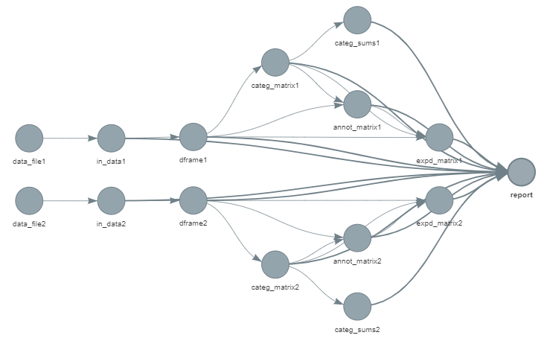

B
A
C
D
Further integrative analyses
(MFA, RGCCA,MCOA…)

Slide 2
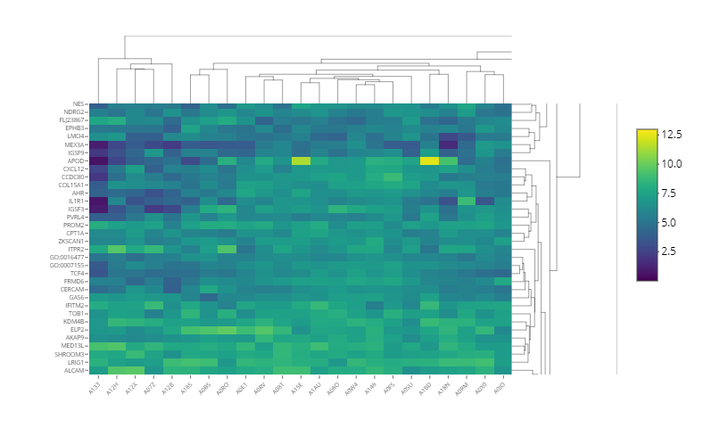
E

