Slide 1


Slide 2

Company History
Started in 1995 by Ed Petry ; Response to the dot-com boom.
First office located off of High Street, near The Ohio State University
1999- Ed and his team landed their first major contract!
After success with Columbus City Schools, notoriety was gained in the Columbus IT community.
To date, B.A. Solutions has worked with: Nationwide Insurance, Huntington Bank, and Cameron Mitchell Restaurants.
Today, B.A Solutions is located in Two Miranova Place, alongside the Scioto River.
The company has grown into a 25 employee operation!

Slide 3
Mission Statement
Our mission is to provide practical networking and IT solutions, as well as develop applications and websites that cater to your business needs. Community pride and a passion for technology keep us striving for excellence.
What does that mean for our customers?

Slide 4
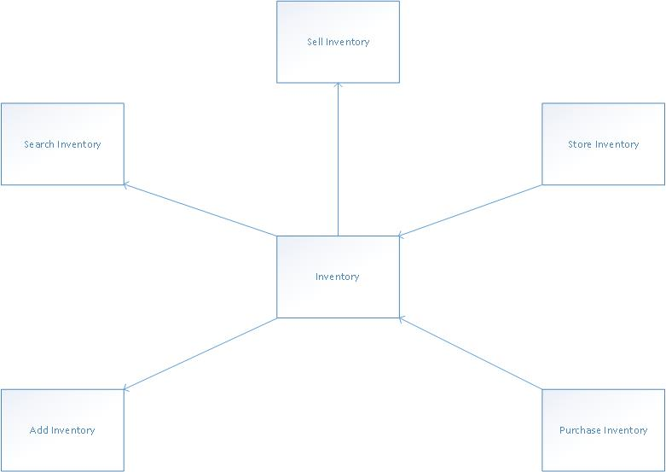
Context Diagram

Slide 5
Interview Questions
Do you have a website?
If not, what features would you desire in a website?
If so, how could we improve your website?
How do you currently keep track of inventory?
How could we improve how you keep track of inventory?
What devices does your department use on a daily basis?
What would you describe as your biggest obstacle?
How do you currently process walk-in sales?
Phone sales?

Slide 6
Problem
M&P Records came to us due to losing $100K last year and 5% of their customer base. If they keep going the way they are going, they are not going to be able to stay in business.

Slide 7
Solution
IT Solution and Front End Interface with Back End support
Accounting System
Access or SQL Server Database
Marketing and advertising materials
Training
Internet and Intranet

Slide 8
Interview Schedule
NAME | TITLE | TIME | DATE | LOCATION
Mom Murdock | Owner | Noon | Feb 5, 2017 | Lunch Appointment
Pop Murdock | Owner | Noon | Feb 5, 2017 | Lunch Appointment
Felix Mulholland | Research | Noon | Feb 4, 2017 | Lunch Appointment
David Bowie | DJ, floor sales | 7pm | Feb 5, 2017 | In-Shop
Freddie Mercury | DJ, purchasing | 8pm | Feb 5, 2017 | In-Shop
John Lennon | DJ, floor sales | Midnight | Feb 5, 2017 | In-Shop
Tupac Shakur | DJ, security | 2am | Feb 15, 2017 | In-Shop
Prince | DJ / inventory | 2am | Feb 25, 2017 | In-Shop
Keith Richards | DJ, buying agent | 1pm | Feb 11, 2017 | In-Shop
Kurt Cobain | DJ, floor sales | 10pm | Feb 12, 2017 | In-Shop
Rick James | DJ, floor sales | 11pm | Feb 17, 2017 | In-Shop
Elvis Presley | DJ, floor sales | 9am | Feb 18, 2017 | In-Shop
Bon Scott | DJ, refreshments and mixology | 9pm | Feb 17, 2017 | In-Shop
Syd Barrett | DJ, recreational flavor | Yes, what dimension? | Feb 28, 2017 | In-Shop
Mark Bolen | DJ, floor sales | 6pm | Feb 23, 2017 | In-Shop
Amy Winehouse | DJ, floor sales | 5pm | Feb 16, 2017 | In-Shop
Janis Joplin | DJ, floor sales | 11:30am | Feb 31, 2017 | In-Shop
Jim Morrison | DJ, floor sales | 5:50am | Feb 11, 2017 | In-Shop

Slide 9
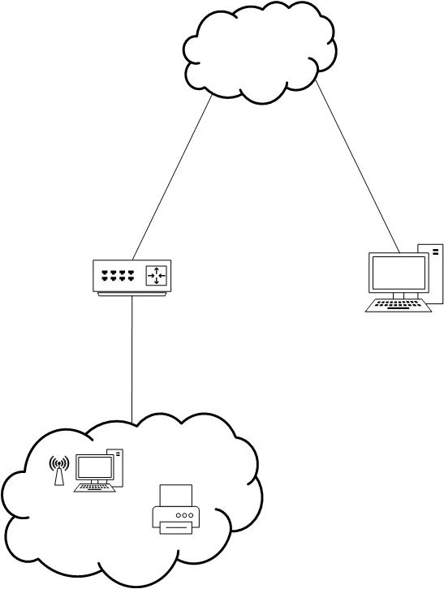
Network Diagram (current)

Slide 10
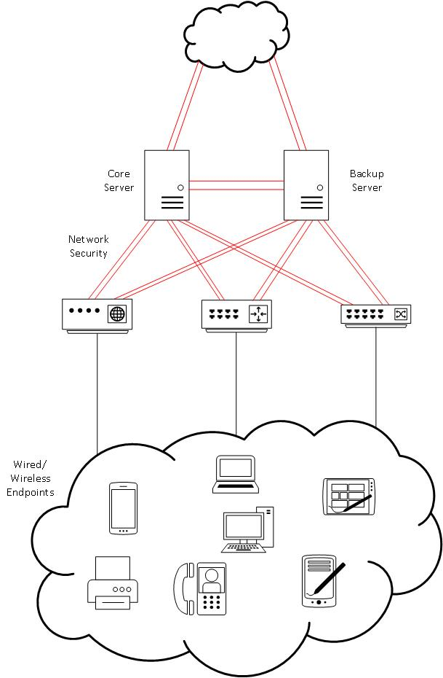
Network Diagram (proposed)

Slide 11
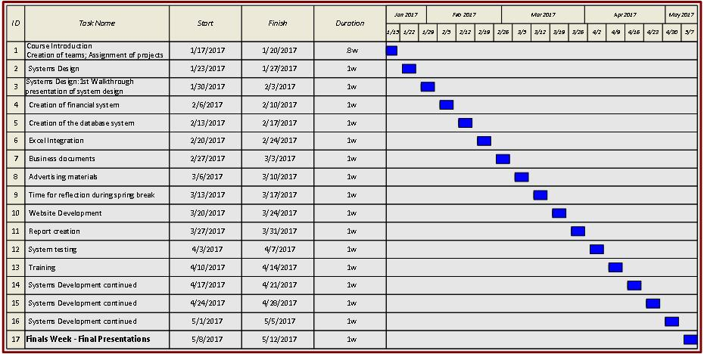
Gantt Chart

Slide 12
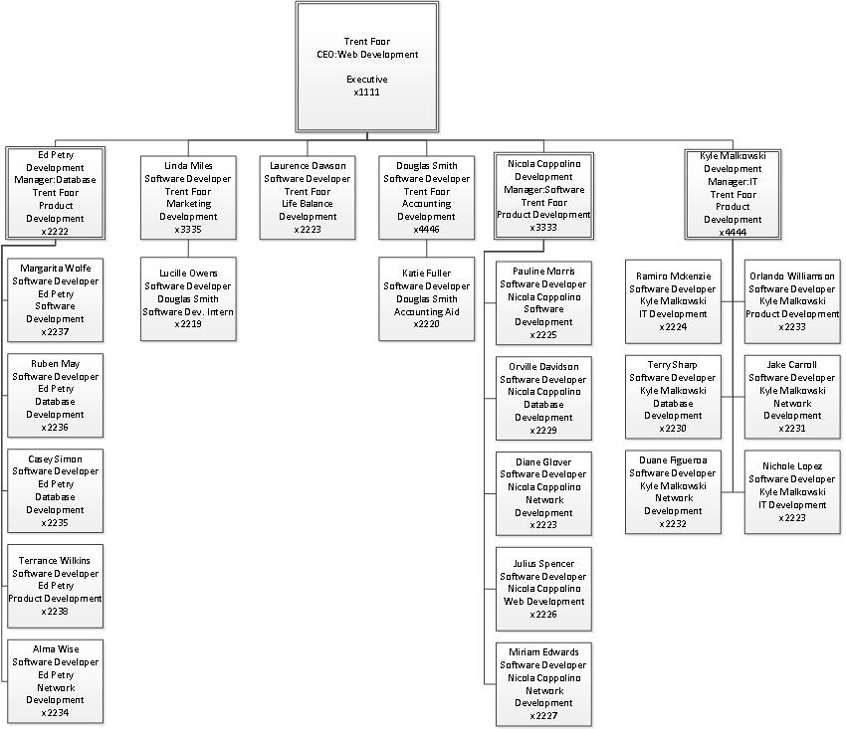
Our Organization Structure

Slide 13
Wireframes

Slide 14
Wireframes

