Slide 1


An IoT Application on Capping Devices
System and device Programming Special Project
Master’s Degree in Computer Science
Nicolò Caradonna (s316993)
Roberto Ferrareis (s308271)
Giuseppe Lisena (s308270)
Academic Year: 2022/2023
Supervisor: Prof. Stefano Quer , Ing. Mario Deda
1/15

Slide 2
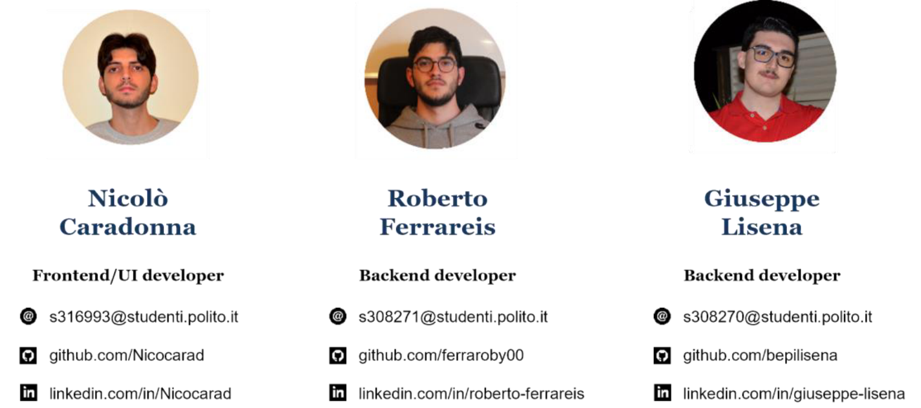
Team Members
2/15

Slide 3
Project Description
This project is done in collaboration with AROL s.p.a. that manufactures complex types of capping machineries.
The goal of the project is to create a user and machinery management modules, allowing employees to create and modify machinery configurations. It enables users to assign machinery to client companies and implements a secure permission system, individually assigning access rights to users while enforcing restrictions to protect system resources.
The project has been developed on an existing web application.
3/15

Slide 4





Tecnological Stack
Frontend
React.js (with hooks)
UI Design Library: Chakra UI
Dashboard Library: React Grid Layout +
existing custom dashboard work
Backend
Express.js
DBMS: PostgreSQL, MongoDB
4/15

Slide 5
Metodologies
Frontend
Backend
Nielsen’s heuristics [1]:
Rest API + permission validation
Axios HTTP Client Request/Response
MVC pattern
Visibility of system status
Match between system and the real world
User control and freedom
Consistency and standards
Error prevention
…
5/15
[1] https://www.nngroup.com/articles/ten-usability-heuristics/

Slide 6

Existing Project
Company
The existing project is thought to be used by a
Company
A company can manage:
Users
Machinaries
Resources permissions
6/15

Slide 7

Extended Project
AROL interface to manage:
Companies
Users
Machineries
Company
Company
Company
7/15

Slide 8

AROL’s user Hierarchy
Chief
Chief: this role encompasses the management of all aspects within the system.
Supervisor: similar to a Chief, a Supervisor possesses the ability to execute various operations but is restricted to a limited set of resources.
Supervisor
Officer: a user with knowledge on the system's resources but does not engage in operational management.
Officer
8/15

Slide 9
AROL’s user Permissions
ROLES | USERS |  |  |  | MACHINARIES |  |  |  | COMPANY
 | C | R | U | D | C | R | U | D | C | R | U | D
CHIEF | Yes | Yes | Yes | Yes | Yes | Yes | Yes | Yes | Yes | Yes | Yes | Yes
SUPERV. | Yes | Yes | Yes | Yes | Yes | Yes | Yes* | Yes* | Yes | Yes | Yes | Yes
OFFICER |  | Yes |  |  |  | Yes |  |  |  | Yes
C: Create, R: Retrieve, U: Update, D: Delete
9/22
* if has permissions

Slide 10
AROL’s user Permissions
ROLES | MACHINERY
 | Dashboards |  |  |  | Documents
 | C | R | U | D | C | R | U | D
CHIEF | Yes | Yes | Yes | Yes | Yes | Yes | Yes | Yes
SUPERV. | Yes* | Yes* | Yes* | Yes* | Yes* | Yes* | Yes* | Yes*
OFFICER | Yes* | Yes* | Yes* | Yes* | Yes* | Yes* | Yes* | Yes*
C: Create, R: Retrieve, U: Update, D: Delete
10/22
* if has permissions

Slide 11
Requirements
Machinery management features:
User management features:
Create/update/delete operations on machinery with
all its sepecifications (including sensors)
Machinery templates support
Create/update/delete operations on machinery
dashboard templates
Creation of new user account
Update of existing user account
Deletion and disabling of existing user account
Modify of user account permissions
Password reset + random password generator
Managing machinery access permissions
Machinery filtering and search
User filtering and search

Slide 12
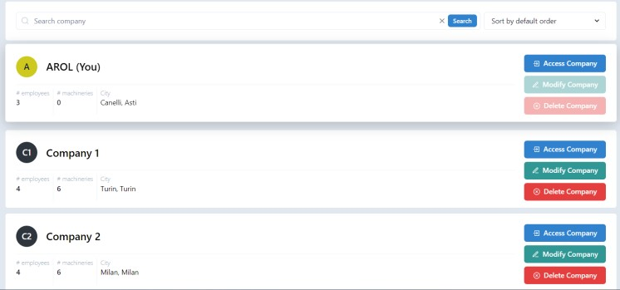
Additional Features
Creation and management module of a Company.

Slide 13
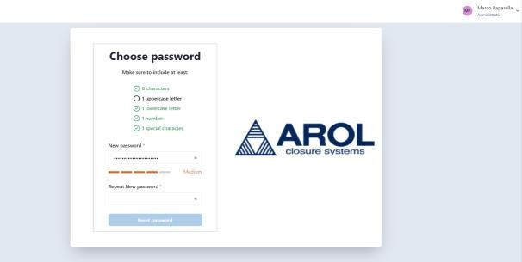
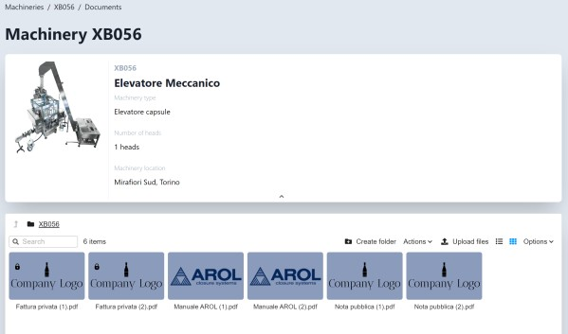
Additional Features
Temporary User
File Privacy

Slide 14
Database Minimal Changes
Companies Catalogue Table:
Add AROL company entry with ID 0
Triggers
Users
Assign all permission when creating
Users Table:
Add isTemp field to manage temporary users
Company Remove users data when deleting
Users Remove data when deleting
Sensors Catalogue Table:
New table to handle the global list of possible sensors in a machinery
Machinery Remove data when deleting
Users Reassign file ownership when deleting
Machinery Documents Table:
Add isPrivate field to manage private/public files
Machinery Assign permission when creating

Slide 15
Time for a DEMO

