Slide 1
OLS655 Cruise Management System Project Part I
Database Design – Entities and Attributes, Functional Dependencies and Entity-Relationship Diagram

Slide 2
Entities and Attributes
Entities
Traveller
Cruise
Attributes
Traveller
traveller_ID
fName
lName
email
administrator
Cruise
ship_id
cruise_name
destination
Other Attributes
cabin
deck

Slide 3
Functional Dependencies
Traveller
traveller_id → traveller_id
→ fName
→ lName
→ email
→ administrator
Cruise
ship_id → ship_id
→ cruise_name
→ destination

Slide 4
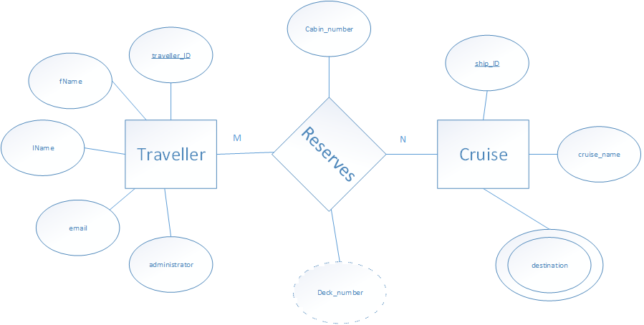
Entity-Relationship Diagram

