Slide 1
Soldering Iron 2022-2023

Slide 2
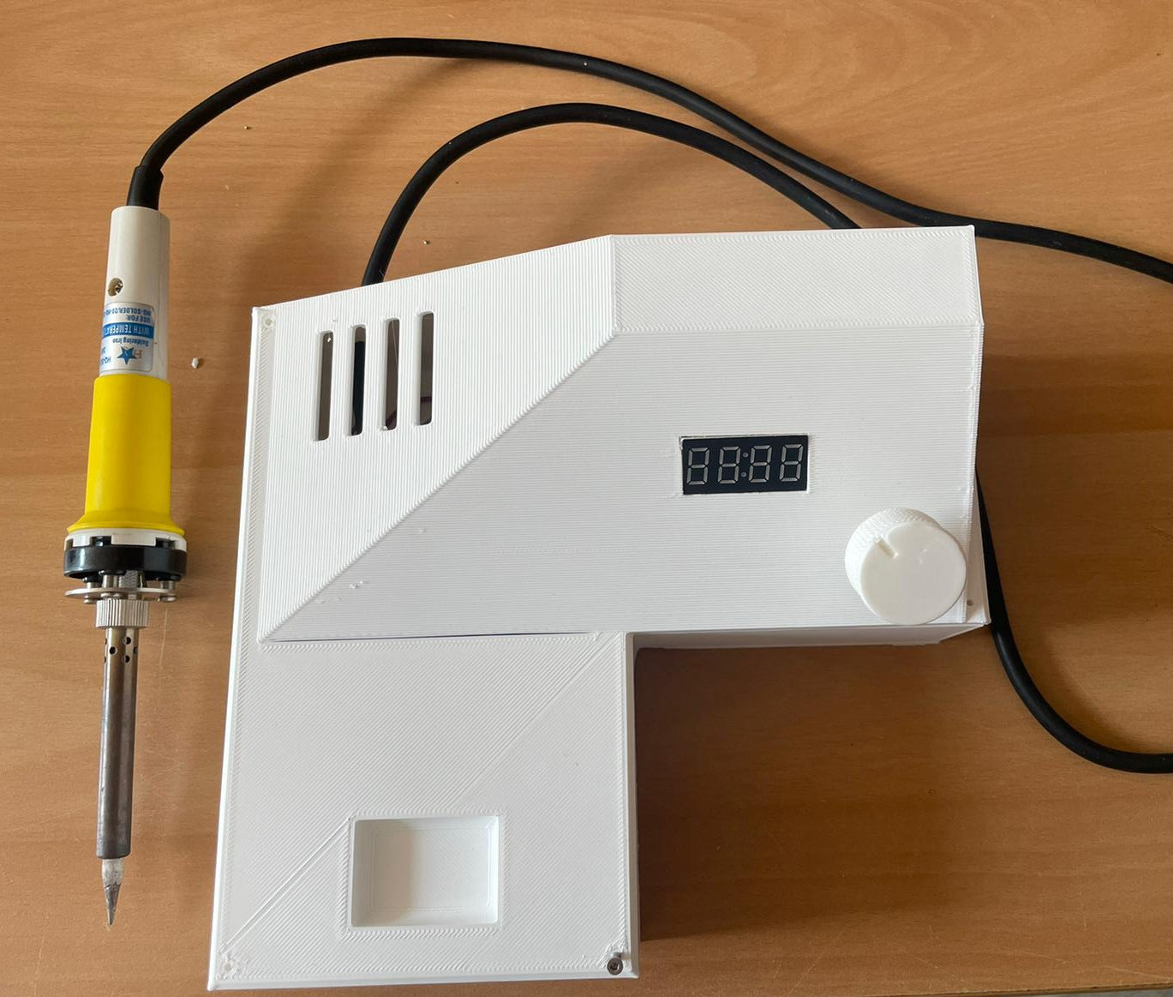
Introduction
Purpose
Signaficane of soldering irons
DIY project
Notes:
The purpose of this project is to make a soldering iron with a 3d printed case
Soldering irons are a must have in the world of electronics its main pupose is to connect compontens to each other or to a PCB this goes hand in hand with tin
This project is a diy project this means that the project is build completly from scratch

Slide 3
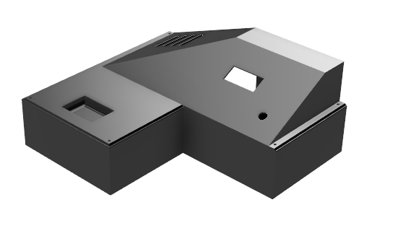
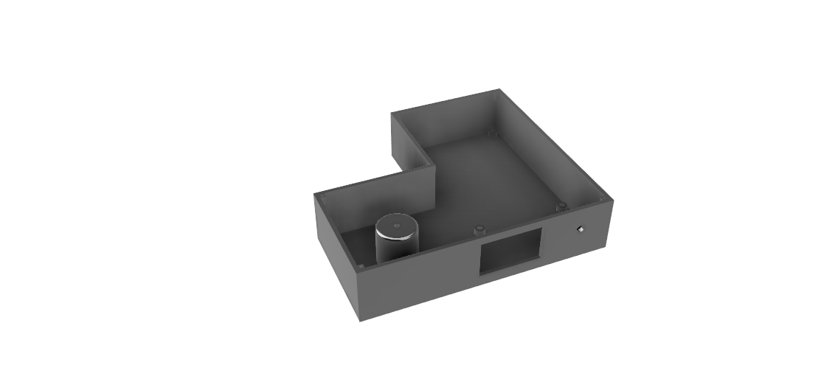
Project Overview
3d printed case
electronics
Motivation
Benefits

Slide 4
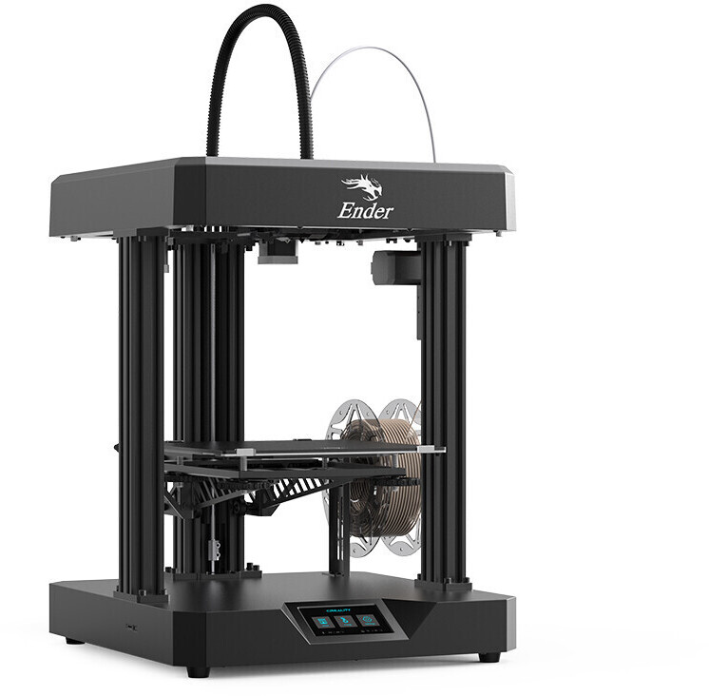
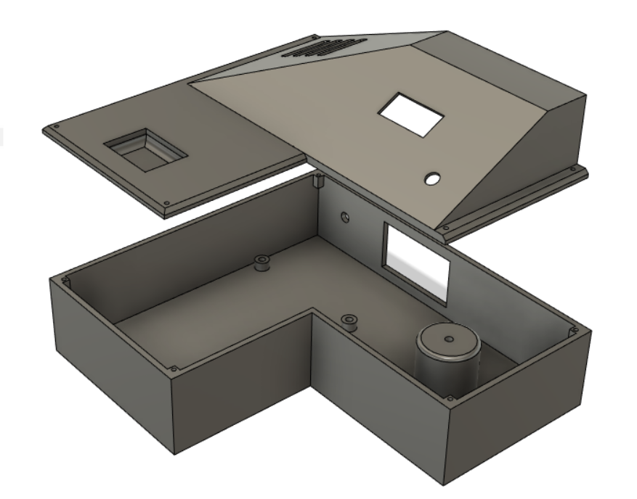
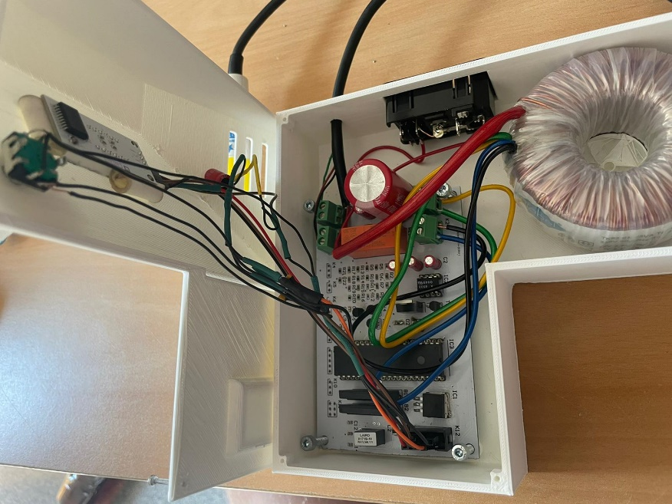
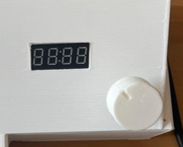
Design and Construction
3D printing
PLA(polylactic acid)
Design
Features

Slide 5
Conclusion
Challanges
Advantages and benefits
Questions

