Slide 1
LLMs4EU WP4: 2026-04-28
**Presenter:** Fabio (David out)
**Slides:** https://docs.google.com/presentation/d/17fm2S4wqtE3fFytk5wfrlrOcI_f1SOqhb_O6QKO4IfU/edit

Slide 2
Slide 1: Recap
• Presenting today on behalf of David and myself
• Last meeting we had reproduced OLMo-3-7B-Instruct-SFT and validated it with LLM-as-a-judge using OpenJury
• Plan was to start continued SFT on mixes of English and EU-language data
• This update covers what came out of that, plus a few new threads

Slide 3
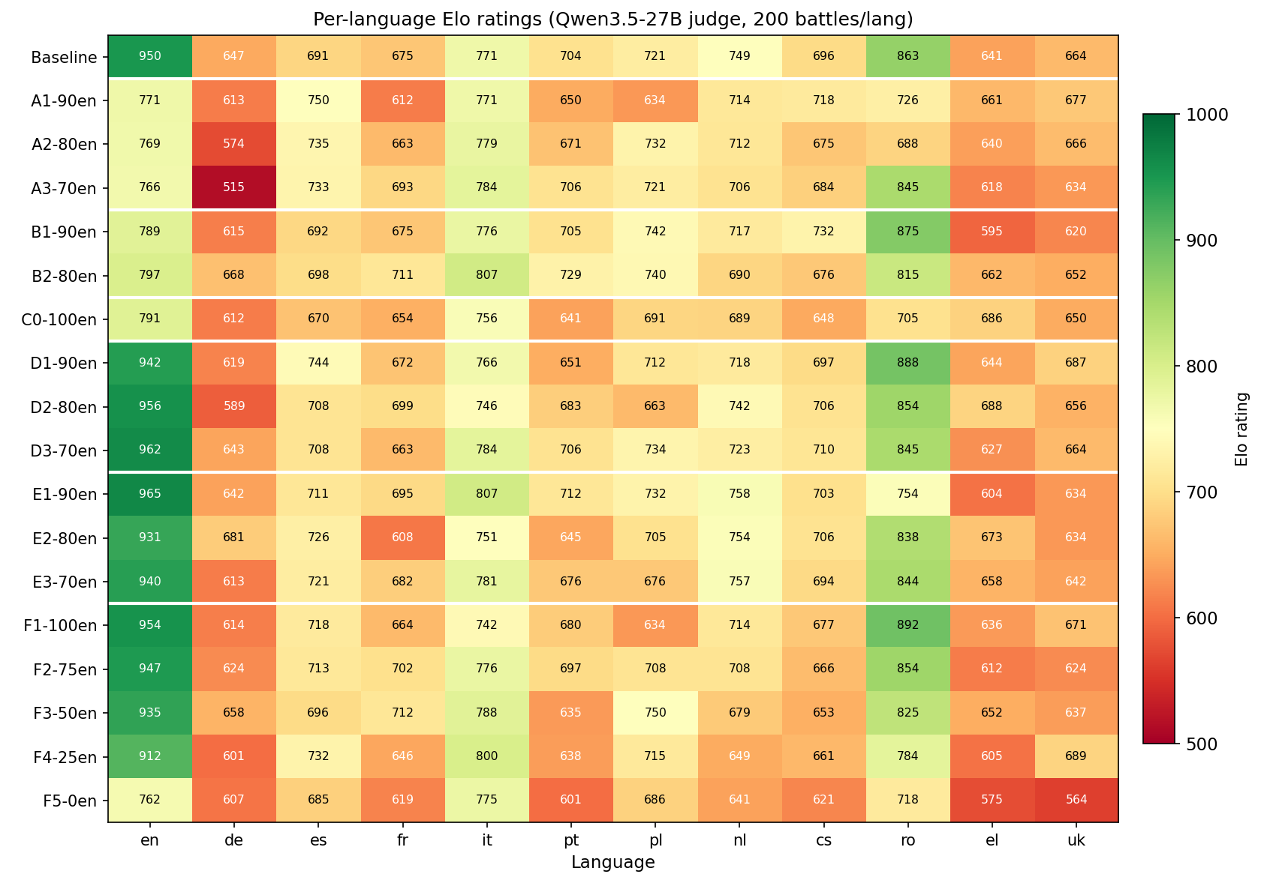
Slide 2: Multilingual SFT, language-ratio sweep
• Heatmap: rows = SFT variants, columns = 12 eval languages, greener = higher Elo [1]
• Takeaway: only Dolci-replay variants (D/E) keep English green without giving up EU; sweet spot ≈ 75/25

Slide 4
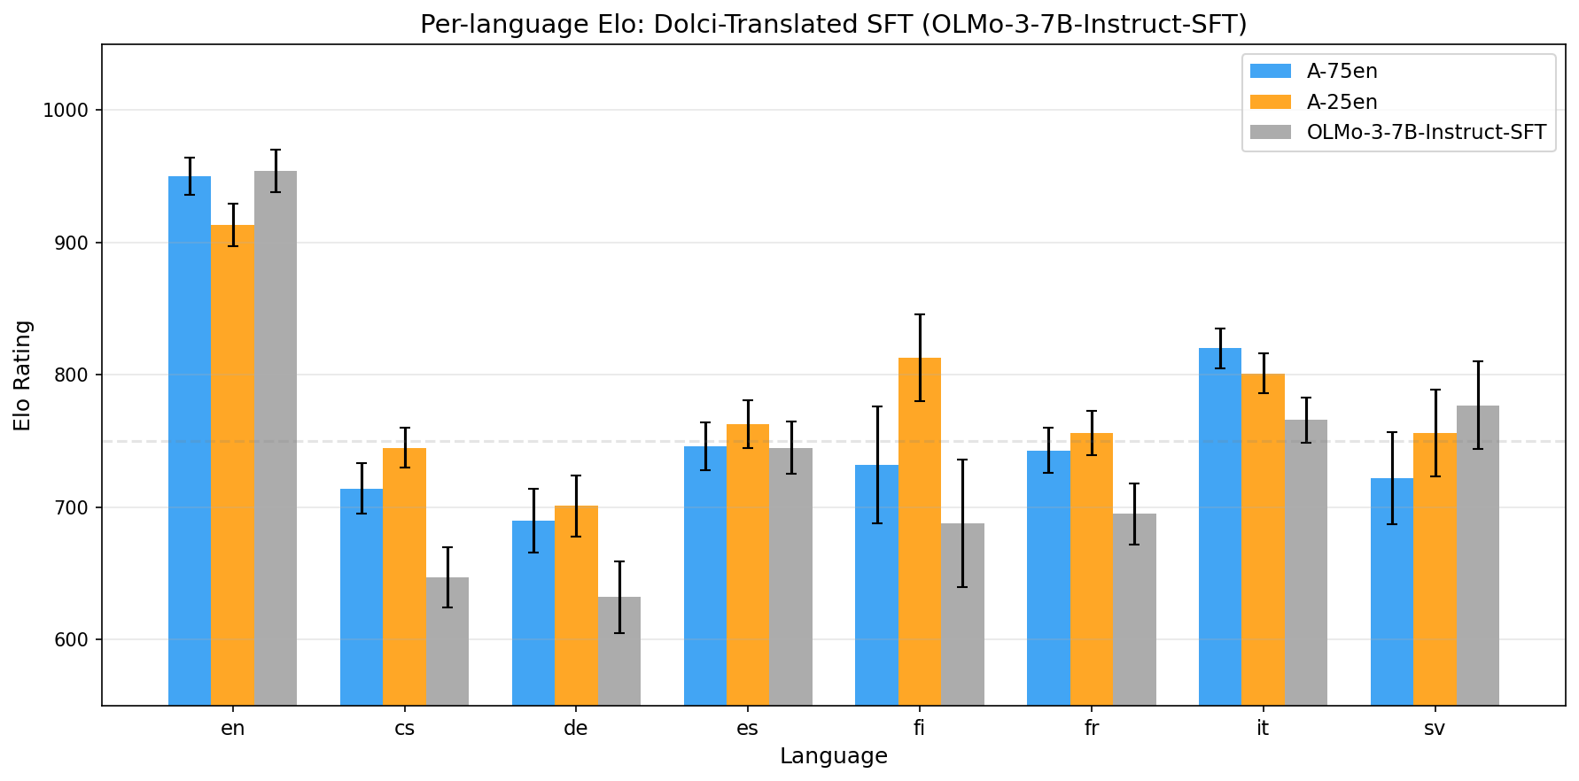
Slide 3: High-quality Dolci translations (gemma-3-27b-it)
• gemma-3-27b-it translations of Dolci-Instruct-SFT in 7 EU languages, replacing NLLB-600M [2]
• Drops the Tracks A-F mixture (WildChat / lmsys / oasst2 / fusion-synth) to isolate translation quality
• Both 75/25 and 25/75 runs improve non-English without sacrificing English (headline result)

Slide 5
Slide 4: Qualitative completions viewer
• Public web tool that qualitatively compares model outputs side-by-side across SFT progress, dataset mixtures (75/25 vs 25/75), and the pre-SFT base, all on the same prompt
• 12 checkpoints × 7 EU languages × 698 LMArena prompts; slider scrubs training in lockstep
• Open the viewer [3]

Slide 6
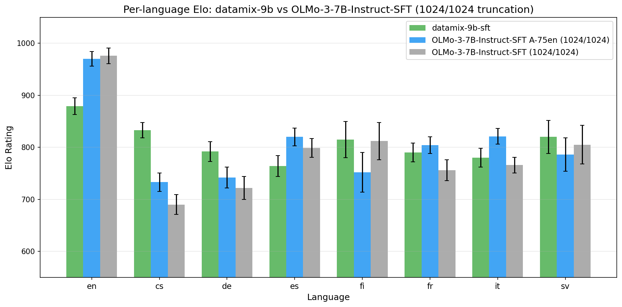
Slide 5: Datamix-9B Instruct SFT (OpenEuroLLM 9B alpha)
• First post-training of the OpenEuroLLM 9B alpha, same 75/25 SFT recipe as our OLMo runs [4]
• Takeaway: already a very strong SFT basis. Beats our OLMo SFT on most non-English at matched context, without any context-length extension yet. Very promising for what comes after extension
• English still lags due to the alpha's 2048-token context limit

Slide 7
Slide 6: JudgeArena (NeurIPS submission)
• Open-source unified LLM-judge framework [5], covering AlpacaEval, Arena-Hard v0.1/v2.0, MT-Bench, m-Arena-Hard v0.1/v2.0 (23 langs)
• Tuned open-weight judges match closed-model judges in meta-eval
• New: simulated LMArena Elo from human annotations + fluency mode for base models

Slide 8
References
• [1] multilingual_eu results: https://github.com/ferreirafabio/open-instruct/blob/main/oellm/experiments/multilingual_eu/results/multilingual_eu_results.md
• [2] dolci_translated results: https://github.com/ferreirafabio/open-instruct/blob/main/oellm/experiments/multilingual_eu/results/dolci_translated_results.md
• [3] Qualitative viewer: https://ferreirafabio.github.io/olmo3-multilingual-dolci-sft-progression/
• [4] datamix_9b results: https://github.com/ferreirafabio/open-instruct/blob/main/oellm/experiments/multilingual_eu/results/datamix_9b_sft_results.md
• [5] OpenJury / JudgeArena: https://github.com/OpenEuroLLM/OpenJury

