Slide 1
Connect4
Monique C F Grinstein
monique.grinstein@accenture.com
(github repo)

Slide 2
Goals Achieved
Overall Goals | Browser | Client - Server
Be able to place pieces on your Connect 4 grid; it should respond to click events | ✓ | ✓
All pushed to Git | ✓ | ✓
Detect victory conditions | ✓ | ✓
Display victory conditions | ✓ | ✓
Display the winner | ✓ | ✓
Have some unit tests that pass; test your (pure) functions | ✓
Bonus Goals | Browser | Client - Server
Add Player names and declare the winner | ✓
Super Bonus Stretch Goals
Split into Client & Server o an index.html with js that talks to o an express API server | ✓

Slide 3
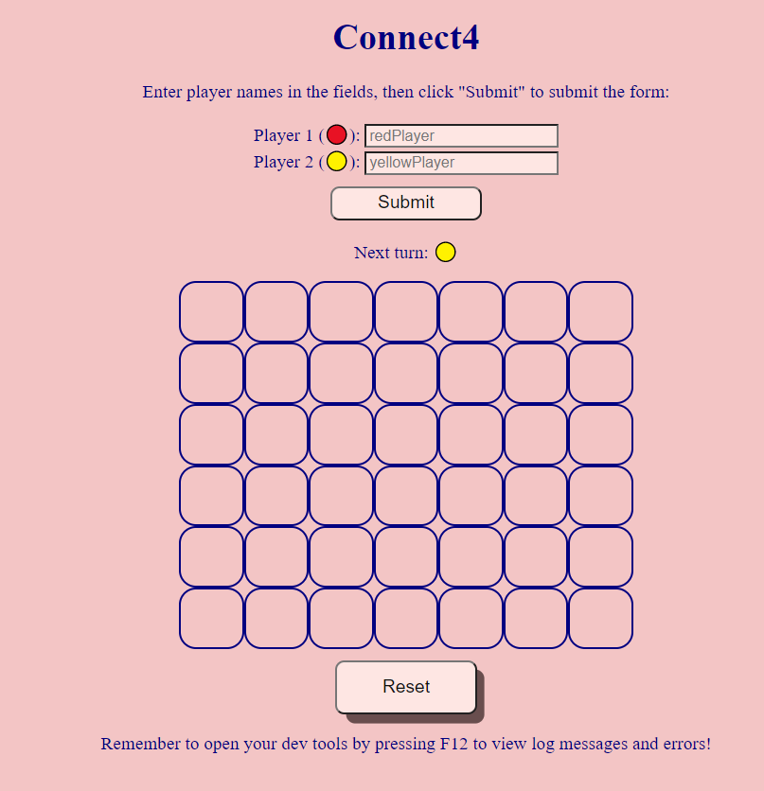
Demo
Browser
Client - Server

Slide 4
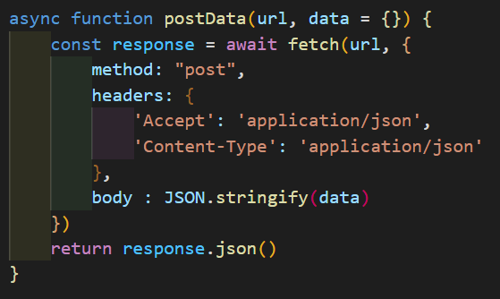
Went well:
Client & Server understanding
POST an object using fetch
The global fetch() method starts the process of fetching a resource from the network, returning a promise which is fulfilled once the response is available.
url: path to the resource you want to fetch
data: data to be posted
The promise resolves to the Response object representing the response to your request.

Slide 5
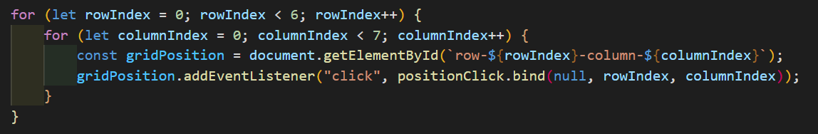
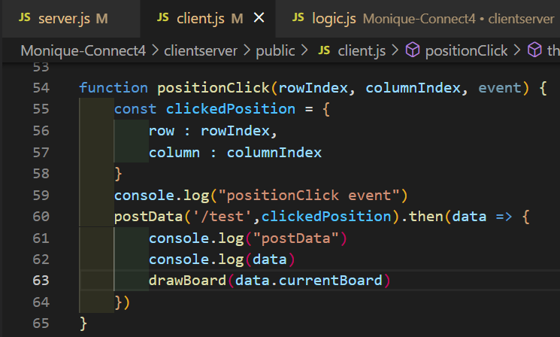
Example: using fetch to takeTurn
EventListener on board grid
Client will POST row & column then wait for json response from Server containing the game’s current state

Slide 6
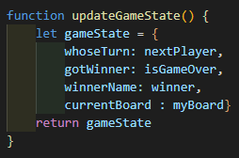
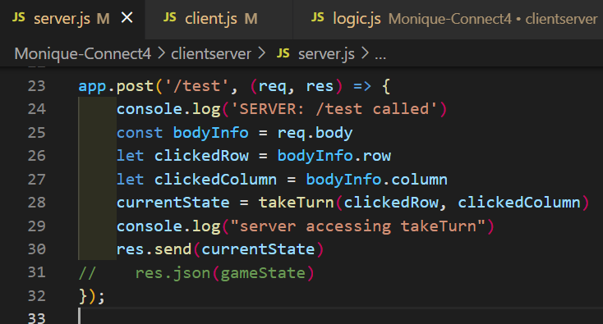
Example: using fetch to takeTurn
EventListener on board grid
Client will POST row & column then wait for json response from Server containing the game’s current state

Slide 7
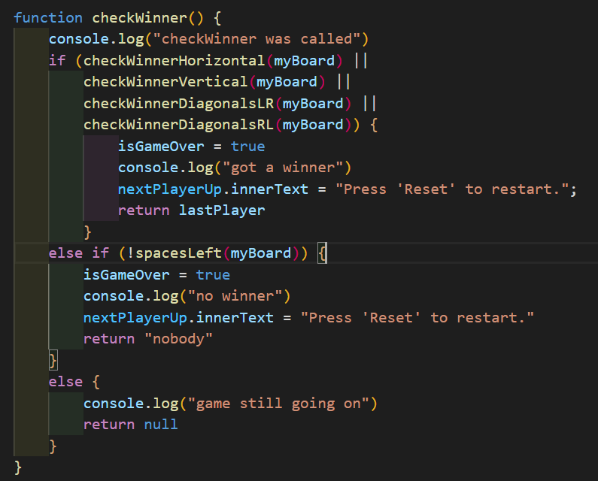
Went bad:
Occasional Repetitive logic
(R.M., not D.R.Y.)
repeated myself
- Similar logic for Horizontal and Vertical – could be only 1 function;
- Same for Diagonal checks.

Slide 8
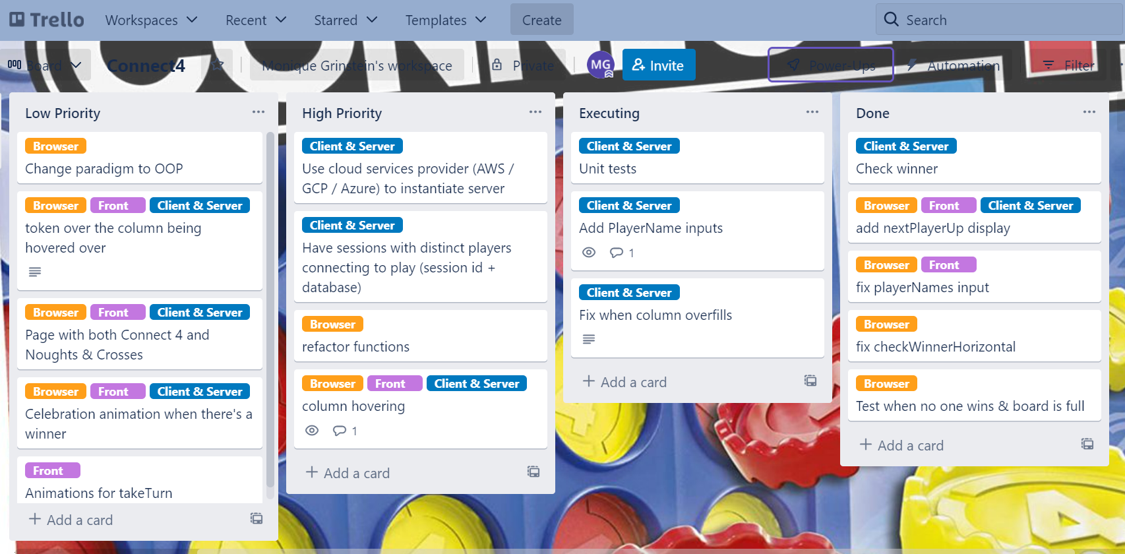
Future improvements

Slide 9
Thank You

Slide 10
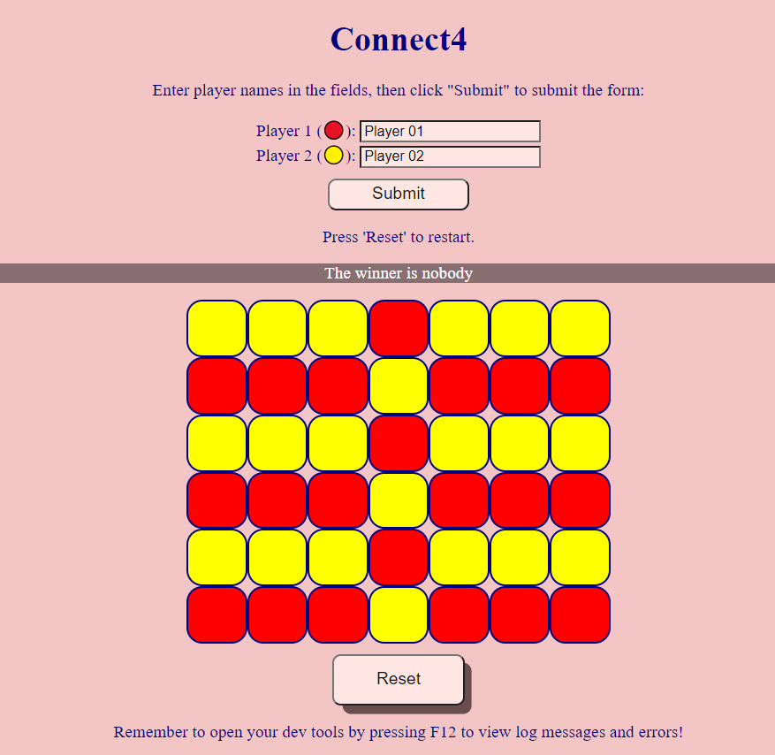
Tie

Slide 11
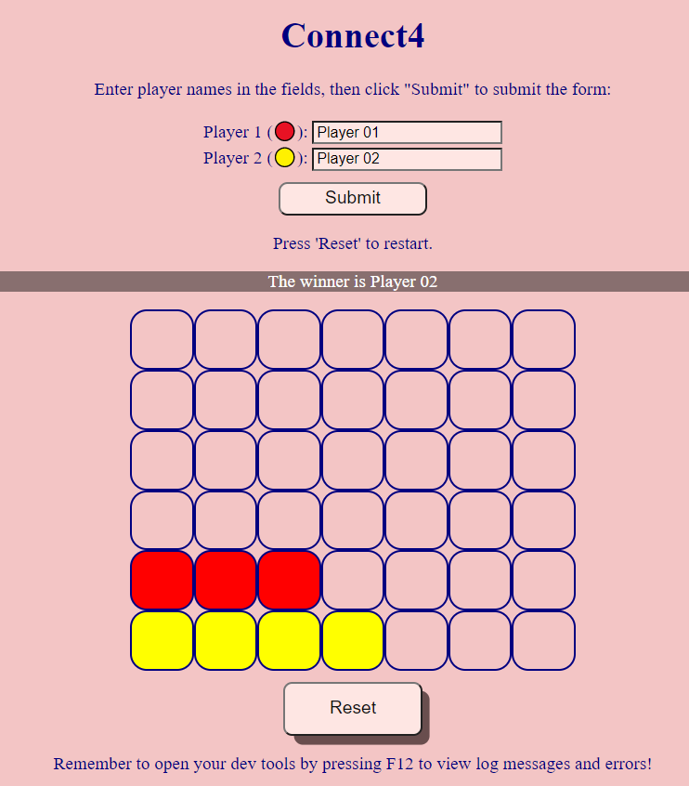
Horizontal

Slide 12
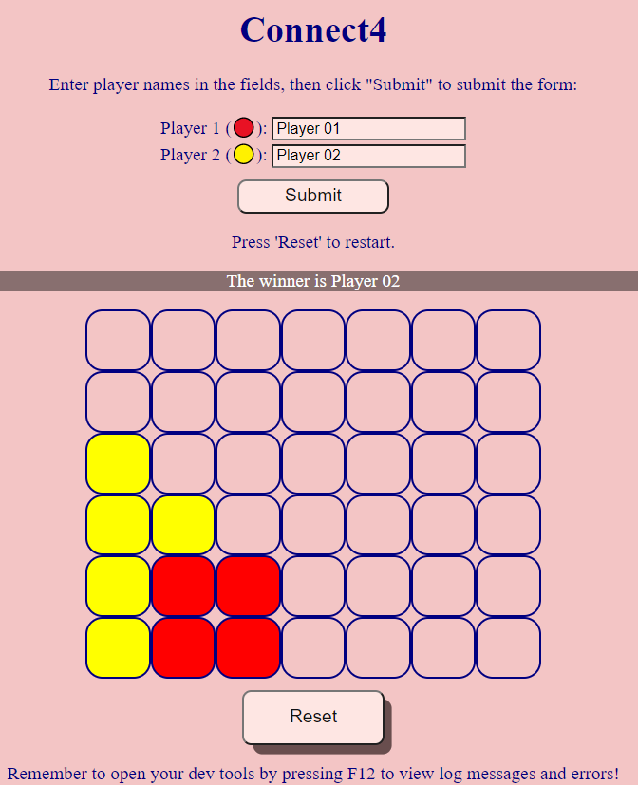
Vertical

Slide 13
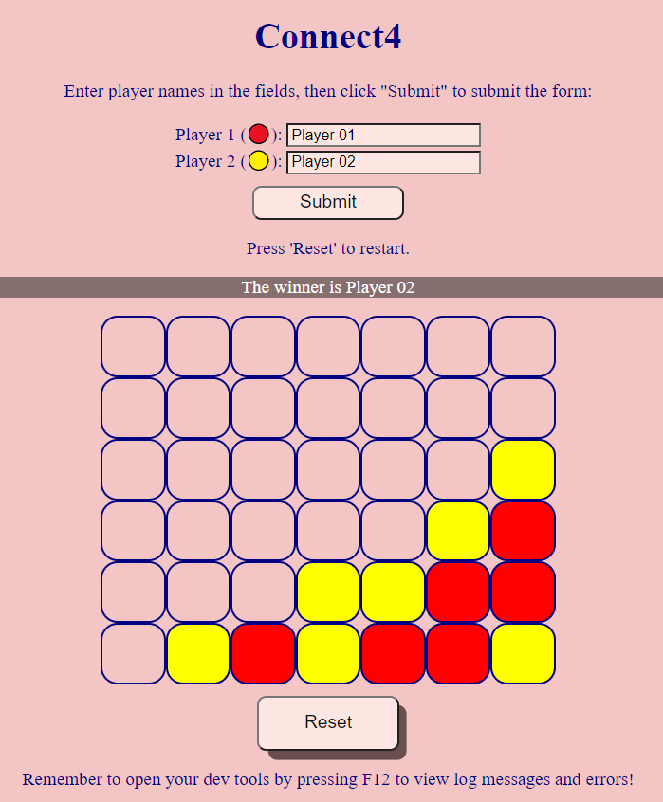
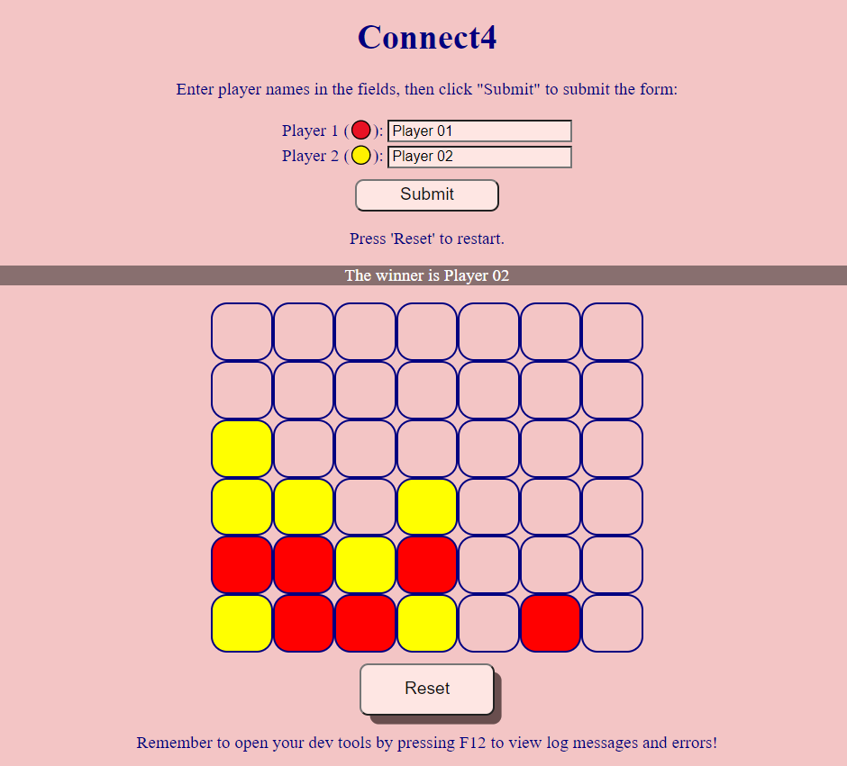
Diagonal

