Slide 1

Customer Segmentation in E-Commerce Using K-Means Clustering
Data Analysts
Turn Data Into Insights
https://github.com/ferrettijaime-cmd/Professional_portfolio

Slide 2
Goal: Transform customer transaction data into actionable customer segments for business decision-making.
Project Overview
Objective
Identify distinct customer segments based on purchasing behavior using unsupervised machine learning techniques.
Business Context
The e-commerce platform has a large customer base with different purchasing patterns. Understanding these behaviors can help the business develop targeted marketing and retention strategies.
Goal: Transform customer transaction data into actionable customer segments for business decision-making.

Slide 3
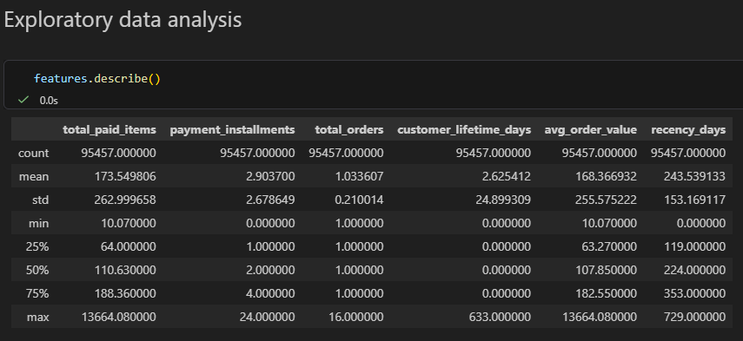
Exploratory Data Analysis
Customer Spending
Average customer spending: 173.5 monetary units.
Median spending: 110.6, indicating a right-skewed distribution.
A small group of customers spends significantly more than the average.
Purchase Frequency
Customers place an average of 1.03 orders.
Median = 1 order.
Most customers purchase only once.
Recency
Average recency is 243 days.
Many customers have not made a purchase for several months.
Indicates a large population of inactive customers.

Slide 4
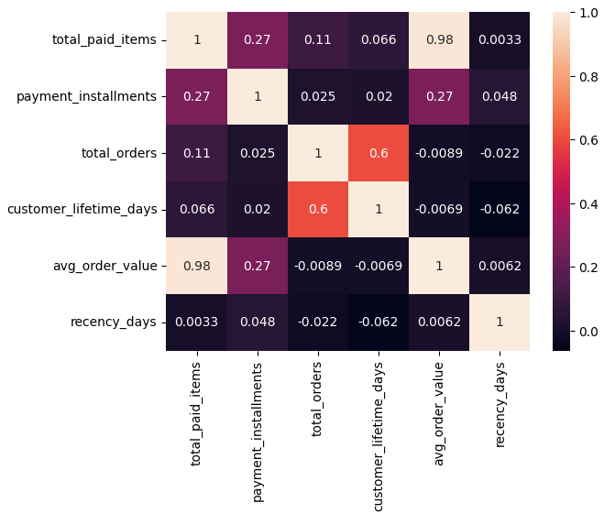
Key Relationships Between Variables
01
total_paid_items vs avg_order_value (0.98)
Extremely strong positive correlation.
Both variables contain nearly the same information.
To avoid redundancy, avg_order_value was excluded from the clustering model.
02
payment_installments vs total_paid_items (0.27)
Weak-to-moderate positive relationship.
Customers spending more tend to use a higher number of installments.
Indicates a preference for financing higher-value purchases.

Slide 5
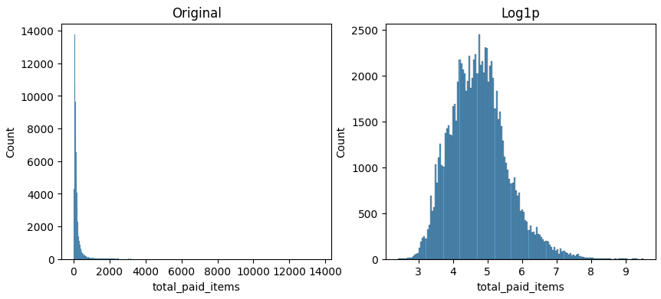
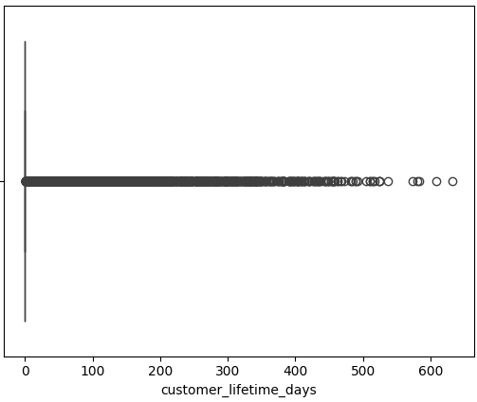
Outlier Treatment
Challenge
Several variables exhibited highly right-skewed distributions and extreme values, particularly:
total_paid_items
customer_lifetime_days
These extreme observations could dominate distance calculations in K-Means clustering.
Approach
Instead of removing customers, a logarithmic transformation was applied:
np.log1p()
This method:
Preserves all customer records.
Reduces the influence of extreme values.
Compresses large values while maintaining their relative order.
Produces more balanced distributions for clustering.

Slide 6
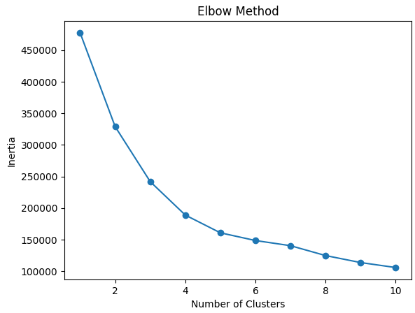
Selecting the Optimal Number of Clusters
Elbow Method
The Elbow Method was used to determine the appropriate number of customer segments for K-Means clustering.
For each value of K (1–10), a K-Means model was trained and the Inertia metric was calculated.
Inertia measures the total within-cluster variation, where lower values indicate more compact clusters.
Interpretation
The curve begins to flatten around K=4, suggesting that most of the meaningful customer structure has already been captured.
Adding more clusters continues to reduce inertia, but the improvement becomes relatively small compared to the increased model complexity.
Decision
Based on the Elbow Method, K=4 was selected as the initial candidate because it provides a balance between cluster compactness and model interpretability.
This choice was later validated using the Silhouette Score and business interpretation of the resulting customer segments.

Slide 7
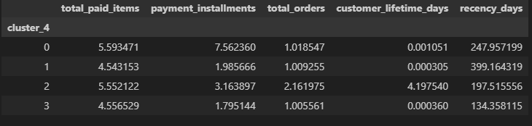
Customer Segment Interpretation
Segment | Key Characteristics | Business Action
High Value One-Time Buyers (Cluster 0) | High spending customers, typically using multiple installments, but with only one purchase. | Encourage a second purchase through personalized promotions.
Dormant Customers (Cluster 1) | Low spending customers with a long period since their last purchase. | Reactivation campaigns and targeted discounts.
Loyal Customers (Cluster 2) | Highest purchase frequency, longest customer lifetime, and relatively recent activity. | Retention programs, loyalty rewards, and exclusive offers.
Recent Customers (Cluster 3) | Low spending customers with recent activity but limited purchase history. | Nurture engagement and encourage repeat purchases.

Slide 8
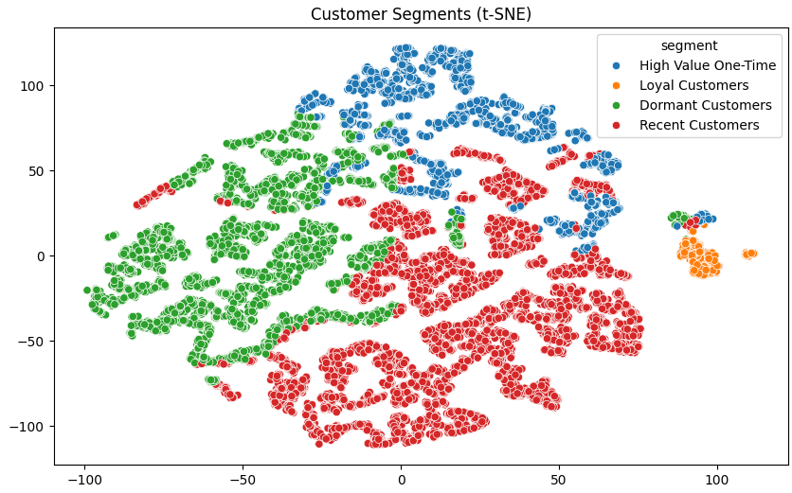
t-SNE Visualization Interpretation
Cluster Separation
The t-SNE visualization confirms that the K-Means algorithm successfully identified meaningful customer segments.
Most customer groups form distinct regions in the feature space, indicating that customers within each segment share similar purchasing behaviors.
Loyal Customers
The Loyal Customers segment appears clearly isolated from the remaining groups.
This suggests that repeat buyers exhibit a unique behavioral pattern characterized by:
Higher purchase frequency.
Longer customer lifetime.
More recent activity.
The strong separation indicates that this segment is significantly different from the rest of the customer base.
The t-SNE visualization supports the clustering results by showing that Loyal Customers form a clearly differentiated segment, while Recent Customers, Dormant Customers, and High Value One-Time Buyers exhibit moderate overlap, reflecting gradual transitions in customer behavior rather than perfectly separated groups.

Slide 9
Business Recommendations
Loyal Customers (2.1% of customers)
Prioritize retention through loyalty programs and exclusive benefits.
Increase customer lifetime value with personalized product recommendations.
Use this segment as a benchmark to identify characteristics that can be replicated in other customer groups.
Recent Customers (47.1% of customers)
Encourage a second purchase through targeted promotions and onboarding campaigns.
Focus on converting first-time buyers into repeat customers.
High Value One-Time Buyers (17.6% of customers)
Develop strategies to transform high-spending buyers into repeat customers.
Offer cross-selling and personalized follow-up campaigns.
Dormant Customers (33.2% of customers)
Implement reactivation campaigns using discounts, email marketing, and personalized offers.
Identify reasons for inactivity and reduce customer churn.

Slide 10
Thank you
for your attention
https://github.com/ferrettijaime-cmd/Professional_portfolio

