Slide 1
Workflow Process
Stages
ETL Process
Created by Jaime Ferretti
https://github.com/ferrettijaime-cmd/Professional_portfolio

Slide 2
Project Overview
This project focuses on designing and implementing a scalable analytics pipeline for e-commerce data.
The workflow begins with extracting multiple CSV datasets using Python and loading them into PostgreSQL. The data is then transformed through a layered architecture consisting of RAW, STAGING, and ANALYTICS schemas. A dimensional model was created using fact and dimension tables, including primary and foreign key relationships to support analytical workloads.
The resulting analytical environment serves as the foundation for exploratory analysis, machine learning models, and business intelligence reporting.

Slide 3
Workflow
Steps Guide
CSV Files
extract_load.py
RAW Schema
run_staging.py
Sending semi-processed data to staging schema, automating the process with Python
Original data file.
Data extraction using Python
Load raw schema data in PostgreSQL
01
02
03
04
STAGING Schema
run_star_schema.py
ANALYTICS Schema
Data type modification using SQL
Sending data to the warehouse, automating the process using Python
Data Modeling and Star Schema Construction
05
06
07

Slide 4
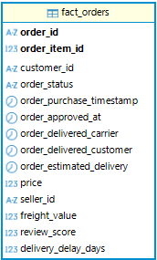

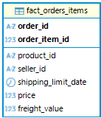
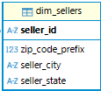
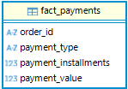
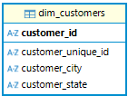
Star Model

Slide 5
ETL Pipeline
The project follows a layered data architecture designed to ensure data quality, reproducibility, and analytical consistency.
RAW
STAGING
ANALYTICS
Phase 1
Phase 2
Phase 3
RAW Layer
STAGING Layer
ANALYTICS Layer
The RAW schema stores the original datasets exactly as they were received from the source CSV files.
The STAGING schema is used to standardize and prepare the data for analytical processing.
The ANALYTICS schema contains the final dimensional model used for reporting, machine learning, and business analysis.
Purpose:
Preserve the original data.
Enable data lineage and traceability.
Allow the pipeline to be rebuilt from scratch at any time.
Process:
CSV files are extracted using Python and Pandas.
Data is loaded into PostgreSQL using SQLAlchemy.
No transformations are applied at this stage.
Purpose:
Convert data types.
Standardize table structures.
Separate transformation logic from source data.
Transformations Applied:
String to timestamp conversions.
Numeric type standardization.
Data preparation for dimensional modeling.
Purpose:
Create a business-friendly data model.
Improve query performance.
Support analytics and predictive modeling.
Components:
Fact Tables
Dimension Tables
Additional Features

Slide 6




06
Automation
05
ANALYTICS Schema
04
CSV Files
Python SQL Execution Script
03
01
STAGING Schema
02
Python SQL Execution Script
Python Extraction Script
RAW Schema

Slide 7
Conclusion
This project demonstrates the complete lifecycle of an analytics solution, from raw data ingestion to advanced analytical modeling.
A multi-layer PostgreSQL architecture was designed using RAW, STAGING, and ANALYTICS schemas to ensure data quality, reproducibility, and scalability. Automated ETL pipelines were developed using Python and SQL, enabling the systematic transformation of source data into a structured dimensional model.
The resulting data warehouse served as the foundation for multiple analytical initiatives, including customer churn analysis, customer segmentation, logistics performance evaluation, regression modeling, and classification models.
Through this project, key competencies were applied across data engineering, data modeling, SQL development, machine learning, and business analytics, providing an end-to-end view of how data can be transformed into actionable insights.

Slide 8
Thank you for your time
https://github.com/ferrettijaime-cmd/Professional_portfolio

