Slide 1
Machine Learning Project
Authors: Julen Ferro (A20512110)
Eneko Gonzalez (A20520157)

Slide 2
INDEX
Introduction
Team members —-- J
Description of the problem —-- J
Project proposal —--- E
Used dataset
Algorithm comparison
Simple Moving Average Model — J
Exponential Moving Average Model —- J
Long Short Term Memory —--- E
Recurrent Neural Network
Analysis of results
Deriving theoretical properties of the algorithm —
Conclusions —- J/E
CONTINUE DEVELOPING POINTS OF THE SCHEMA
CONTENT

Slide 3
INTRODUCTION
1.1. Team members
Julen Ferro Bañales - Industrial Electrical Engineer - Data Science at IIT
Eneko Gonzalez - Telecommunications Engineer - Computer Science at IIT

Slide 4








INTRODUCTION
1.2. Description of the problem

Slide 5

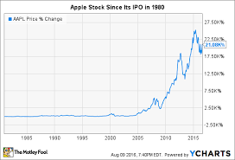

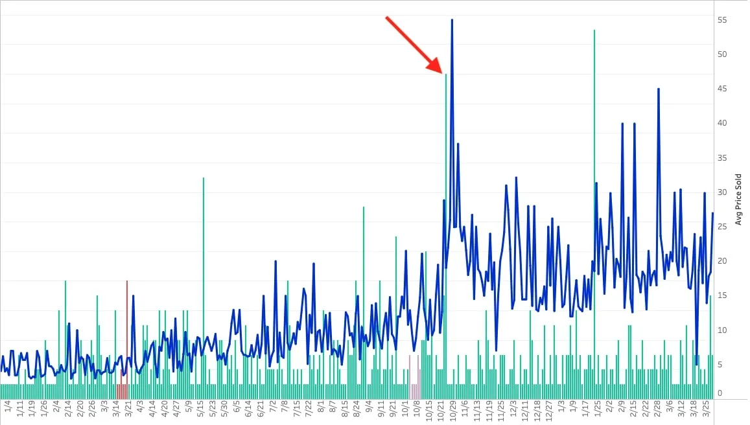

INTRODUCTION
1.3. Project proposal

Slide 6




INTRODUCTION
1.3. Project proposal
I need a tool for predicting the stock evolution…
Alakazam:
IQ = 5000
Psychic type
Inf. memory
I need to ask students from the best engineering institute to develop it…

Slide 7
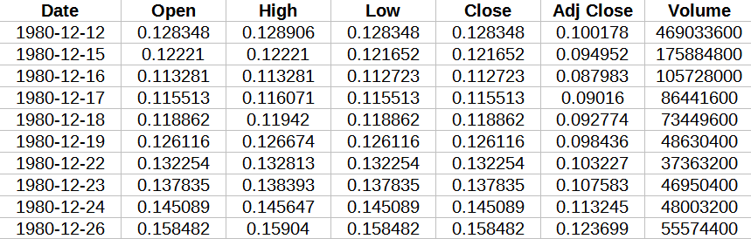
2. USED DATASET
Apple Stock Price from 1980-2021

Slide 8
2. USED DATASET
Apple Stock Price from 1980-2021

Slide 9
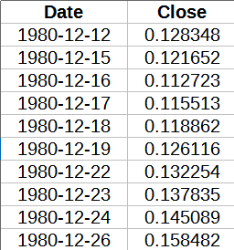
2. USED DATASET
Apple Stock Price from 1980-2021
Scaling
Training and testing (0.?)
MODEL
Past ‘Close’ prices
Future ‘Close’ prices

Slide 10
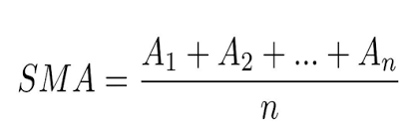
3. ALGORITHM COMPARISON
3.1. Simple Moving Average (SMA)
SMA → SME = 50
SMA → SME = 300

Slide 11
3. ALGORITHM COMPARISON
3.3. Long Short Term Memory (LSTM)

Slide 12
3. ALGORITHM COMPARISON
3.4. Recurrent Neural Network (RNN)

Slide 13
4. ANALYSIS OF RESULTS
MODEL | SMA | LSTM | RNN
Training error
Testing error
Computing time
Complexity

Slide 14
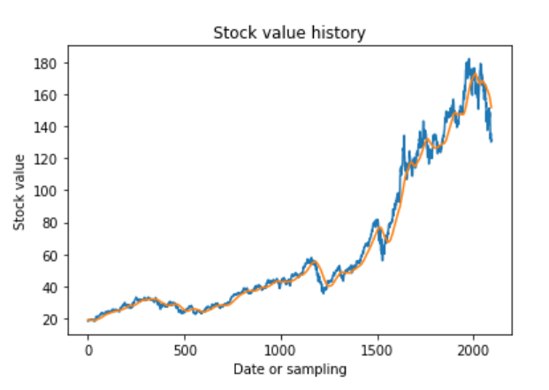
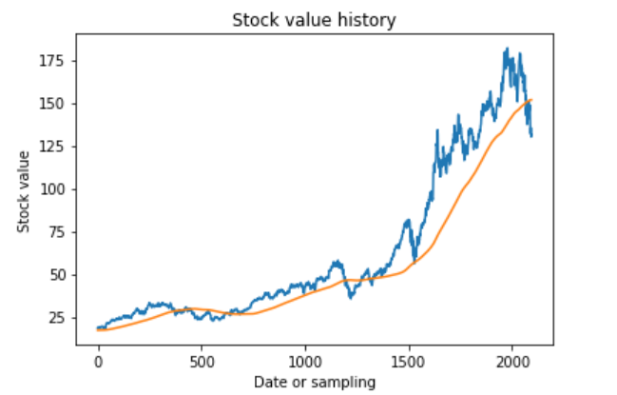
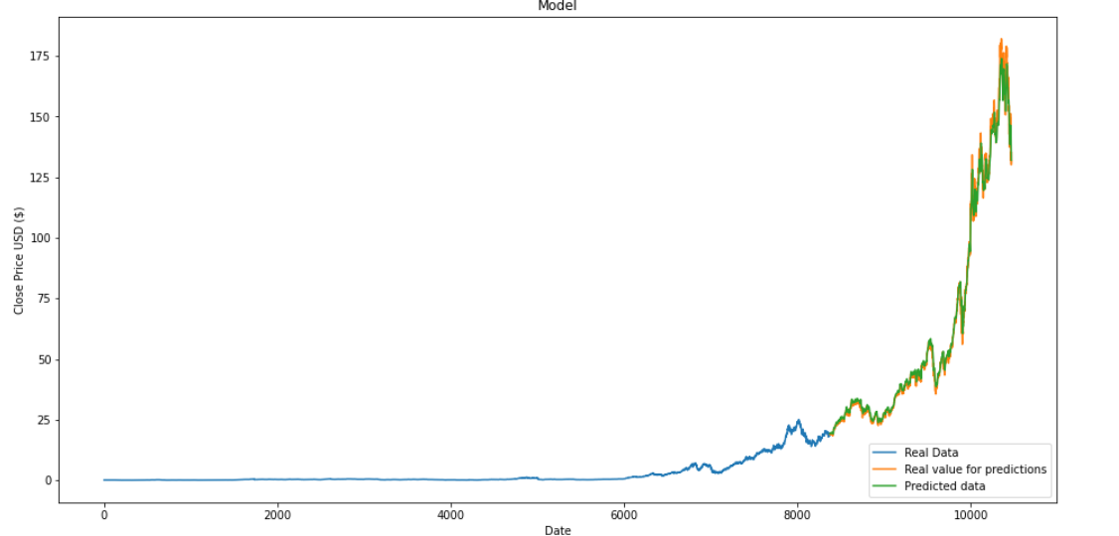
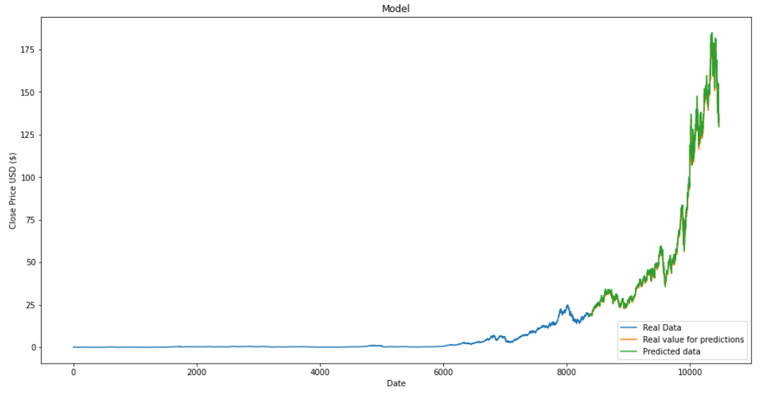
4. ANALYSIS OF RESULTS
SMA
SMA
WS = 50
WS = 300
LSTM
RNN

Slide 15
5. DERIVING THEORETICAL PROPERTIES

Slide 16
6. CONCLUSIONS
SMA the worst one
Window size of SMA
Importance of Machine Learning
LSTM vs RNN

