Slide 1

MACHINE LEARNING ALGORITHM FOR STOCK VALUE PREDICTION
Final Project
CS584 - Machine Learning
Julen Ferro (A20512110) & Eneko Gonzalez (A20520157)
Disclaimer: This presentation does not encourage investment in financial assets.

Slide 2
INDEX
Introduction
Team members
Description of the problem
Project proposal
Description of the dataset
Selected dataset
Data preparation
Algorithm comparison
Simple Moving Average Model
RNN - Simple
RNN - LSTM
Analysis of results
Conclusions

Slide 3
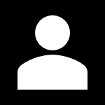
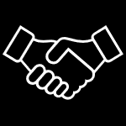
1. INTRODUCTION
1. 1. Team members
Julen Ferro Bañales
Industrial Electrical Engineer
Data Science at IIT
Eneko Gonzalez Telecommunications Engineer
Computer Science at IIT

Slide 4
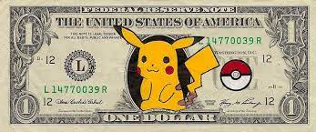







1. INTRODUCTION
1. 2. Description of the problem

Slide 5

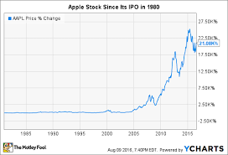

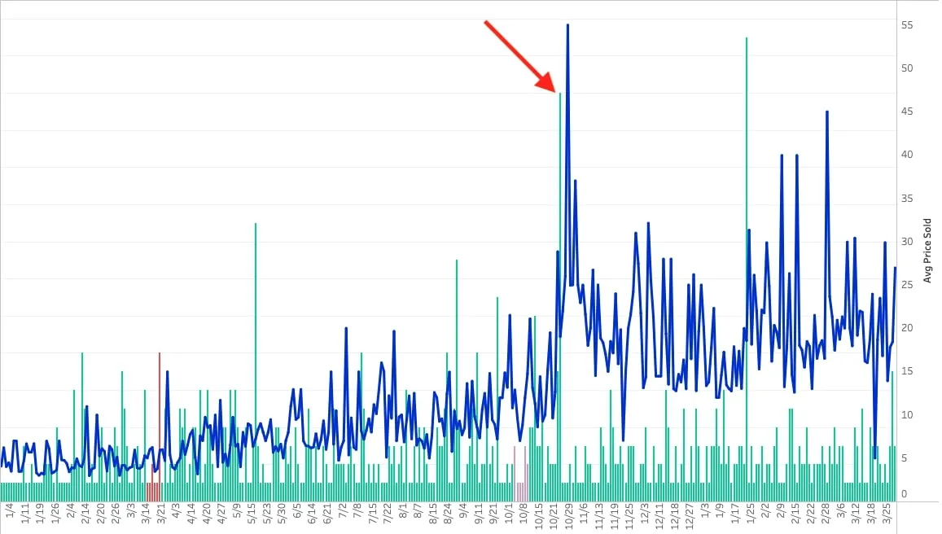

1. INTRODUCTION
1. 2. Description of the problem

Slide 6
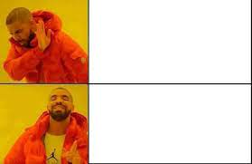
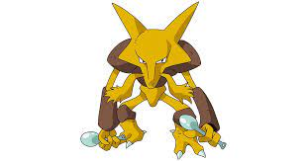


1. INTRODUCTION
1. 3. Project Proposal
I need a tool for predicting the stock evolution…
Alakazam:
IQ = 5000
Psychic type
Inf. memory
I need to ask students from the best engineering institute to develop it…

Slide 7
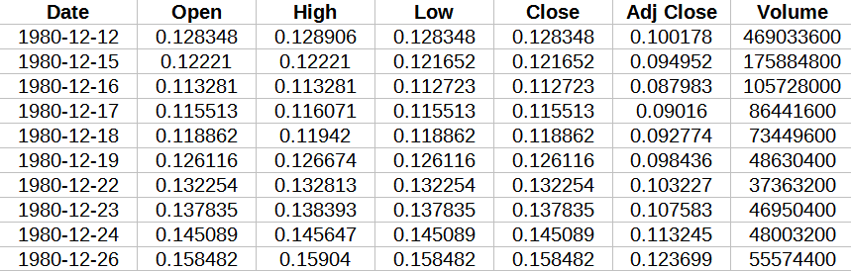
2. Description Of The Dataset
2. 1. Selected Dataset
Apple Stock Price from 1980-2021

Slide 8
2. Description Of The Dataset
2. 1. Selected Dataset
Apple Stock Price from 1980-2021

Slide 9
2. Description Of The Dataset
2. 2. Data preparation
SEPARATE & CLEAN DATA
NORMALIZE DATA MIN-MAX SCALER
1
3
2
4
SPLIT DATA & LABELS
TRAIN & TEST SUBSETS

Slide 10
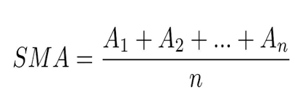
3. Algorithm Comparison
3. 1. Simple Moving Average (SMA)
SMA → Window Size = 50
SMA → Window Size = 300
No ML in here → ML will give us accuracy

Slide 11
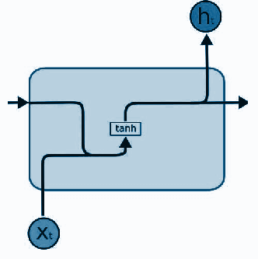
3. Algorithm Comparison
3. 2. Simple Recurrent Neural Networks
Stock Data values are not independent.
RNN use sequential data or time series data.
Not actual use of memory
Different levels of complexity

Slide 12
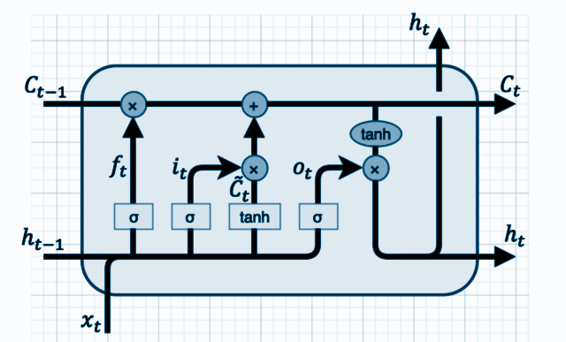
3. Algorithm Comparison
3. 3. Long Short Term Memory Recurrent Neural Network
Introduction of gates
More flexibility
More control
Better results

Slide 13
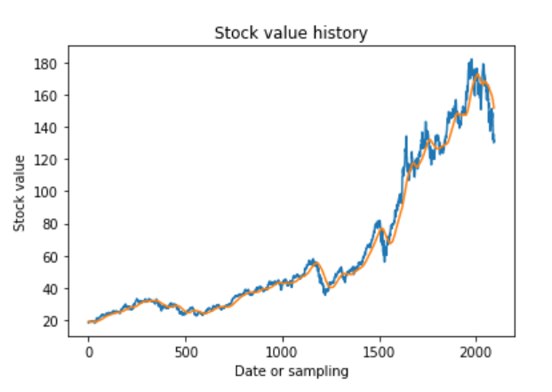
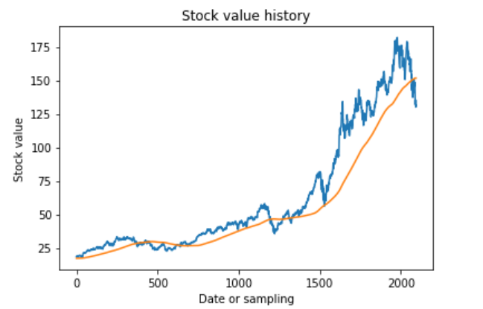
4. Analysis Of Results
4. 1. Simple Moving Average (SMA)

Slide 14
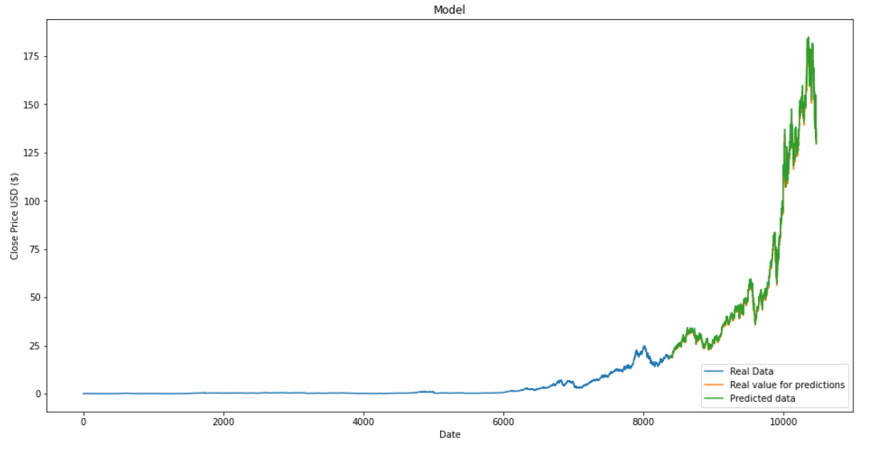
4. Analysis Of Results
4. 2. Simple Recurrent Neural Networks

Slide 15
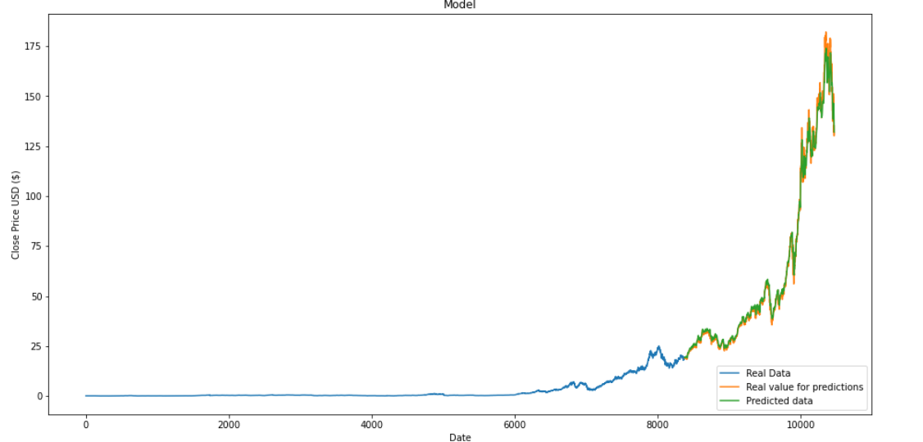
4. Analysis Of Results
4. 3. Long Short Term Memory Recurrent Neural Network

Slide 16
4. Analysis Of Results
4. 4. Comparison Table
MODEL | SMA (WS = 50) | SMA (WS = 300) | RNN - Simple | RNN - LSTM
Training error | 5.8 % | 16.2 % | 0.001% | 0.0001%
Testing error | – | – | 1.18% | 0.01%
Computing time | 0.1 s | 0.5 | 1 s 5 ms | 1 s 10 ms

Slide 17
5. Conclusions
SMA Model is the worst one
Window size of SMA
Importance of Machine Learning
RNN-LSTM potential
1
2
3
4

Slide 18
MACHINE LEARNING ALGORITHM FOR STOCK VALUE PREDICTION
Final Project
CS584 - Machine Learning
Julen Ferro (A20512110) & Eneko Gonzalez (A20520157)

