Slide 1
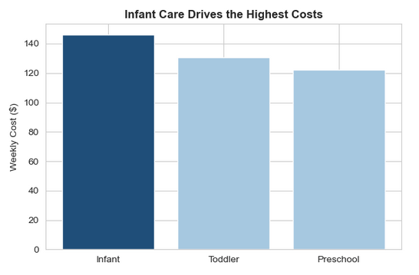
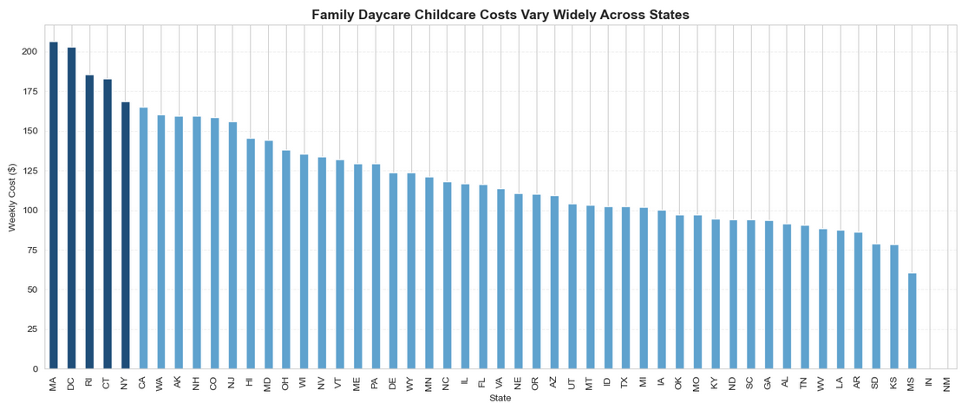
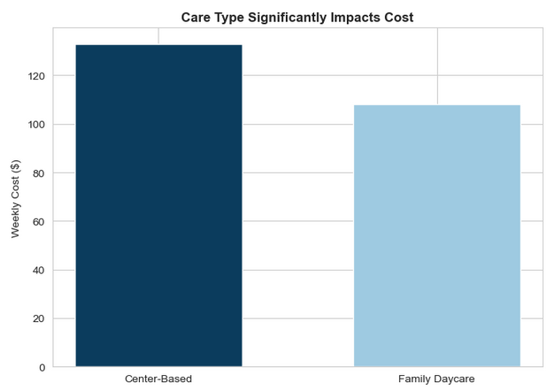
Childcare Cost and Affordability Overview (U.S.) Comparing cost differences across states, care types, and age groups
Avg Weekly Cost (Center-Based)
Avg Weekly Cost
(Family Daycare)
Center-Based care costs ~20-25% more
per week than
Family Daycare
Highest Cost State (Family Daycare)
Lowest Cost State (Family Daycare)
Massachusetts ~$270/Week
Mississippi ~$70/Week
~$133
~$108
Childcare Costs Vary Widely Across States
Costs decrease slightly as children age but remain a significant weekly expense across all groups.
Center-Based care is regularly more expensive than Family Daycare, increasing overall cost burden for families.
Higher-cost states create uneven
financial burden across regions

