Slide 1

Childcare Costs and Economic Strain Across U.S. States
Teresa Ferrill
DSC 640 Data Presentation and Visualization
April 26, 2026
Understanding cost differences and their impact on affordability

Slide 2

Childcare Costs Impact
Workforce Participation
Childcare is a major household expense
That Varies Widely
Can impact workforce participation
(U.S. Department of Labor, 2023)

Slide 3
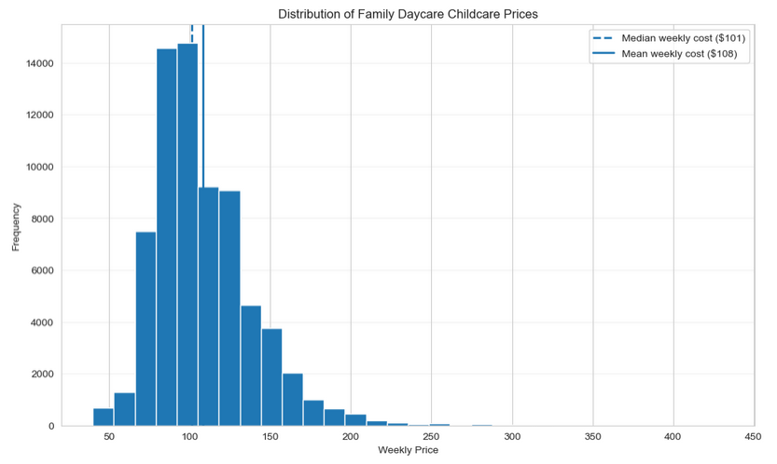
Family Daycare Costs Are Around $100 per Week, with Some Higher-Cost Outliers
The Average exceeds the Median, Indicating a Small Number of Higher-Cost Observations

Slide 4
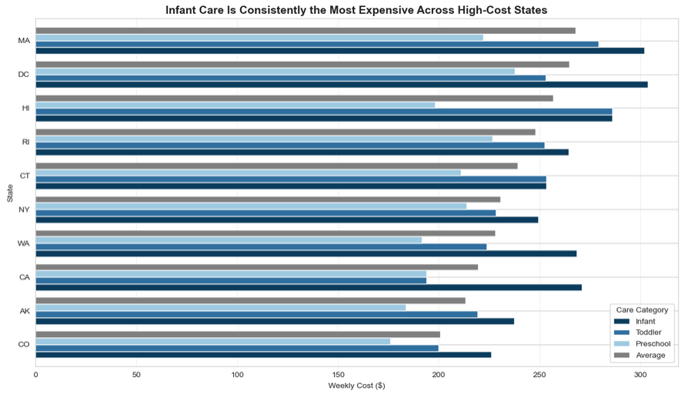
Infant Care is Consistently the Most Expensive Across High-Cost States
Infant Care Represents the Highest Weekly Cost Across High-Cost States

Slide 5
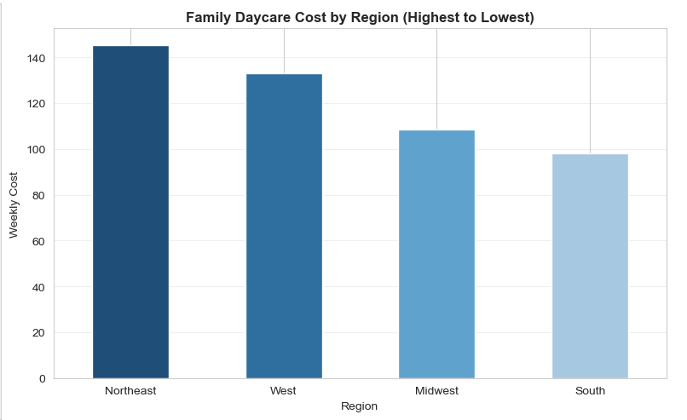
Childcare Costs Differ Across Regions
Family Daycare Costs are Highest in the Northeast and Lowest in the South

Slide 6
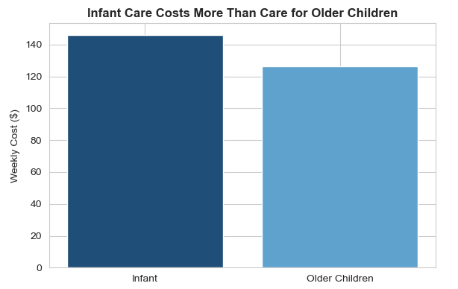
Infant Care is the Most Expensive Age Group
Infant Care Costs are Approximately 15% Higher than Toddler and Preschool Care
Highest-Cost Childcare Stage: Infant Care

Slide 7
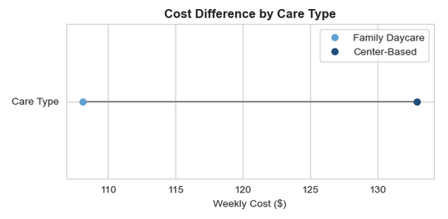
Care Type Creates a Meaningful
Cost Gap for Families
Center-Based Care Costs More than Family Daycare
+20-25% Higher Cost for Center-Based Care

Slide 8
Multiple Factors Drive Higher Childcare Costs
Costs vary by state and region
Infant Care is the most expensive
Center-based care increases overall cost
combined cost drivers
– location, age, and care type –
create financial strain for working families
Childcare Costs May Impact Workforce
Participation and Financial Stability
(Child Care Aware of America, 2022)

Slide 9
Key Takeaways and Implications
Childcare costs vary widely across states and regions
Infant care and center-based care drive higher costs
Childcare costs may act as a barrier to workforce participation
Addressing childcare affordability is critical to supporting workforce stability and economic participation

Slide 10
References
U.S. Department of Labor, Women’s Bureau. (2022). National database of childcare prices. https://www.dol.gov/agencies/wb/data/childcare-prices
Child Care Aware of America. (2022). The U.S. and the high price of child care. https://www.childcareaware.org
U.S. Department of Labor. (2023). Childcare and labor force participation. https://www.dol.gov
Knaflic, C. N. (2015). Storytelling with data: A data visualization guide for business professionals. Wiley.

