Slide 1


Forecasting Hays County Housing Market Speed
A One-Month-Ahead Decision Support Model
Teresa Ferrill
October 4, 2026
Notes:
Hello, I’m Teresa Ferrill. This project examines whether information about Hays County’s housing market can help estimate its median days on market one month in advance. I compared several forecasting approaches and considered how real estate professionals could use the result when discussing market conditions with clients.

Slide 2
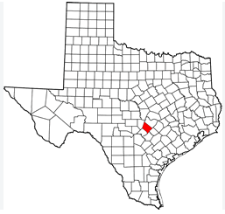
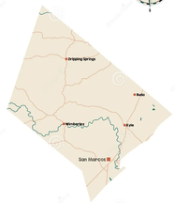
The Business Question
Can we anticipate next month’s market pace?
  Outcome: countywide median days on market (MDOM)
  Audience: real estate professionals advising buyers and sellers
Hays County,
Texas
Notes:
Median days on market, or MDOM, describes the middle value of listing times for homes in the county. It gives us a way to discuss how quickly the market is moving. My question was whether current housing conditions, mortgage rates, and seasonal patterns could provide a useful estimate of next month’s MDOM. This is a countywide forecast for Hays County, Texas, rather than a prediction for any particular home.

Slide 3
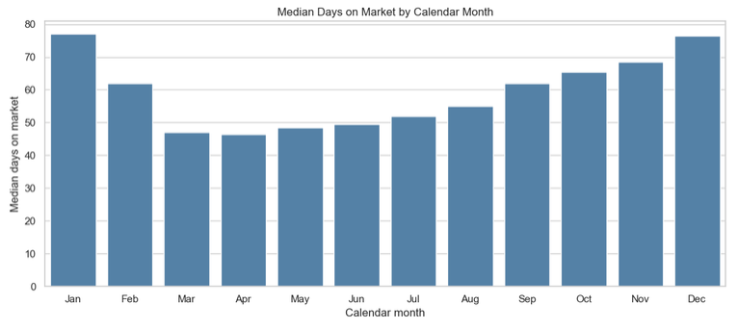
Why Market Speed Matters
Market speed changes over time
  January median: 77 Days
  April median: 46.5 days
Notes:
The chart shows a clear seasonal pattern. Across the period I studied, January had the highest calendar-month median at 77 days, while April had the lowest at 46.5 days. Market speed also changed substantially from year to year. An agent advising a client needs to understand both patterns: what typically happens during the season and whether current conditions suggest a change in pace.

Slide 4
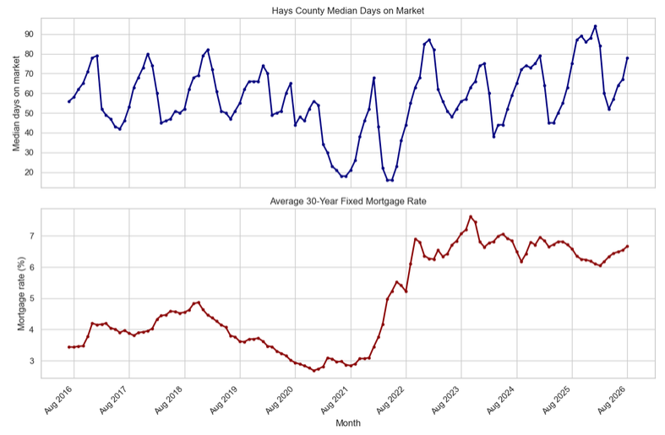
Data and Preparation
Two sources, one monthly dataset
  Realtor.com:
    Hays County listings
  Freddie Mac:
    30-year mortgage rates
    July 2016 – August 2026, 122 months
Notes:
I combined two public data sources. Realtor.com supplied monthly housing measures for Hays County, including median days on market, listing prices, and inventory. Freddie Mac supplied weekly 30-year mortgage rates, which I averaged by month so the dates would match. The combined dataset covers July 2016 through August 2026, or 122 consecutive months. I checked for missing and duplicate months, joined the sources by month, and placed each following month’s MDOM on the current month’s row as the outcome to predict. That left 121 rows with a known outcome for model development and evaluation.

Slide 5
A Fair Test of the Forecast
Earlier months trained the models; later months tested them
  Training: 97 Observations
  Test: 24 Observations
  Compared with previous month and prior-year forecasts
Training – 97 Observations
Aug 2016 – Aug 2024
Testing – 24 Observations
Sep 2024 – Aug 2026
Forecast
Sep 2026
Model tuning used time-series cross-validation within the training period
The final 24 months were held back to test predictions on later data
Notes:
Because this is a forecast, I kept the observations in date order. I trained the models on 97 earlier observations and reserved the final 24 for testing. I used time-series cross-validation within the training period when tuning ridge regression and random forest. I also compared the models with two straightforward forecasts: carrying forward the current month’s MDOM and using the value from the same month a year earlier. The August 2026 predictor record was saved for the September forecast after the model comparison.

Slide 6
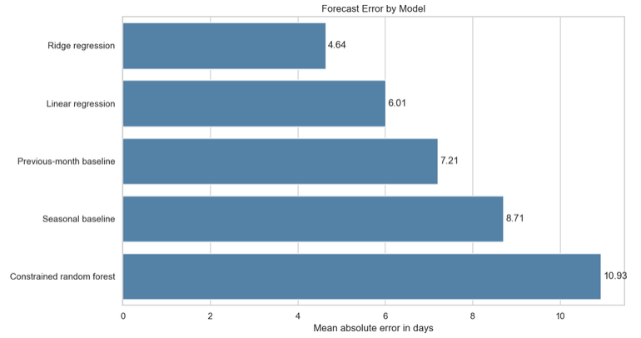
Which Approach Worked Best
Ridge had the lowest average error
  Ridge: 4.64 days
  Previous-month
  baseline: 7.21 days
  35.7 % lower
  average error
Notes:
I tested linear regression, ridge regression, and a constrained random forest. Ridge regression was useful here because several housing measures are related, and its regularization limits how strongly the model responds to those overlapping inputs. This chart compares mean absolute error, which is the average size of a forecast miss in days. Ridge had the lowest error at 4.64 days. The previous-month forecast missed by 7.21 days on average, so ridge reduced average error by 35.7 percent in this test period. The more complex random forest did not improve on the simpler approaches in this dataset.

Slide 7
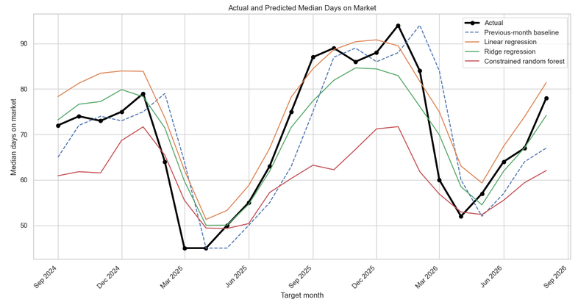
What did the Predictions Look Like
Ridge generally followed the observed changes
  Test period:
  Sep 2024 – Aug 2026
  Largest miss:
  about 14.7 days
  (Mar 2025)
Notes:
This chart compares the observed monthly values with the model predictions across the 24 test months. Ridge generally followed the changes in market speed, including the broad seasonal movement. It was not right every month. Its largest miss was about 14.7 days in March 2025, when its estimate was higher than the observed value. That is why I would show the model’s historical error when presenting a new forecast and review unusually large changes before sharing them.

Slide 8
September 2026 Estimate
September Forecast: 82.5 days
78 Days
82.5 Days
August Actual Days on Market
September Estimated Days on Market
About 4.5 Days Longer
Countywide estimate; test-period average error: 4.64 days
Notes:
After selecting ridge, I refitted it using all 121 observations with known outcomes. Using the August 2026 housing and mortgage-rate information, it estimated September’s countywide median days on market at 82.5 days. August’s observed value was 78 days, so the estimate suggests a slightly slower market, by about 4.5 days. The 4.64-day figure at the bottom is the model’s average error during testing. It is context for the estimate, not a guaranteed range around 82.5 days.

Slide 9
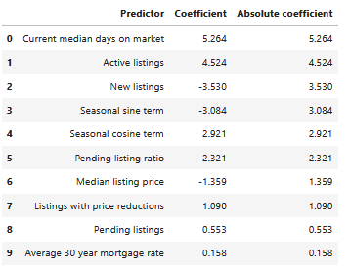
What Informed the Forecast
Current market speed and active listings mattered most
  Other inputs:
    New listings
    Seasonality
    Pending ratio
    Prices
    Mortgage rates
Notes:
Current median days on market and the number of active listings had the strongest positive coefficients in the ridge model. New listings, seasonal measures, and the pending ratio also contributed. Mortgage rates were included, although their coefficient was comparatively small after accounting for the other inputs. These coefficients describe relationships in this fitted model. They do not show that changing any one factor would cause the market to speed up or slow down.

Slide 10
Limits and Responsible Use
Use the forecast with context
  One county and one 24-month test period
  Individual homes can differ
  Show the historical error with every estimate
An estimate is not a guarantee; do not use it to target or exclude protected groups
Notes:
This analysis covers one county, and its performance was measured on one 24-month test period. Conditions can differ among Hays County communities, and a home’s location, condition, and asking price can make its experience very different from the county median. The forecast should be described as an estimate, alongside its historical error, and considered with comparable sales and professional judgment. It should never be presented as a guarantee or used to target or exclude protected groups.

Slide 11
Recommendations
Add a monthly forecast to a market dashboard showing:
  Forecast
  Latest actual
  Expected change
  Historical error
Review unusual changes before sharing
Ridge provided a useful countywide early indicator,
with an average test error of 4.64 days
Notes:
I recommend updating the forecast each month after the new source data become available. A market dashboard could display the forecast, the latest actual MDOM, the expected change, and the model’s historical error. An analyst or broker should review unexpected changes before using the result with clients. In the period tested, ridge provided a useful early indicator of countywide market speed, with an average error of 4.64 days. Its best use is to support a conversation about current conditions and reasonable expectations. This forecast gives real estate professionals another way to discuss countywide market conditions with clients. Thank you.

Slide 12
References
Freddie Mac. (n.d.). Primary Mortgage Market Survey [Data set]. Retrieved September 5, 2026, from https://www.freddiemac.com/pmms
Realtor.com Economic Research. (n.d.). Residential real estate data library [Data set]. Retrieved September 5, 2026, from https://www.realtor.com/research/data/
U.S. Department of Housing and Urban Development. (n.d.). Housing discrimination under the Fair Housing Act. https://www.hud.gov/helping-americans/fair-housing-act-overview

