Slide 1
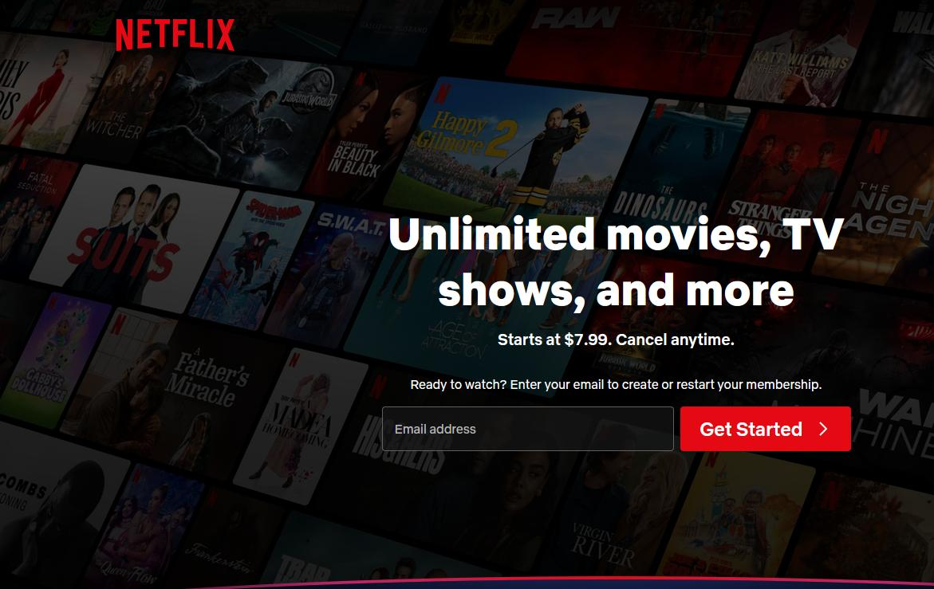

Driving Global Growth Through Content Strategy
Netflix Top 10 Viewership Analysis
Teresa Ferrill
Netflix Viewership Analysis
March 29, 2026
Notes:
This analysis looks at how Netflix titles perform globally and across countries.
The Goal is to identify where Netflix should focus investment for growth.

Slide 2
Contents
Introduction
  Define the Story
  Call to Action
  Overview of Data Used
Design Approach
  Visuals
Key Findings
Limitations
Ethical Considerations
Conclusions
References

Slide 3

Introduction
Analyze Netflix Top 10 performance across global and country datasets
Identify patterns in global engagement
Focus on cross-market content performance
Support data-driven content investment decisions (Knaflic, 2015)

Slide 4

Define the Story
Story
  Global audiences are driving Netflix success
  Cross-country titles consistently outperform
Audience
  Netflix Content Executives
  Focused on high-level insights, not technical detail
Purpose
  Identify content that drives global growth
  Recommend where to invest

Slide 5

Call to Action
Invest in Globally Scalable Content
  Prioritize titles with cross-country performance
  Expand marketing for global top performers
  Focus development on broadly appealing content
Key question:
  Where should Netflix invest to maximize global growth?

Slide 6

Overview of Data Used
Data Sourced from Netflix Top 10 site
  Global Top 10 performance trends
  Country-level viewing patterns
  Most popular titles by total viewership
  Combined to identify scalable content opportunities
Uses three Netflix Datasets:
  All Weeks Countries
  All Weeks Global
  Most Popular

Slide 7

Design Approach
Color: High contrast to highlight key insights
Text: Minimal, focused on key takeaways
Layout: consistent alignment across slides
Spacing: Clean design to reduce cognitive load

Slide 8
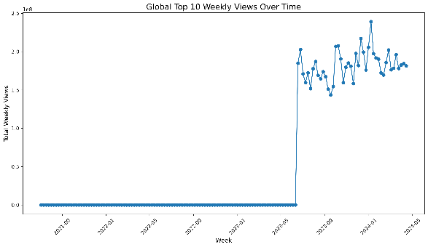
Visual 1 – Global Engagement Over Time
Engagement trends vary over time across global Top 10
Sustained presence indicates stronger audience interest
Early data may reflect incomplete reporting
Global engagement trends provide a high-level view of performance over time (Cairo, 2016)

Slide 9
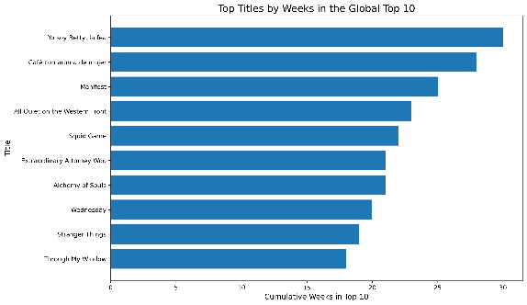
Visual 2 – Top Title by Longevity
Longer Top 10 duration reflects sustained engagement
Consistent performers outperform short-term spikes
Sustained Top 10 presence reflects long-term audience engagement (Knaflic, 2015)

Slide 10
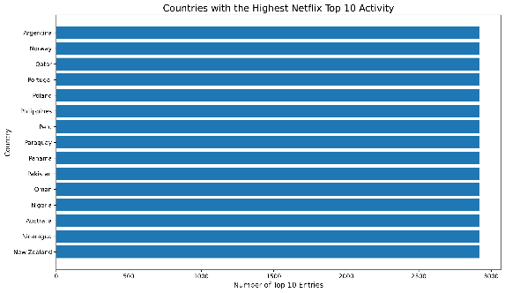
Visual 3 – Country-Level Activity
Country activity varies, but patterns reflect dataset coverage
Similar counts suggest equal observation periods
Country-level activity highlights differences in market engagement

Slide 11
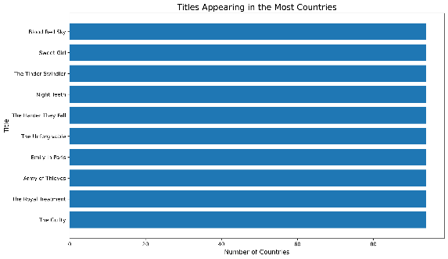
Visual 4 – Titles Across Countries
Titles appearing in multiple countries perform more consistently
Cross-country reach signals strong global appeal
Titles with cross-country reach consistently outperform others (Knaflic, 2015)

Slide 12
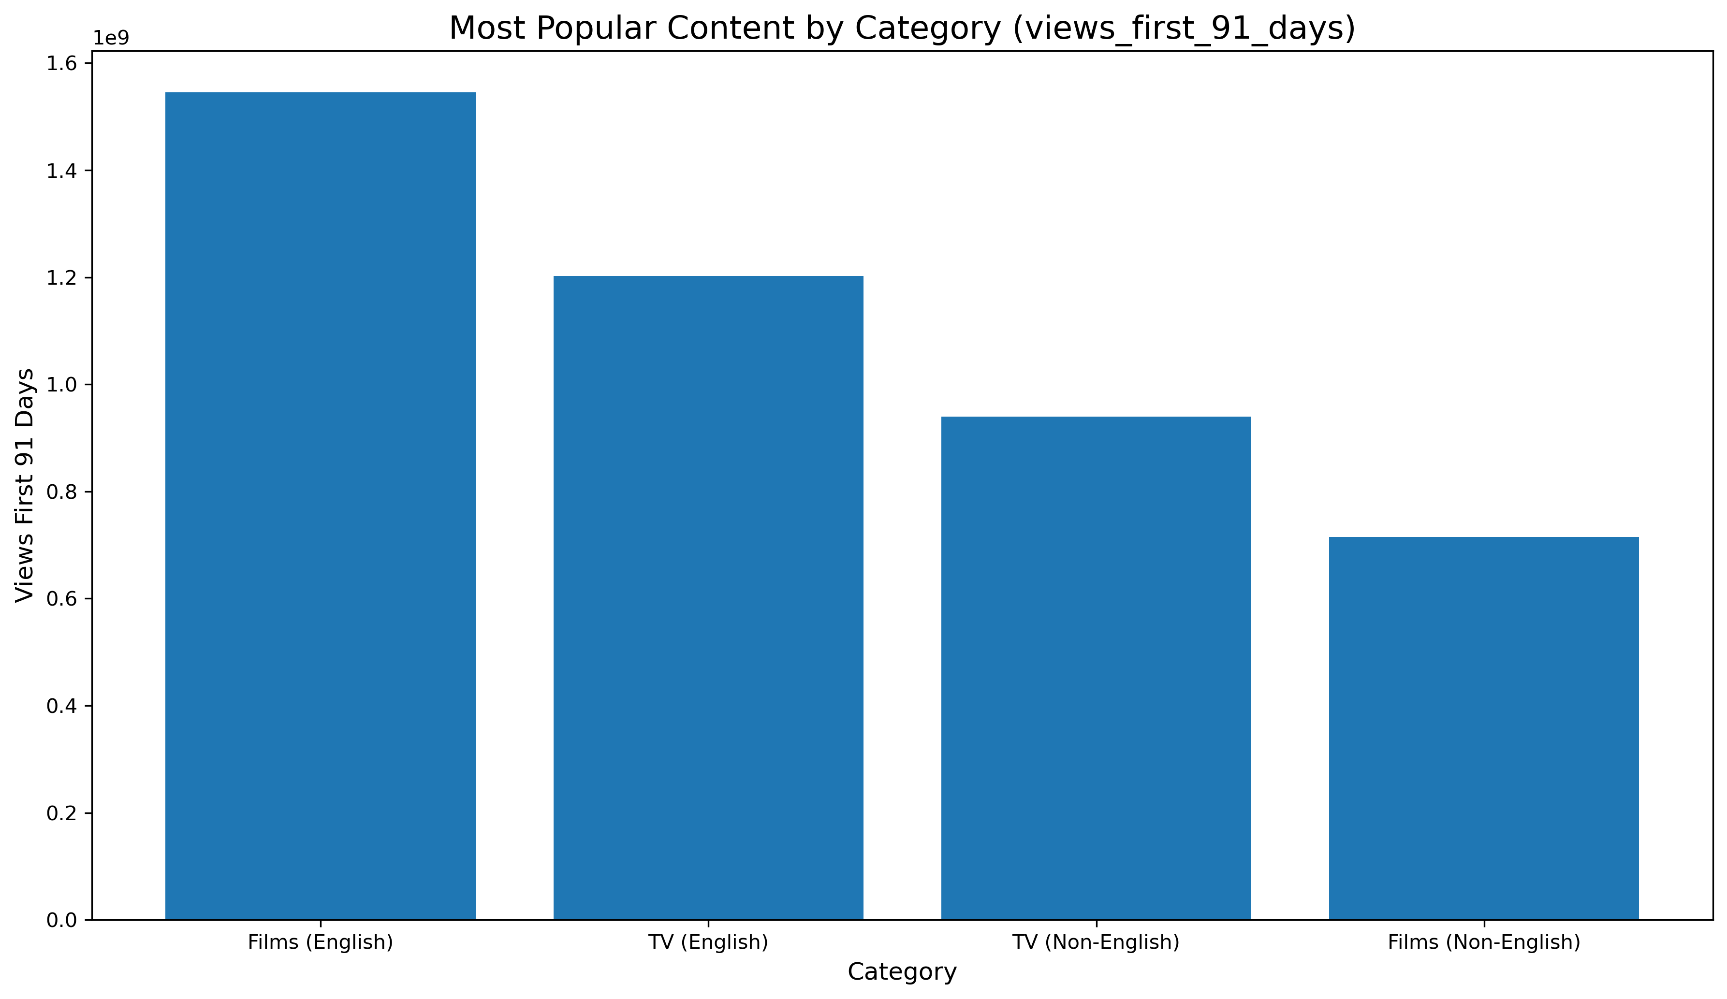
Visual 5 – Category Performance
Films and TV both contribute to engagement
Differences in total viewing highlight investment opportunities
Content format differences can guide future investment decisions (Kuhn & Johnson, 2019)

Slide 13
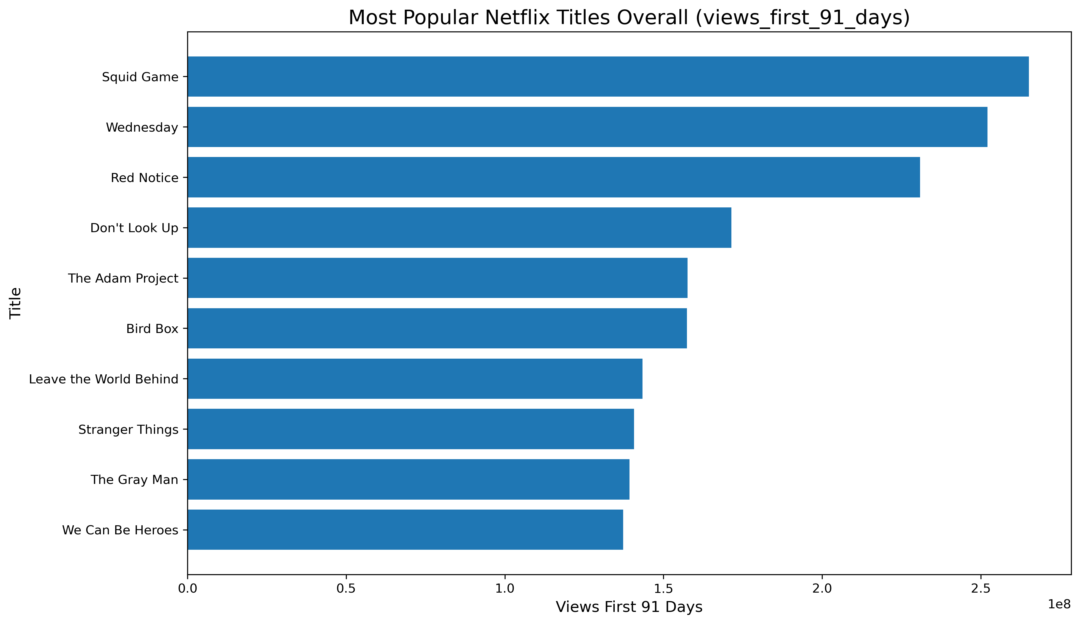
Visual 6 – Most Popular Titles
High viewership does not always translate to long-term success
Short-term popularity differs from sustained performance
Peak popularity does not always indicate sustained success

Slide 14
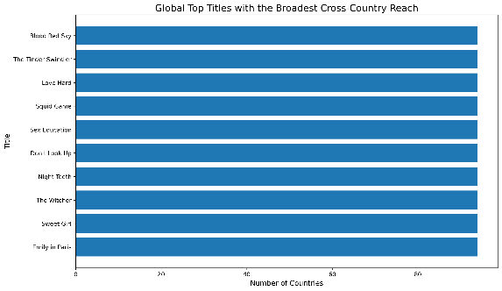
Visual 7 – Cross-Market Overlap
Titles successful across markets are the strongest performers
Cross-market overlap identifies top investment candidates
Cross-market performance is the strongest indicator of content success (Knaflic, 2015)

Slide 15
Key Findings
Cross-market performance is the strongest predictor of sustained success
Sustained Top 10 presence matters
Global reach supports growth
Short-term popularity is not enough
Global reach and sustained performance matter more than short-term popularity (Cairo, 2016)

Slide 16
Limitations
Country comparisons may reflect data coverage
Top 10 duration does not capture full engagement
Results require contextual interpretation (Cairo, 2016)

Slide 17
Ethical Considerations
Data sourced from publicly available Netflix Top 10 datasets
No personal or sensitive data used – no privacy concerns
Data Cleaned (standardized titles, numeric conversion)
Aggregated data may mask regional differences
Assumptions made (e.g., weeks in Top 10 = engagement)
Visuals designed to avoid misleading conclusions

Slide 18
Conclusion
Global and sustained performance matter most
Focus on cross-market
Prioritize scalable titles
Use data to guide strategy
Future work – incorporate additional engagement metrics (Kuhn & Johnson, 2019)

Slide 19
References
Cairo, A. (2016). The truthful art: Data, charts, and maps for communication. New Riders.
Knaflic, C. N. (2015). Storytelling with data. Hoboken: John Wiley & Sons.
Kuhn, M., & Johnson, K. (2019). Feature engineering and selection: A practical approach for predictive models. CRC Press.

