Slide 1

White House Visitor Log Analysis
October–December 2022 vs. 2023
Teresa Ferrill
Bellevue University, DSC 640 – Data Presentation and Visualization
Assignment – Weeks 3 & 4
April 12, 2026

Slide 2
Purpose
Identify visit patterns
Compare across years
Support operational decision-making
Call to Action: Improve Planning Using Data

Slide 3
Audience
White house operations leadership
Familiar with data context
Focused on decision, not technical detail

Slide 4
Medium
Jupyter notebook for data analysis and visualization
PowerPoint presentation for executive-level communication
Separates technical detail from key insights

Slide 5
Design Considerations
Clear and consistent formatting across visuals
Minimal color to highlight key differences
Logical flow from trends to detailed insights
Gestalt principles used to group related visuals
Focus on readability and quick interpretation

Slide 6
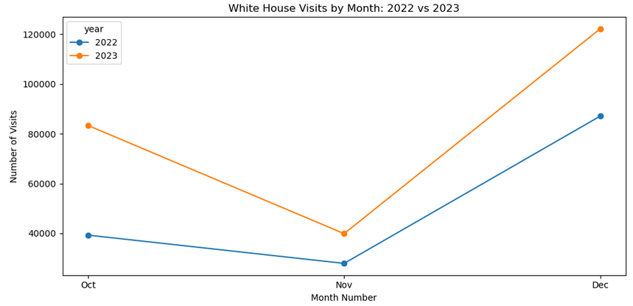
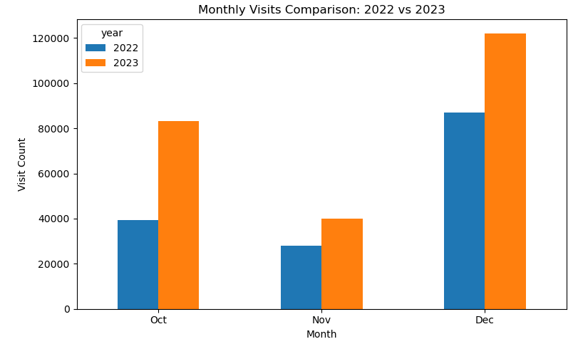
Key Finding 1 – Volume Increased
Higher visit volume in 2023 across holiday season
Increase is consistent, not isolated
(Han et al., 2012)

Slide 7
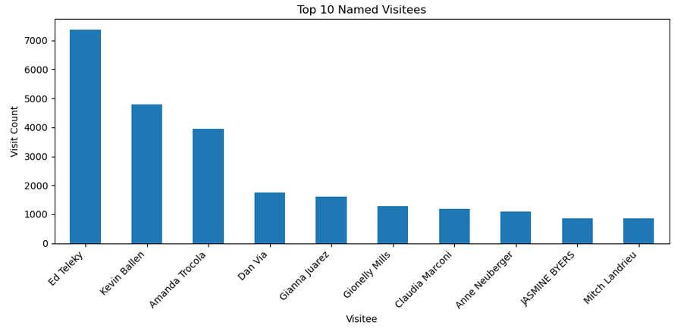
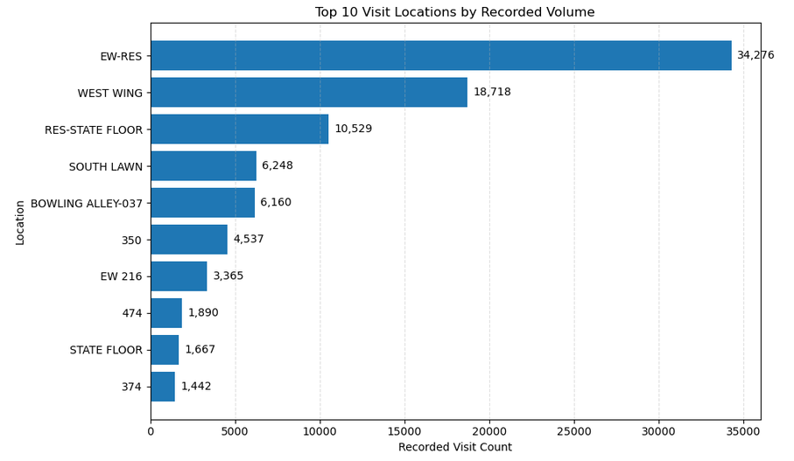
Key Finding 2 – Activity is Concentrated
Small number of categories drive most activity
Not evenly distributed across all groups
(Han et al., 2012)

Slide 8
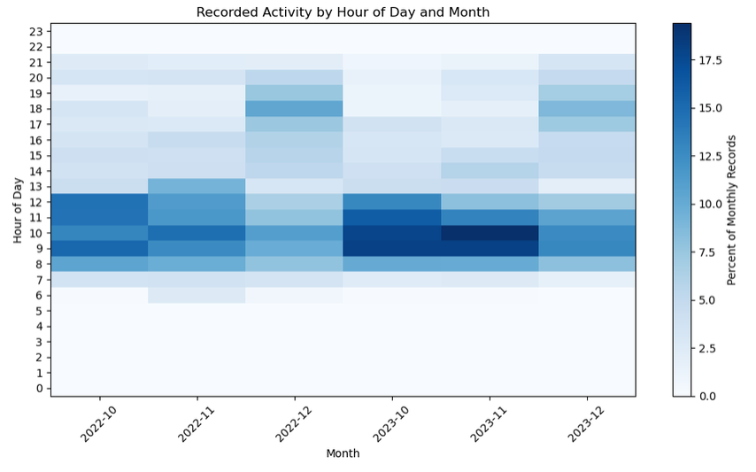
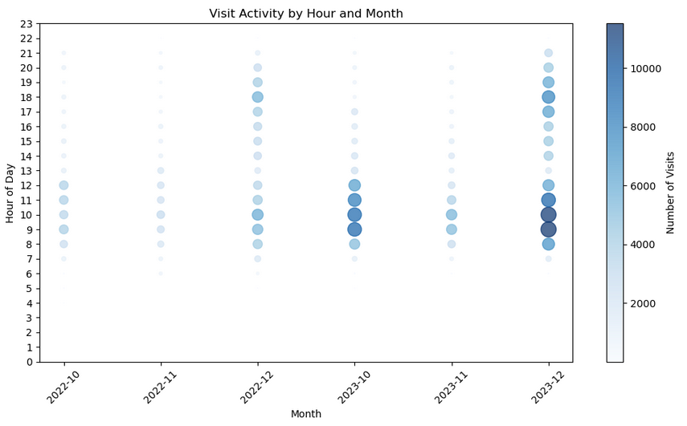
Key Finding 3 – Timing is Predictable
Activity concentrated in late morning-afternoon
Consistent across holiday months
(James et al., 2021)

Slide 9
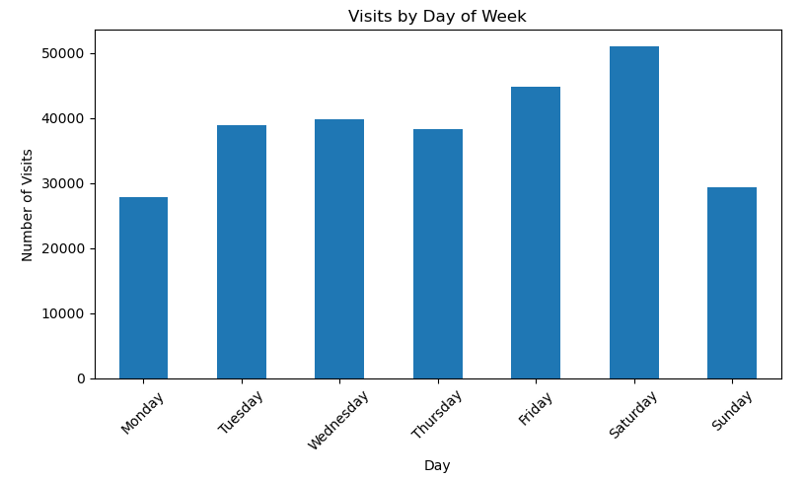
Key Finding 4 – Weekly Pattern
Weekday visits dominate
Weekend activity is minimal

Slide 10
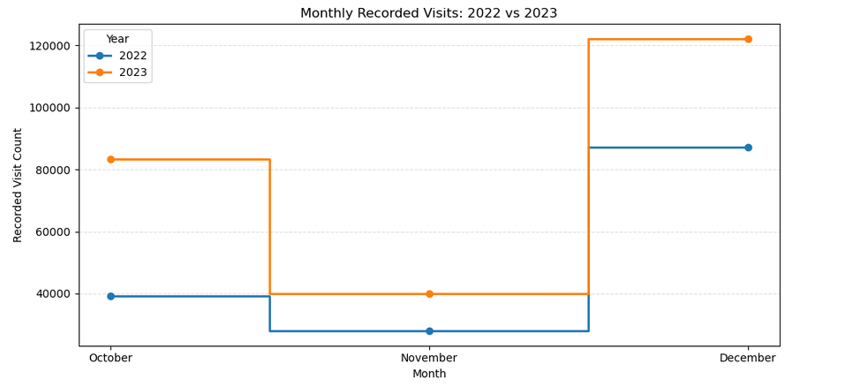
Supporting Trend
Clear stepwise increase from 2022 to 2023
Reinforces upward trend

Slide 11
Recommendations
Align staffing with peak hours (late morning – afternoon)
Focus resources on high-demand locations
Use historical data to anticipate demand
Plan proactively instead of reacting to volume

Slide 12
Conclusion
Visit patterns are consistent and predictable
Demand increased in 2023 across holiday months
Activity is concentrated and time-based
Data enables proactive operational planning
(James et al., 2021; Cairo, 2016; Knaflic, 2015)

Slide 13
References
Cairo, A. (2016). The truthful art: Data, charts, and maps for communication. New Riders.
Han, J., Kamber, M., & Pei, J. (2012). Data mining: Concepts and techniques (3rd ed.). Morgan Kaufmann.
James, G., Witten, D., Hastie, T., & Tibshirani, R. (2021). An introduction to statistical learning: With applications in R (2nd ed.). Springer.
Knaflic, C. N. (2015). Storytelling with data: A data visualization guide for business professionals. Wiley.

