Slide 1


University dropout Prediction
Ferrill, Teresa
March 8, 2026
Notes:
NOTE:
To change the image on this slide, select the picture and delete it. Then click the Pictures icon in the placeholder to insert your own image.

Slide 2
Contents
Introduction
Overview of Data Used
Methods of Analysis
  Exploratory Data Visualization
  Withdrawal Rate by Age Band
  Withdrawal Rate by Education Level
  Distribution of Studied Credits
  Model Performance Comparison
Results and Findings
  Confusion Matrix Interpretation
Conclusions
References

Slide 3

Introduction
Early withdrawal affects student outcomes and institutional effectiveness
Student retention remains a critical issue for universities (Tinto, 2012)
Research shows these characteristics are associated with persistence and completion:
  Demographic background
  Academic preparation
  Enrollment characteristics (Denley, 2019)

Slide 4

Overview of Data Used
Project examines
  Student dropout factors
  Develops predictive models
  Estimates likelihood that a student will withdraw
Uses StudentInfo.csv dataset from The Open University Learning Analytics Dataset (OULAD), which includes these data features:
  Demographic
  Enrollment
  Academic outcome (Kuzilek, 2017)

Slide 5

Methods of Analysis
Exploratory Data Analysis (EDA)
  Evaluate Data Quality
  Review Class Balance
  Identify Early Patterns – Predictors and Dropout Status (Han, 2012)
EDA found a Class Imbalance existed with non-withdrawal outcomes occurring more frequently than withdrawals
  Supports need to emphasize recall during model evaluation – failing to identify at-risk students carries practical consequences (James, 2021)
Comparisons across demographic groups suggest these topics affect withdrawal rates
  Age range of the student
  Their highest education level
  Disability status
  Enrollment intensity (percentage of full-time coursework) (Tinto, 2012)

Slide 6
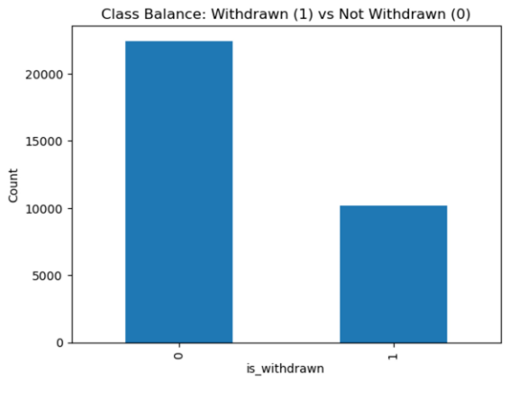
Exploratory Data Visualization
Visualization: Distribution of Withdrawn vs Non‑Withdrawn Students
Purpose: Show class imbalance in the dataset
Insight: Most students did not withdraw, which requires careful model evaluation
Included chart: Bar chart of withdrawal distribution
Notes:
Explain that the dataset contains more non-withdrawn students than withdrawn students, which influences model evaluation metrics.

Slide 7
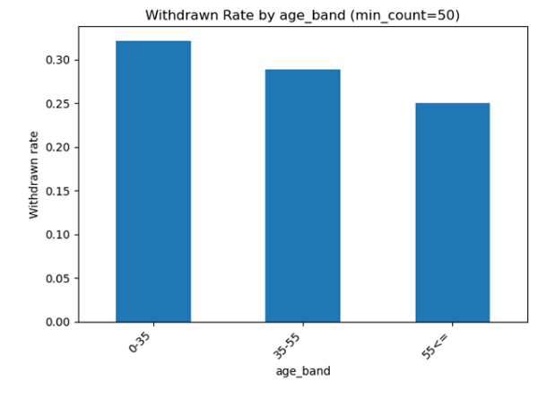
Withdrawal Rate by Age Band
Visualization: Withdrawal rate across student age groups
Purpose: Identify demographic patterns in student persistence
Insight: Age differences may influence withdrawal likelihood
Included chart: Stacked bar chart
Notes:
Discuss how withdrawal patterns vary across different student age groups.

Slide 8
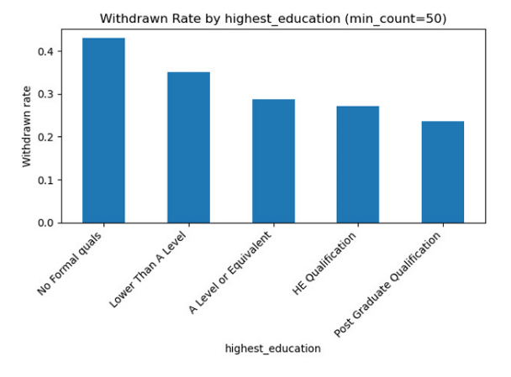
Withdrawal Rate by Education Level
Visualization: Withdrawal probability by highest education level
Purpose: Understand the relationship between academic preparation and dropout risk
Insight: Students with lower academic preparation may have higher withdrawal risk
Included chart: Bar chart
Notes:
Explain how academic preparedness influences persistence.

Slide 9
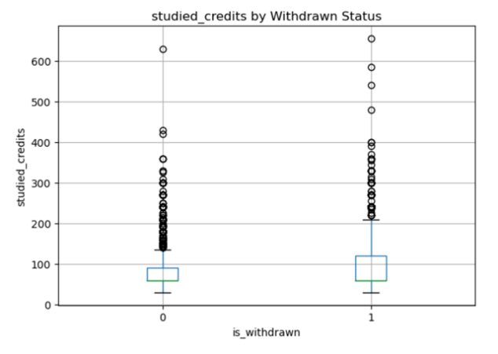
Distribution of Studied Credits
Visualization: Distribution of studied credits by withdrawal status
Purpose: Compare enrollment intensity across outcomes
Insight: Students taking fewer credits may face higher dropout risk
Included chart: Boxplot
Notes:
Explain how enrollment intensity may correlate with persistence.

Slide 10
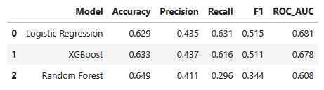
Model Performance Comparison
Logistic Regression – Strong recall performance
Random Forest – Highest accuracy but low recall
XGBoost – Comparable performance to Logistic Regression
Key takeaway: Logistic Regression best identifies at‑risk students
Notes:
Explain why recall is prioritized and summarize model performance.

Slide 11
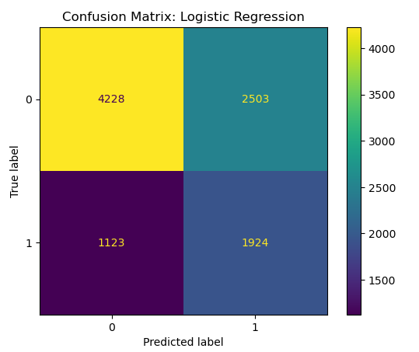
Confusion Matrix Interpretation
Shows model predictions vs actual outcomes
True positives represent correctly identified at‑risk students
False positives represent students flagged but not withdrawn
False negatives represent missed at‑risk students
Notes:
Explain why false positives are less problematic than missing at-risk students.

Slide 12
Feature Importance Insights
Course enrollment modules influenced withdrawal risk
Academic preparation variables were strong predictors
Disability status showed moderate predictive influence
Socioeconomic indicators also affected persistence outcomes
Notes:
Discuss which features most influenced predictions.

Slide 13

Ethical Considerations
Predictive models may reflect historical inequalities present in data
Variables such as socioeconomic status or disability may correlate with withdrawal risk due to systemic factors
Model predictions should support student success interventions rather than punitive decisions
Human oversight and fairness monitoring are necessary for responsible implementation.

Slide 14
Conclusion
Results suggest that student withdrawal risk is influenced by multiple related factors (Chawla, 2002):
  Course enrollment patterns
  Prior academic preparation
  Disability status
  Socioeconomic context
Future improvements could include:
  Additional feature engineering
  Probability calibration
  Cross-validation
  Fairness monitoring
  Incorporate behavioral engagement variables (including learning platform activity, assignment completion patterns)
Notes:
Discuss which features most influenced predictions.

Slide 15
References
Chawla, N. V., Bowyer, K. W., Hall, L. O., & Kegelmeyer, W. P. (2002). SMOTE: Synthetic minority over-sampling technique. Journal of Artificial Intelligence Research, 16, 321–357. https://doi.org/10.1613/jair.953
Denley, T. (2019). How predictive analytics and choice architecture can improve student success. EDUCAUSE Review, 54(4), 10–25.
Han, J., Kamber, M., & Pei, J. (2012). Data mining: Concepts and techniques (3rd ed.). Morgan Kaufmann.
James, G., Witten, D., Hastie, T., & Tibshirani, R. (2021). An introduction to statistical learning: With applications in R (2nd ed.). Springer.
Kuzilek, J., Hlosta, M., & Zdrahal, Z. (2017). Open University Learning Analytics Dataset. Scientific Data, 4, Article 170171. https://doi.org/10.1038/sdata.2017.171
Tinto, V. (2012). Completing college: Rethinking institutional action. University of Chicago Press.

