Slide 1




Smart City
APEX | APEX
Vikrant Pathania | 2511981265
Prince Raj | 2511981192
Anil Thapa | 2511981029

Slide 2
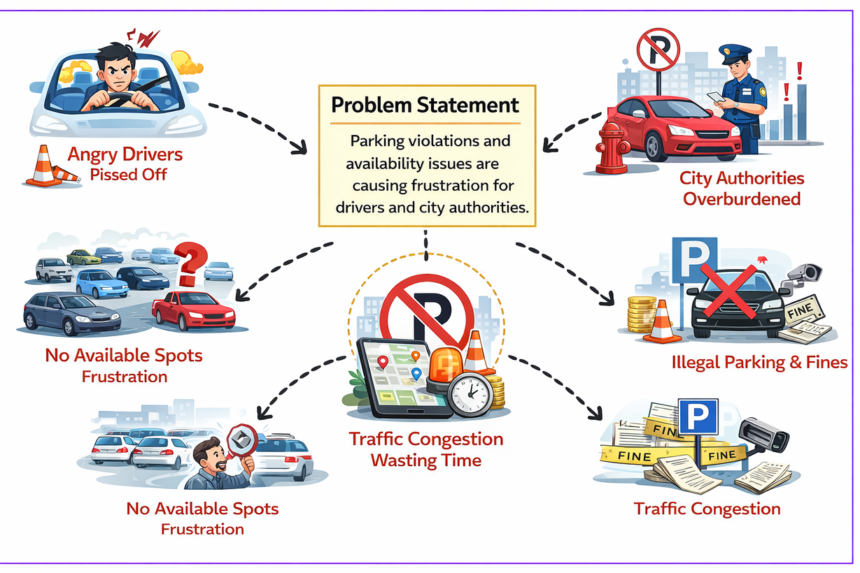
Problem Statement
Traffic: Static timers cause jams; emergency vehicles get stuck.
Waste: Zero automated segregation leads to landfill overflow.
Safety: Blind spots in dense areas/roads.
Energy: Streetlights stay 100% bright on empty roads.

Slide 3
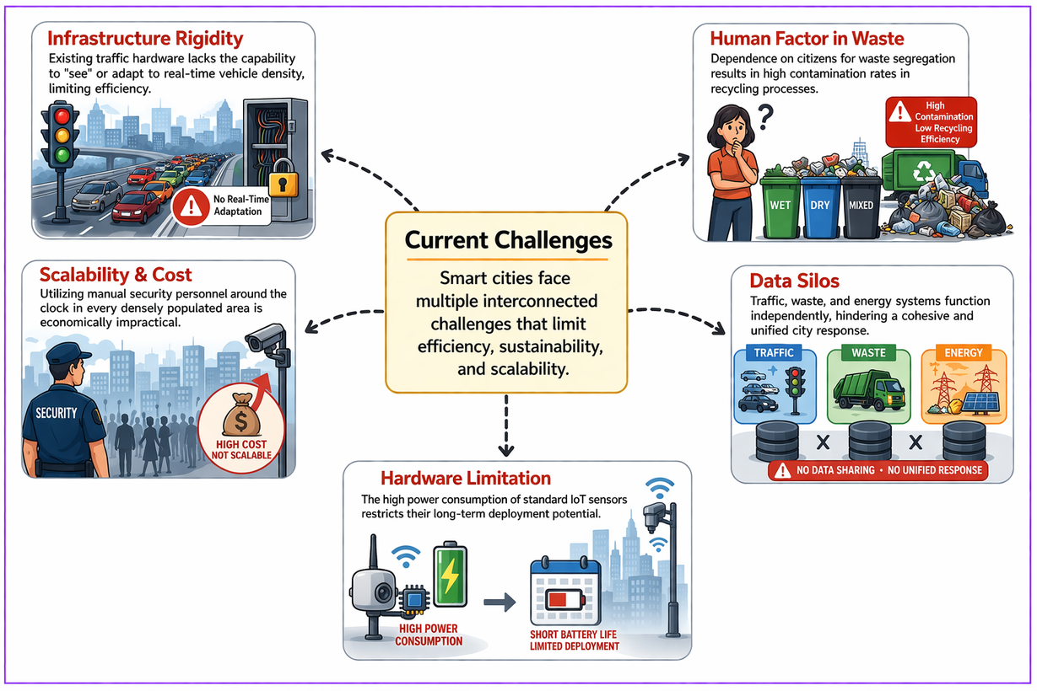
Current Challenges
Static Tech: Infrastructure can't "see" or adapt to real-time data.
Human Error: Manual waste sorting is slow and inaccurate.
Scale: 24/7 manual surveillance is too expensive.
Isolated Data: Systems don't talk to each other.

Slide 4
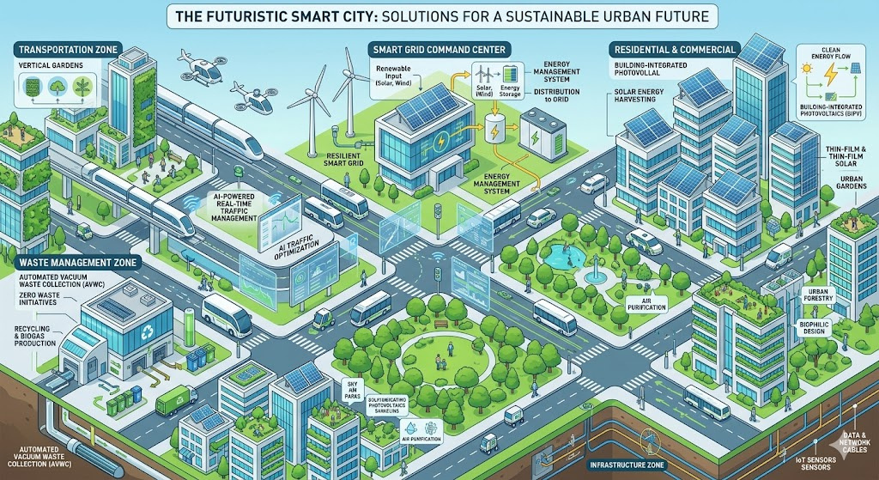
Proposed Solution
AI Traffic: Computer Vision for signal override and lane management.
Smart Bin: Automated mechanical segregation via spectral sensors.
Drone Sentinel: 24/7 autonomous aerial safety patrols.
Adaptive Light: Motion-sensor-based dimming for energy efficiency.

Slide 5

Solution Workflow
Input: Cameras, IoT Sensors, and Drones.
Edge: Python (CV) and C++ process data instantly.
Control: Central Hub (HTML/JS) monitors city health.
Output: Lights change, waste is sorted, and power is saved.

Slide 6
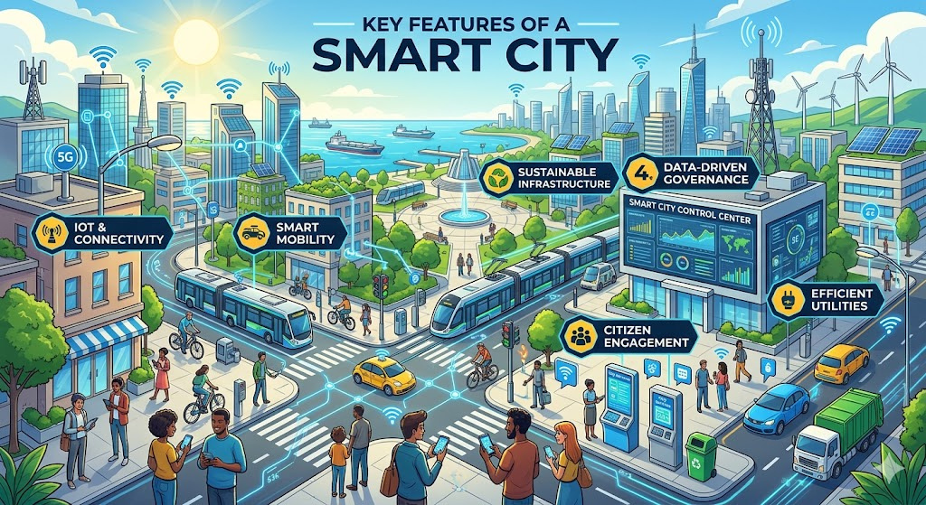
Key Features
Life-First: Instant emergency vehicle priority.
Eco-Friendly: Up to 60% energy reduction in lighting.
Automated: Eliminates human error in waste segregation.
Unified: One dashboard for all city services.

Slide 7


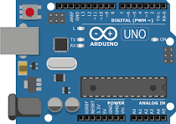







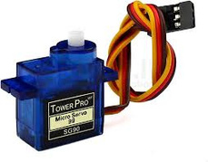




Technical Approach
+

Slide 8
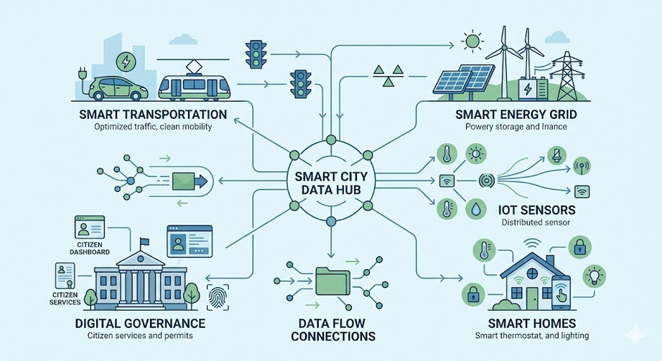
Impact &
Future Scope
Impact: 25% faster commutes; massive energy/cost savings.
Scaling: Integration with Autonomous Vehicles (V2X).
Predictive: AI that predicts crime or traffic before it happens.
Goal: A data-driven, sustainable urban ecosystem.

