Slide 1
15.03.06 - Mechatronics and Robotics
Focus (profile): Artificial intelligence
NSU
The “Snake” Game
23933
Vladislav Polyansky
Arina Seigel
Vladimir Zyablov
Novosibirsk, 2024

Slide 2
Analogues
In 1995, the company Nokia comes to work Taneli Armanto - a programmer from Finland, he wrote a game for Nokia 6110, the same snake, which became a hit.
The snake game for Nokia 6110 was written in the J2ME (Java 2 Platform, Micro Edition) programming language.

Slide 3
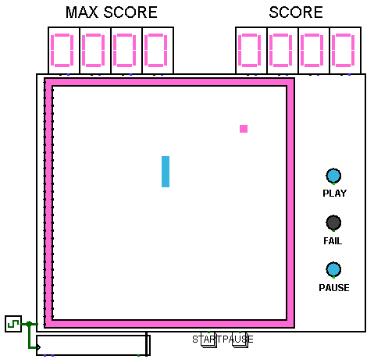
User interface

Slide 4
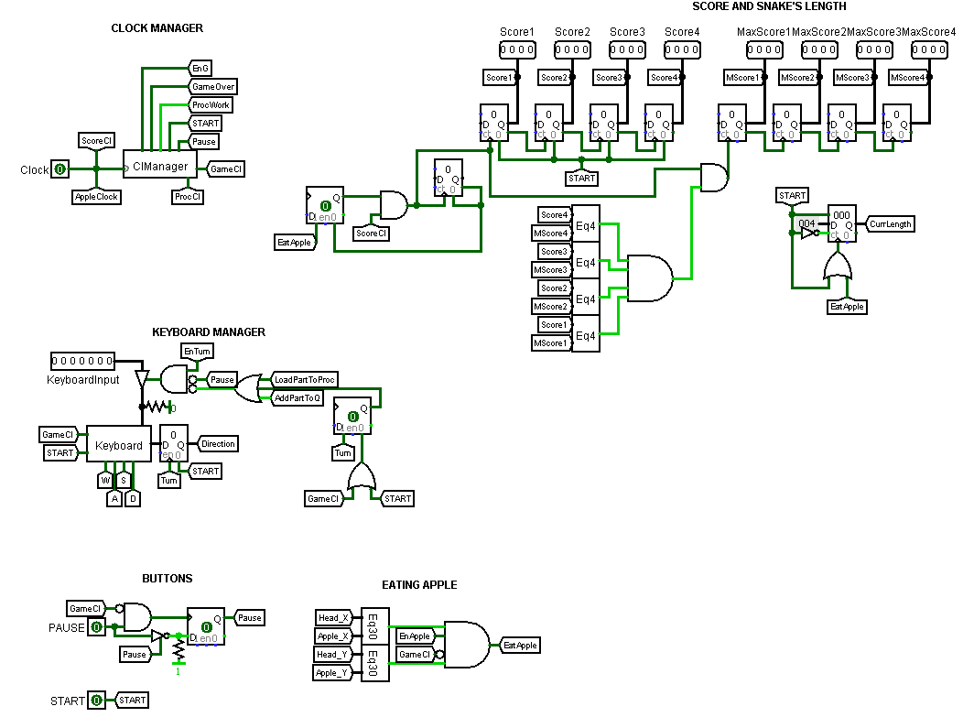
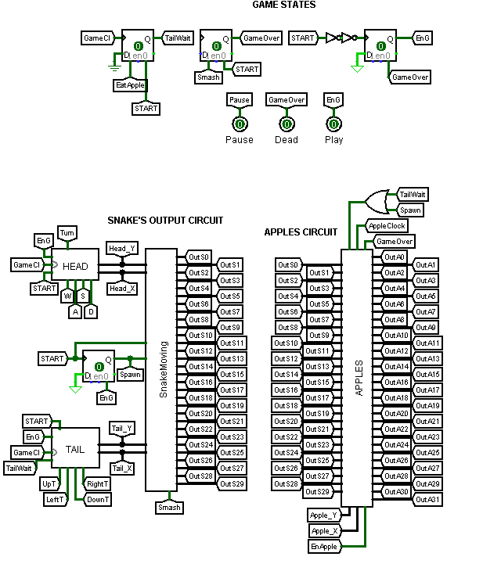
Main circuit

Slide 5
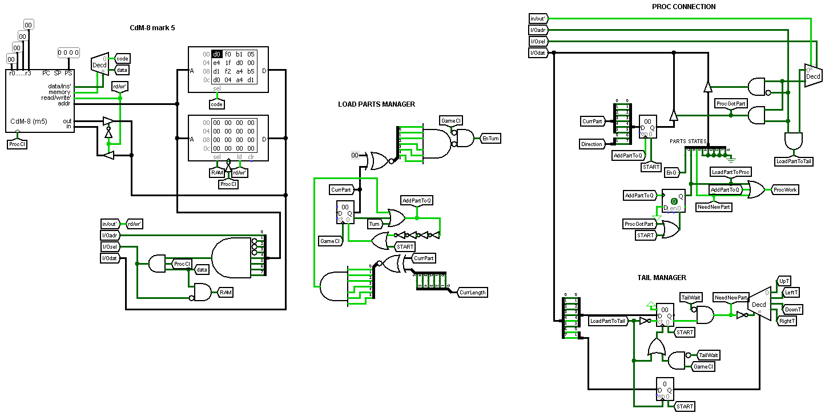
Main circuit

Slide 6
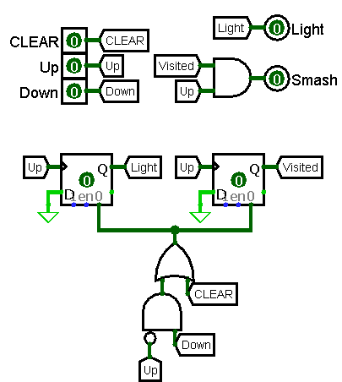
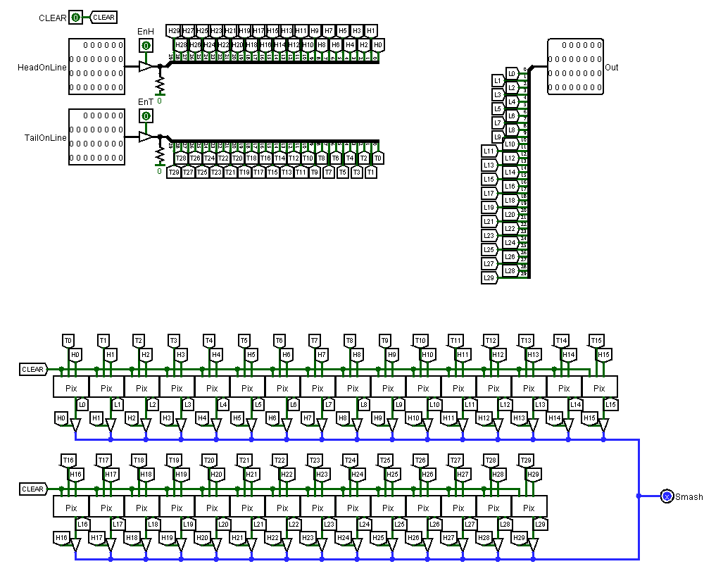
Snake output: Pixel and Line
Novosibirsk, 2024

Slide 7
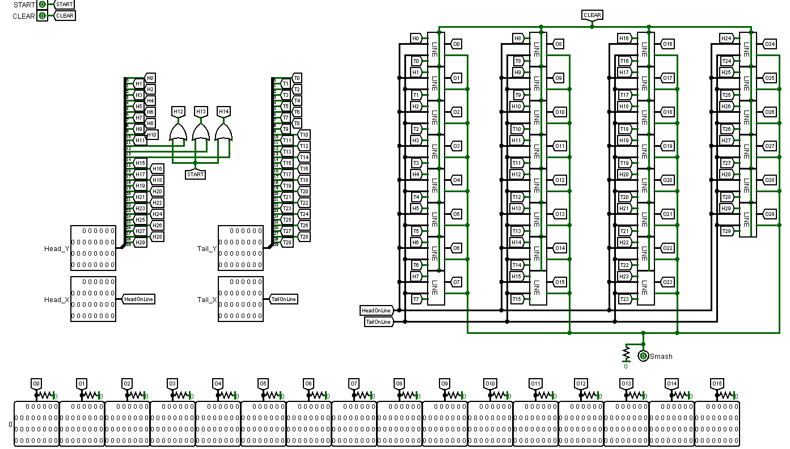
Snake output: toMatrix
Novosibirsk, 2024

Slide 8
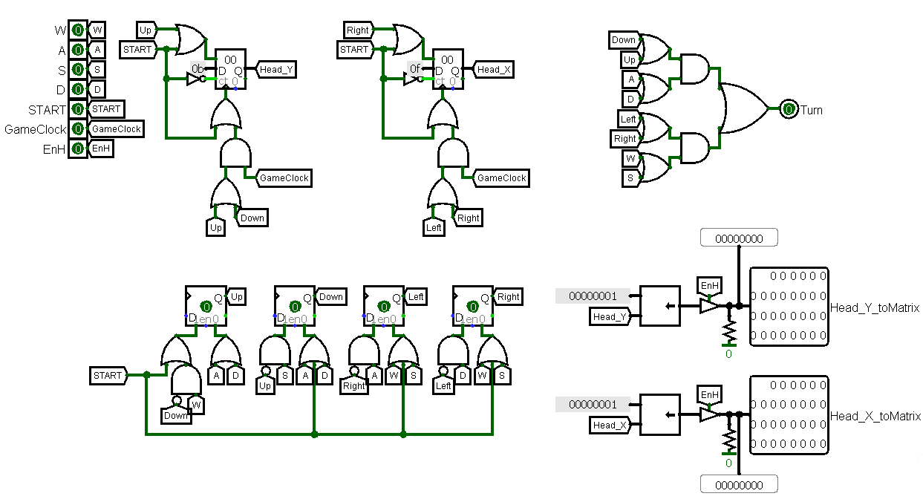
Head movement

Slide 9
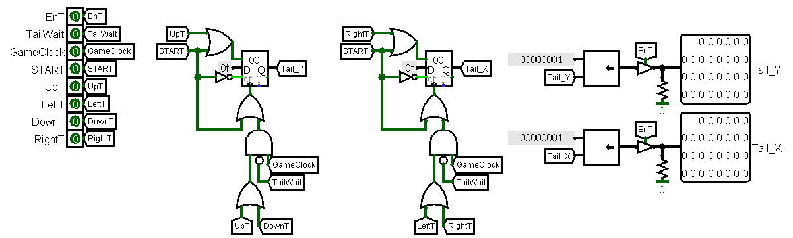
Tail movement

Slide 10
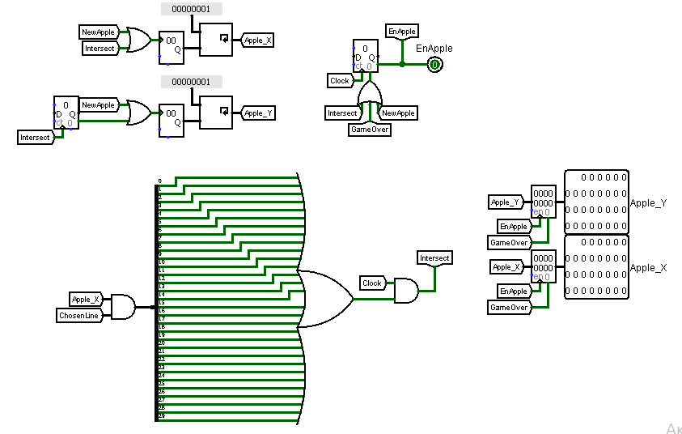
Apple generation

Slide 11
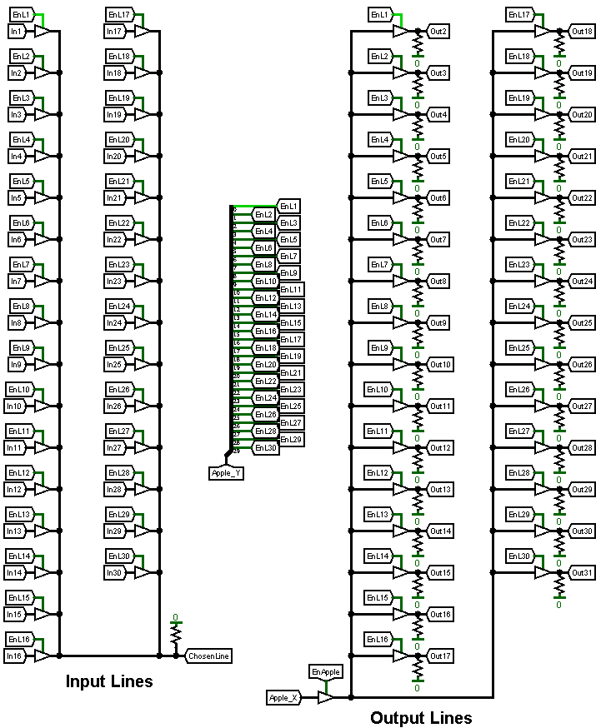
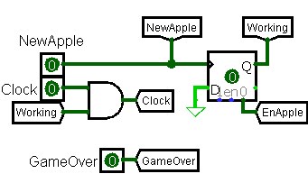
Input and output

Slide 12
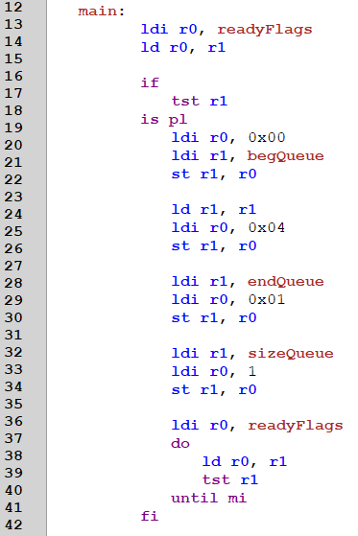
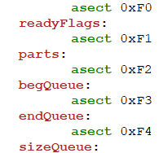
Initialization of variables

Slide 13
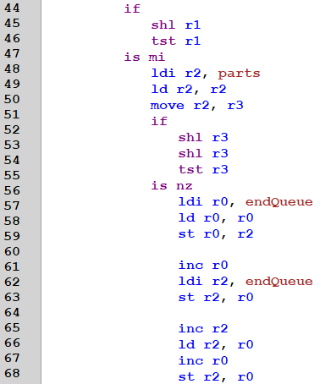
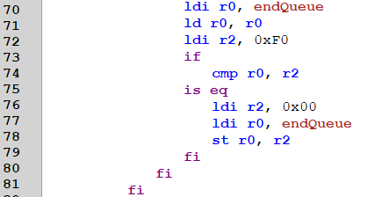
Store new segment

Slide 14
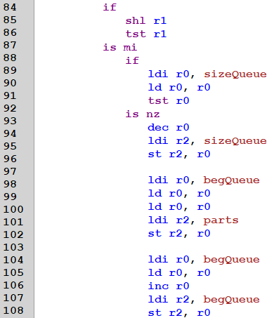
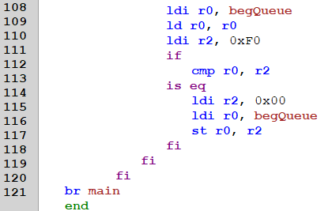
Output of segment

