Slide 1
Mobile Node Pilot
Fernando Gros González
04-03-2013

Slide 2
Outline
Introduction
Mesh and Manet Networks
QMP
Main features
Quick deployments
Dynamic Routing Protocol
BMX6
Mobile Node
Information sources

Slide 3
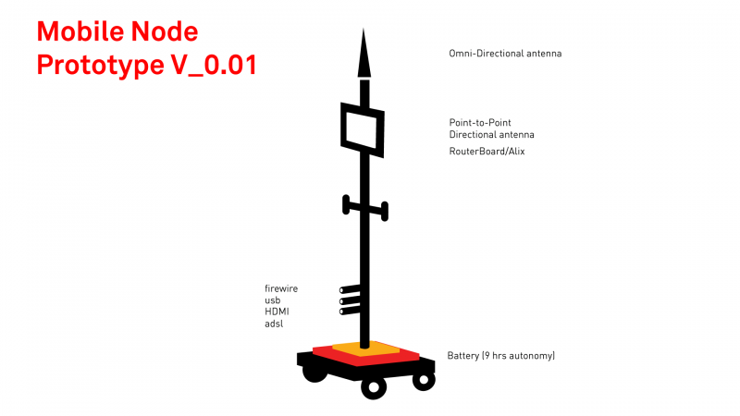
Introduction
The main idea within the Mobile Node Pilot is to create a free transmission workstation that can be used in the urban space and contributes to the digital mesh through other networks.

Slide 4
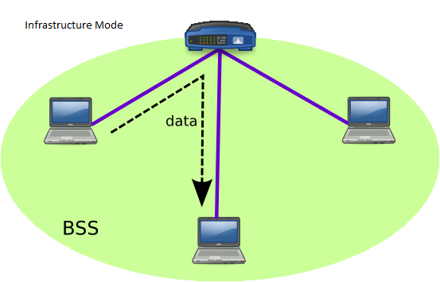
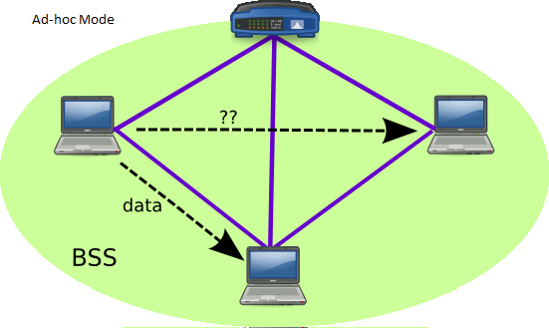
Mesh and Manet Networks (I)
A mesh network is a network where all the participants are also routers. They are level 3 networks (Network layer).
Every node has to be connected, at least, to another node in the network, independently of the method (Cable, Wi-Fi, OF, etc.)
It is not strictly necessary that this kind of networks use the Ad-hoc mode, they can use infrastructure mode too, although it is useless in many cases.

Slide 5
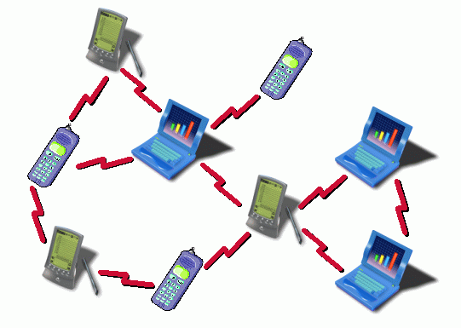
Mesh and Manet Networks (II)
When we have a mesh network which uses a wireless system to interconnect the nodes and is built in Ad-hoc mode, we talk about MANET (Mobile Ad-hoc Network).
So a MANET network:
“ is a self-configuring infrastructureless network of mobile devices connected by wireless.” (Wikipedia)
In order to allow this self-configuring feature, we use Dynamic Routing protocols (DRP) which are specially optimized for MANET deployments.

Slide 6

QMP
Main Features
OpenWRT based
802.11a/b/g/n support
IPv6 native
IPv4 tunneled over IPv6
Auto configuration system
Web GUI to monitor and configure
Visualization tools (maps, graphs, etc.)
Automatic dynamic routing (zero-conf)
BGP (Border Gateway Protocol) support (half implemented)
Open Source

Slide 7
QMP
Quick Deployments

Slide 8
Thank you for your time!

