Slide 1
AI-Driven Social Media Dashboard
Mohamed Farid
Notes:
https://www.kaggle.com/datasets/crowdflower/twitter-airline-sentiment

Slide 2
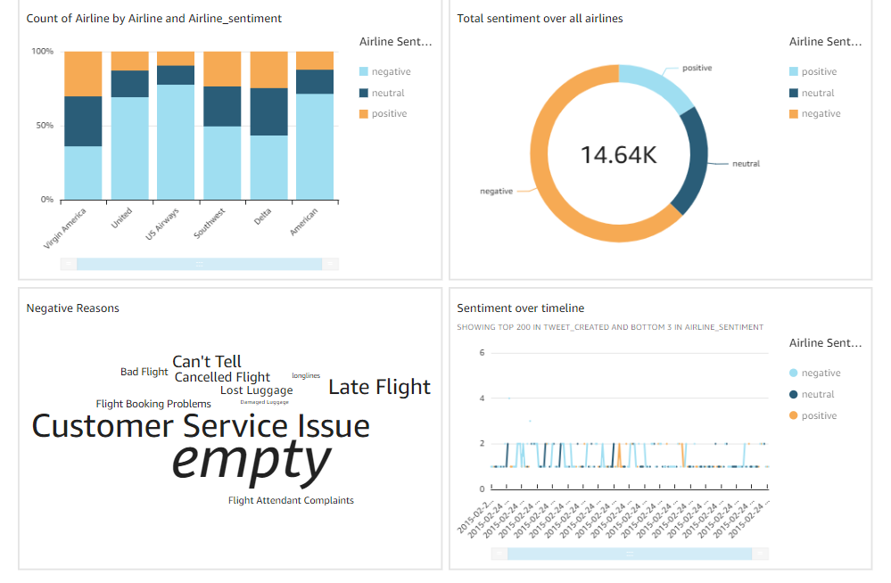
Sentiment Analysis Dashboard

Slide 3
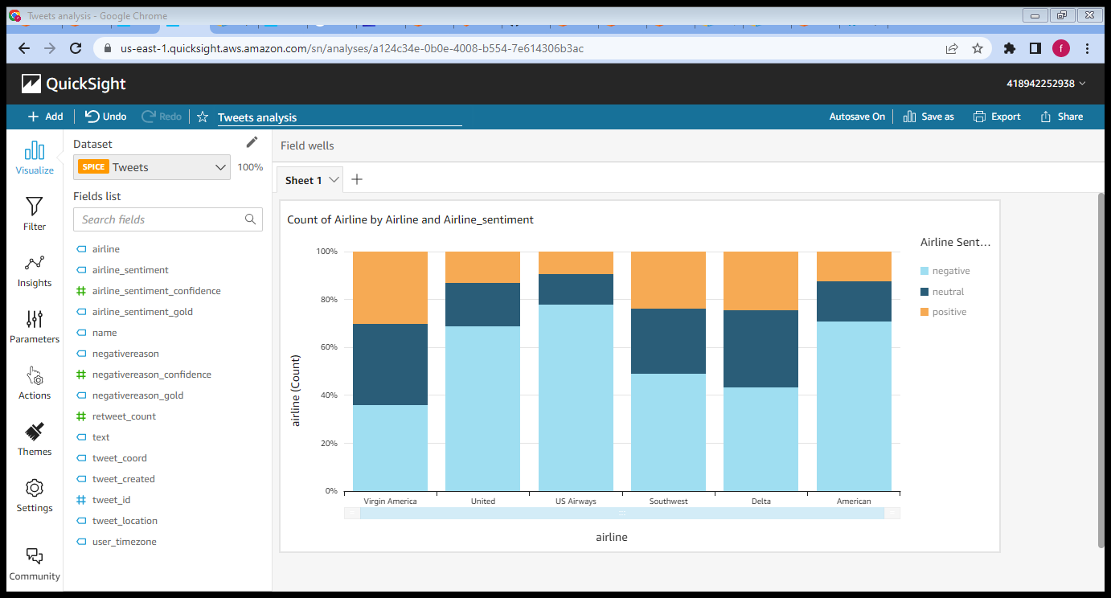
Sentiment Analysis Dashboard

Slide 4
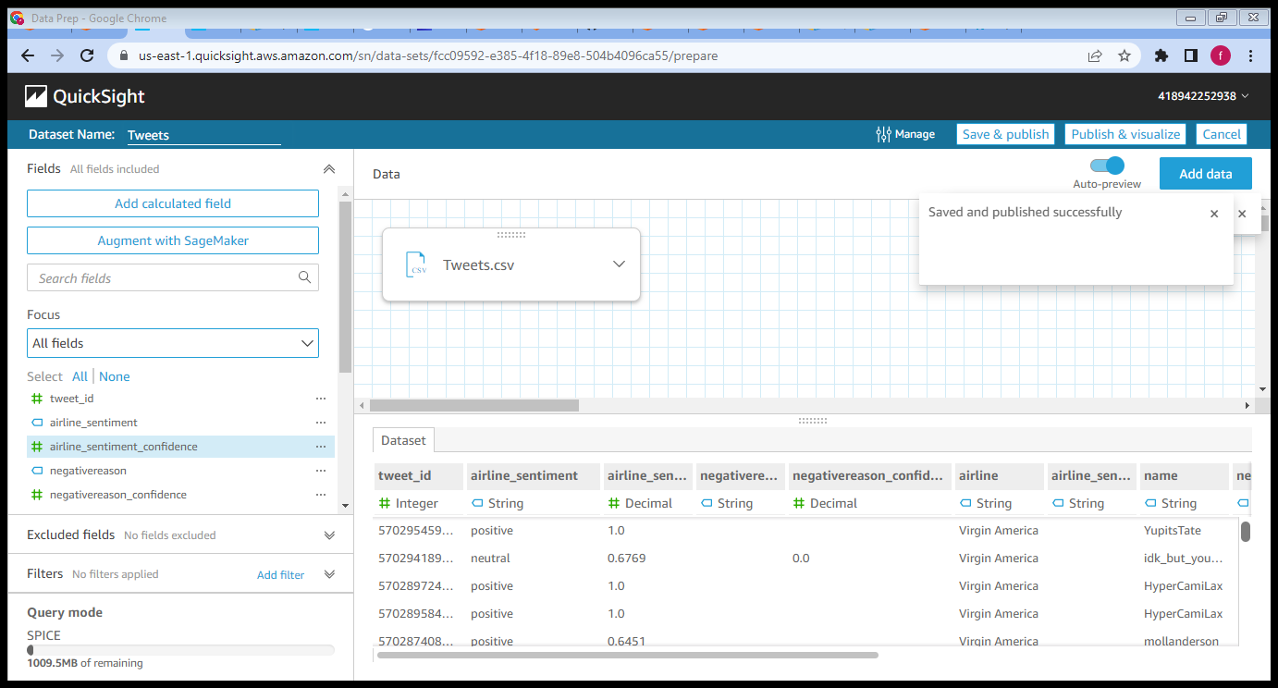
Sentiment analysis processed data

Slide 5
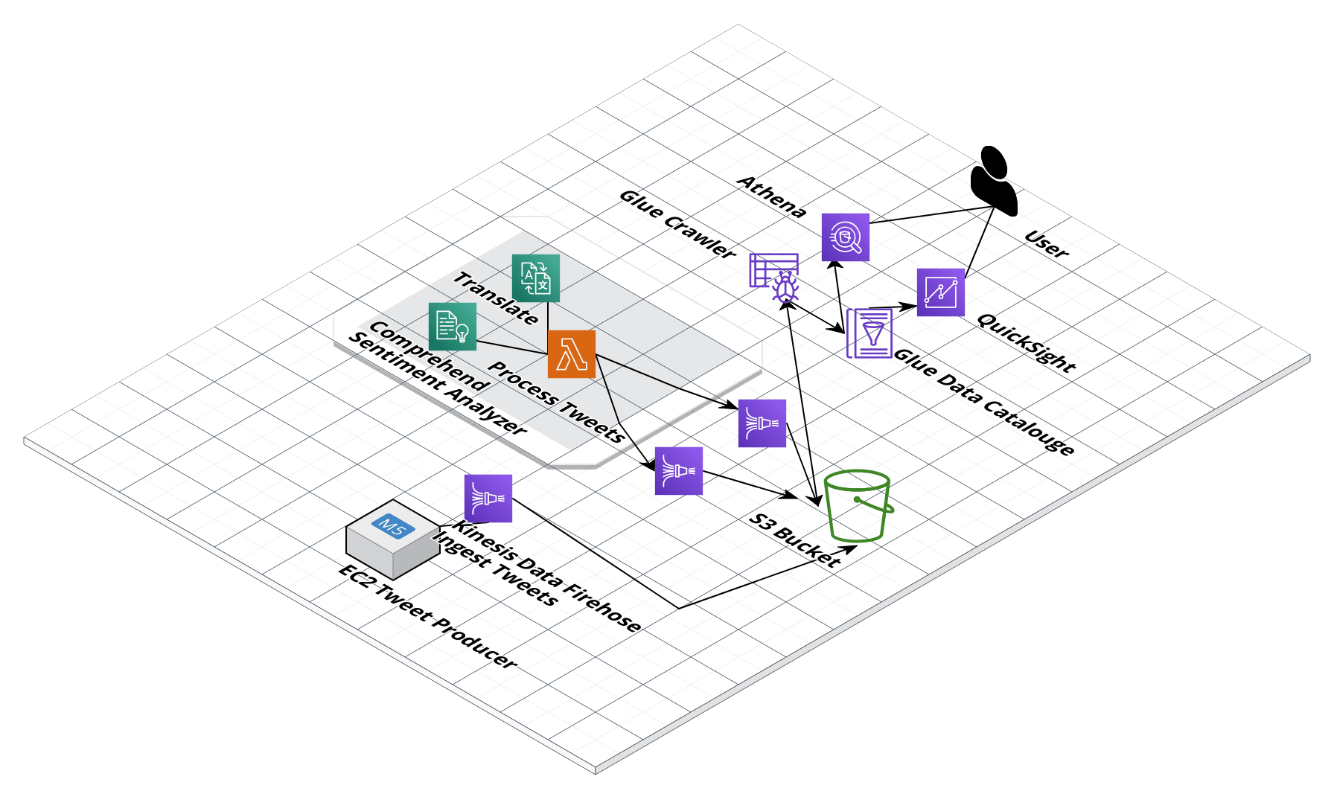
System architecture
Drawn by cloudcraft.co
Notes:
https://aws.amazon.com/blogs/machine-learning/build-a-serverless-twitter-reader-using-aws-fargate/

Slide 6
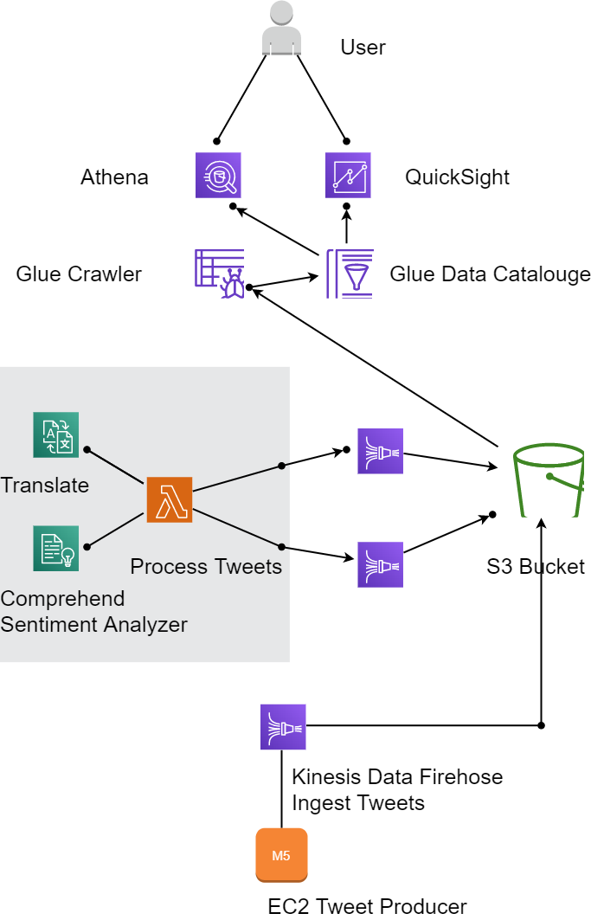
System architecture
Drawn by diagrams.net
Notes:
https://aws.amazon.com/blogs/machine-learning/build-a-serverless-twitter-reader-using-aws-fargate/

Slide 7
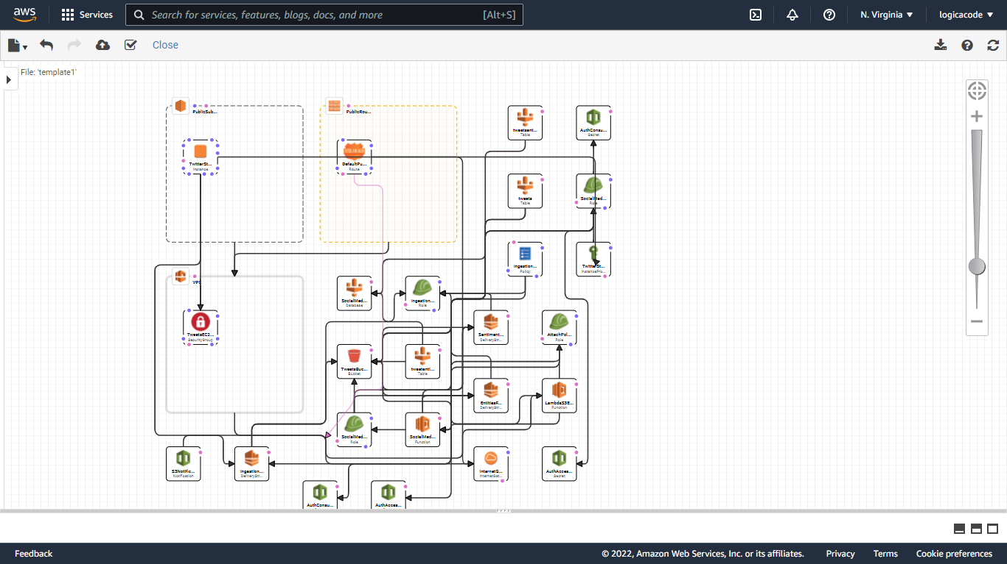
System architecture (detailed)

Slide 8
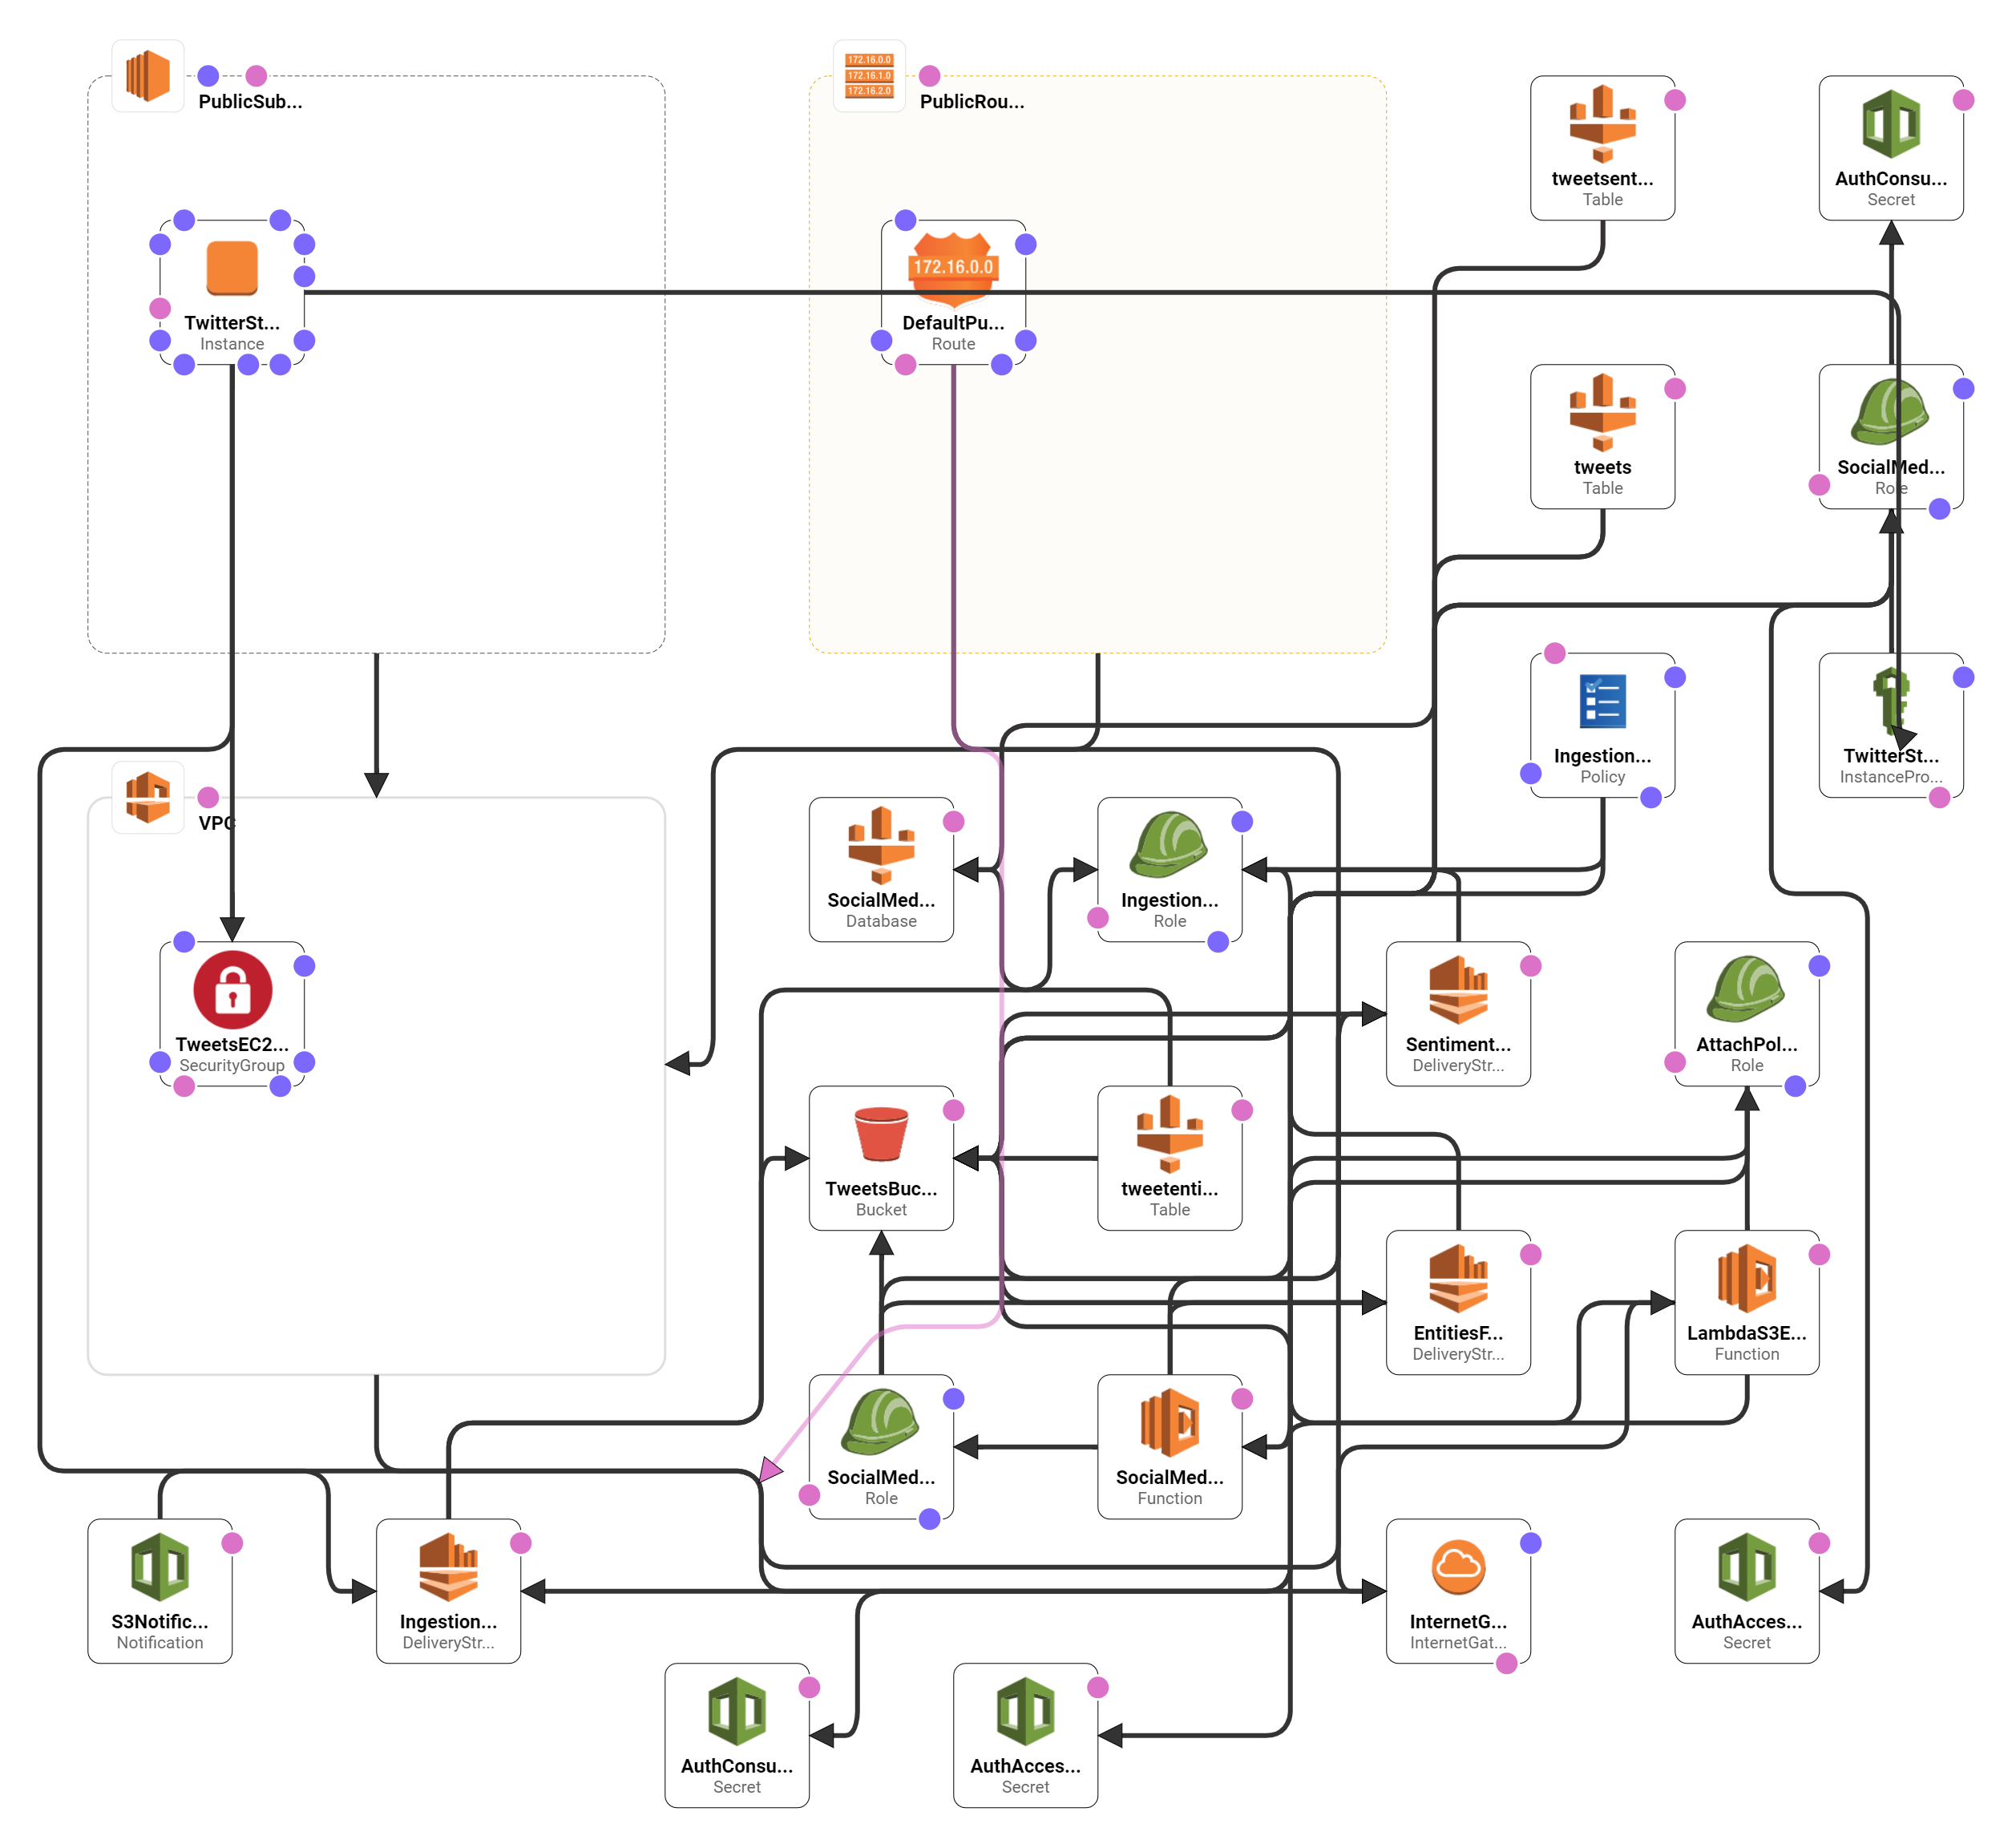

Slide 9

Sending data from the json file
Instead of writing another program to stream the content of the json file
We decided to use AWS solution
AWS kinesis agent for Windows
Can run on local PC or AWS Cloud EC2 Windows
Configure the agent to send the content to the AWS kinesis firehose
Define in a json configuration file the source, sink abd pipline
Run from PowerShell

Slide 10
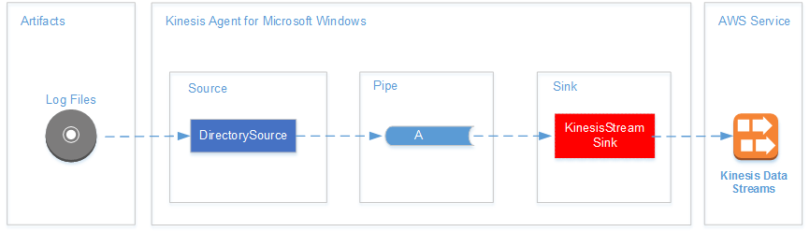
Amazon Kinesis Agent for Microsoft Windows
Notes:
https://docs.aws.amazon.com/kinesis-agent-windows/latest/userguide/kinesis-agent-windows-concepts.html
https://docs.aws.amazon.com/kinesis-agent-windows/latest/userguide/what-is-kinesis-agent-windows.html

Slide 11
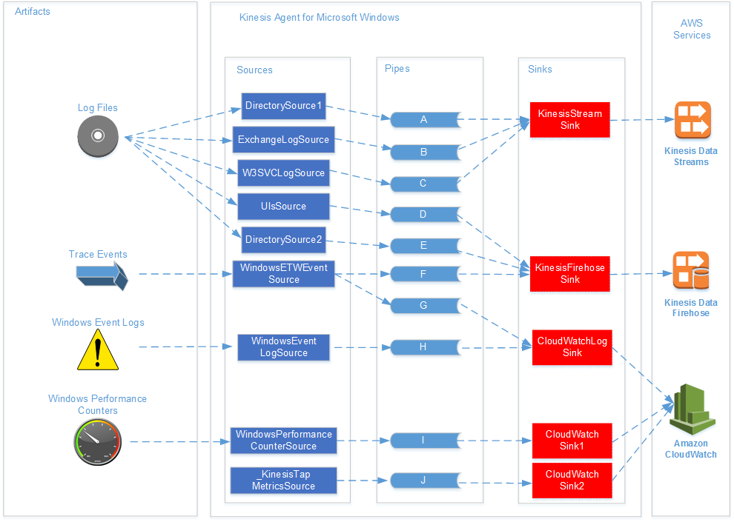
Amazon Kinesis Agent for Microsoft Windows
Notes:
https://docs.aws.amazon.com/kinesis-agent-windows/latest/userguide/kinesis-agent-windows-concepts.html
https://docs.aws.amazon.com/kinesis-agent-windows/latest/userguide/what-is-kinesis-agent-windows.html

Slide 12
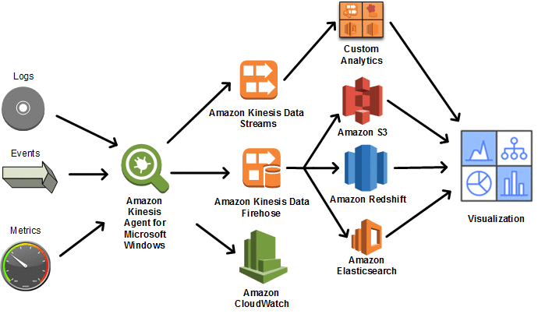
Amazon Kinesis Agent for Microsoft Windows
Notes:
https://docs.aws.amazon.com/kinesis-agent-windows/latest/userguide/kinesis-agent-windows-concepts.html
https://docs.aws.amazon.com/kinesis-agent-windows/latest/userguide/what-is-kinesis-agent-windows.html

Slide 13
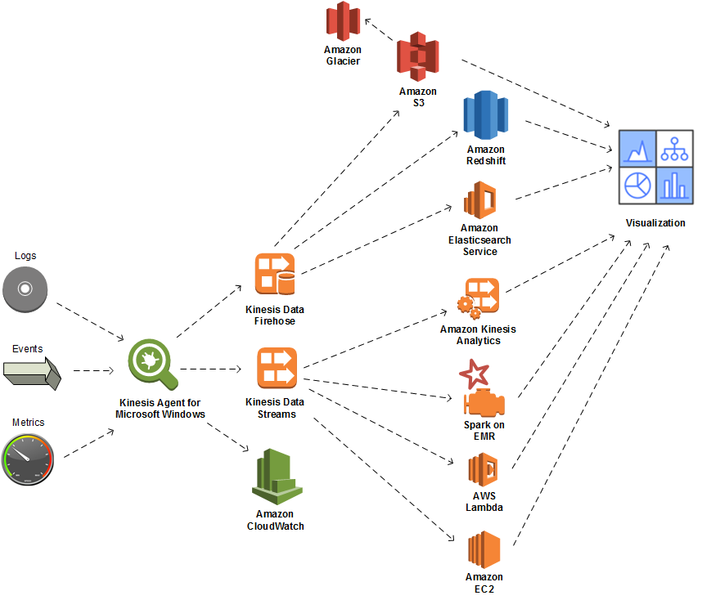
Amazon Kinesis Agent for Microsoft Windows
Notes:
https://docs.aws.amazon.com/kinesis-agent-windows/latest/userguide/kinesis-agent-windows-concepts.html
https://docs.aws.amazon.com/kinesis-agent-windows/latest/userguide/what-is-kinesis-agent-windows.html

Slide 14
More advanced Architecture
AWS Fargate is a technology for Amazon Elastic Container Service (ECS) that allows you to run containers without having to manage servers or clusters.
With AWS Fargate, you no longer have to provision, configure, and scale clusters of virtual machines to run containers. This removes the need to choose server types, decide when to scale your clusters, or optimize cluster packing.

Slide 15
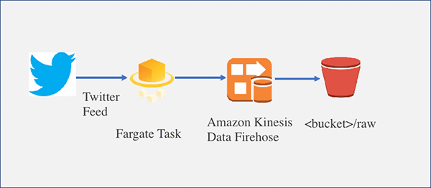
Build a serverless Twitter reader using AWS Fargate
Notes:
https://aws.amazon.com/blogs/machine-learning/build-a-serverless-twitter-reader-using-aws-fargate/

Slide 16
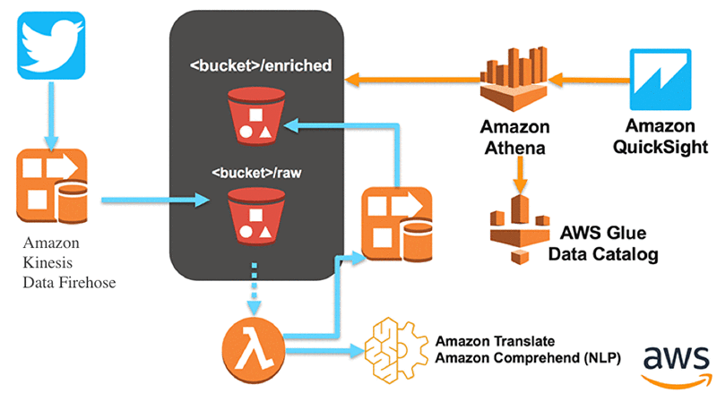
Build a serverless Twitter reader using AWS Fargate
Notes:
https://aws.amazon.com/blogs/machine-learning/build-a-serverless-twitter-reader-using-aws-fargate/

Slide 17
Using the KPL with Kinesis Data Firehose
Notes:
https://docs.aws.amazon.com/sns/latest/dg/sns-firehose-as-subscriber.html
https://aws.amazon.com/blogs/big-data/stream-twitter-data-into-amazon-redshift-using-amazon-msk-and-aws-glue-streaming-etl/
https://aws.amazon.com/blogs/machine-learning/build-a-serverless-twitter-reader-using-aws-fargate/
https://aws.amazon.com/solutions/implementations/ai-driven-social-media-dashboard/
https://docs.aws.amazon.com/AWSEC2/latest/UserGuide/putty.html

Slide 18
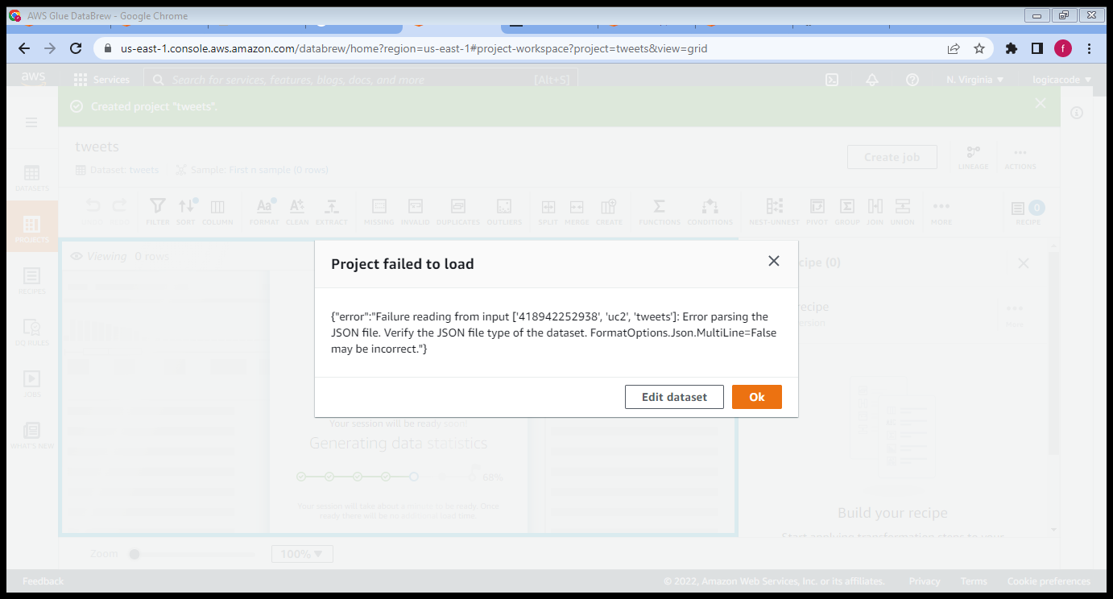

Slide 19
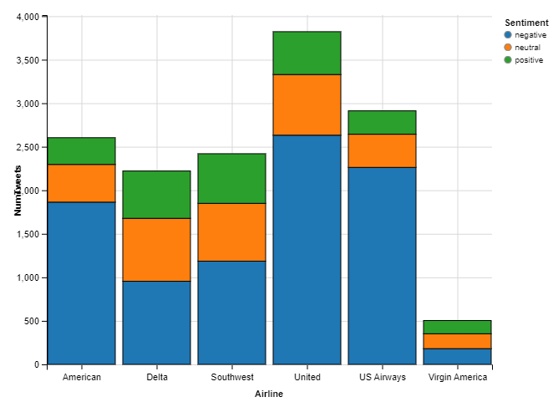
Notes:
https://www.kaggle.com/code/benhamner/exploring-airline-twitter-sentiment-data?scriptVersionId=0

Slide 20
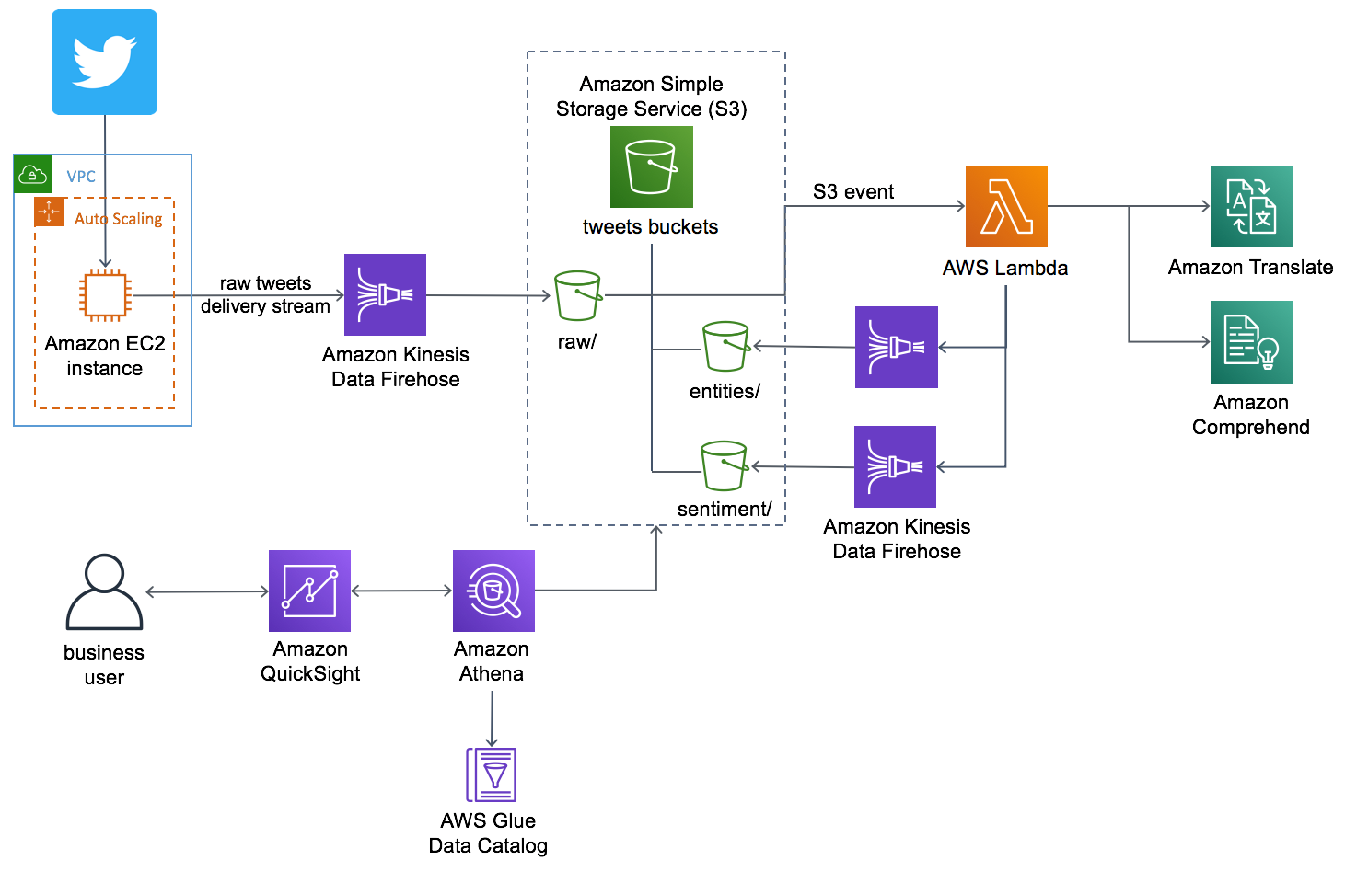
AI-Driven Social Media Dashboard
Notes:
https://aws.amazon.com/blogs/machine-learning/build-a-serverless-twitter-reader-using-aws-fargate/

Slide 21
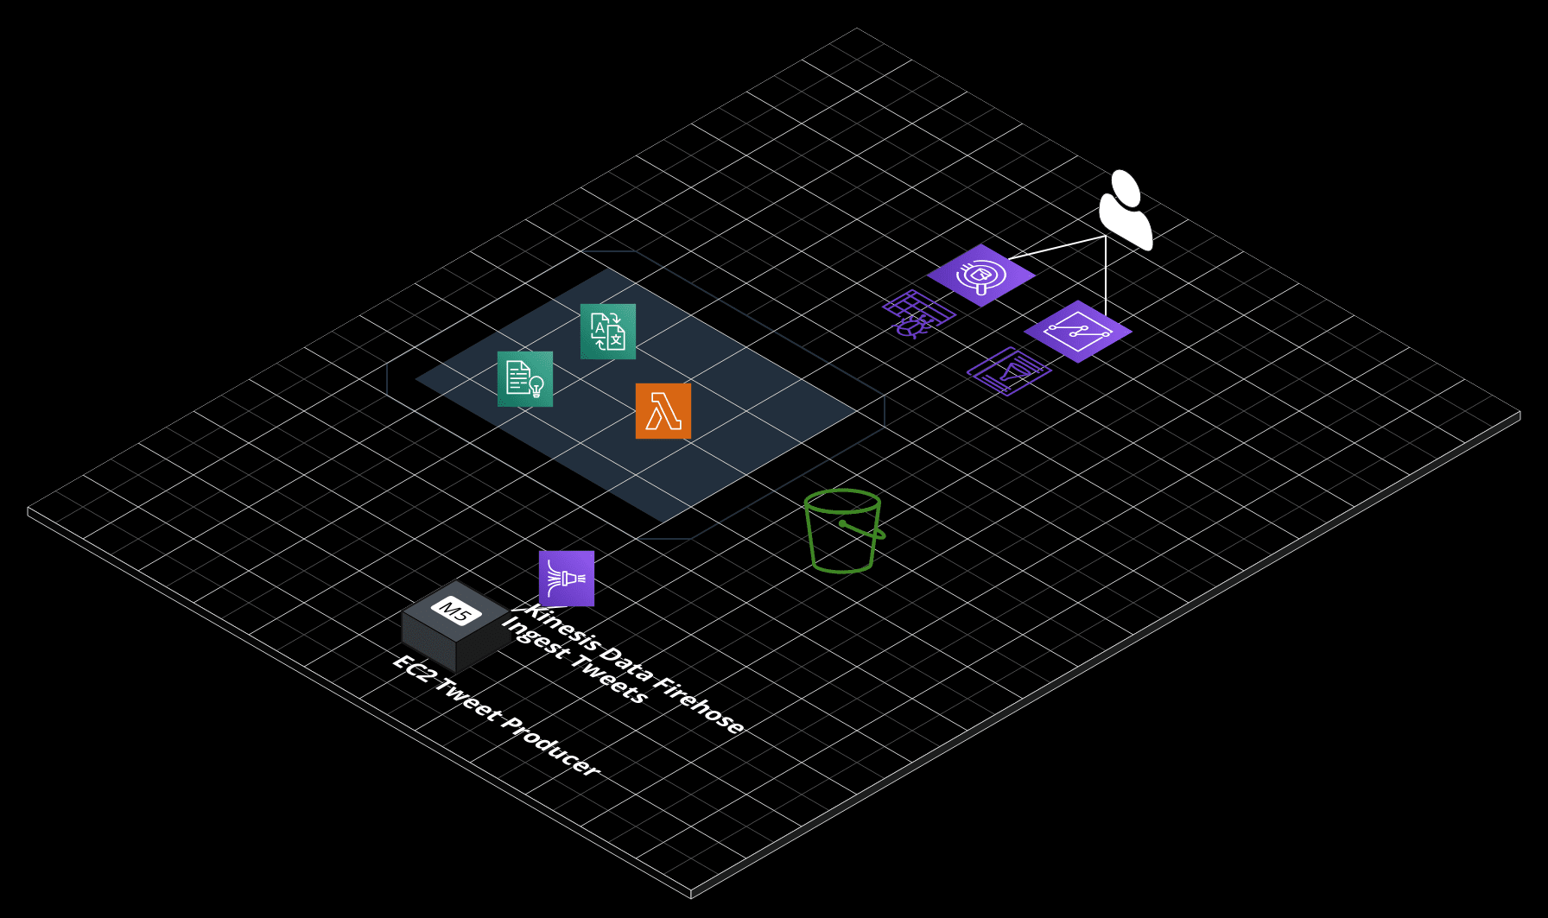
AI-Driven Social Media Dashboard
Notes:
https://aws.amazon.com/blogs/machine-learning/build-a-serverless-twitter-reader-using-aws-fargate/

