Slide 1
Suzuki Dealer Management System (SDMS)
Business Operation Flow
IT Development

Slide 2
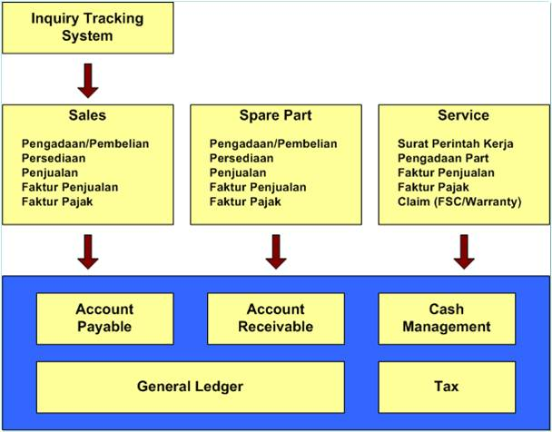
SDMS
Overview

Slide 3
Sales: Unit Purchase Flow
IT Development

Slide 4
Sales: Unit Sales Flow
IT Development

Slide 5
Sparepart: Purchasing Flow
IT Development

Slide 6
Sparepart: Sales Flow
IT Development

Slide 7
Service: Operation Flow
IT Development

Slide 8
Service: Warranty Claim Flow
IT Development

Slide 9
Service: PDI & KSG Flow
IT Development

Slide 10
Finance: Bank / Kas In Flow
IT Development

Slide 11
Finance: Bank / Kas Out Flow
IT Development

