Slide 1
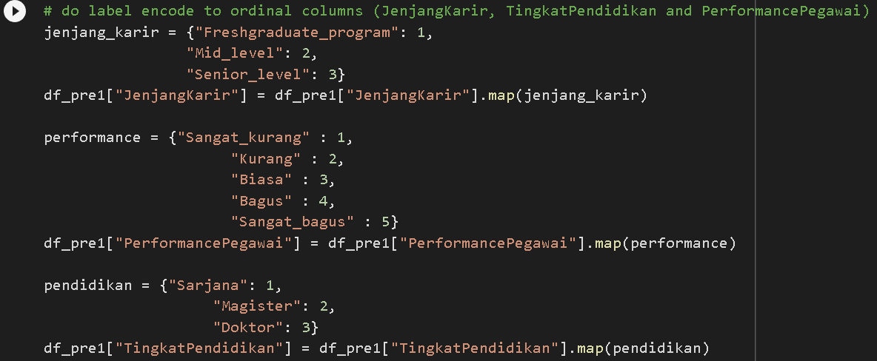
Build an Automated Resignation Behavior Prediction using Machine Learning
The encoding feature on the JenjangKarir, PerformancePegawai and TingkatPendidikan columns is done using the label encoder method because all of these columns contain ordinal values (have an order).

Slide 2
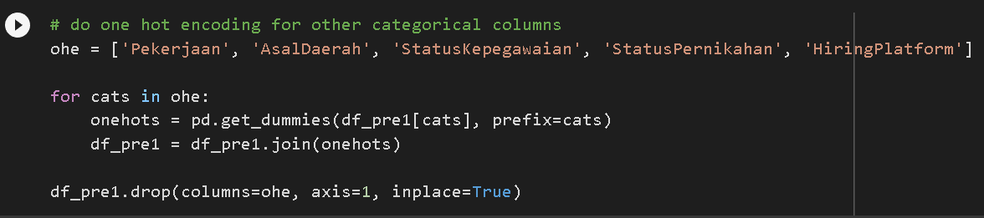
Build an Automated Resignation Behavior Prediction using Machine Learning
While for the Pekerjaan, AsalDaerah, StatusKepegawaian, StatusPernikahan, HiringPlatform columns, encoding is done using the one hot encoding method so that each value of the column has the same value when training the model.

Slide 3
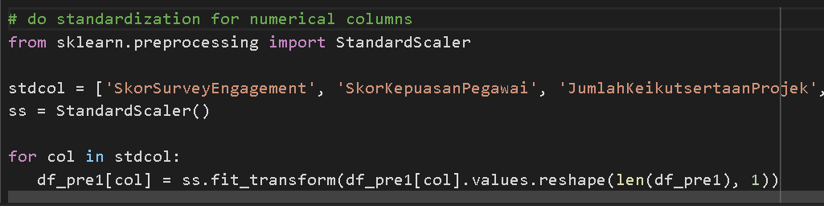
Build an Automated Resignation Behavior Prediction using Machine Learning
For the columns SkorSurveyEngagement, SkorKepuasanPegawai, JumlahKeikutsertaanProjek, JumlahKeterlambatanSebulanTerakhir, JumlahKetidakhadiran, standardization is carried out to equalize the scale of each column.

Slide 4
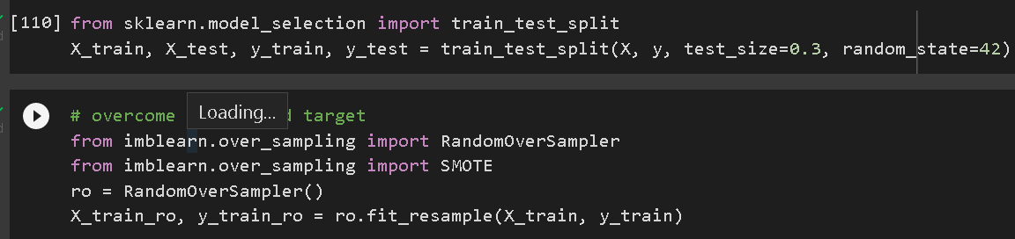
Build an Automated Resignation Behavior Prediction using Machine Learning
Split train and test data is divided by a ratio of 70:30, while to overcome the imbalance class, a random oversampling method is performed using the RandomOverSampler library on the minority class to balance the class.

Slide 5
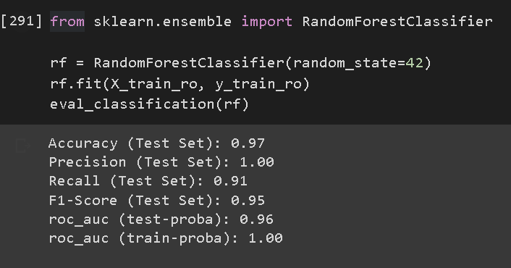
Build an Automated Resignation Behavior Prediction using Machine Learning
The model was trained using several algorithms namely logistic regression, KNN, Decision Tree, Random Forest, Naive Bayes and XGBoost. However, Random forest was chosen as the best model because of the best overall score.

Slide 6
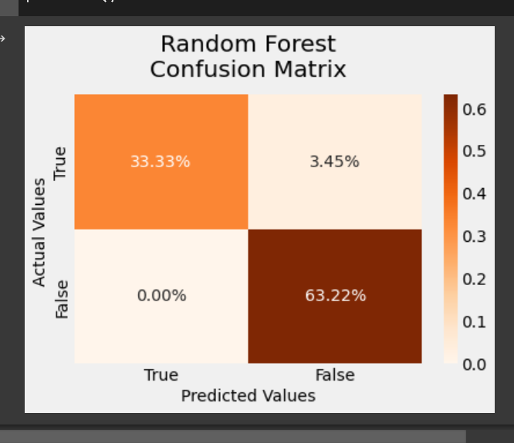
Build an Automated Resignation Behavior Prediction using Machine Learning
The results of the confusion matrix show, from 87 test data, the model can accurately separate 33.33% of the data are employees who will resign while 63.22% are employees who remain. Since we use recall metrics, it can be seen that the model can recognize most of the patterns of employees who will positively resign with a low false negative rate.

