Slide 1
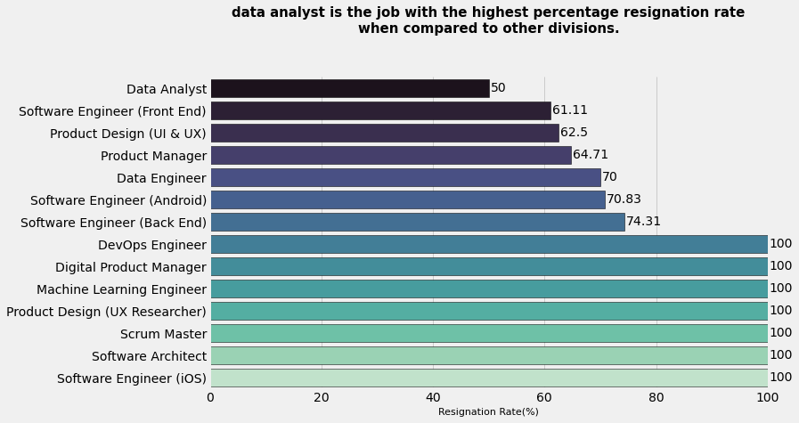
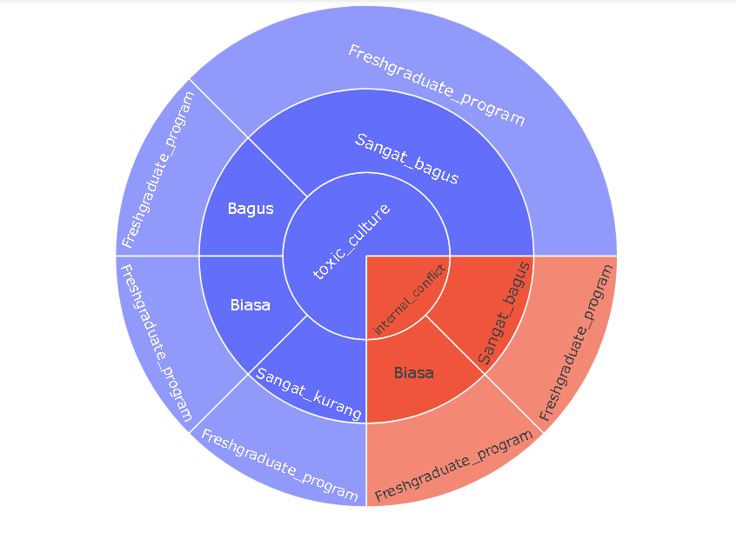
Resign Reason Analysis for Employee Attrition Management Strategy
From the sunburst chart above, the 2 main causes of resigning data analysts are toxic culture and internal conflict within the company. All of the resigned data analyst employees are also fresh graduates who may not be accustomed to the work environment or culture in the company. Actions that can be taken by company management in order to overcome this problem include :
For more details, see jupyter notebook here

Slide 2
Resign Reason Analysis for Employee Attrition Management Strategy
- Give appreciation to employees for their achievements, make them feel valuable to the company.
- Focus on the strengths of each individual, by focusing on the strengths of each employee, the management can use their strengths to help the company's needs and provide opportunities for them to shine with their strengths.
- Create a positive discussion environment, if there is an internal problem, then management must focus on what problems occur and the source of the problem, do not focus on things that are personally attacking an individual. Create a long-term strategy to prevent this from happening again in the future.
For more details, see jupyter notebook here

