Slide 1
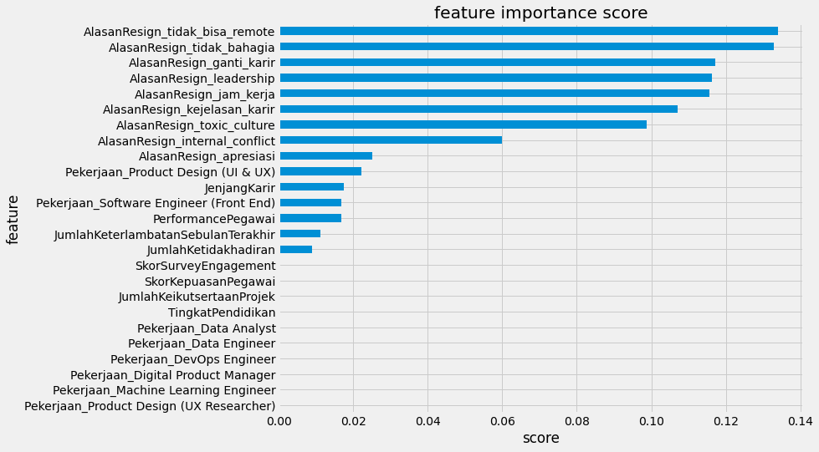
Presenting Machine Learning Products to the Business Users

