Slide 1
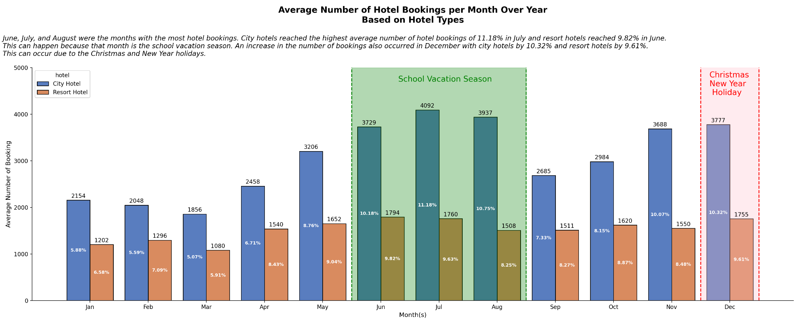
Monthly Hotel Booking Analysis Based on Hotel Type
- June, July, and August are the peak months for hotel bookings.
- These two types of hotels reached the highest bookings in July for city hotels at 11.18% (4092 bookings) and in June for resort hotels at 9.63% (1760 bookings). this can occur due to the holiday season for schools.
- An increase in hotel booking trend also occurred in December, which amounted to 10.32% (3777 bookings) for city hotels and 9.61% for hotel resorts (1755 bookings). This can occur due to the Christmas and New Year holidays.
For more details, you can check out the jupyter notebook here

