Slide 1
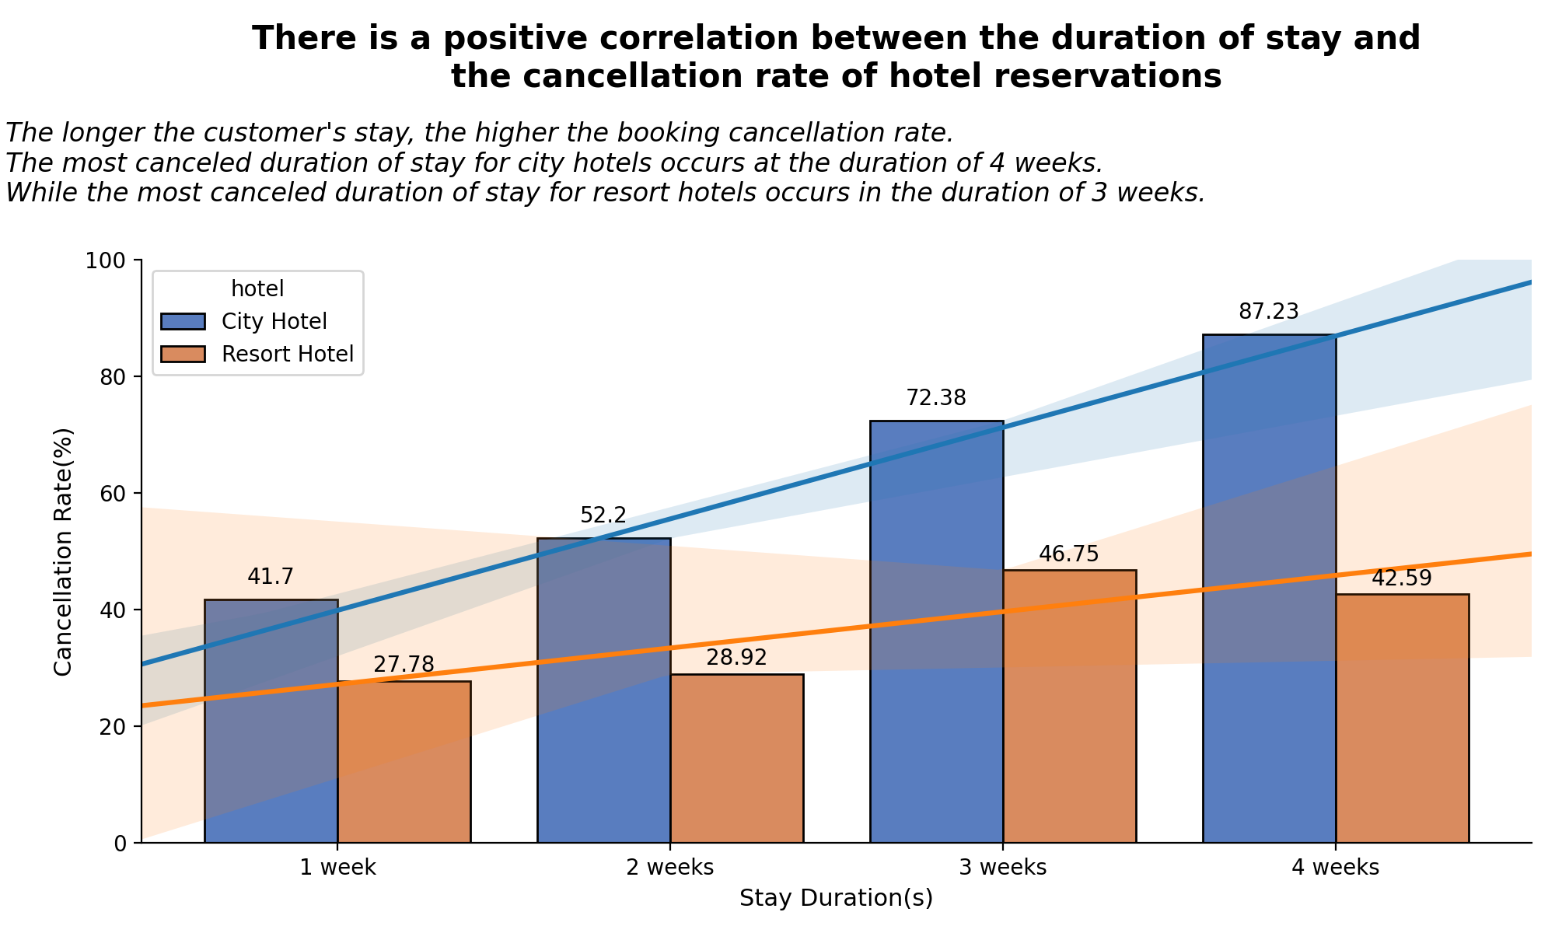
Impact Analysis of Stay Duration on Hotel Bookings Cancellation Rates
- There is a positive correlation between the booking cancellation ratio and the duration of stay for each hotel type. The longer the duration of stay, the higher the booking cancellation ratio.
- The most canceled duration of stay for city hotels occurs at the duration of 4 weeks (87.23%). While the most canceled duration of stay for resort hotels occurs in the duration of 3 weeks (46.75%).
- There are several possibilities as to why this might happen. Some examples include sudden emergencies that have to be canceled, vacation plans that have changed, or purely human errors.
For more details, you can check out the jupyter notebook here

