Slide 1
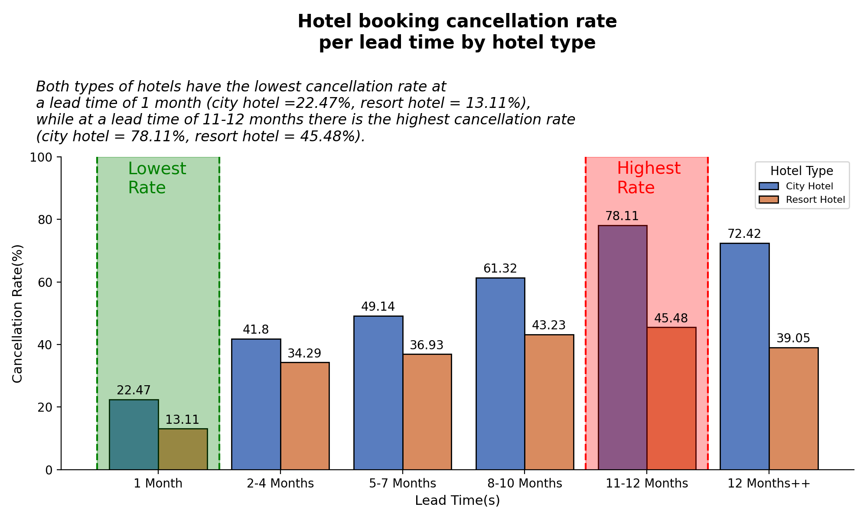
Impact Analysis of Lead Time on Hotel Bookings Cancellation Rate
- Both types of hotels have the lowest cancellation rate at a lead time of 1 month (city hotel =22.47%, resort hotel = 13.11%)
- Both types of hotel also have the highest cancellation rate at a lead time of 11-12 months (city hotel = 78.11%, resort hotel = 45.48%).
- Significant growth in cancelation rate occurs when the lead time passes 1 month.
- This growth can happen because there are initially many vacation plans that have not been thought of, but with the length of the lead time, there are more possible vacation plans that could cause the original plan to shift and have an impact on hotel bookings.
For more details, you can check out the jupyter notebook here

