Slide 1
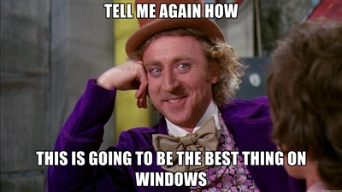
Chocolatey goodness - what…
Rob Reynolds

Slide 2
Who am I? Who cares…
Rob Reynolds
Technical Lead for VML
OSS
Chuck Norris Framework
Chocolatey
NuGet core team member
Various contributions to other projects
ferventcoder – twitter, gmail, you name it
ferventcoder.com / Devlicio.us
Project managers never ask Chuck Norris for estimations…ever.

Slide 3
What the …. Is Chocolatey?
Familiar w/Debian? apt-get?
APT – advanced packaging tool
Automates retrieval, configuration, and installation of software
Windows hasn’t really had anything take off

Slide 4
Chocolatey
Chocolatey NuGet – local machine repository
Think ruby gems on steroids
Think apt-get for windows
What is it?
PowerShell instructions for “retrieval, configuration, and installation of software”
Global PowerShell Execution Engine
Notes:
The original intent was to replace the executable tool gems that you could get in ruby

Slide 5
What does it mean?
Chocolatey can download a native installer (msi or install.exe)
Then execute it silently
Then perform additional setup
BUT IT CAN DO OTHER THINGS AS WELL
It’s PowerShell, you can do nearly anything

Slide 6
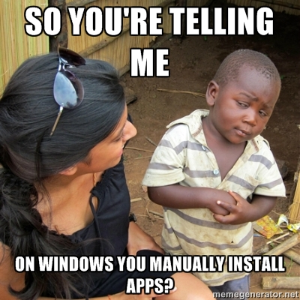
Why Chocolatey?
Because of this…

Slide 7
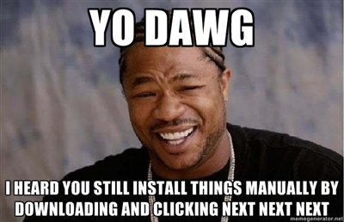
Applications and Tools
Application –
native installer
add/remove programs
Tool
everything else
.zip

Slide 8
Install Chocolatey?
Listed on chocolatey.org
@powershell -NoProfile -ExecutionPolicy unrestricted -Command "iex ((new-object net.webclient).DownloadString('http://bit.ly/psChocInstall'))" && SET PATH=%PATH%;%systemdrive%\chocolatey\bin

Slide 9
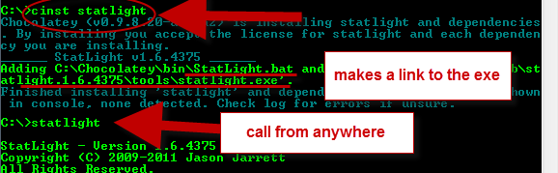
Install a Tool
Statlight

Slide 10
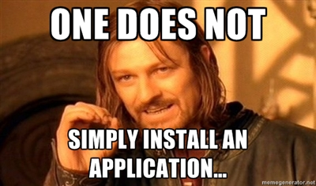
Install an Application
UH, WUT?!

Slide 11
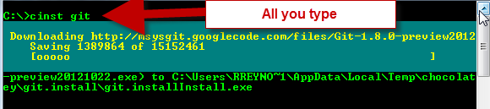
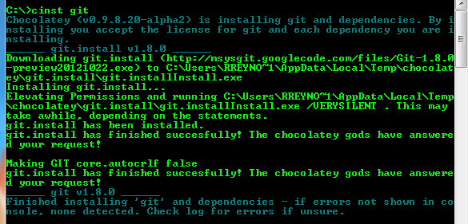
Install an App
Git

Slide 12
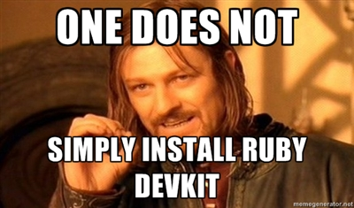
Install something hard
Wrong again…

Slide 13
What can I install?
clist (chocolatey list) searchTerm
Chocolatey.org
Nuget.org
Myget feeds
File shares

Slide 14
Chocolatey Update
cup SomePackage
cup all

Slide 15
Uninstall?
Yep, chocolatey uninstall
cuninst

Slide 16
Demo

Slide 17
Scripting
Packages.config
setup.ps1 – set up an full Dev environment!
Someone needs Ruby for Rake? Install it
SQLExpress? Install it
Visual Studio? Install it
Check setup.ps1 into source control

Slide 18
Demo

Slide 19

Creating packages…
Is easy
You just have to …….install x number of things, configure your environment for……then………………………….
…………………………………………….
……………………………………….
……………

Slide 20

Creating packages….
No really, it’s easy!
Install-ChocolateyPackage 'windirstat' 'exe' '/S' 'http://windirstat.info/wds_current_setup.exe'

Slide 21
Demo

Slide 22
Automatic Packages
I released new versions of packages this morning.
Well, twitter told me I did

Slide 23
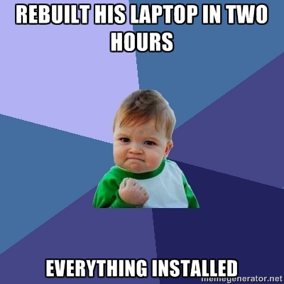
Questions?
ferventcoder – twitter, gmail, etc
Chocolatey - http://chocolatey.org

Slide 24


