Slide 1


A Better Way to Get to Done: NuGet Package Management aka NuGet-R-Done!
Rob Reynolds

Slide 2
Who am I? Who cares…
Rob Reynolds
Technical Lead for VML
OSS
  Chuck Norris Framework
  NuGet core team member
  Various contributions to other projects
ferventcoder – twitter, gmail, you name it
ferventcoder.com / Devlicio.us

Slide 3
Topics
NuGet
  “NuGet” – Tools to get your nuggets
  “‘Er” – Running a server
  “Done” – Creating packages
Extending NuGet
  MyGet
  Chocolatey
  Octopus

Slide 4
What is NuGet?
Free, Open Source developer focused package management system for .NET.
What exactly does that mean?
More importantly, why should you care?
Notes:
Break down the words

Slide 5
What do you do now?
Open a browser
Find site
Downloads
Find the one you want
Download it
Unblock / Unzip
Put it in project references folder
Dependency collisions!

Slide 6
What’s wrong with that?
It’s slow
Too many decisions
Dependencies may be hard to manage
Upgrade blocks

Slide 7
What could you be doing?
someCommand packageName
Brings library and dependencies
Resolves dependency issues
Gives you a starting setup
  Configuration set up
  Source code
  etc

Slide 8
Why is this good?
Speed
Decision tree is reduced
Immediate feedback
Upgrading becomes easier
Getting 3rd party software libraries together for use no longer takes hours. Read that again. A free tool. Saves you hours.
Notes:
This tool keeps saving you more and more time each time you use it. So you can just donate that money to me. My paypal is ferventcoder@gmail.com.

Slide 9
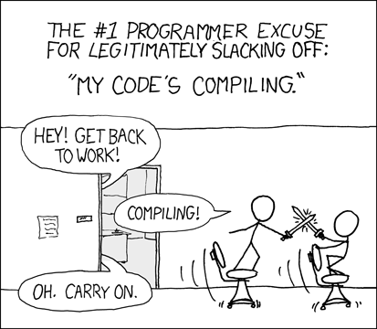

Slide 10
NuGet – Package Management for .NET
“Get your package here”

Slide 11

“NuGet” - Tools of The Trade
Nu

Slide 12
NuGet Tools
GUI
Package Manager Console
NuGet.exe
NuGet Package Explorer

Slide 13
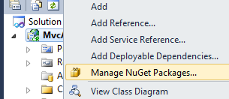
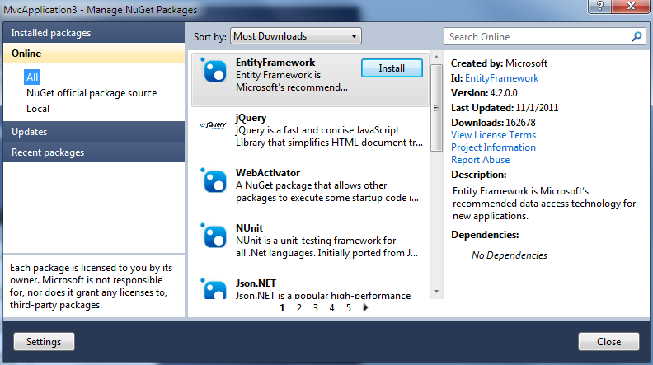
GUI – Getting Nuggets the easy way
Like “chewey” except
gooey!

Slide 14
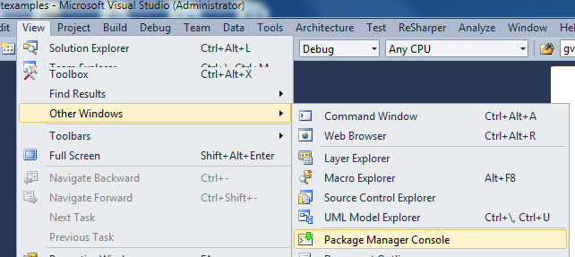
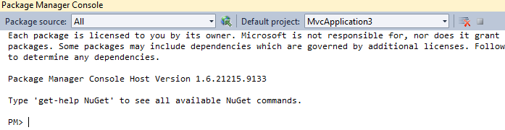
PowerShell – In my Visual Studio?
Package
Manager
Console

Slide 15
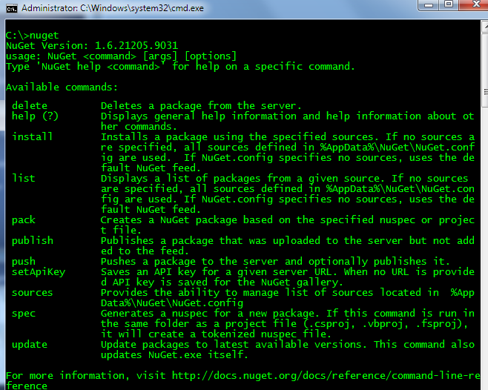
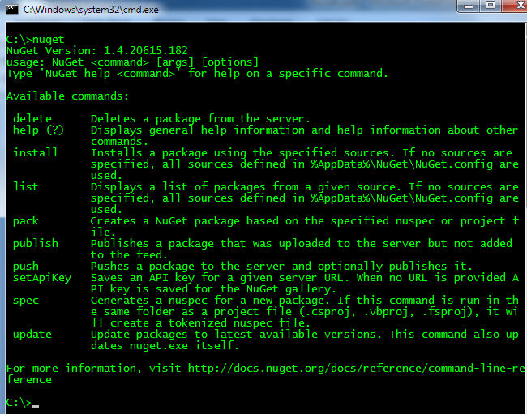
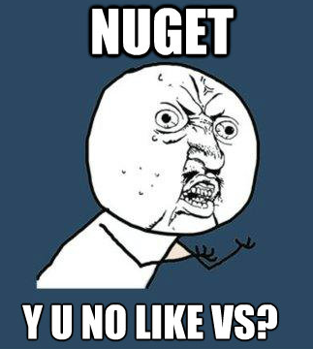
Y U no like Visual Studio?! – NuGet.exe
I use
notepad
as my
IDE
Notes:
Yes, there is also a command line tool

Slide 16
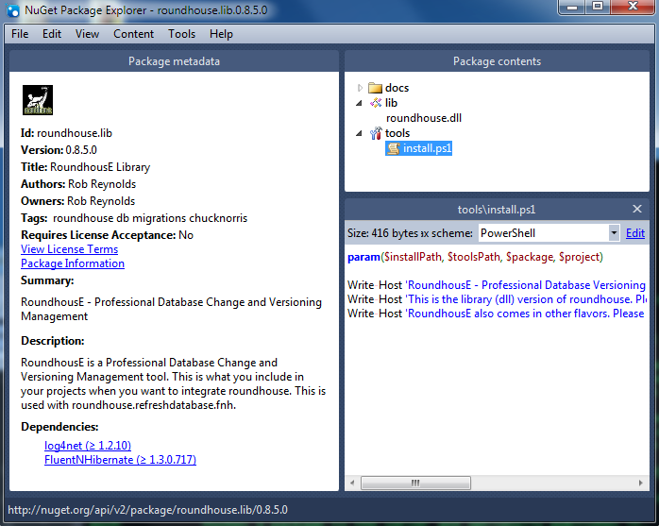
NuGet Package Explorer
I just
want
to
see
the
bits,
no
install
pls?!!

Slide 17
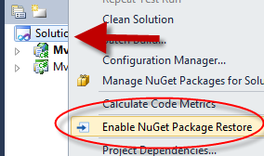
Have a problem with commitment?
Want to check in packages? Don’t want to check in packages?
NuGet supports either
scenario natively at v1.6
“To commit or not to commit, that is the question: Whether ‘tis nobler in the mind to…” – Unknown, 1503 AD (okay not really)

Slide 18
NuGet Tools Demos

Slide 19

R - Run Package Server

Slide 20
Run a Server: Why?
Company Requirements
To Learn
To Shield from the unforeseen
IDK, just b/c NuGet and I are going to be BFFs!!!

Slide 21
Run a Server: Pick your evil
NuGet.Server
NuGet Gallery
MyGet
NuServe
TeamCity
Others?

Slide 22
Package Server Demos

Slide 23

“Done” - Creating Packages

Slide 24
What to Include In Your Packages
Binaries, source code, PowerShell, oh my!
Folders
  Content
  Lib
  Tools

Slide 25
Alternative package creation method
NuGet pack *.csproj –Symbols
Not getting into it today

Slide 26
Creating Packages Demos

Slide 27
Extend NuGet

Slide 28
Extend NuGet
MyGet – protect yourself
Octopus – Conventional Deployment w/NuGet
Chocolatey – kind of like apt-get, but for Windows

Slide 29
MyGet – Host Packages, No Hassle
Or shield from change
Share beta packages
Keep private packages w/auth

Slide 30
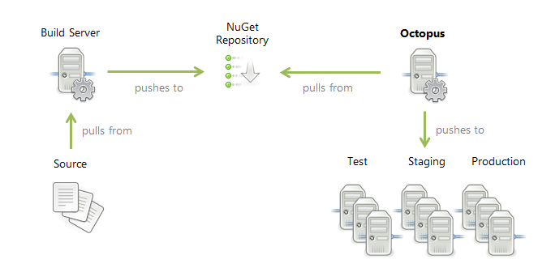
Octopus – Deploy with NuGet?
NuGet, meet deployment – Hello Octopus!
  Freemium model
  Conventional Deployment for .Net
  Tentacles

Slide 31
Chocolatey – everything else
NuGet, meet apt-get. Let’s get Chocolatey!
  Tools in bin, on the path
  Native installers? No problem!

Slide 32
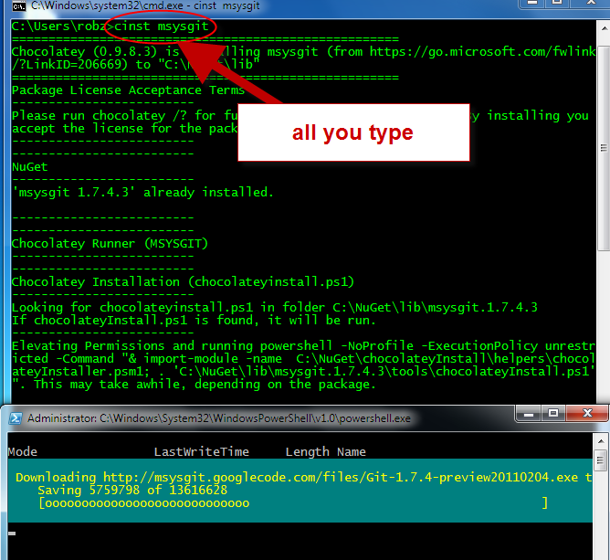
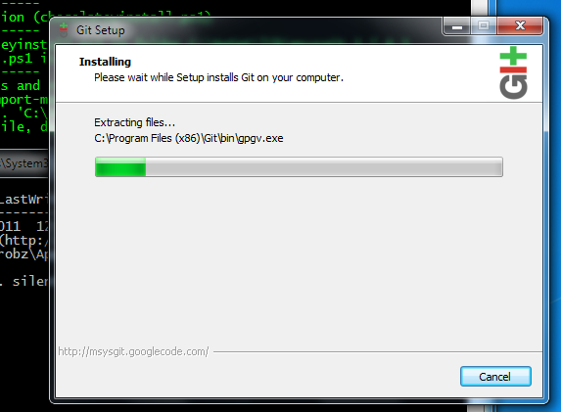
Git

Slide 33
Questions?
ferventcoder – twitter, gmail, etc
NuGet – http://nuget.org
MyGet – http://myget.org
Octopus - http://octopusdeploy.com/
Chocolatey – http://chocolatey.org

Slide 34

Nu

