Slide 1

FREE as in BEER!!! Manage Your Packages with NuGet
Rob Reynolds

Slide 2
Who am I?
Rob Reynolds
C# MVP
Technical Lead for Heartland Crop Insurance
Active in OSS
Chuck Norris Framework
NuGet core team member
Various contributions to other projects
ferventcoder – twitter, gmail, you name it
ferventcoder.com / Devlicio.us
Recently given a new nickname: Inspector Gadget

Slide 3
Topics
NuGet
Secret Tool

Slide 4
What is NuGet?
Free, Open Source developer focused package management system for .NET.
What exactly does that mean?
More importantly, why should you care?
Notes:
Break down the words

Slide 5
What do you do now?
Open a browser
Find site
Downloads
Find the one you want
Download it
Unblock / Unzip
Put it in project references folder
Dependency collisions!

Slide 6
What’s wrong with that?
It’s slow
Too many decisions
Dependencies may be hard to manage
Upgrade blocks

Slide 7
What could you be doing?
someCommand packageName
Brings library and dependencies
Resolves dependency issues
Gives you a starting setup
Configuration set up
Source code
etc

Slide 8
Why is this good?
Speed
Decision tree is reduced
Immediate feedback
Upgrading becomes easier
Getting 3rd party software libraries together for use no longer takes hours. Read that again. A free tool. Saves you hours.
Notes:
This tool keeps saving you more and more time each time you use it. So you can just donate that money to me. My paypal is ferventcoder@gmail.com.

Slide 9
NuGet – Package Management for .NET

Slide 10
That’s it!
We’re done here.
Now you can go forth and be productive
Thanks for coming
Any questions?

Slide 11
You’re not leaving…?!

Slide 12
Oh you want to see the tool? Demos?

Slide 13
We can do Demos

Slide 14
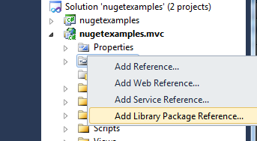
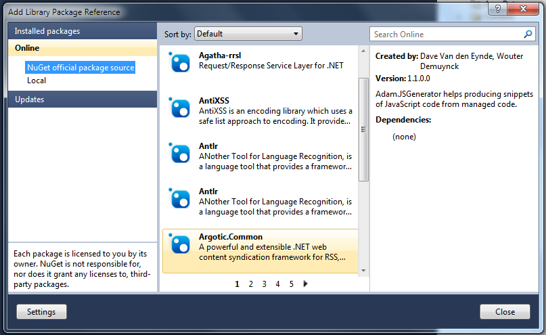
Add Library Package Reference
Demo

Slide 15
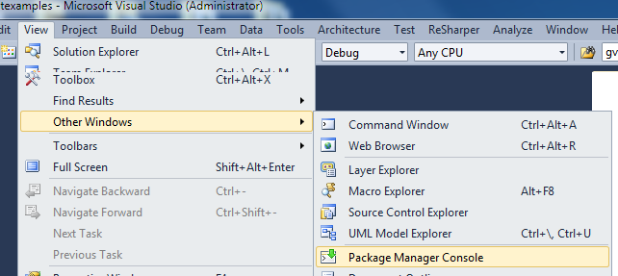
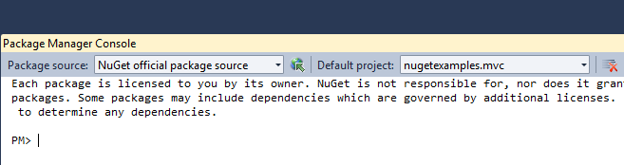
PowerShell – In my Visual Studio?
Demo

Slide 16
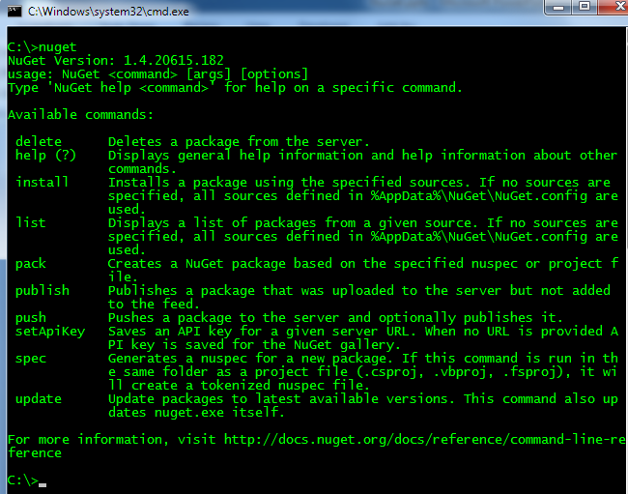
Yet another tool – NuGet.exe
Demo
Notes:
Yes, there is also a command line tool

Slide 17
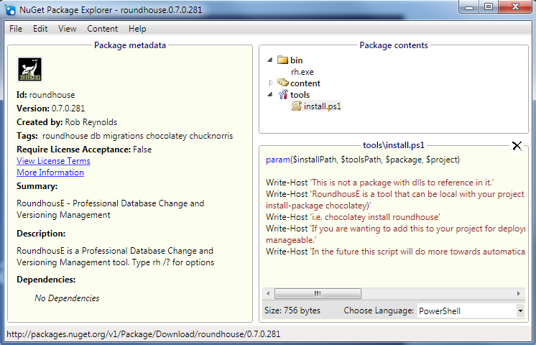
NuGet Package Explorer
Demo

Slide 18
Demo : Run Package Server

Slide 19
Demo : Creating Packages

Slide 20
Alternative package creation method
NuGet pack *.csproj –Symbols
Not getting into it today

Slide 21
Option for not checking pkgs in to Source Control
Nuget.exe install packages.config
Not getting into it today

Slide 22
So we’re good now…?

Slide 23
Did I promise a secret tool for uber productivity?

Slide 24
I suppose we can talk about that one, too

Slide 25

A Secret Weapon – Be Uber
Familiar w/Debian? apt-get?
apt-get – application packaging tool
Automates retrieval, configuration, and installation of software
Windows hasn’t really had anything take off
…

Slide 26
Chocolatey - A not so Secret Weapon
Chocolatey NuGet – local machine repository
Think ruby gems on steroids
Think apt-get for windows
What is it?
PowerShell instructions for “retrieval, configuration, and installation of software”
Notes:
The original intent was to replace the executable tool gems that you could get in ruby

Slide 27
What does it mean?
Chocolatey can download a native installer (msi or install.exe)
Then execute it silently
Then perform additional setup
It’s PowerShell, you can do nearly anything

Slide 28
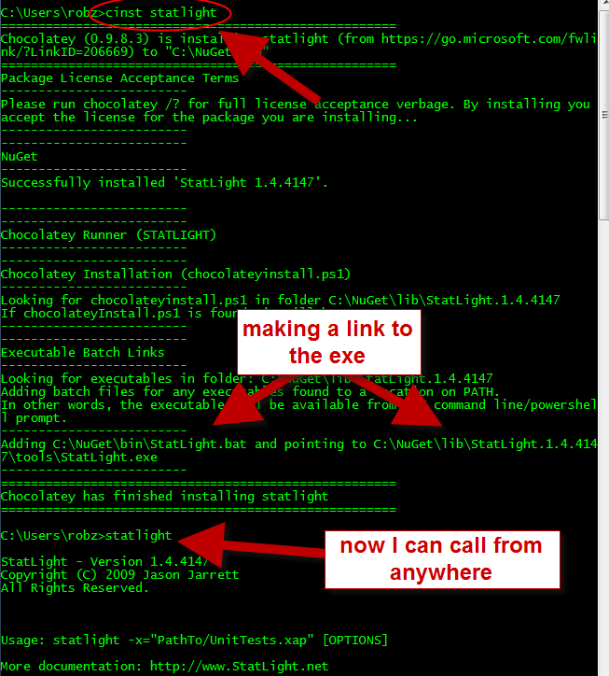
Statlight

Slide 29
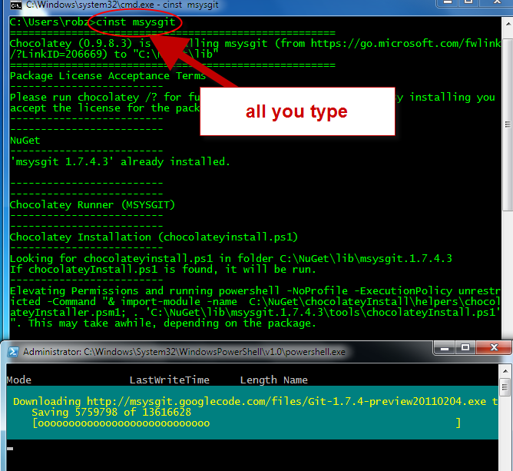
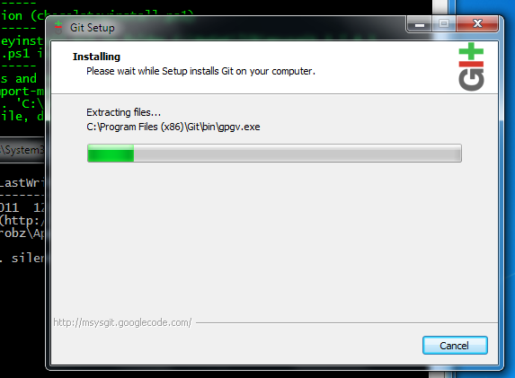
Git

Slide 30
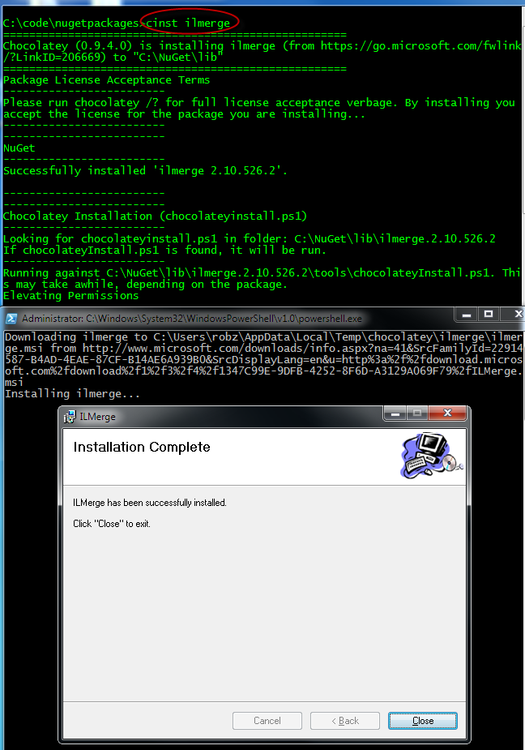
ILMerge
notSilent

Slide 31
Demo

Slide 32
Questions?
ferventcoder – twitter, gmail, etc
NuGet – http://nuget.codeplex.com
Chocolatey - http://nuget.org/List/Packages/chocolatey

