Slide 1
Chocolatey goodness - what…
Rob Reynolds

Slide 2
Who am I? Who cares…
Rob Reynolds
Technical Lead for VML
OSS
Chuck Norris Framework
Chocolatey
NuGet core team member
Various contributions to other projects
ferventcoder – twitter, gmail, you name it
ferventcoder.com / Devlicio.us
Project managers never ask Chuck Norris for estimations…ever.

Slide 3
What the …. Is Chocolatey?
Familiar w/Debian? apt-get?
apt-get – application packaging tool
Automates retrieval, configuration, and installation of software
Windows hasn’t really had anything take off

Slide 4
Chocolatey
Chocolatey NuGet – local machine repository
Think ruby gems on steroids
Think apt-get for windows
What is it?
PowerShell instructions for “retrieval, configuration, and installation of software”
Global PowerShell Execution Engine
Notes:
The original intent was to replace the executable tool gems that you could get in ruby

Slide 5
What does it mean?
Chocolatey can download a native installer (msi or install.exe)
Then execute it silently
Then perform additional setup
It’s PowerShell, you can do nearly anything

Slide 6
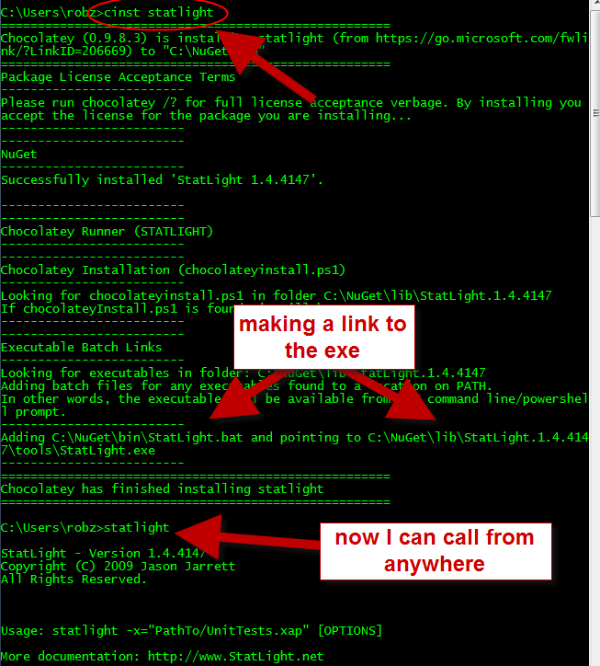
Statlight

Slide 7
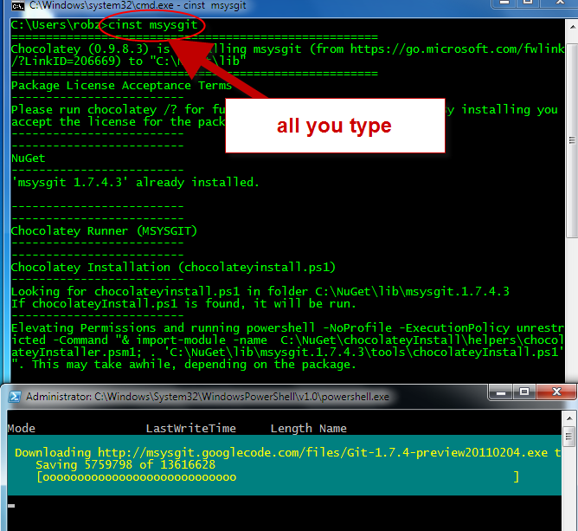
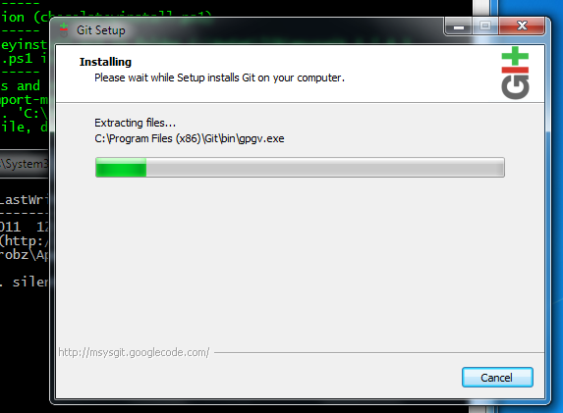
Git

Slide 8
Demo

Slide 9
Questions?
ferventcoder – twitter, gmail, etc
NuGet – http://nuget.codeplex.com
Chocolatey - http://chocolatey.org

