Slide 1

DropkicK Your Code!
Rob Reynolds

Slide 2
Who am I? Who cares…
Rob Reynolds
Technical Lead for VML
OSS
Chuck Norris Framework
NuGet core team member
Various contributions to other projects
ferventcoder – twitter, gmail, you name it
ferventcoder.com / Devlicio.us

Slide 3
Topics
What is DropkicK?
What does DK look like?

Slide 4

What is DropkicK?
Free, OSS deployment tool based heavily on lambdas and extension methods
“I love lampbda”
Fluent experience
Notes:
Break down the words

Slide 5
Is DropkicK Right For You?
Windows
.NET
Known Environments
Put them in source
Reach Environments
Administrative Deploy (best scenario)
WMI

Slide 6
What are the advantages?
Fluently describe your deployment
No installs
No applications / services / listeners to run
OSS
FREE
Separation of what from where
Print and show your network admins

Slide 7
What are the limitations?
Must be an admin
WMI enabled
Environment Reach (\\someserver)
Know Your Environments Before Deploy Time

Slide 8
Where does DK integrate well?
Organizations w/internal IT
IT companies that deploy apps internally
SOx
Structured approach

Slide 9
Where does DK not do so well?
Organizations w/lots of clients
Not as structured
Location changes
Not all environment accessible
Software Companies

Slide 10

Where are You?
Good Integration?
This will be a good intro to an awesome tool
Not so good integration?
Hopefully this is entertaining…look! Free Food!

Slide 11

Where am I?
Leaning toward the not so good integration.
Diverse clients / diverse teams / diverse technologies

Slide 12
But that’s okay
DK is still very active – just closed five pull requests in the past two months

Slide 13
What it means to be CNF
CNF == Chuck Norris Framework
Convention over configuration
Simple to learn and use
Simple upgrades
Independent tool – doesn’t lock you into other CNF tools to use
DK gets 2 out of 4

Slide 14
Why is DK so different?
My deploy looks nothing like your deploy
Conventions are created in each organization
Simple is in the eye of the beholder
Some might find it simple, the majority will not due to open conventions

Slide 15
If it’s hard, why use it?
DropkicK can be a full deployment
Here’s a server with a share (and default permissions)
DK can set up IIS / Windows Services / ACLs / Databases with RH
DK is a complete deployment mechanism
Go from almost nothing to completely set up

Slide 16
How do you make it easier?
NuGet package with working example
Wiki – https://github.com/chucknorris/dropkick/wiki

Slide 17
DropkicK – Concepts / Terminology

Slide 18
DK Concepts
Deployment Plan
Deployment Role
Deployment Step / Task
Deployment Settings
Deployment Server

Slide 19
DK Concepts
Deployment ServerMap / Configuration
Remote Execution
Deployment Logs
Environments

Slide 20
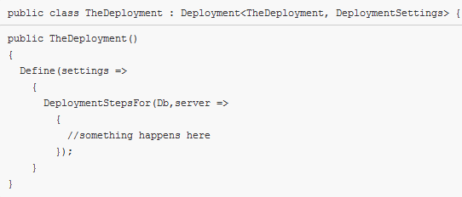
Deployment Plans
Contain Roles, Tasks, and Steps

Slide 21
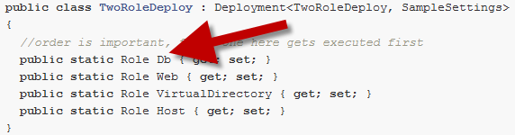
Deployment Role
A defined set of tasks usually toward the same idea, i.e. a database role
At least one role in a deployment plan
Order is important if you don’t specify in deployment

Slide 22
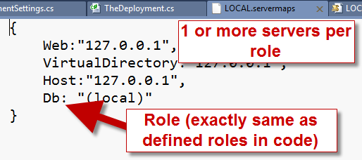
Deployment Server Maps
Mapping your deployment roles to one or more physical locations
environment.servermaps - JSON property file

Slide 23
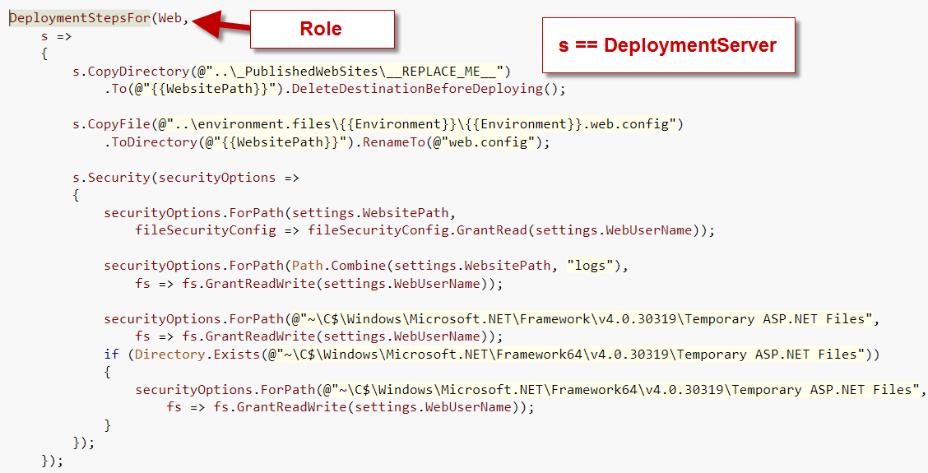
Deployment Step / Task
Lots of steps in this task

Slide 24
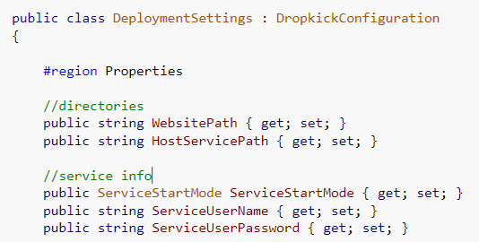
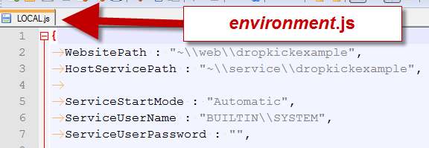
Deployment Settings / Configuration
C# Configuration
JSON property file
Items match in casing & all

Slide 25
Deployment Server
Server(s) you are deploying to – during configuration it’s declarative / proto server
During runtime, resolves physical servers tied to roles in *.servermaps file

Slide 26
Remote Execution
Built into DropkicK
Certain tasks must be run on machine
Copy executable to a special location on the remote machine
WMI Remote Execution
Grab output and brings it back to running log

Slide 27
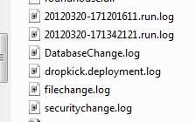
Deployment Logs
Several Logs
Run log – full per run
Dropkick Deployment
File Change
Security Change
Database Change
Most are appended to

Slide 28
Environments
First class citizens
Required by dropkick
Must be known prior to deploy
Could be written on the fly depending on how dynamic the settings.js file is

Slide 29
Demos

Slide 30
Questions?
DropkicK
ChuckNorris Framework (CNF)
ferventcoder (gmail/twitter/github)

