Slide 1
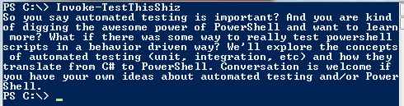
Automated Testing but like For PowerShell
Rob Reynolds

Slide 2


Slide 3
Who am I? Who cares…
Rob Reynolds
Technical Lead for VML
OSS
Chocolatey / Chuck Norris Framework / NuGet
Various contributions to other projects
ferventcoder – twitter, gmail, you name it
ferventcoder.com / Devlicio.us
Automated Testing for 8 years

Slide 4
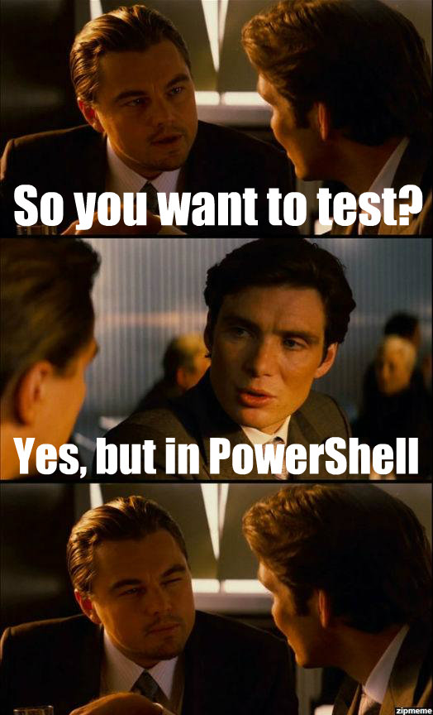
Topics d
Automated Testing…
Integration Testing
Mocking
Unit Testing
Behavior Driven Development…
What does it all mean?
..but like for PowerShell?
Pester
Entire presentation w/examples:
http://bit.ly/powershellbdd

Slide 5
Back to Basics

Slide 6
Test Automation
Test automation is the use of software to control the execution of tests, the comparison of actual outcomes to predicted outcomes, the setting up of test preconditions, and other test control and test reporting functions.^{[1]} Commonly, test automation involves automating a manual process already in place that uses a formalized testing process.
-Wikipedia

Slide 7
So what is test automation?
Making executable tests to determine your software works appropriately

Slide 8
Fallacies of automated testing
“Automated tests will prove the absence of bugs”
“’Unit’ testing is easy”
“One class – one test class”
“Testing takes little time”
Notes:
– Only confidence in what you tested works in the scenarios you tested it in
– unit testing is the hardest type of testing

Slide 9
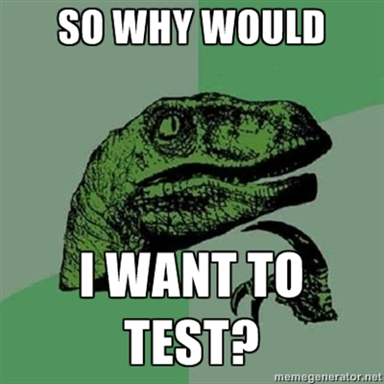

Slide 10
Why do automated testing?
“We never touch that piece of code. A guy wrote it a long time ago and he’s not here anymore. It just works.”
Translation “We have no idea WTF it does and have no test automation on it to help us figure it out.”

Slide 11
So why do automated testing?
Maintenance – change is a constant
Feedback cycles
Scenarios / edge cases
Gives you confidence in the code
Works appropriately

Slide 12
What are the types of automated tests?
White box (MSTest / Nunit / xUnit / MbUnit)
Unit
Integration
Functionality – Groups of functionality
Database Tests
Black box (FitNesse)
End 2 End – System Integration Testing
Performance testing

Slide 13
What are the types of automated tests?
White box (MSTest / Nunit / xUnit / MbUnit)
Unit
Integration
Functionality – Groups of functionality
Database Tests
Black box (FitNesse)
End 2 End – System Integration Testing
Performance testing

Slide 14
What are the types of automated tests?
White box
Unit
Integration
Functionality – Groups of functionality
Database Tests
Why do we categorize? Is it because we are just developers and everything has a place?

Slide 15
Reasons for categorization
Feedback cycles
Maintenance
“The more units put into something the greater the feedback cycle and the less maintainable the test.”

Slide 16
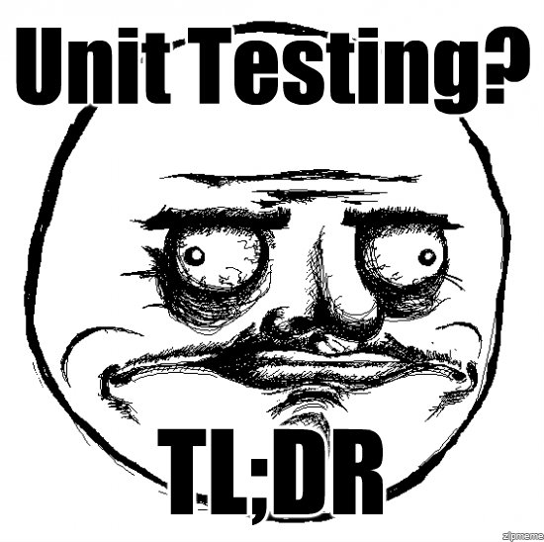
Unit Testing
Test a “unit” of something
But WTF is a unit?
A near religion around this
For purposes of discussion a unit is one class / sometimes one method in code

Slide 17
Integration Testing
Integration
Functionality – Groups of functionality
Database Tests
“Anything that tests more than one unit as part of the same test is an integration”

Slide 18
But wait, couldn’t that mean all tests are integration?

Slide 19
Integration Testing
Integration
Functionality – Groups of functionality
Database Tests
“Anything that tests more than one unit as part of the same test is an integration”
Yes, most tests we write are a blend of unit and integration but we strive for unit testing

Slide 20
Demo

Slide 21
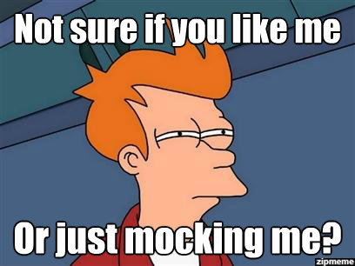
Where does Mocking come in?

Slide 22
Where does mocking come in?
Fakes, mocks, stubs – oh my!
Dummies - objects are passed around but never used
Fake - working implementations with possible shortcuts
Stubs - provide canned answers (answer state questions)
Mocks - objects with you can set expectations and verify behavior on
Known as test doubles

Slide 23
Test Doubles – is it okay to blend?
Most of us never write a true stub/fake/mock/etc but something that blends ideas from each of these

Slide 24
Behavior Driven Development…

Slide 25
This is not BDD…
...but the style of writing for your tests in a natural language
BDD can be a religious battle and this talk is not about that (check out Dan North for more info)
Describe behaviors and interactions
Think not about “tests” but about behaviors and specifications

Slide 26
Demo

Slide 27
…but like for PowerShell

Slide 28
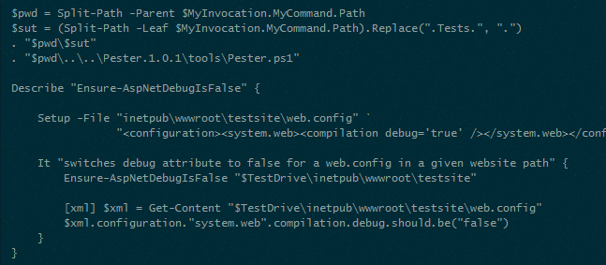
Meet Pester
https://github.com/scottmuc/Pester
BDD style of test writing

Slide 29
Demo

Slide 30
But is Pester enough?
Does not get you to unit testing alone
Does no mocking/stubbing

Slide 31
How to get there
A little ingenuity
Maybe a mocking/stub framework for PowerShell in the future – what would you name it?
PowerMock?
PSomething
PShellshock

Slide 32
PowerShell Unit Testing
A PowerShell unit is a function
Functions can be overwritten by scoping a function of the same name

Slide 33
PowerShell Stubbing
Functions can be overwritten by a function of the same name and parameters
This allows you to interrupt and stub the functionality
“I want behavior verification. I want my mock”

Slide 34
PowerShell Mocking
After you have implemented the stubs you allow different behaviors to be returned through conventional properties and flags

Slide 35
Demo

Slide 36
Questions?
ferventcoder – twitter, gmail, etc
Pester – https://github.com/scottmuc/Pester#readme
Chocolatey – http://chocolatey.org
Mocks aren’t stubs -http://martinfowler.com/articles/mocksArentStubs.html

Slide 37
