Slide 1




















PLATINUM SPONSORS
GOLD SPONSORS
SILVER SPONSORS

Slide 2
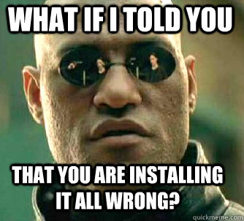
Chocolatey goodness - what…
Rob Reynolds

Slide 3
Who am I? Who cares…
Rob Reynolds
Technical Architect for VML
OSS
Chuck Norris Framework
Chocolatey
NuGet core team member
Various contributions to other projects
ferventcoder – twitter, gmail, you name it
ferventcoder.com / Devlicio.us
Project managers never ask Chuck Norris for estimations…ever.

Slide 4


Full-Service Digital Marketing Agency
World-class Clients
Vibrant Culture
Benefits Philosophy
http://vml.com

Slide 5

What the …. Is Chocolatey?
Familiar w/Debian? apt-get?
APT – advanced packaging tool
Automates retrieval, configuration, and installation of software
Windows hasn’t really had anything take off

Slide 6
Chocolatey
Chocolatey NuGet – local machine repository
Think ruby gems on steroids
Think apt-get for windows
What is it?
PowerShell instructions for “retrieval, configuration, and installation of software”
Global PowerShell Execution Engine
Notes:
The original intent was to replace the executable tool gems that you could get in ruby

Slide 7
What does it mean?
Chocolatey can download a native installer (msi or install.exe)
Then execute it silently
Then perform additional setup
BUT IT CAN DO OTHER THINGS AS WELL
It’s PowerShell, you can do nearly anything

Slide 8
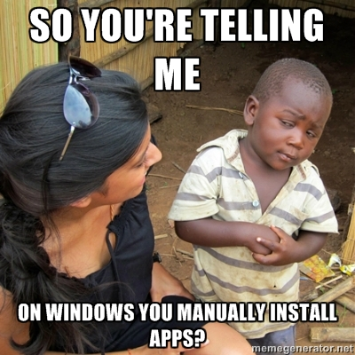
Why Chocolatey?
Because of this…

Slide 9
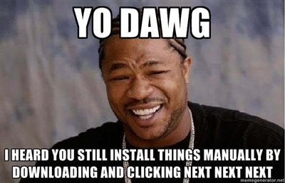
Applications and Tools
Application –
native installer
add/remove programs
Tool
everything else
.zip

Slide 10
Install Chocolatey?
Listed on chocolatey.org
@powershell -NoProfile -ExecutionPolicy unrestricted -Command "iex ((new-object net.webclient).DownloadString('https://chocolatey.org/install.ps1'))" && SET PATH=%PATH%;%systemdrive%\chocolatey\bin

Slide 11
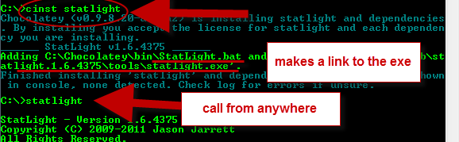
Install a Tool
Statlight

Slide 12
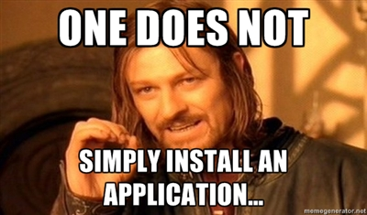
Install an Application
UH, WUT?!

Slide 13
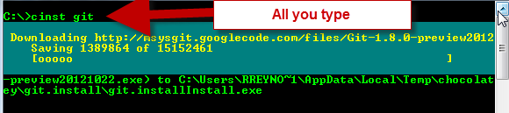
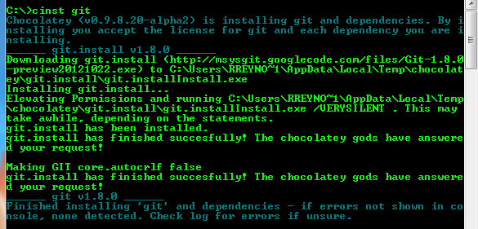
Install an App
Git

Slide 14
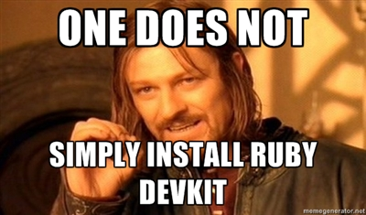
Install something hard
Wrong again…

Slide 15
What can I install?
clist (chocolatey list) searchTerm
Chocolatey.org
Nuget.org
Myget feeds
File shares

Slide 16
Chocolatey Update
cup SomePackage
cup all

Slide 17
Uninstall?
Yep, chocolatey uninstall
cuninst

Slide 18
Demo

Slide 19
Scripting
Packages.config
setup.ps1 – set up an full Dev environment!
Someone needs Ruby for Rake? Install it
SQLExpress? Install it
Visual Studio? Install it
Check setup.ps1 into source control

Slide 20
Demo

Slide 21

Creating packages…
Is easy
You just have to …….install x number of things, configure your environment for……then………………………….
…………………………………………….
……………………………………….
……………

Slide 22

Creating packages….
No really, it’s easy!
Install-ChocolateyPackage 'windirstat' 'exe' '/S' 'http://windirstat.info/wds_current_setup.exe'

Slide 23
Demo

Slide 24
Automatic Packages
I released new versions of packages this morning.
Well, twitter told me I did

Slide 25
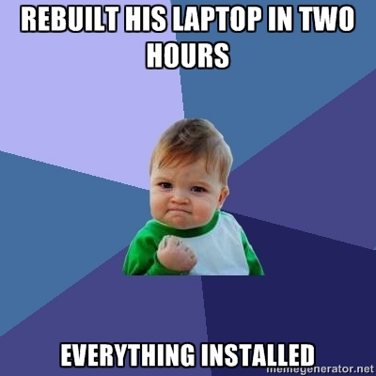
Questions?
ferventcoder – twitter, gmail, etc
Chocolatey - http://chocolatey.org

Slide 26


