Slide 1
AI assisted fuzzy primer Design: Leveraging GPUs and PyTorch for Fuzzy Sequence Matching.

Slide 2
Agenda
The Oligo Screening Problem. HPC Architecture & Parallelization. Deep Dive: Encoding Strategies (Decimal vs. One-Hot). Real-World Vectorized Matching. Datasets and data processing. Results Discussion Future Directions: Cancer Gene Signature Screening. Acknowledgements

Slide 3
The Oligo Screening Problem.
Why the project was conceived
and implemented.
Where AI assisted.

Slide 4
Why look for fuzzy oligos using AI
Sequence determines function
Evolutionary selective pressures tend to introduce mutations
Some positions are more important (conserved) than others
Fuzzy search allow discovery of related oligos still functioning similarly but harboring some differences
AI assisted in Prompt Engineering to screen several algorithms
AI was used to facilitate GPU/CPU orchestration.

Slide 5
2. HPC Architecture & Parallelisation.
Leveraging HPC for large dataset analysis.

Slide 6
HPC Architecture & Parallelization
With increasing number of sequences, the
difficulty of finding oligos with limited ambiguity
increases exponentially
When dealing with tens of millions of sequences,
traditional CPU-based searching is insufficient. We
need a highly parallel, memory-efficient solution.

Slide 7
HPC Architecture & Parallelization
Problem | Screening 4 to 40 Million oligo Sequences in Minutes to hours, Not Days.
Requirement 1 | Fuzzy Matching: We need to find oligos that match perfectly except for a pre-defined number of ambiguous positions (degenerate sites).
Requirement 2 | High-Performance Compute: Generating all degenerate patterns for just one oligo involves thousands of combinations. Multiply that by thousands of query oligos.
Solution | The Hybrid Architecture: CPU for complex combinatorics, GPU for brute-force vector comparison.

Slide 8
HPC Architecture & Parallelization
CPU Role | Orchestration & Combinatorics (30 Cores)
GPU Role | Massive Vectorized Comparison (4 GPUs)
Data Flow | Master Data (400GB RAM) GPU VRAM Match Counts GPU Query Patterns CPU
Key Component | GpuManager Class: Handles data splitting, GPU assignment, and memory management across devices (the heart of the parallel strategy).

Slide 9
3. Deep Dive:
Encoding Strategies (Decimal vs. One-Hot).
The three choices in DNA encoding:
    binary,
    decimal,
    one-hot

Slide 10
The three faces of DNA encoding:
A | C | G | T
1 | 2 | 3 | 4
1. DECIMAL ENCODING
A | C | G | T
00 | 01 | 10 | 11
2. BINARY ENCODING
 | A | C | G | T
A | 1 | 0 | 0 | 0
C | 0 | 1 | 0 | 0
G | 0 | 0 | 1 | 0
T | 0 | 0 | 0 | 1
3. ONE-HOT ENCODING

Slide 11
Why choose decimal encoding?
A | C | G | T
1 | 2 | 3 | 4
1. DECIMAL ENCODING
Encoding Used | Decimal Encoding (The torch.int8 Strategy) We map bases to single-digit integers: A=1, C=2, G=3, T=4, Wildcard/N=0. The entire sequence is stored as a single tensor of 8-bit signed integers.
Pro: Memory Footprint (CRITICAL) | Massive 4x Memory Saving. Each base takes 1 byte of memory. For 10 million sequences of length 20, we save 300+ GB of VRAM compared to standard 32-bit floats. This allows us to fit the entire master dataset on the GPUs.

Slide 12
Why choose decimal encoding?
A | C | G | T
1 | 2 | 3 | 4
1. DECIMAL ENCODING
Con: Flexibility | Limited to Simple Fuzzy Rules. This encoding is only effective for exact base match or wildcard/don't care (0). It cannot natively handle complex IUPAC degeneracies (like 'R' for A/G or 'Y' for C/T) without complex bitwise operations.
Conclusion | Decimal wins for speed/scale. The memory efficiency is worth the trade-off in complex matching rules, as the fuzzy rule is fixed (3 non-flanking ambiguities).

Slide 13
Why decimal encoding was chosen over one-hot encoding
Feature | Decimal Encoding (A=1, C=2, G=3, T=4) | One-Hot Encoding (e.g., A=1000, C=0100)
Memory/Base | 1 byte (torch.int8). | 4 to 8 bytes (depending on storage).
Matching Rule | master_base == pattern_base. | torch.dot(master_base, pattern_base) > 0.
Handling IUPAC | Must implement complex external mapping logic. | Natively supported. 'R' (A/G) is encoded as 1100, matching any base with 1 in the A or G channel.
Bandwidth | Extremely Low (minimal data transfer needed). | High (requires transferring much larger tensors).
Best For | Massive-scale, fixed-rule, simple fuzzy matching (our current script). | Complex, variable-rule, generic sequence alignment/scoring.

Slide 14
4. Real-time Vectorized Matching.
CPU - GPU orchestration

Slide 15
Vectorized Matching: The GPU Kernel
Goal | Match an (1 x L) pattern against an (N x L) master chunk.
Step 1: The Mask | Identify Fixed Bases. fixed_base_mask = (pattern_tensor != BASE_TO_INT['.'])
Step 2: Comparison | Compare All Bases. match_comparison = (master_chunk == pattern_tensor)
Step 3: Apply Fuzzy Rule | The torch.where Trick. positional_match = torch.where(fixed_base_mask, match_comparison, True)
Step 4: Final Count | Sequence Reduction & Summation. sequence_matches = positional_match.all(dim=1)
Optimization | Clearing VRAM: Immediate cleanup using del pattern_tensor and torch.cuda.empty_cache() after each pattern is processed.

Slide 16
5. Datasets and data processing.
All the oldies helped:
-bash
-grep
-wget/curl

Slide 17
Datasets: acquisition and munging
Curated databases were pulled (wget/curl) from ARB/SILVA and NCBI
Data was reduced to non redundant set (remove 100% identical sequences)
Data was transformed into a one-off overlapping oligos of 18-24 base length
Results were compiled and assessed for accuracy (grep) and efficiency time on task.

Slide 18
6. Results
Show me the money fuzzy!

Slide 19
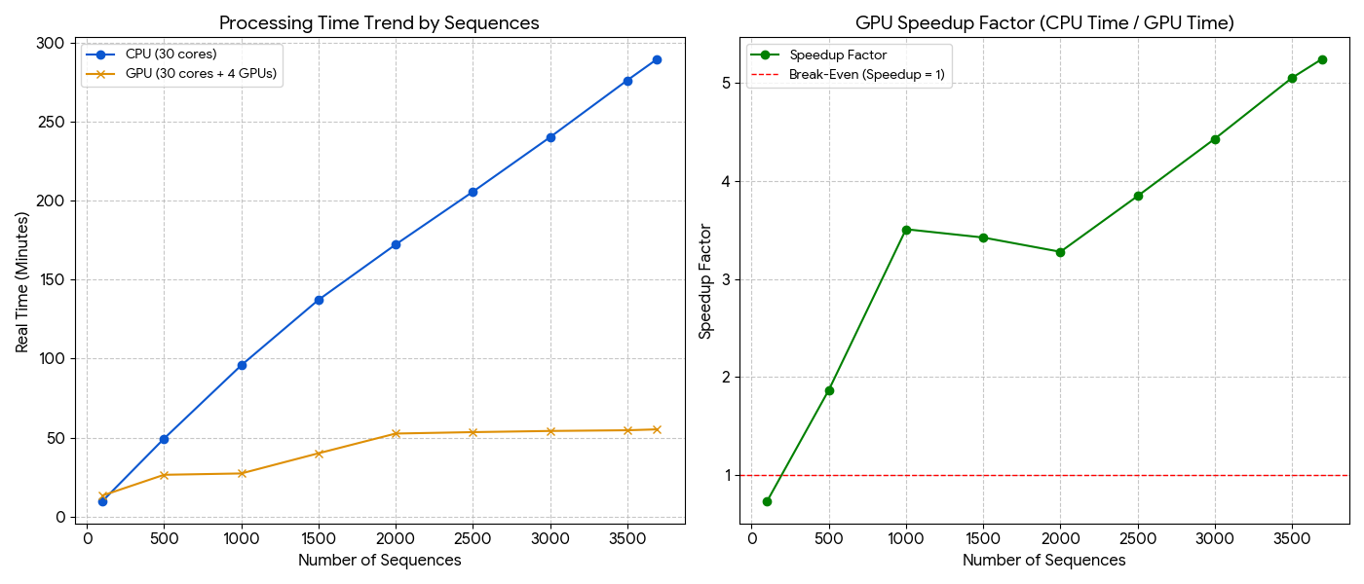
GPU orchestration gain of performance

Slide 20
Results: Benchmark 1 – Bacteria and Archaea (27,732 sequences)
Query ID | Degenerate Pattern | Ambiguous Positions | Match Count | % Match
>NR_118751.1_514 | TG.CAGC.GCCGCGGT.A | 3#8#17 | 27281 | 98.37
>NR_118751.1_1059 | CGTCAGCTCGT...GTGA | 12#13#14 | 26913 | 97.05
>NR_118751.1_1386 | TTG.AC.CAC.GCCCGTC | 4#7#11 | 26222 | 94.56
>NR_118751.1_338 | TCCT.CGGGAG..AGCAG | 5#12#13 | 25779 | 92.96
>NR_118751.1_1172 | AGGAAGG.G.GGA.GACG | 8#10#14 | 25597 | 92.30
>NR_118751.1_918 | GACGGGG..C.GCACAAG | 8#9#11 | 25479 | 91.88
>NR_118751.1_881 | GGG.AGTACG..CGCAAG | 4#11#12 | 25326 | 91.32

Slide 21
Results: Benchmark 2 – Fungi 18S (3,996 sequences)
Query ID | Degenerate Pattern | Ambiguous Positions | Match Count | % Match
NG_062708.1_1288 | T.AG.TACCGT.GTAGTC | 2-5-12 | 3615 | 97.91
NG_062708.1_862 | GTAATTCCAGCTC.A..A | 14-16-17 | 3614 | 97.89
NG_062708.1_470 | A...GAGGGCAAGTCTGG | 2-3-04 | 3610 | 97.78
NG_062708.1_348 | GCAGCAGGC.CG.AA.TT | 10-13-16 | 3588 | 97.18
NG_062708.1_1084 | AGC.TGGAATAAT..AAT | 4-14-15 | 3555 | 96.29
NG_062708.1_468 | C.A..GGAGGGCAAGTCT | 2-4-05 | 3554 | 96.26
NG_062708.1_476 | GGGCAAGTCTGGTG...G | 15-16-17 | 3515 | 95.21

Slide 22
7. discussion

Slide 23
Effective use of resources
One Hot encoding scripts takes too long to finish the task before overflowing available memory
Decimal encoded script finished task within minutes to hours – based on input size.
The script is flexible: the position and number of allowed ambiguous positions can be changed to fit requirements
The script is adoptable: the flexibility outlined above makes it target agnostic - beyond primer design oligos can be diagnostic of function or other biological targets.

Slide 24
8. Future Directions:
Cancer Gene oligo Signature Screening.
Where oligos matter count me in.

Slide 25
8. Future Directions
Adopting the Script for Medical Oligo Screening:
Use Case | Minimal Residual Disease (MRD) Screening in Cancer.
Oligo Role | Designing Target-Specific Probes.
The Adaption | High-Specificity Off-Target Check.
Fuzzy Need | Accounting for Polymorphisms.
Impact | Accelerated Diagnostic Development.

Slide 26
8. Future Directions
Adopting the Script for configurable call:
Use Case | Target users with limited Linux exposure
Planned Update | Designing Config-file based operation.
The Adaption | Use of a single config file to submit the workflow with ALL variables set in one place.
Need | Accommodate all users to get maximal use of the tool.
Impact | Accelerated Discovery by all potential users.

Slide 27
Summary & takeaways
Summary | Data Parallelism is key: CPU for logic, GPU for arithmetic.
Takeaway 1 | torch.int8 (Decimal Encoding) is the optimal choice for high-scale, memory-constrained sequence work, offering ~4X memory savings.
Takeaway 2 | Vectorization with torch.where implements the fuzzy match logic in one highly parallelized GPU instruction.
Takeaway 3 | This approach is directly applicable to clinical genomics, specifically in rapidly validating highly-specific oligo probes for MRD and gene signature screening.

Slide 28


9. Acknowledgements
NAIRR/JS2 Office Hours Panel

Slide 29
No questions?
Thank you!
Feseha Abebe-Akele
252-335-3975
fabebeakele@eceu.edu

