Slide 1
History of industry
Made by Sascha, Fabian, Felix and Nico

Slide 2
Content - WiP
Introduction
1st industrial revolution
2nd industrial revolution
3rd industrial revolution
4th industrial revolution / Industry 4.0

Slide 3
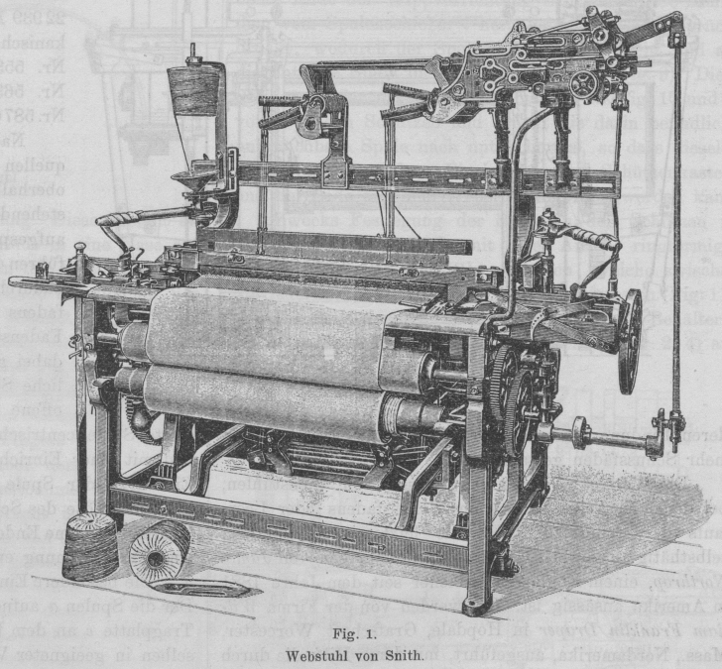
Industry 1.0
18th century
1st industrial machines (e.g. looms) powered by human
Mechanical machines powered by water and air
New jobs were created
First programming basics for
industry 3.0→inventor: Ada Lovelace

Slide 4
Industry 2.0
Started late 19th century
Electricity as main driving force
Automation of production through assembly lines
Broad use of telephone & telegram
First automobiles
First steps of globalization → global transport of goods
Start of aviation

Slide 5
Industry 3.0
Started during 1970s
1st Computer “Z3” released in 1941
Z3 was fully programmable / able to execute programs automatically
Pace of computer development increased
Focus on Automation / IT- infrastructure

Slide 6
Industry 4.0
Based on the internet and modern technologies like AR & VR
Communication of machines optimizing the flow of information
Big Data allows to correlate information from all parts involved in the production line
Majority of tasks and decisions are handled by machines; human interaction is the exception

Slide 7
Design Principles / Goals
Interconnection
IoT & IoP
Information transparency
Big Data, process overhaul
Technical assistance
Augmented reality, physical support
Decentralized decisions
mostly autonomous systems

Slide 8
Sources
industrie-wegweiser.de
wikipedia.org

