Slide 1
Calculating X-ray absorption spectra using RSPt
Felix Sorgenfrei
Uppsala University, Sweden

Slide 2
Outline
Introduction
Theoretical Methodology
Applications
Ferrites (Fe₃O₄, CoFe₂O₄, NiFe₂O₄)
Notes:
Xray spectroscopy ….

Slide 3
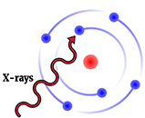
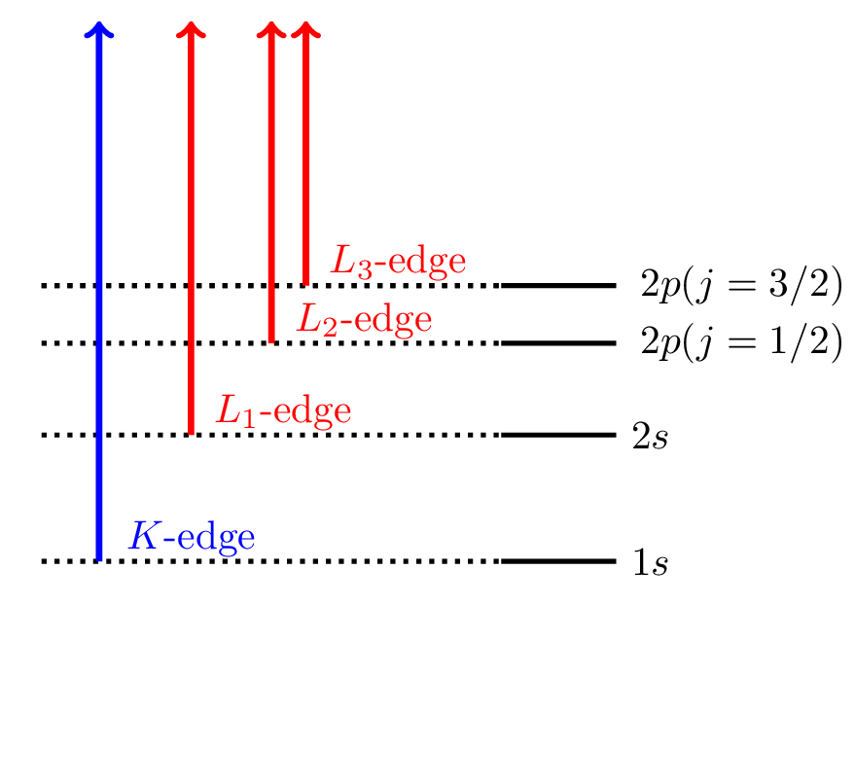
X-ray Absorption Spectroscopy (XAS)
Continuum
Naming Scheme of edges
Notes:
Xray spectroscopy ….

Slide 4
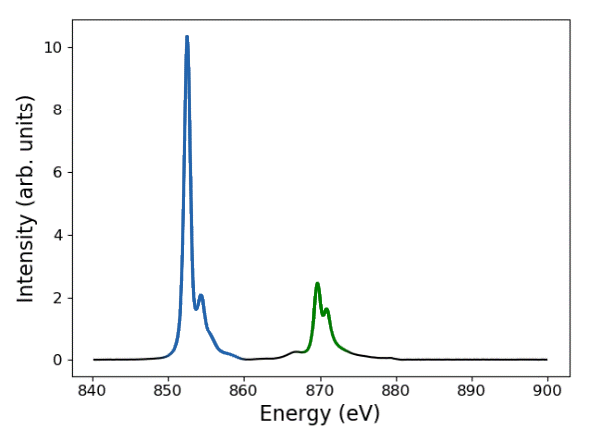
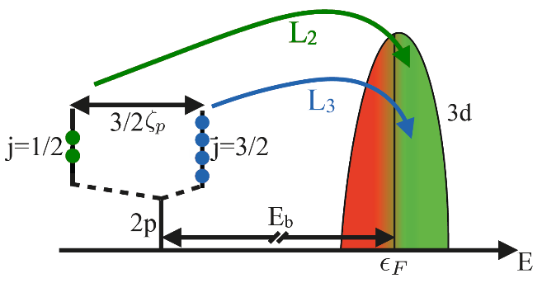
X-ray Absorption Spectroscopy (XAS)
Ni site of NiFe₂O₄
L₃
L₂
Johan Schött: Theoretical and Computational Studies of Strongly Correlated Electron Systems
Notes:
Xray spectroscopy ….

Slide 5
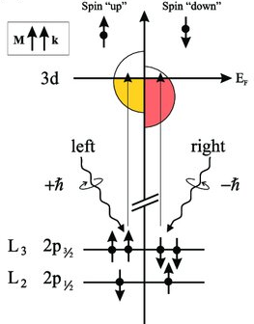
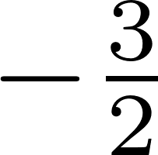
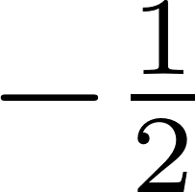
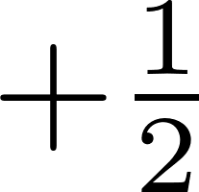
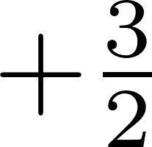
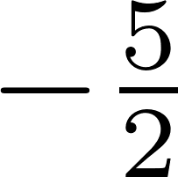
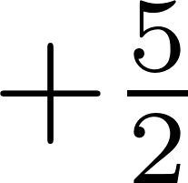
X-ray Magnetic Circular Dichroism (XMCD)
3d_{3/2}
3d_{5/2}
+ℏ (left)
2p_{1/2}
2p_{3/2}
Notes:
Xray spectroscopy ….

Slide 6
Importance of XAS & XMCD
Element and angular momentum specific
XAS gives insight into electronic structure
XMCD gives insight into magnetic structrure

Slide 7
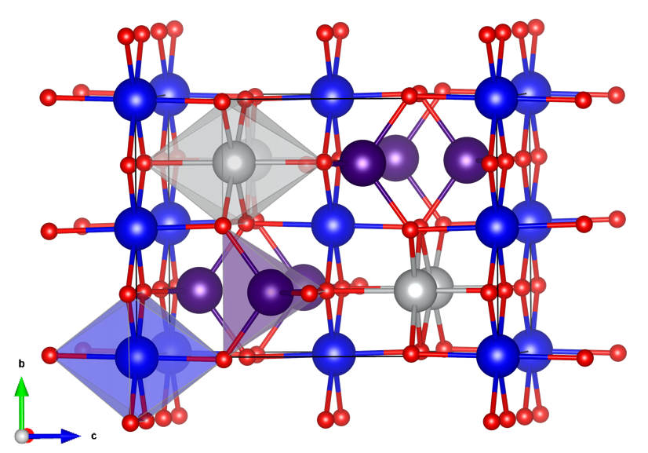
Our Approach: DFT+U+MLFT
Nearly parameter-free calculation of spectra with multiplet effects
NiFe₂O₄
XAS
XMCD
Intensity (arb. units)
7
experiment theory
Intensity (arb. units)
2
experiment theory
6
0
5
2
4
3
Ni
4
Ni
2
6
1
0
8
840 850 860 870 880 890 900
Energy (eV)
840 850 860 870 880 890 900
Energy (eV)
Theory
Experiment

Slide 8
Theoretical Methodology
Hybridization function
DFT (+U / +DMFT)
MLFT
(multi-configurational)
+ describes all many body effects
+ works well for localized systems
- strong parameter
dependence
MLFT: Multiplet Ligand Field Theory
+ parameter free
+ detailed description of chemical structure
(DFT) only describes groundstate
(DFT) electron-electron correlations too simplified
XAS & XMCD

Slide 9
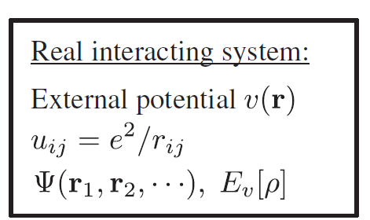
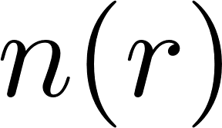
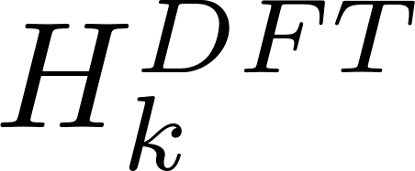
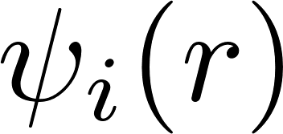
Density Functional Theory
Non-interacting system (DFT)
Calculate electron density
Calculate Potential
Solve for KS wavefunction
Construct DFT Hamiltonian

Slide 10
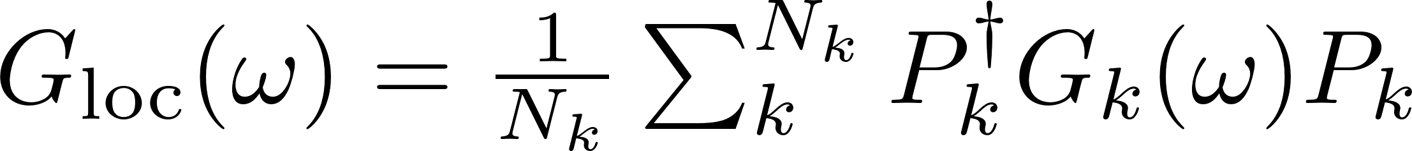
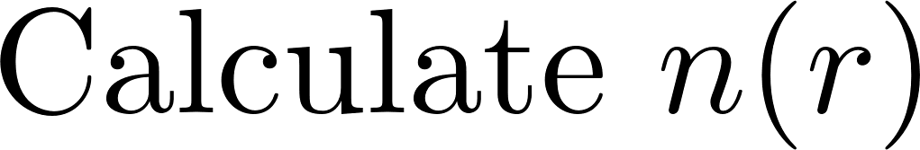

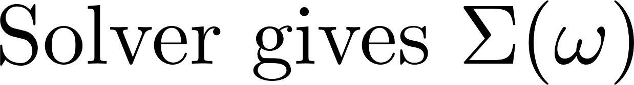
Dynamical Mean-Field Theory
DFT Part
DMFT Loop
MLFT
Hybridization function
yes
no

Slide 11
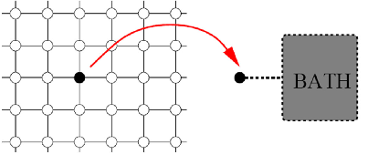
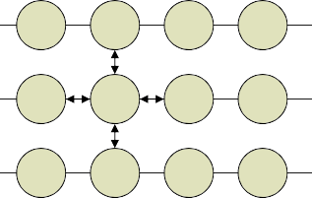
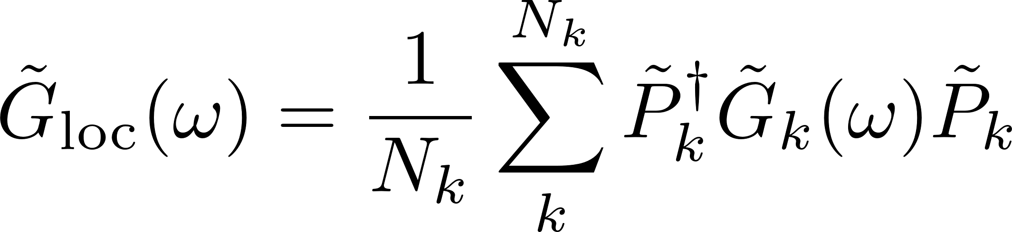
MLFT: generating impurity model
Lattice Green’s function:
Local Green’s function:
U
U
U
U
t U
t U
t
t
U
U
U
U
U
U
Hybridization function:
Figure: Leonid Pourosvskii Nordita 2016

Slide 12
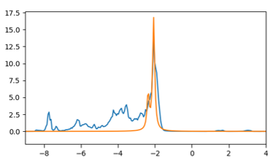

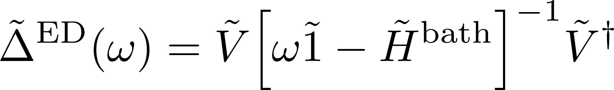
MLFT: Hybridization function
Hybridization function:
Fitted hybridization function:
Energy (eV)

Slide 13
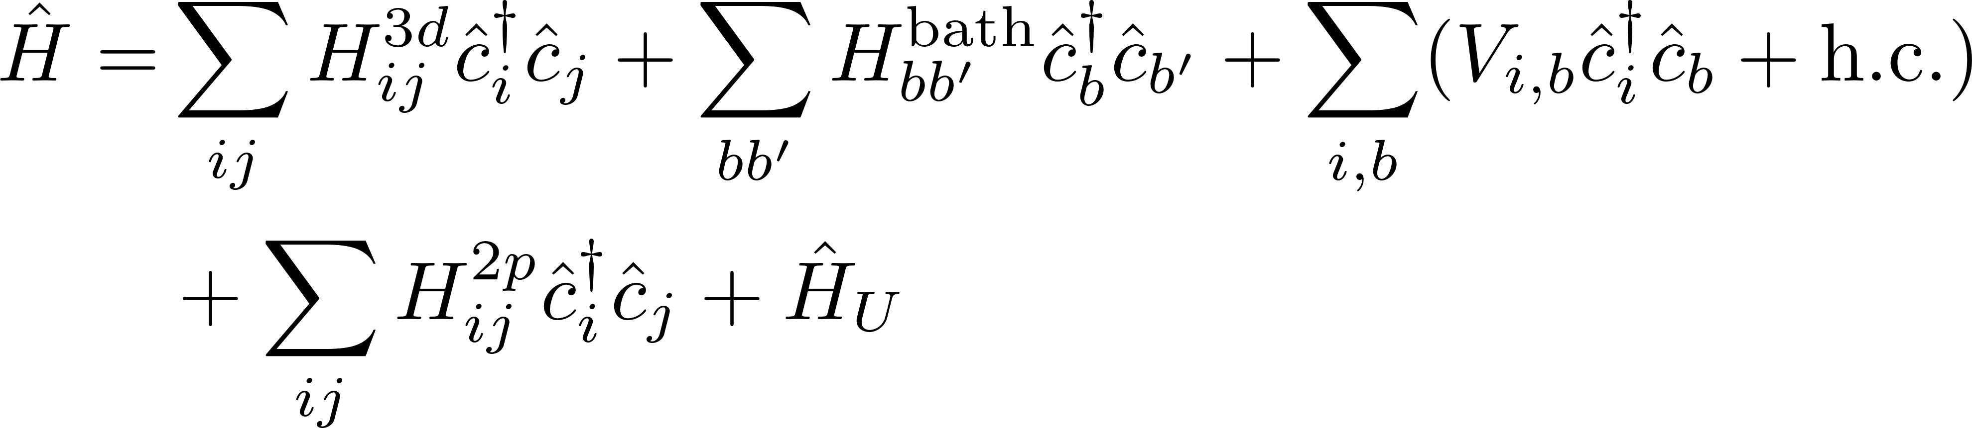
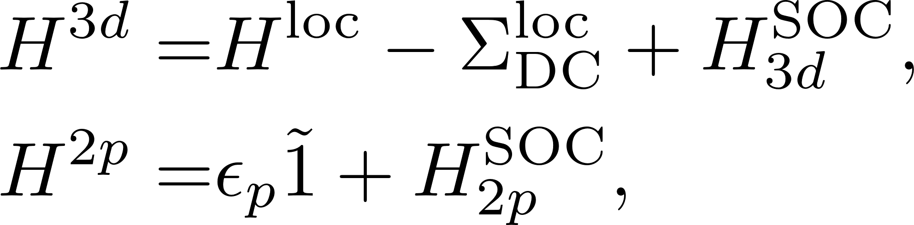
MLFT: Impurity Hamiltonian
U
U
U
U
with
t U
t U
t
t
U
U
U
U
U
U
Calculated from first-principles
Figure: Leonid Pourosvskii Nordita 2016
Fitted

Slide 14
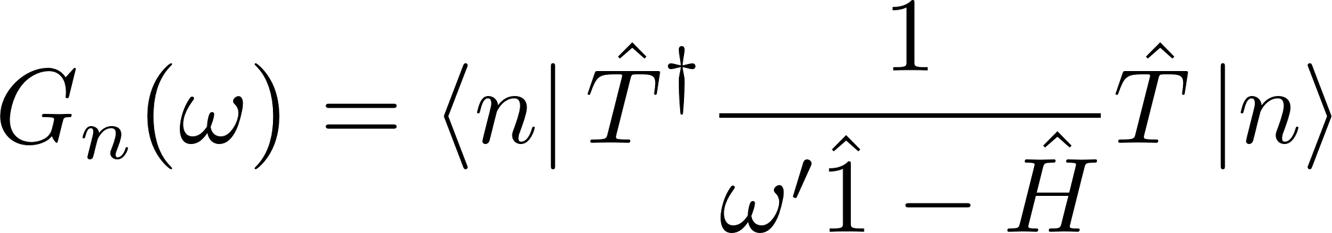
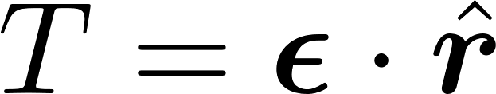
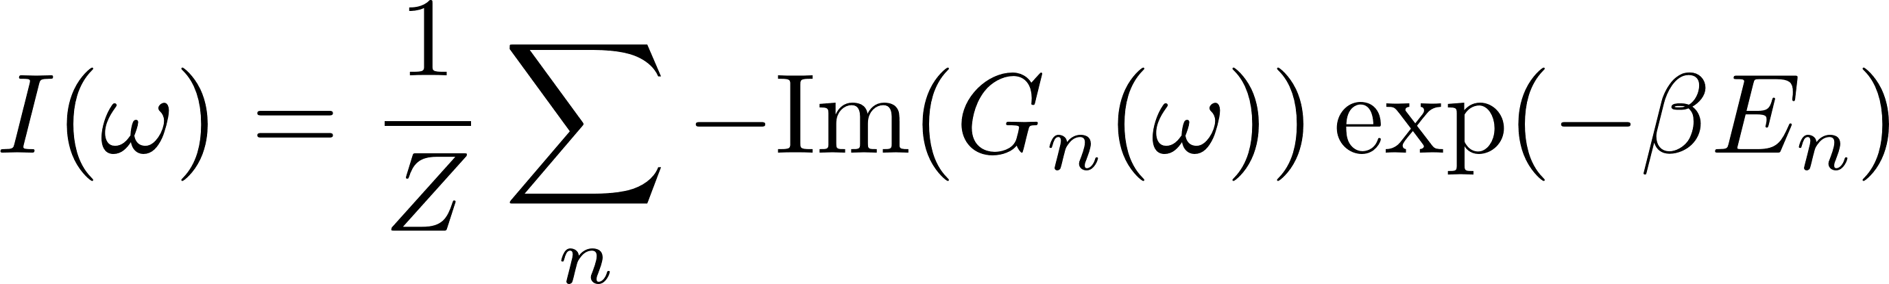
MLFT: Spectra
Green’s Function
with
Spectral Function

Slide 15
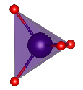
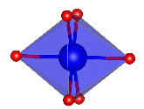
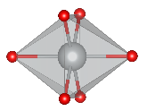
Ferrites
3+
Fe T_{d}
Fe (T_{d})
(minority)
Fe/Ni/Co (O_{h})
Fe (O_{h})
3+
O
Fe O_{h}
(majority)
2+
Fe/Ni/Co O_{h}
(majority)

Slide 16
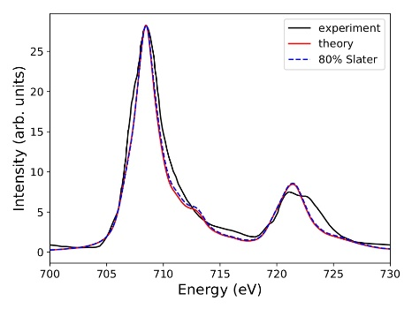
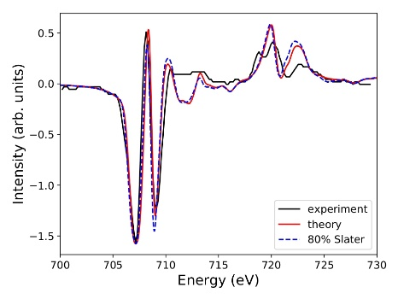
Fe₃O₄
Fe T_{d}
(minority)
XAS of Fe
XMCD of Fe
L₃
L₂
L₂
L₃
Experiment
Fe O_{h}
Fe O_{h}
(majority)
(majority)
Theory (70-90% Slater)
Theory (80% Slater)

Slide 17
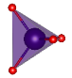


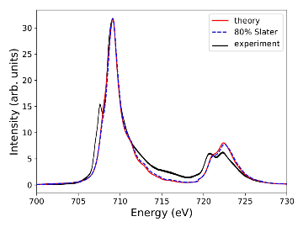
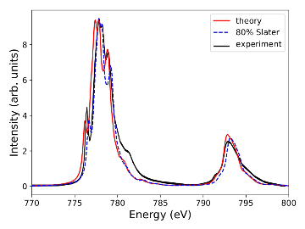
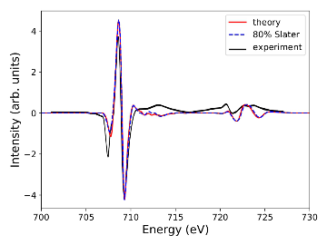
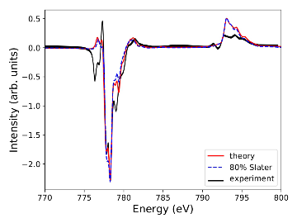
CoFe₂O₄
Fe
Co
XAS
XMCD
Experiment
Theory (70-90% Slater)
Theory (80% Slater)

Slide 18
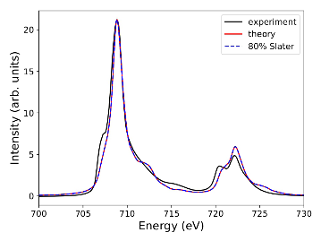
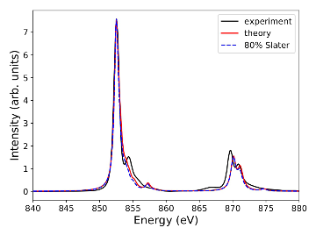
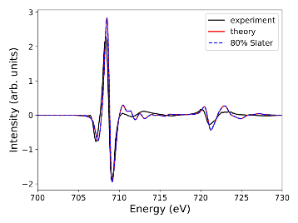
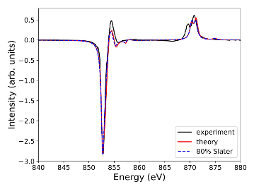
NiFe₂O₄
Fe
Ni
XAS
XMCD
Experiment
Theory (70-90% Slater)
Theory (80% Slater)

Slide 19
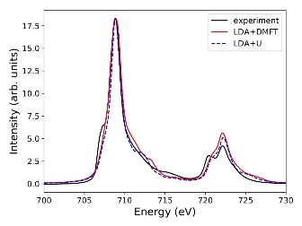
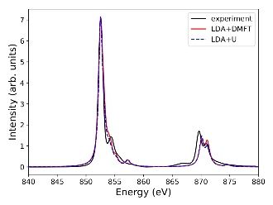
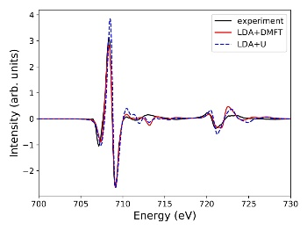
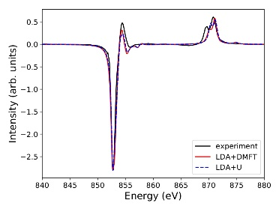
NiFe₂O₄: DMFT
Fe
Ni
XAS
XMCD
Experiment
LDA+DMFT
LDA+U

Slide 20
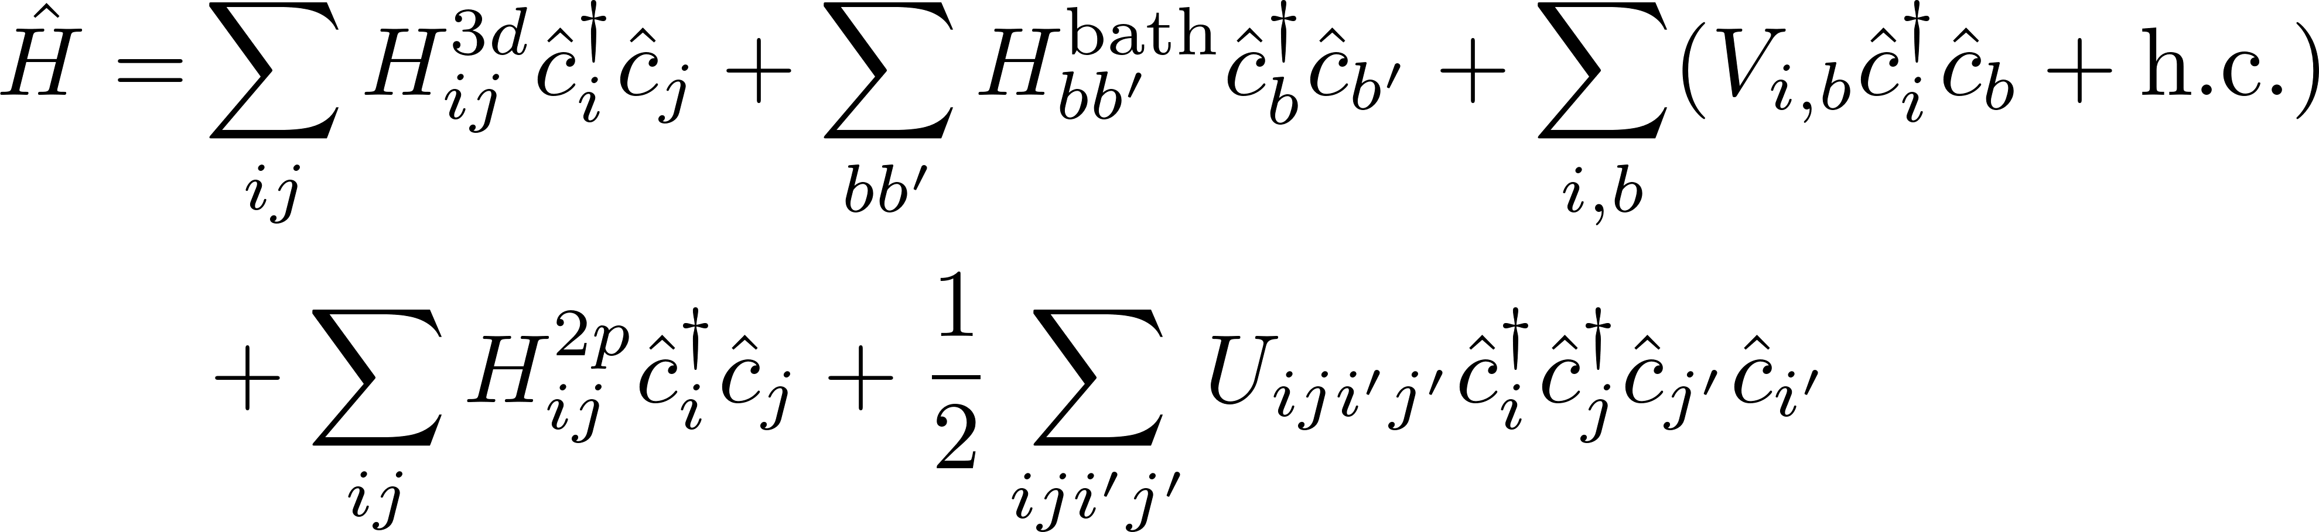
MLFT: Impurity Hamiltonian
U
U
U
U
with
t U
t U
t
t
U
U
U
U
U
U
Calculated from first-principles
Figure: Leonid Pourosvskii Nordita 2016
Fitted

Slide 21
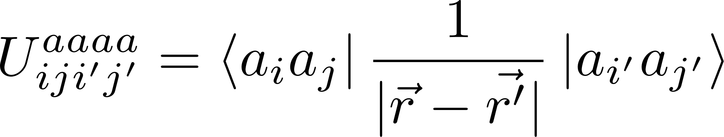
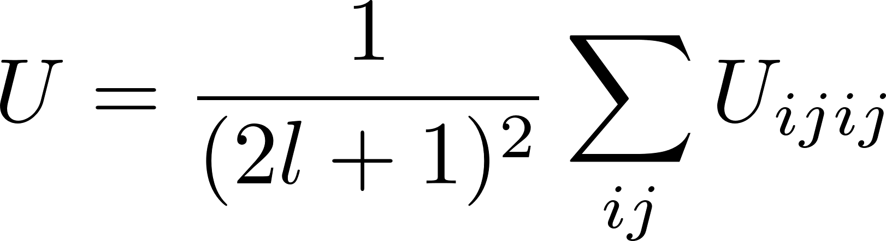

MLFT: Hubbard U and J
Notes:
https://link.springer.com/article/10.1007/s00205-021-01692-x

Slide 22


MLFT: Calculating the U matrix
radial
angular
Notes:
https://link.springer.com/article/10.1007/s00205-021-01692-x

Slide 23


MLFT: Calculating the U matrix
Angular part
Expectation value can be factorized into angular and radial part if separates
Depends only on Y
well known solution
Notes:
https://link.springer.com/article/10.1007/s00205-021-01692-x

Slide 24
MLFT: Calculating the U matrix
Radial part
Depends on radial part of
Called Slater integrals
Numerically evaluated
Notes:
https://link.springer.com/article/10.1007/s00205-021-01692-x

Slide 25






MLFT: Impurity Hamiltonian
Direct interaction
where $F^{k}$ , k = 0, 2, 4, … (k ≤ 2l) are multipole expansion coefficients
Exchange interaction
where $G^{k}$ , k = 1, 3, 5, … (k ≤ 2l) are multipole expansion coefficients
Notes:
https://link.springer.com/article/10.1007/s00205-021-01692-x

Slide 26


MLFT: Screening at the L-edge
Notes:
https://link.springer.com/article/10.1007/s00205-021-01692-x

Slide 27





cDFT: Calculation of $F_{dd}^{0}$

Slide 28

cDFT: Calculation of $F_{pd}^{0}$

Slide 29

Results
Compound | $${ F}_{dd}^{0}$$ |  | $${ F}_{pd}^{0}$$
 | Calculated | Ref. [1] | Calculated | Ref. [1]
FeO | 5.34 | 6.50 | 7.55 | 7.50
NiO | 7.21 | 7.50 | 8.73 | 8.90
[1] Fitted by Lüder et al. 2017

Slide 30



NiFe₂O₄: Influence of $G_{pd}^{1}$
XAS
XMCD
90% of bare value
80% of bare value
70% of bare value

Slide 31






NiFe₂O₄: Influence of $F_{pd}^{0}$
XAS
XMCD
$${1.3 F}_{dd}^{0}$$
${ F}_{dd}^{0}$+ 1 eV
${ F}_{dd}^{0}$+ 0.5 eV

Slide 32

MLFT: Double Counting
The Es are averaged over all possible states

Slide 33

MLFT: Double Counting
parameter
Shifts energy of the ligands
Spin independent (no exchange)
LSDA can lead to weird branching ratios
Use LDA instead

Slide 34
Conclusion
Nearly parameter-free calculation of spectra with multiplet effects
Calculates XAS branching ratios correctly
Works well for strongly localized and hybridized systems
NiFe₂O₄
XAS
XMCD
7
experiment theory
2
experiment theory
Intensity (arb. units)
6
Intensity (arb. units)
0
5
2
4
3
Ni
4
Ni
2
6
1
0
8
840 850 860 870 880 890 900
Energy (eV)
840 850 860 870 880 890 900
Energy (eV)
Theory
Experiment

