Slide 1
Intro to Deep Learning
Atanas Mirchev

Slide 2
Machine learning

Slide 3
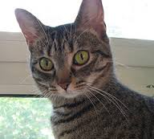
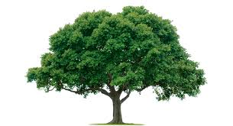
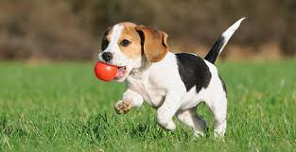
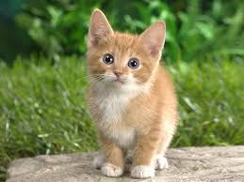
The problem statement
We focus on supervised learning (we do not cover unsupervised and reinforcement learning)
We want a recommender or predictor
Equivalent formulation: learn a function f : X →Y
Example: f(<dog image>) = “yes”, f(<cat image>) = “no” is a dog vs. cat classifier
Better formulation: learn a function f : X →𝛳
cat
dog
tree
dog
cat
cat
tree
X space
𝛳 space
dog
f
tree
𝜃 = ( 0.8, 0.15, 0.05)

Slide 4
What should the function be?
The function f should be as unrestricted as possible, because real world classification & prediction tasks are very complex
Linear functions will not suffice, hence Deep Learning
The form of the function should be learned automatically
We will present training examples of mappings (object -> prediction) and the function will gradually change to fit those examples

Slide 5

Training in machine learning
The function f should map objects from X space to parameters of probability distributions 𝜽
𝜽 = (0.8, 0.15, 0.05) could define a prob. distribution (uncertainty) over 3 states (cat, dog, tree)
𝜽 = (𝝁, σ) = ( 3.32, 2.6) could define a normal (gaussian) prob. distribution over ∞ many states, which is used when we want to predict real numbers
The way we train the neural network is determined by how we interpret the outputs 𝜽. This defines our LOSS function.

Slide 6
Loss functions
Main idea: maximize the likelihood of the mappings (object -> prediction) in the training data with respect to f (Max. likelihood estimation, MLE)
slightly better: maximize the probability of the parameters W_{i} in the network given the mappings in the training data (Max. a-posteriori, MAP)
Based on this, one can derive different loss functions depending on the different tasks:
Regression (number predictions): sum of squared errors
Binary classification (2 classes): binary cross-entropy
Multi-class classification: categorical cross-entropy
We skip the derivation of the loss formulas at this point

Slide 7
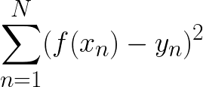
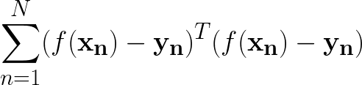

Loss functions
Sum of squared errors:
Binary cross-entropy:
Many more loss functions can be formulated. Most of the common ones are directly implemented in modern deep learning frameworks.

Slide 8
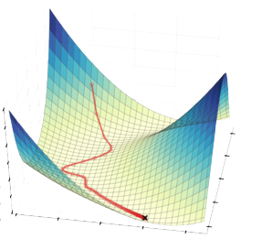
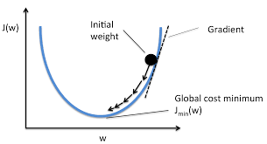
Training procedure
Separate data into training, validation and test sets
training
validation
test
Form mini-batches (e.g. 32 samples) from the training set
Pass each mini-batch through the network at once, and adjust the network parameters to optimize the loss function for this mini-batch - gradient descent
Source: http://librimind.com/2016/03/optimizations-of-gradient-descent/
Source: https://sebastianraschka.com/faq/docs/closed-form-vs-gd.html

Slide 9

Training procedure
Frequently check the performance of the model on the validation set
When the validation loss improves, save your model weights
Continue training until there is no significant improvement in the validation loss over time

Slide 10
Deep Learning

Slide 11
Problems in previous techniques
There was no established way to train functions of arbitrary complexity
Thus, often linear models were used (e.g. linear regression), which provide optimality guarantees
Or one can use convex optimization, but not every problem can be easily reformulated -> difficult
To compensate for the simplicity of the function, people used to extract “hand-crafted features” from the data, which should make the problem easier
E.g. HOG, SURF, ORB, etc., for computer vision tasks; similarly done in other fields
Problem: no guarantee that the selected features are optimal
To some extend, these approaches were also enforced by the limited computational power in the past

Slide 12



Idea behind deep learning
Or written in another way:
W₁
𝜎
W₂
𝜎
W₃
𝜎
W_{L-1}
𝜎
W_{L}
𝜎
...
x
𝜃

Slide 13
Intuition
With the layering of non-linearities σ with locally linear functions given by the W_{i} we get functions that can express (arguably) virtually anything
Thus deep learning has the capacity of modelling most real world phenomena
Alternative interpretation: with each layer, the network extracts more abstract, global features of the input that are then used to make predictions
Example: the first layers extract small edges, in the following layers the edges are combined to form shapes, in further layers the shapes are combined to understand objects, in the last layers objects are combined to understand the whole scene.
This automatizes the feature extraction (older approaches use hand-crafted features for ML)

Slide 14
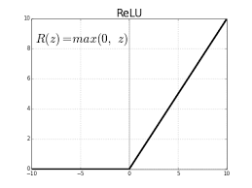
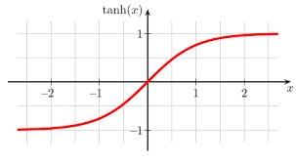
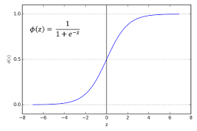
Activations
The σ in the diagram before are called activation functions or non-linearities
They are the key that makes a deep neural network powerful, without them it would be just a linear function
There are different types of σ in usage; in recent years ReLU is mostly used
ReLU
tanh
sigmoid

Slide 15
Notes on training deep networks
The training procedure is called backpropagation (backprop)
It’s essentially the chain rule of derivatives applied to our composed function f. The rest is standard gradient descent.
Here are some important notes:
Gradients in the network tend to become smaller and smaller as they are propagated further back from the last layer (vanishing gradient problem)
The usual solution is to use ReLU activations in the hidden layers (tanh and sigmoid saturate on both ends => gradient ~ 0)
In very deep networks ReLU has the problem of exploding gradients - use gradient clipping (restricting the gradient with a threshold) to remedy this
In today’s deep learning, to have meaningful training and gradient flows, the outputs of each hidden layer should be distributed around 0 -> check during training, use batch normalization layers if this is not the case, to make training faster and more efficient

Slide 16
Neural networks
The layering described before is realized via neural networks
they were originally conceived as a way to mimic the function of the brain, hence “neural”
There are three major categories of networks (or layers):
Fully connected (dense) neural networks
Convolutional neural networks
Recurrent neural networks
Note that, since two functions f and g can be composed together: f(g(x)), we can also compose whole networks and form different network architectures by connecting different “blocks” of the 3 types above.
There are additional “add-ons” (again, layers) that can be added to an architecture to improve the learning & performance: e.g. dropout, batch-norm, etc.

Slide 17

Fully connected
The all-to-all connections correspond to matrix multiplications of the vectors a_{i-1} and the matrices W_{i}
a₄ = 𝜃 = f(x)
x
a₁
a₂
a₃
W₁
W₂
W₃
W₄

Slide 18
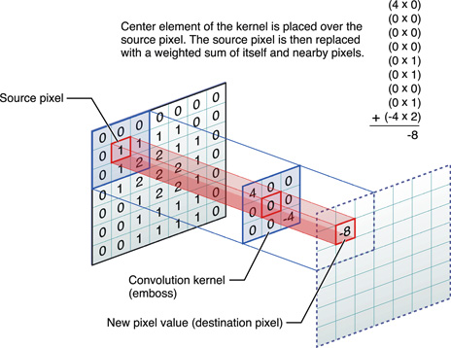
Convolutions
Source: http://stats.stackexchange.com/questions/116362/what-does-the-convolution-step-in-a-convolutional-neural-network-do
Source: https://developer.apple.com/library/content/documentation/Performance/Conceptual/vImage/ConvolutionOperations/ConvolutionOperations.html

Slide 19
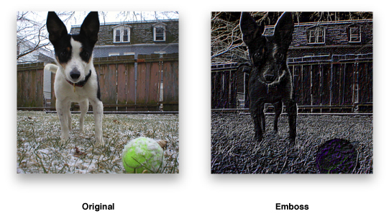
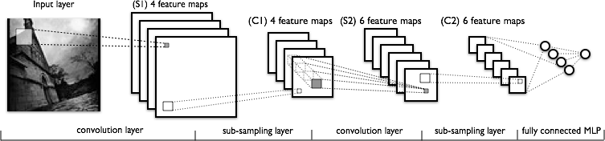
Convolutional networks
Multiple filters in every layer of the network
Source: https://developer.apple.com/library/content/documentation/Performance/Conceptual/vImage/ConvolutionOperations/ConvolutionOperations.html
Source: http://deeplearning.net/tutorial/lenet.html

Slide 20
Difference: convolutional vs. fully connected
output features
Input features
Fully connected layer
Convolutional layer (one filter)
Convolutional layers are sensitive to local features
In the context of one filter in the convolutional layer, the same weights are shared for the filtering of different local patches in the image.

Slide 21

Recurrent networks
A generalization of the other networks, which allows us to have (theoretically) “infinitely deep” models
The best way to think about recurrent networks is as context machines
Source: http://colah.github.io/posts/2015-08-Understanding-LSTMs/

Slide 22
Hands-on workshop

Slide 23
Computational frameworks
Both Theano and TensorFlow build computational graphs which are then compiled into executable functions
A
B
An expression (formula):
X = A / C + B / C
+
f
temp
C
/
X

Slide 24
Key points
Raising the model complexity
Effect of augmentation
Effect of dropout, after augmentation
Effect of dropout on its own
Improving performance further
Wider network
Deeper network

Slide 25
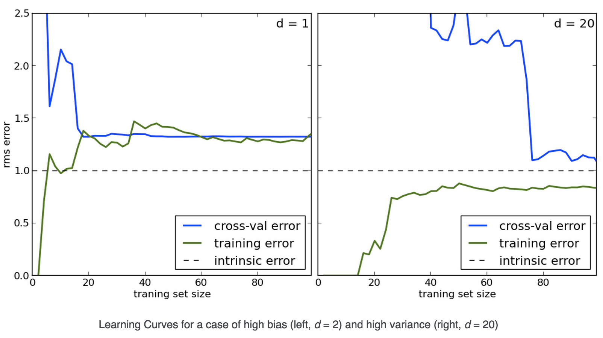
Bias-variance decomposition
Source: http://datascience.stackexchange.com/questions/5268/how-to-detect-overfitting-of-a-stock-screener

Slide 26
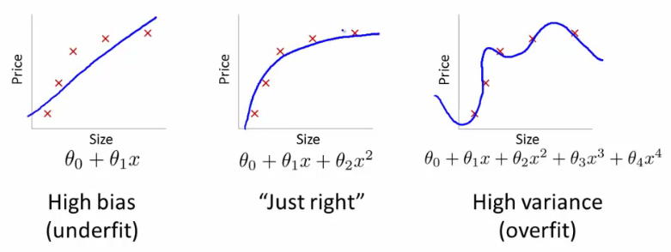
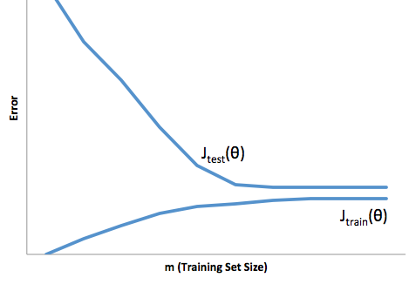
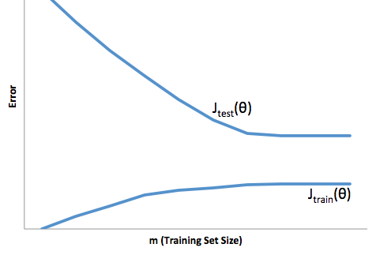
Overfitting & Underfitting
Source: http://datascience.stackexchange.com/questions/361/when-is-a-model-underfitted

Slide 27
Regularization: dropout
Source: https://chatbotslife.com/regularization-in-deep-learning-f649a45d6e0#.vrteyvoai

Slide 28
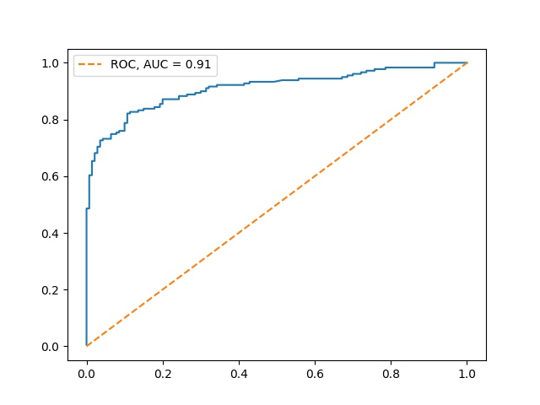
Evaluating performance
For both regression and classification: the overall loss (NLL, negative log-likelihood) are good indicators of the performance
Specifically for classification: ROC curves (not just accuracy!)
TPR - proportion of all positive samples predicted correctly to be positive
FPR - proportion of all negative samples predicted wrongly to be positive
TPR
FPR

Slide 29
Links and references
Curated paper lists
https://github.com/ChristosChristofidis/awesome-deep-learning
https://github.com/kjw0612/awesome-deep-vision
https://github.com/terryum/awesome-deep-learning-papers
Tooling
https://github.com/tensorflow/tensorflow
https://github.com/Theano/Theano
https://github.com/dmlc/mxnet -> has a GoLang API
https://github.com/fchollet/keras/tree/master/keras
https://github.com/Lasagne/Lasagne
Books
“Pattern Recognition and Machine Learning” - Christopher Bishop

