Slide 1


Unleash Your INNOVATION WITH ARDUINO
MANOLO, festo

Slide 2
purpose
Discover how Arduino can empower you to turn your ideas into real projects.
Learn how to create interactive devices, gadgets, and robots.
Gain hands-on experience in programming and electronics.

Slide 3
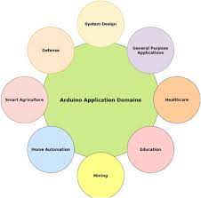
applications

Slide 4
arduino
Arduino is an open-source electronics platform that combines hardware and software to create interactive electronic projects.
It consists of microcontrollers (the brains) and the Arduino Integrated Development Environment (IDE) for programming.

Slide 5
Why arduino
Versatility:
Learning and Prototyping:
Innovation and Creativity:

Slide 6
Like …
IoT (Internet of Things):
Energy Management
Accessibility Devices
Security Systems
Entertainment and Gaming
Automotive Customization:
Aquaponics and Hydroponics
Weather Stations:
Home Automation
Health and Wellness
Education:
Robotics:
Environmental Monitoring
Agriculture

Slide 7
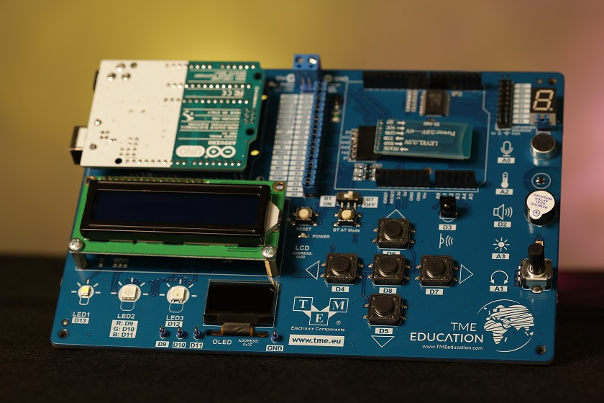
TME

Slide 8
Without further ado…
ALARMING TRAFFIC LIGTHTS
VERY CHARMING FIRE ALARM
MUSIC VIRTUARIZER
AUTOMATED LIGHTS
QUITE BULBS

