Slide 1

ECE 4300
Term Project
Group D:
Raymond Banda
Freddy Estrada
Kyle Gerfin
Jeffrey Hymas
John Wilson

Slide 2
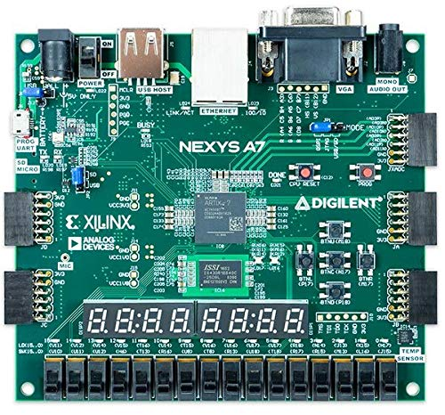
Implementation
Microblaze Soft Processor Core
Running on Xilinx Nexys A7
Implementing AES Encryption/Decryption Algorithm Options
Software implementation utilizing C++ libraries
Hardware implementation utilizing Vivado AES IP/custom written hardware

Slide 3
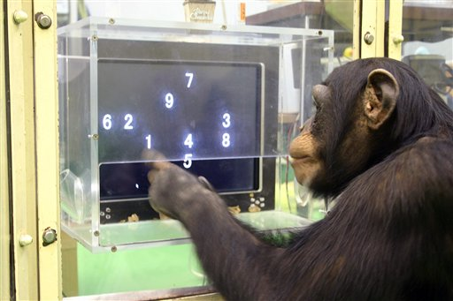
Performance Evaluation
Potential Evaluation Metrics
Execution Time
CPI
MFLOPS/MIPS
Amdahl's law
Throughput

Slide 4
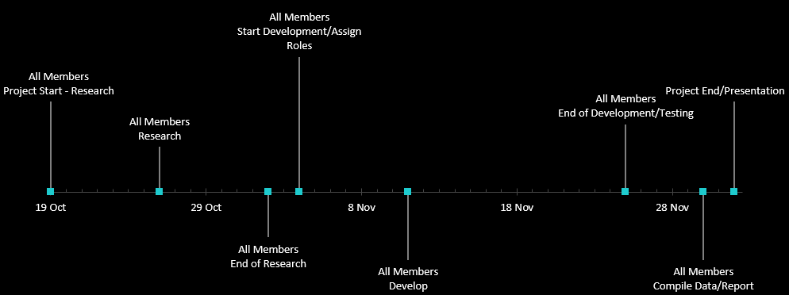
Project Timeline

