Slide 1


AES Encryption Core with Microblaze on Xilinx Nexys A7: Performance and Benchmarking
Jeffrey Hymas, John Wilson, Raymond Banda, Kyle Gerfen, Freddy Estrada
ECE4300: Computer Architecture
Dr. Mohamad El-Hadedy

Slide 2
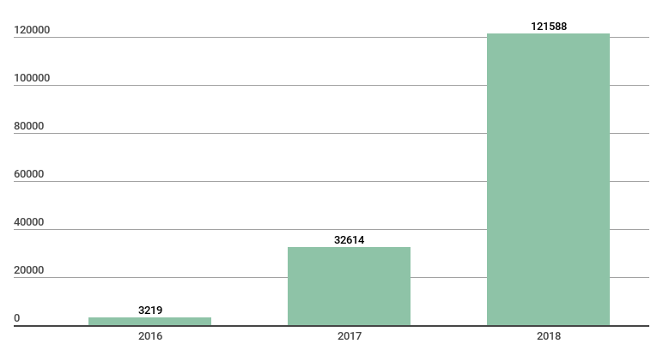
Project Background and Goals
IOT Maleware Catalogued by Kaspersky
Design and implement an AES encryption system on FPGA
Benchmark system to determine:
Encryption execution time
Power consumption
Board resource usage
https://securelist.com/new-trends-in-the-world-of-iot-threats/87991/

Slide 3
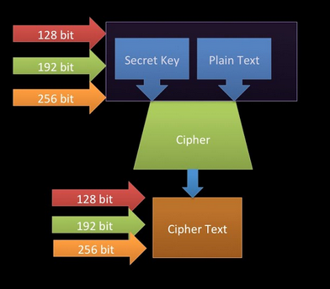
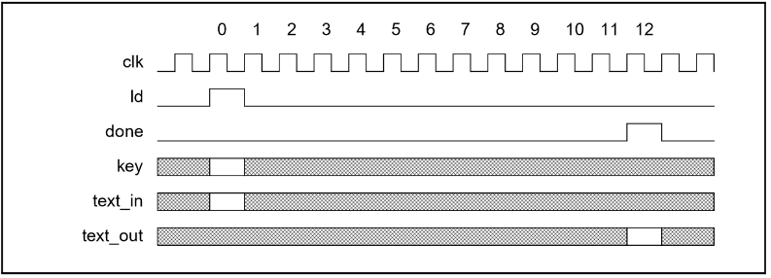
AES Design and Timing

Slide 4
Xilinx Microblaze and AXI
MicroBlaze soft-core processor
RISC Harvard architecture
Designed for Xilinx FPGAs, implemented entirely on FPGA fabric
Advanced eXtensible Interface (AXI)
Communication Protocol
Three Types of AXI Interfaces Provided by Xilinx
AXI-Full
AXI-Lite
AXI-Stream
AXI4-Lite- lightweight single 32-bit transaction memory mapped
Processor
IP Core
AXI

Slide 5
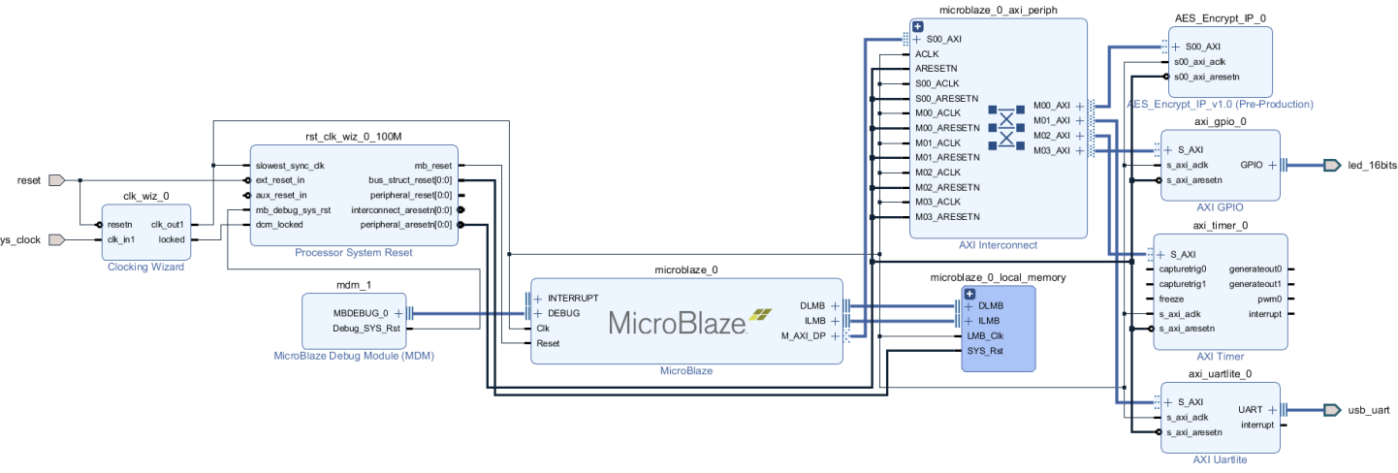
Design

Slide 6
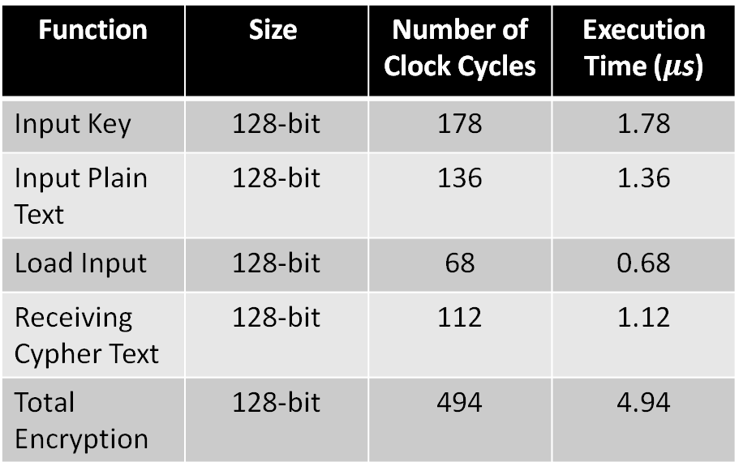
Results and Evaluation: Timing
Function | Size | Number of Clock Cycles | Execution Time ($μ$s)
Input Key | 128-bit | 178 | 1.78
Input Plain Text | 128-bit | 136 | 1.36
Load Input | 128-bit | 68 | 0.68
Receiving Cypher Text | 128-bit | 112 | 1.12
Total Encryption | 128-bit | 494 | 4.94
Size of Encrypted Data | Execution Time (seconds)
100MB | 20.54
1GB | 205.4
1TB | 205400
Notes:
Thanks Jeff
I’m Johnny Wilson and I’ll be covering The Results and evaluation portion of the presentation and I’ll also talk a bit about future work
Here we have our timing charts:
By clocking each instruction block we can see how long it takes for each operation to execute, with the total time to encrypt a single block of data being 4.94 micro-seconds
For our primary test, we encrypted 100MB of data and later 1GB of data.
Because both of those test correlated perfectly, we were confident in extrapolating that outward to see how long it would take encrypt a terabyte of data

Slide 7
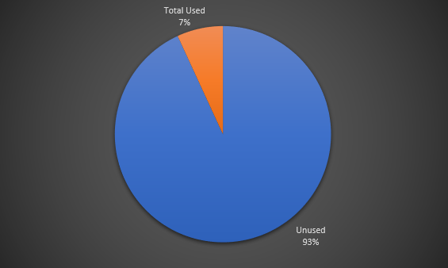
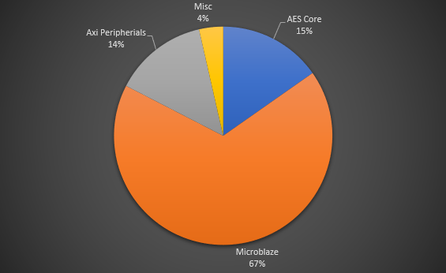
Results and Evaluation: Board Resources
Component | LUTs Used
Total Available | 63400
AES CORE | 665
Microblaze | 2934
AXI Peripherals | 605
Misc | 155
Total Used | 4359
Total Unused | 59041
Notes:
Here we are showing the total using of look up tables for our AES core implementation.
We only used about 7% of our total resources, most of that being the soft-core processor.
This leads us to believe that we may be able to implement more processors in the future

Slide 8
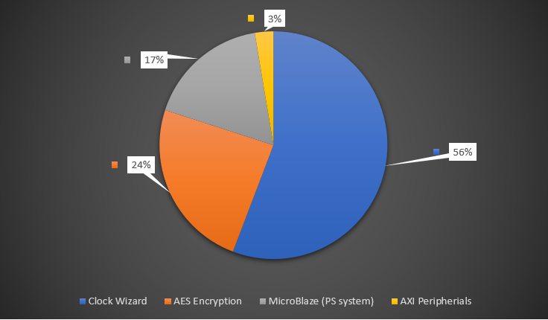
Results and Evaluation: Power Usage
Component | Power Useage (W) | Useage %
Clock Wizard | 0.106 | 55.79
AES Core | 0.046 | 24.21
Microblaze | 0.033 | 17.37
AXI Peripherials | 0.005 | 2.63
Total Used | 0.19
Notes:
Moving on to Power usage:
The total power used in this implementation is only 0.19 watts
The Clock wizard uses the majority of that power, meaning that implementing more cores and soft-processors will not significantly increase power draw
In a field test, we found that an 100MB encryption test run used 0.01 Wh of energy and 1mAh of power,
This means that we could run this encryption system for 9hours on a 5v, 2200 mAh battery pack

Slide 9
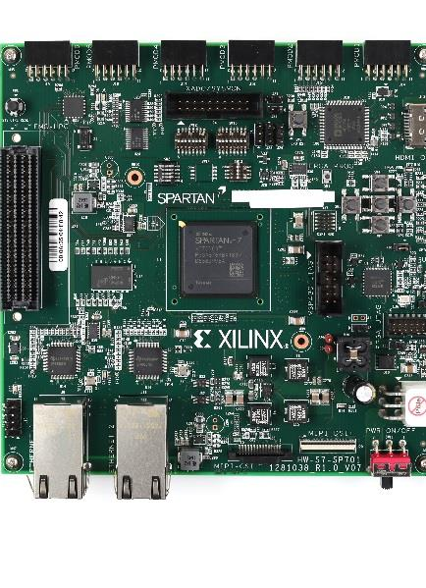
Future Work
Integrate serial communication (IC2, RS-232)
Implement FIFO data flow-through to accomadate data streaming
Implement multiple soft-core processors for further streamlining of encryption and transmission of data
Use multiple FPGA boards to create a point-to-point system, utilizing on-board Ethernet PHY RJ-45 connections
Research more robust and capable FPGA development boards to accommodate the proposed changes for future work.
Notes:
Looking forward, the team would like to focus on integrating a communication protocol so that we can send and receive data with the end goal of implementing data streaming
To process the influx of data, the team would likely attempt to integrate more soft-processors to reduce bottle-necking
If successful, the team would attempt to set up a proof-of-concept between 2 FPGA development boards for encryption and decryption
It is inevitable that the scope of these changes would outpace the capability of the Nexys A7 board we are currently using.
We are currently researching more robust FPGA dev board solutions to accommodate the changes
And that raps up our presentation on the AES encryption core Developed for the Artix A7
We want to thank our co-authors, Freddy Estrada, Kyle Gerfen and Raymond Banda for all their hard work on this project
And warm thank you to Professor Mohammad El-Hadeddy for his guidance

