Slide 1

Fetal Tissue Annotation and Segmentation
MICCAI 2024 Challenge
CeSNE DIGAIR team

Slide 2

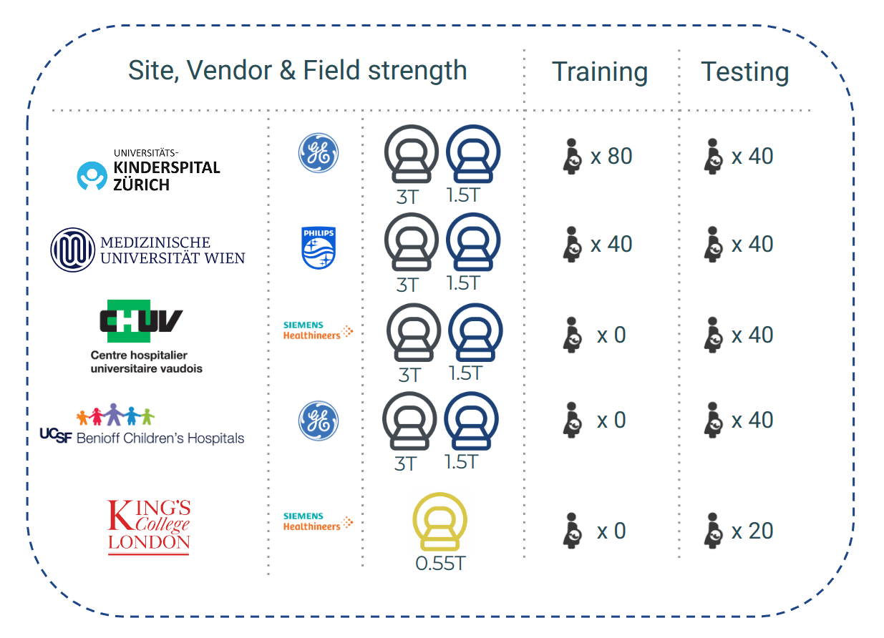

Data and constraints
Data constraints
different scanners and field strengths
post processing heterogeneity - SR algorithms (NistyMIC, MialSRTK, IRTK) - final voxel size (0.4 mm³ – 1 mm³) - image size (number of voxels)
test-set with unseen data
Other constraints:
NVIDIA GeForce GTX 1080 Ti (12Gb RAM)

Slide 3
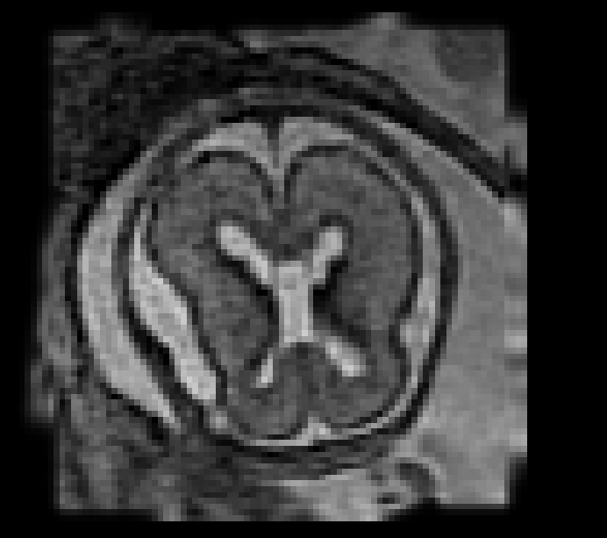
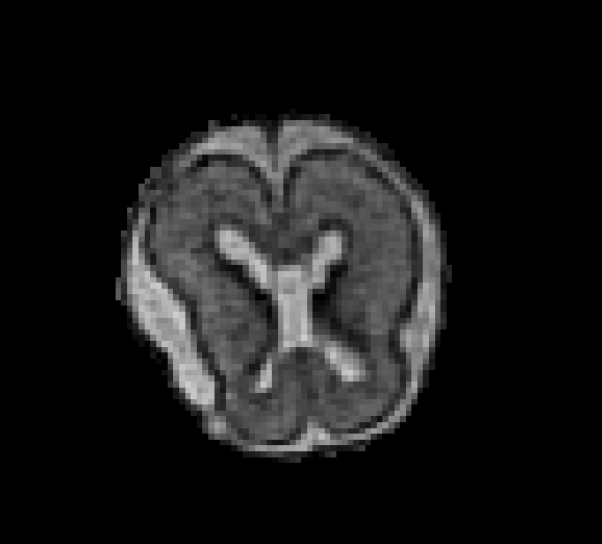
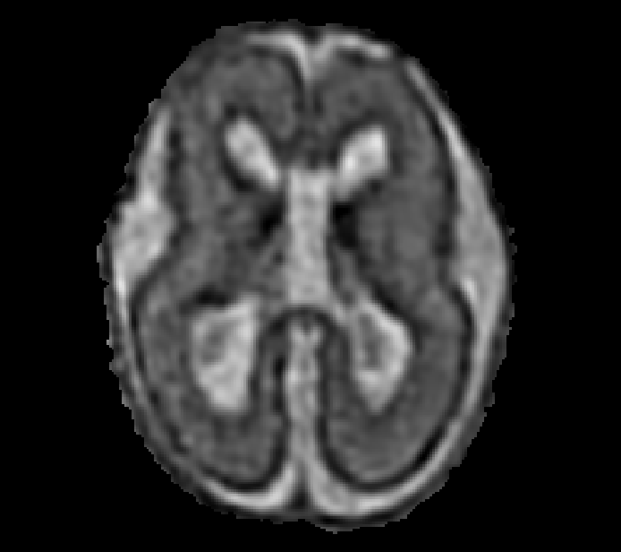
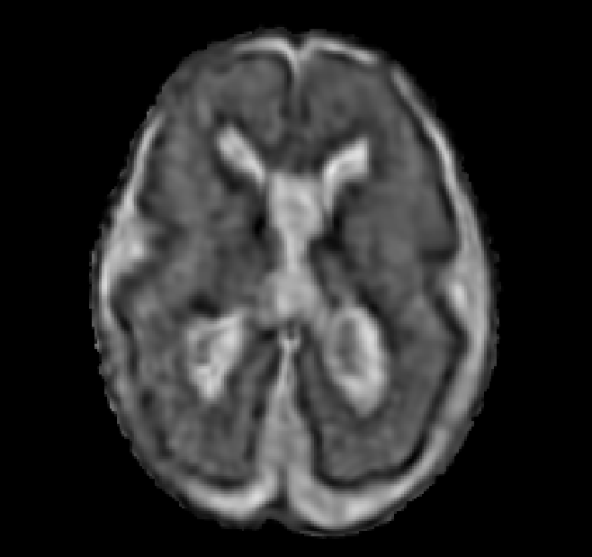
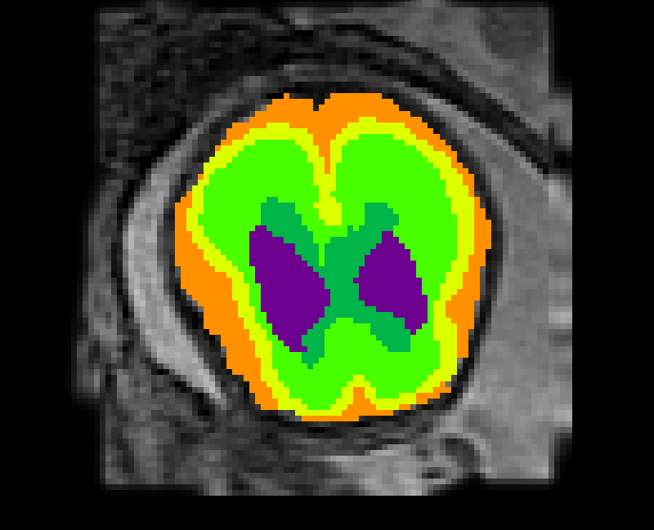
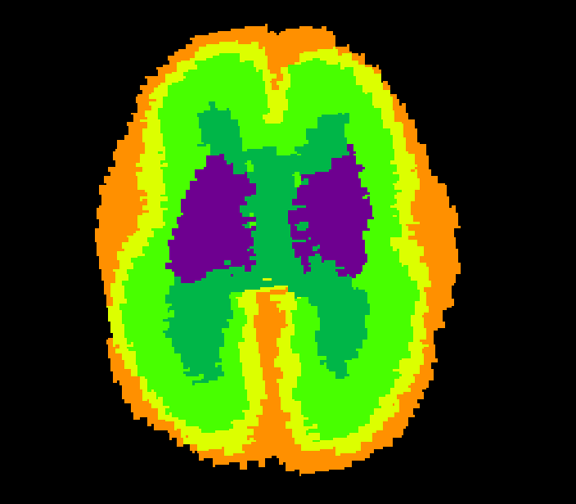
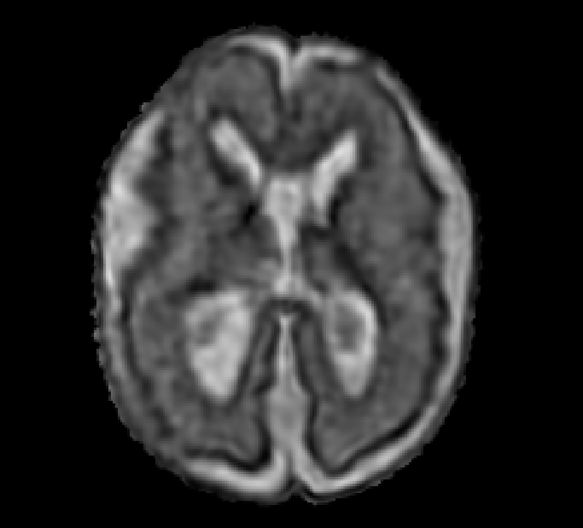
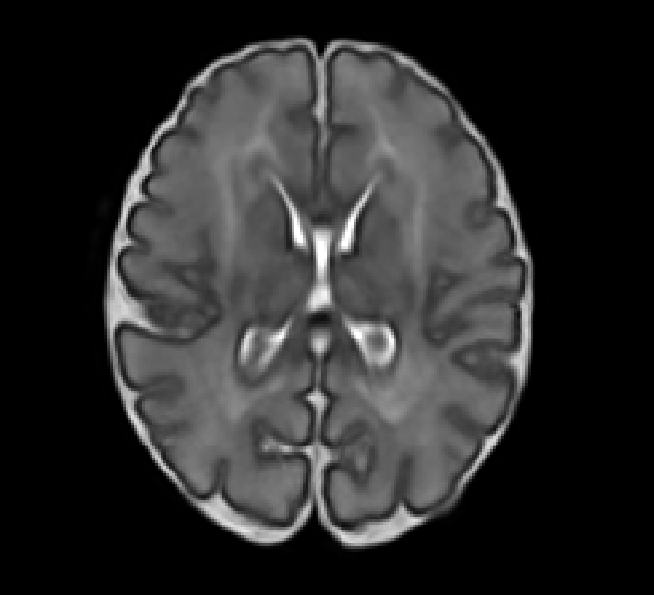
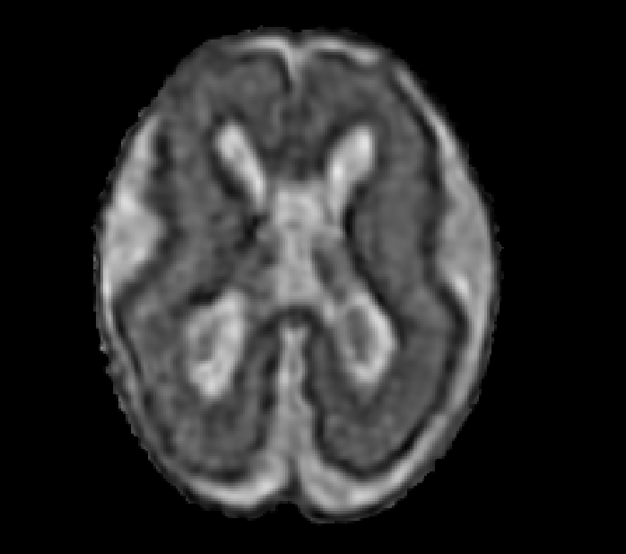
Preprocessing
raw data
brain data
preproc. data
Augmented data
BRAIN EXTRACTION
REGISTRATION
REGISTRATION
Atlas
Brain extraction (BOUNTI) → removal of extra tissue
Rigid registration to atlas space (ANTs) → standard orientation and resolution (176x224x176 vox; 0.5x0.5x0.5 mm³)
Data augmentation (ANTs) → improving data heterogeneity via deformable registration across clinical conditions and processing pipelines (training set N=600)

Slide 4
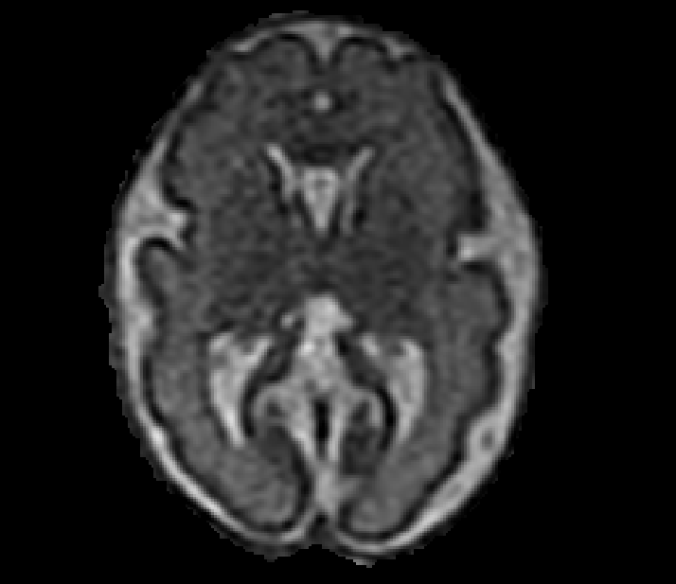
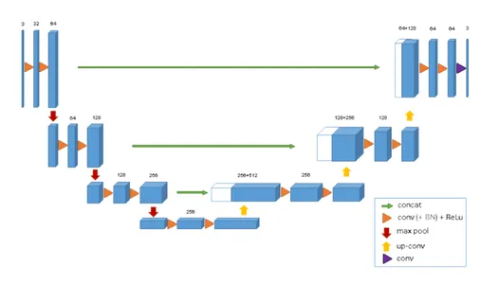
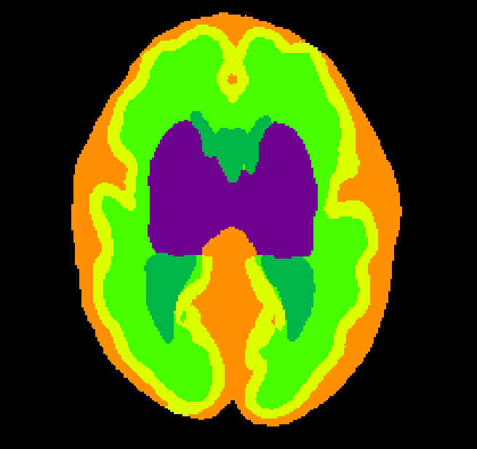

Task 1: tissue segmentation
preproc. data
3D U-NET
pred. labels
Label prediction
Architecture: 3D U-NET (MONAI), 5 layers (channels: 16, 32, 64, 128, 256) with skip connections, 3x3x3 kernel size, 96x96x96 patch size (Total: 4 815 745 parameters)
Data augmentation: dropout, mirroring, rotation, zoom, Gaussian noise, Gaussian blur, random bias field
Training strategy: Adam optimizer (learning rate of 1e-4; batch size of 2 (10% data as validation set); DICE loss function) training for 600 epochs (75h)

Slide 5
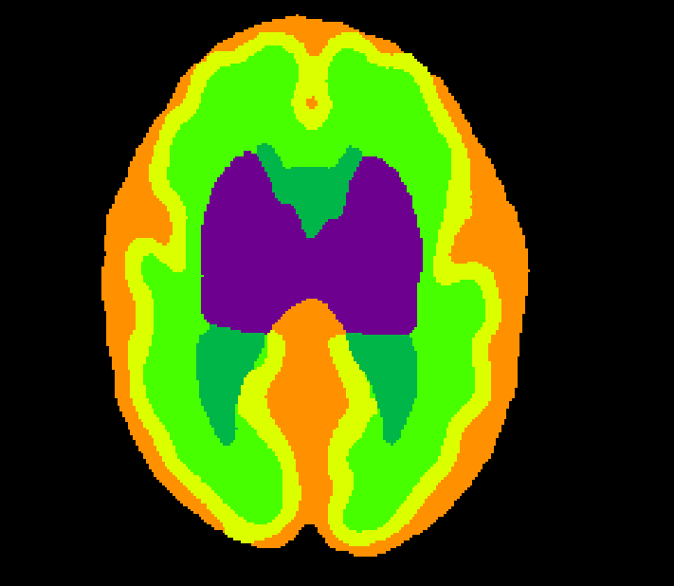
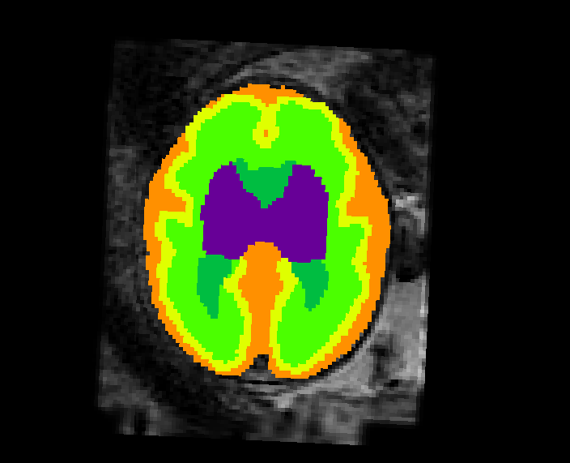
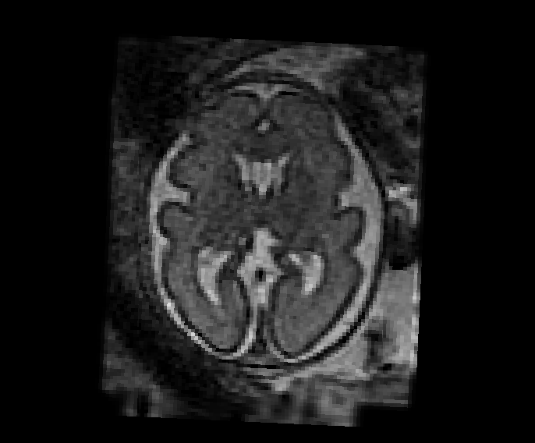
Task 1: Post processing
preproc. data
3D U-NET
pred. labels
autoencoder
denoised labels
labels
INV. TRANSFORM
ENC.
DEC.
Post processing
Label denoising/correction
Architecture: 3D autoencoder (MONAI), 6 layers (3 enc. + 3 dec.; channels: 16, 32, 64), 3x3x3 kernel size of 3x3x3, 96x96x96 patch size (Total: 145 325 parameters)
Data augmentation: region dilatation, dropout, label swapping along the region boundaries
Training strategy: Adam optimizer (learing rate = 1e-4; batch size of 1; DICE loss function) training for 500 epochs (6h)
Resampling
Inverse transform is applied to project the predicted labels to the original space (ANTs)

Slide 6
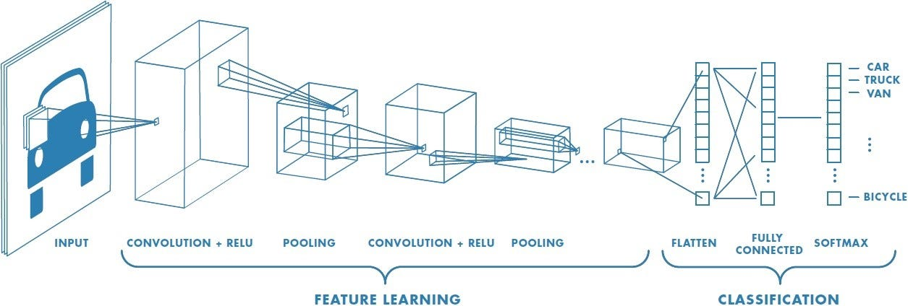

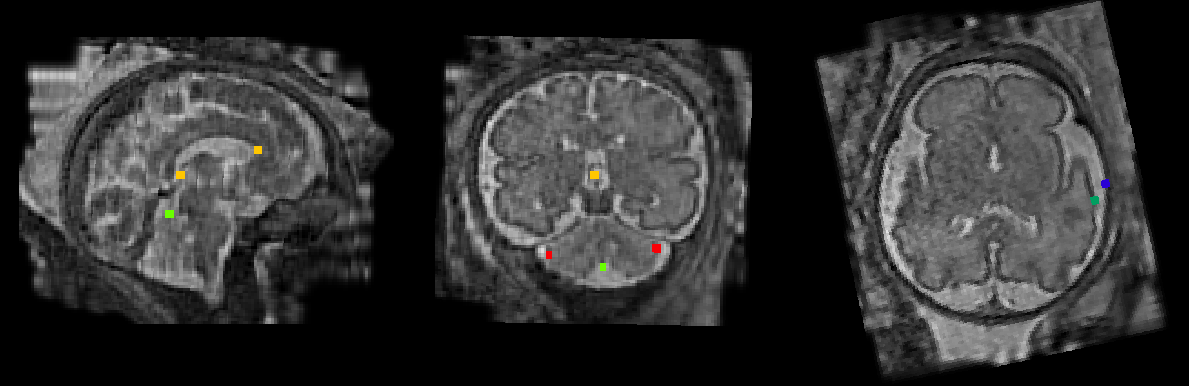
Task 2: Biometric measurements
Coordinates in atlas space
Key-points in original space
denoised labels
coordinates prediction
Local optimization
INV. TRANSFORM
Step 1: key-point coordinate prediction
Architecture: 3D CNN, 4 convolutional layers + 2 max poling layers + 2 downsampling layers + 1 FC layer; kernel size 3x3x3; patch size 128x128x128
Training strategy: Adam optimizer (learning rate of 1e-5; batch size of 10; MSE loss function; early stopping criteria based on loss function)
Step 2: post processing
Local optimization: customized optimization function aiming to evaluate how “external” is the key-point Vs the belonging tissue. Research space constrained to a 2D small patch centered on a the CNN predicted coordinates.
Inverse transform is applied to project the predicted key-points to the original space

Slide 7




CeSNE DIGAIR team
Tommaso Ciceri
Marina Di Stefano
Giulia Frigerio
Giorgio Longari
Francesca Maccarone
Simone Melzi
Denis Peruzzo
Prudentino Rocco
Rizzato Gloria

