Slide 1
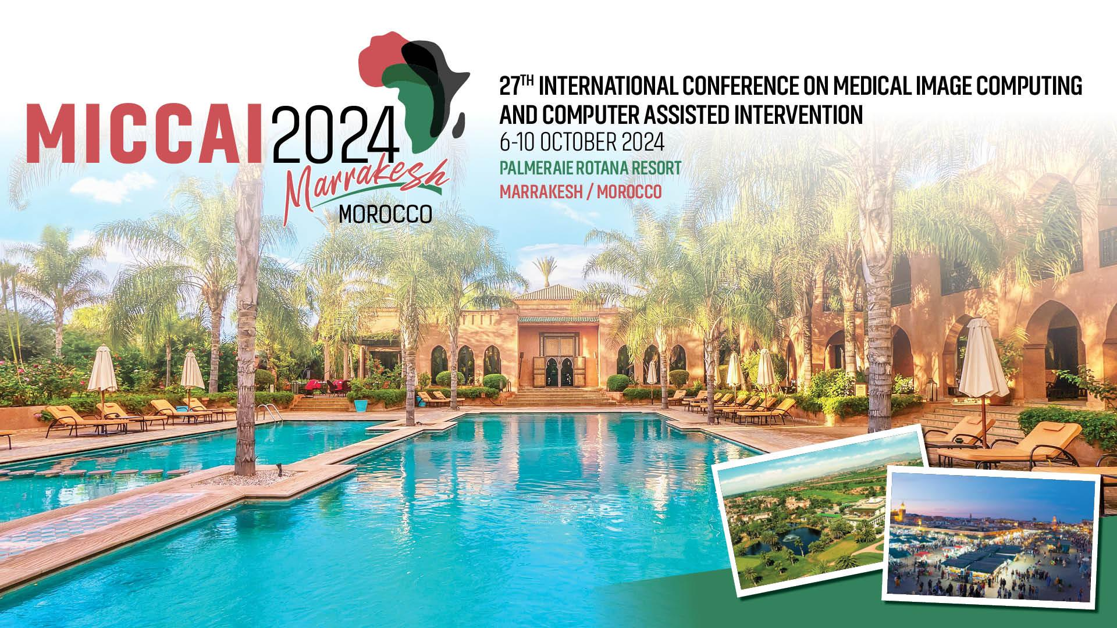
Team FeTA_Sigma: Prenatal Brain Segmentation and Biometry Algorithm Overview
Jingwen Jiang, Lyuyang Tong, Bo Du
School of Computer Science, Wuhan University
williamsriver@whu.edu.cn, Lyuyangtong@whu.edu.cn
Notes:
(20s)
…

Slide 2

Background
Methods
Experiment Setting
Conclusion

Slide 3
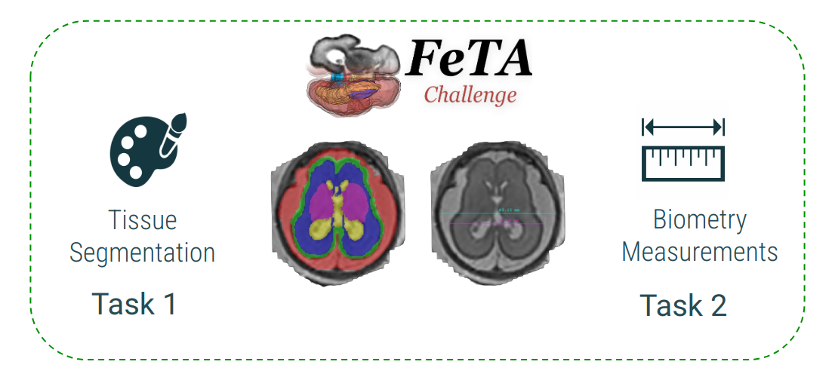
Background
FeTA 2024 Chanllenge
Why It Matters
Fetal MRI helps diagnosis and intervention of congenital disorders
Automated methods help reduce time & human errors
Challenges
Rapid brain changes during prenatal development
Image quality issues (movements, artefacts)
Different morphology of abnormal brains
What’s New in FeTA 2024
Automated Biometry Task: Predict fetal measurements.
Low-field MRI Data: Includes 0.55T MRI.
Goal
Robust algorithms for better prenatal brain segmentation and biometry, enhancing clinical decision-making globally.
Notes:
(30s)
Congenital disorders are a leading cause of infant mortality.
Fetal MRI enables early detection and intervention of neurological issues. On the other hand, automated segmentation and biometry help reduce time cost and human error.
At present, there are still some challenges to overcome in getting better result.
With the new biometry task and more general MRI data in FeTA 2024, our team aim to develop a better and robust algorithm on the two tasks for prenatal brain

Slide 4

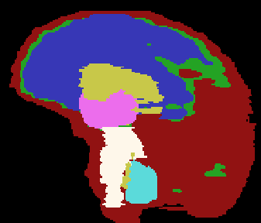
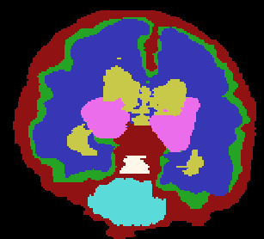
Background
Segmentation Task
Importance
Segmentation of fetal brain tissues is crucial for assessing brain development and detecting early pathologies.
Data
120 cases from two institutions including both neurotypical and pathological brains across varying gestational ages.
Challenge
varying original resolutions between institutions
Intracranial space
Cerebral ventricles
External border of the cortex cerebri
Cerebellum
External border of the white matter
Deep gray matter
Brainstem
Notes:
(10s)
Segmentation task includes 7 tissues, including brains across various gestational ages.

Slide 5
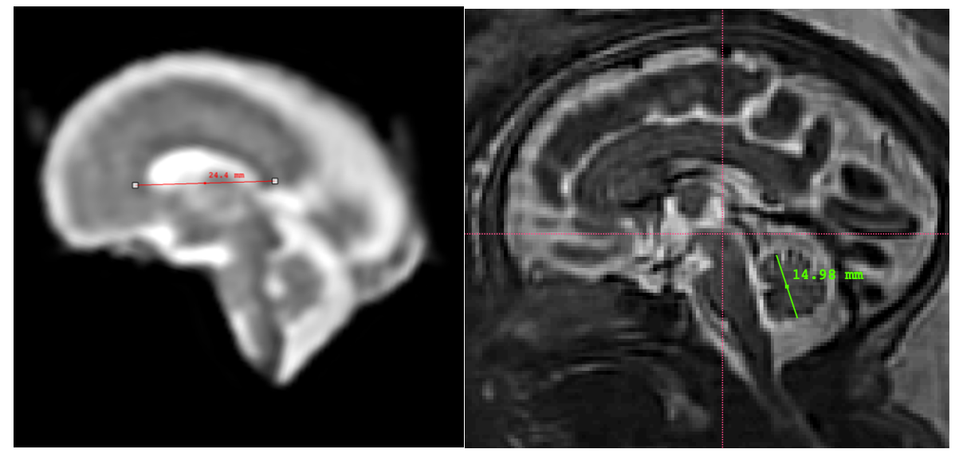
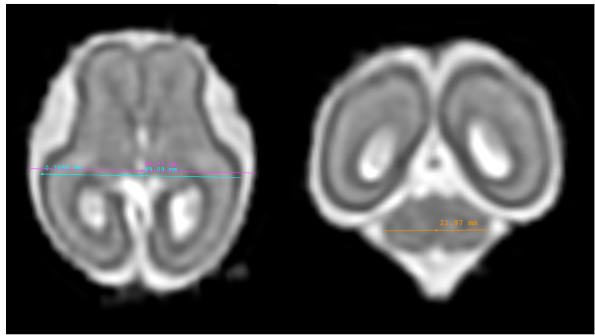
Background
Biometry Task
Importance: Precise measurement of brain structures is key for evaluating fetal brain development and potential abnormalities.
Task: Predict biometric measurements from super-resolution fetal brain images.
Biometry Targets
LCC: length of the corpus callosum
TCD: maximum transverse cerebellar diameter
HV: height of the vermis
bBIP: brain biparietal diameter
sBIP: skull biparietal diameter
Notes:
(10s)
biometry task includes 5 objects, precise measurement is essential for brain development evaluation.

Slide 6
Background
Methods
Experiment Setting
Conclusion

Slide 7
Method Summary
Geometric Transformations
Rotations
Scaling
Cropping
Mirror
Content Alterations
Blurring
Intensity(Contrast & Brightness)
Resolution Simulation
Gamma Transformation
nnUnet
Ensemble
(average)
Segmentation Result
MRI Images
xLSTM-Unet
Classification Network
(nnUnet)
Fetal Statistics
Postprocessing
Gestational age
Linear Regression
Biometry Result
Notes:
(40s)
MRI images must first undergo extensive preprocessing transformations,
which can be categorized into geometric transformations such as rotations or scaling,
and content alterations including blurring or intensity modifications.
The preprocessed images then enter two parallel branches—segmentation and classification—simultaneously.
The results from multiple segmentation models are averaged and subsequently multiplied
element-wise by the binary classification result to yield segmentation outcome that exclude imaging artefacts outside the brain.

Slide 8
Segmentation Models
Input Patch
Conv3D + InstanceNorm
xLSTM
Conv3D + Softmax
Transposed Conv
Conv Module x3
Conv Module x2
Linear
Skip connection
Flip
… x2
… x2
mlstm
SiLU
Flip
Conv Module
Linear
Linear
Conv Module x2
LN
Flatten
xLSTM
IN+LeakyReLU
… x2
… x2
Conv
nnUnet
xLSTM-Unet
Isensee, Fabian, et al. "nnU-Net: a self-configuring method for deep learning-based biomedical image segmentation." Nature methods 18.2 (2021): 203-211.
Chen, Tianrun, et al. "xLSTM-UNet can be an Effective 2D\& 3D Medical Image Segmentation Backbone with Vision-LSTM (ViL) better than its Mamba Counterpart." arXiv (2024).
Notes:
(20s)
For segmentation models, we use nnUnet which can automatically adapts to a given dataset and configure a corresponding segmentation pipeline, and xLSTM-Unet which get good result on medical segmentation recently with its creative improvement from the classic LSTM module.

Slide 9
Biometry Models
Fetal Statistics
Gestational age
Average
LCC
OLS Linear Regression
HV
N
MLP Regression
differences between measurements
Too much?
bBIP
sBIP
Y
Maximum width
With transformation
TCD
Choose
Default One
Notes:
(30s)
There are two main sources for predicting the biometry task:
the first involves identifying the maximum width slice by slice after segmentation,
while the second employs regression based on the gestational age and the length of the measured object in the training set.
We choose to average multiple results or use the default one based on the differences among them.

Slide 10
Background
Methods
Experiment Setting
Conclusion

Slide 11
Experimental Setting
Data Source | Cases
University Children’s Hospital Zurich (Kispi) | 80
General Hospital Vienna/Medical University of Vienna | 40
Model Name | N.O. parameters
nnUnet | 31200424
xLSTM-Unet | 43701120
Hyperparameters | Value
Learning rate | 0.001
Loss function | Dice Loss, Cross Entropy Loss
Optimizer | SGD
Training Epochs | 200
Batch Size | 1
Notes:
(25s)
We use the all the 120 training cases and use cross validation to choose the best model.
The segmentation models we use both have approximately above 30 million training parameters.
We use dice loss and cross entropy loss to supervise the correct shape and class prediction.
Due to the limit of CUDA memory, we could only use a batch size of 1 to train our model.

Slide 12
Background
Methods
Experiment Setting
Conclusion

Slide 13
Conclusion
Algorithm Summary
Segmentation
Models: (1) nnUnet (2) xLSTM-Unet
Preprocessing: Geometric Transformations, Content Alterations
Postprocessing: Remove redundant segmented regions using nnUnet as classification model
Biometry
Apply linear regression to the linear correlation between maternal gestational weeks and the target measurement length
Based on the segmentation results of the organ tissue, find the maximum length of the target measurement on the specified cross-section(using transformation or not)
Notes:
(30s)
In conclusion, We utilized nnUNet and xLSTM-Unet for segmentation,
incorporating transformations as preprocessing and parallel classification as postprocessing.
For biometry, regression assessed the correlation between gestational weeks and measurement lengths,
while segmentation helped identify maximum lengths by slices.
Our approach significantly enhances fetal diagnostics and get a relative good result.

Slide 14

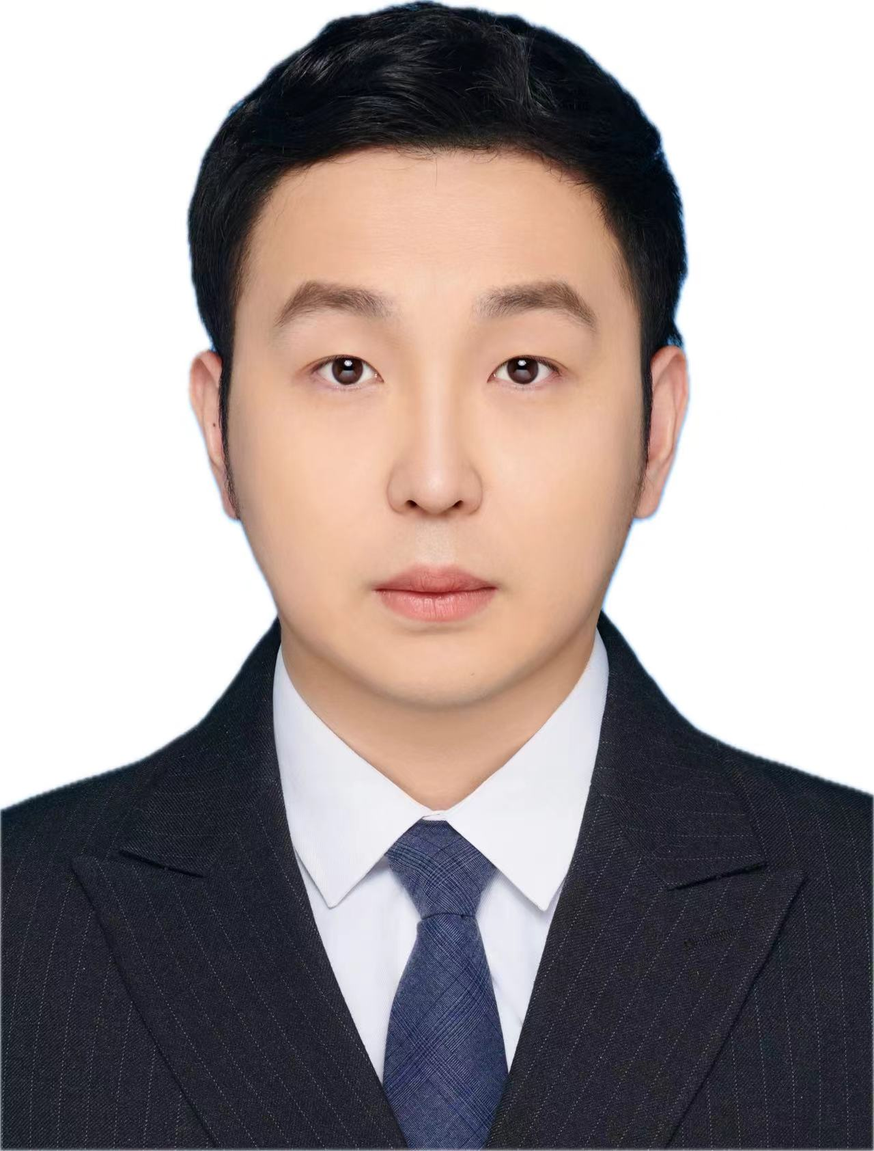
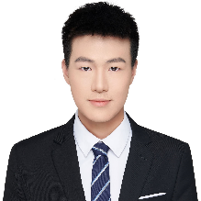



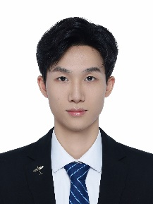
Team Introduction
Bo Du
Professor
Wuhan University
Lyuyang Tong
Postdoctoral
Wuhan University
Jingwen Jiang
Graduate Student
Wuhan University
Chensheng Zhang
Graduate Student
Wuhan University
Hanling Wang
Undergraduate Student
Xi'an Jiaotong-Liverpool University
Xuezhi Zhang
Graduate Student
Wuhan University
Jiarui Cao
Graduate Student
Wuhan University

Slide 15
Thank you !

