Slide 1
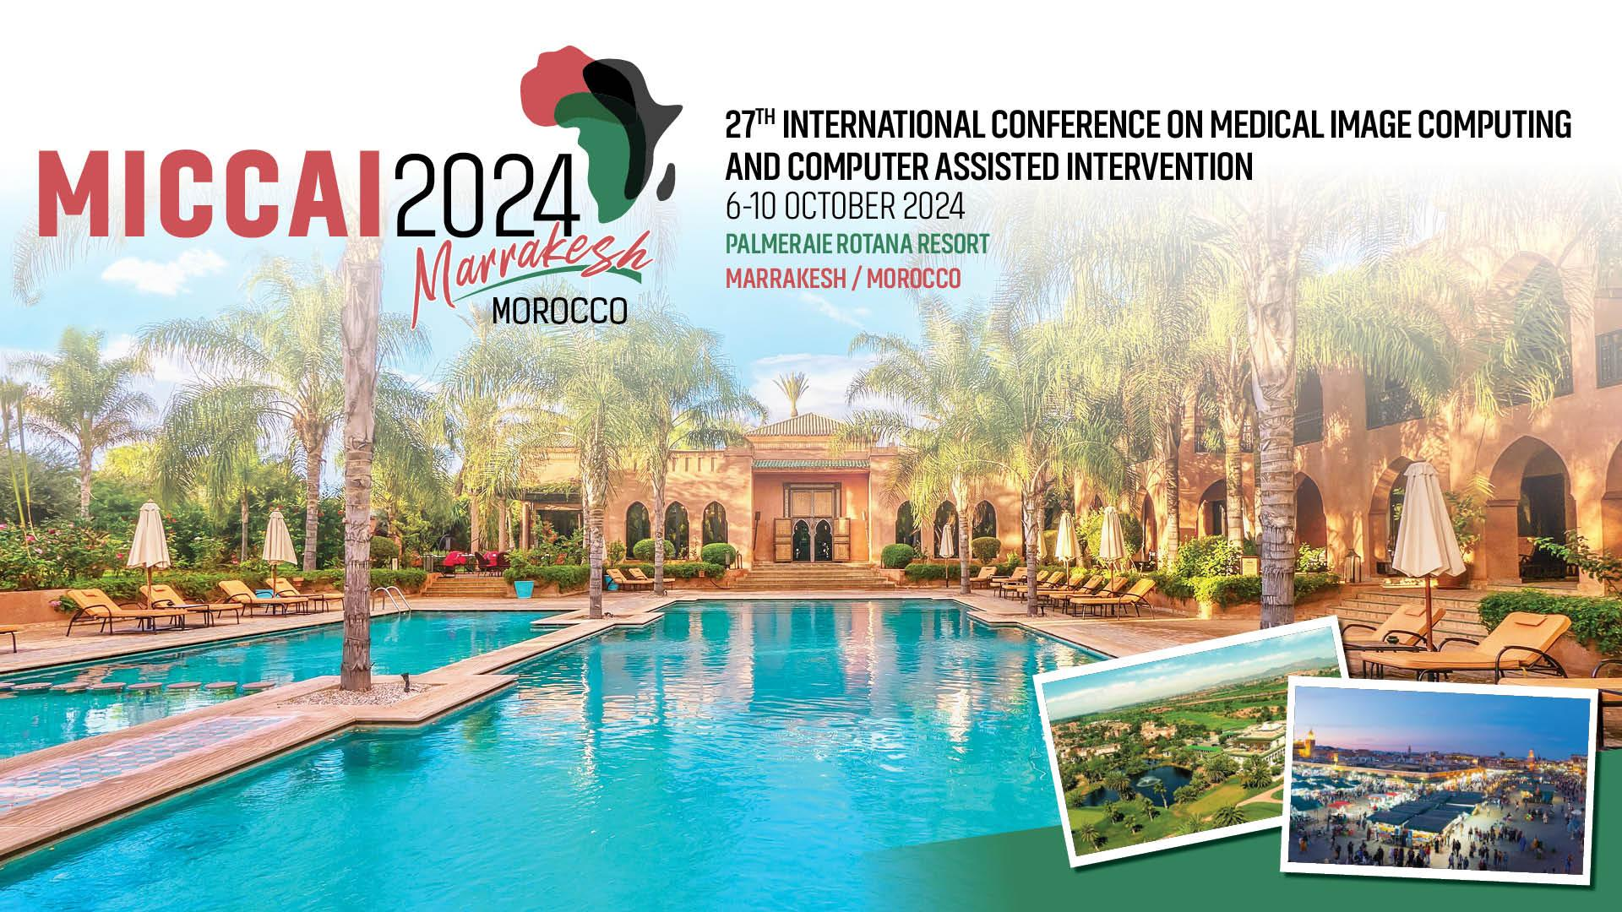

Slide 2



NIC-VICOROB Team: Fetal Tissue Annotation and Segmentation challenge (FeTA 2024)
Rachika E. Hamadache$^{1}$, Amina Bouzid$^{1}$, Ricardo Montoya$^{1}$, Marawan Elbatel$^{2}$,
Cansu Yalçın$^{1}$, Hadeel Awwad$^{1}$, Clara Lisazo$^{1}$, Valeriia Abramova$^{1}$,
Adrià Casamitjana$^{1}$, Arnau Oliver$^{1}$, Robert Martí$^{1}$, and Xavier Lladó$^{1}$
$^{1}$ Research Institute of Computer Vision and Robotics (ViCOROB), Universitat de Girona, Catalonia, Spain
$^{2}$ Hong Kong University of Science and Technology (HKUST)

Slide 3
NIC-VICOROB Team: General pipeline
Keypoints
Use of real and synthetic data during training
Use of random bias field and motion augmentations during training
Use of Sharpness-Aware Minimization optimizer
Finetuning with simulated low-resolution data
FeTA 2024 Challenge
MICCAI October 6-10, 2024 - Marrakesh/MOROCCO
1

Slide 4
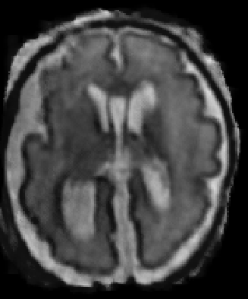
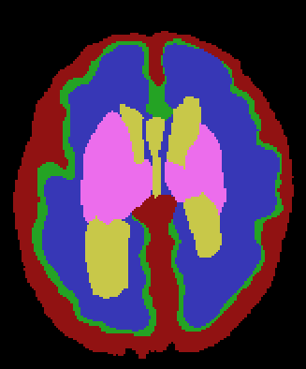
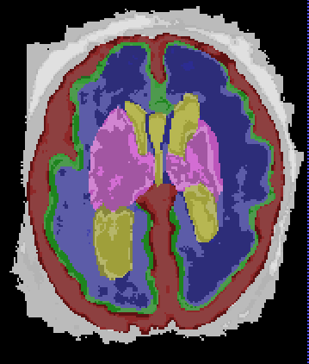
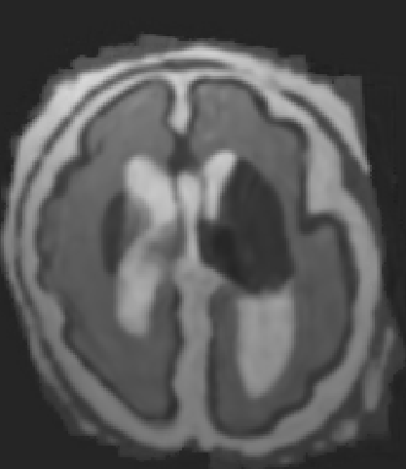
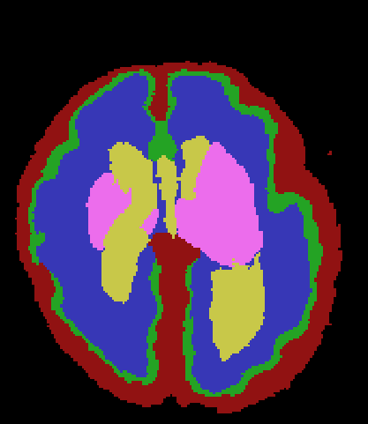
NIC-VICOROB Team: General pipeline
Training data
Original T2w data
Synthetic T2w data
Segmentation mask with subregions
Deformed synthetic T2w images with corresponding tissue masks [1]
FeTA 2024 Challenge
MICCAI October 6-10, 2024 - Marrakesh/MOROCCO
2

Slide 5
NIC-VICOROB Team: General pipeline
Training data
Original T2w data
Synthetic T2w data
Segmentation mask with subregions
Deformed synthetic T2w images with corresponding tissue masks [1]
FeTA 2024 Challenge
MICCAI October 6-10, 2024 - Marrakesh/MOROCCO
2

Slide 6
NIC-VICOROB Team: General pipeline
Training data
Original T2w data
Synthetic T2w data
Segmentation mask with subregions
Deformed synthetic T2w images with corresponding tissue masks [1]
FeTA 2024 Challenge
MICCAI October 6-10, 2024 - Marrakesh/MOROCCO
2

Slide 7
NIC-VICOROB Team: General pipeline
Training data
Original T2w data
Synthetic T2w data
Segmentation mask with subregions
Deformed synthetic T2w images with corresponding tissue masks [1]
[1] Billot, Benjamin, et al. "SynthSeg: Segmentation of brain MRI scans of any contrast and resolution without retraining." Medical image analysis 86 (2023)
FeTA 2024 Challenge
MICCAI October 6-10, 2024 - Marrakesh/MOROCCO
2

Slide 8
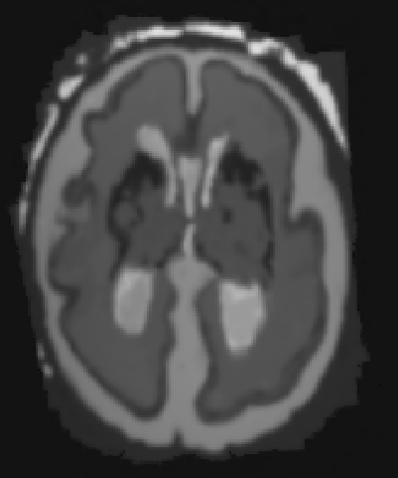
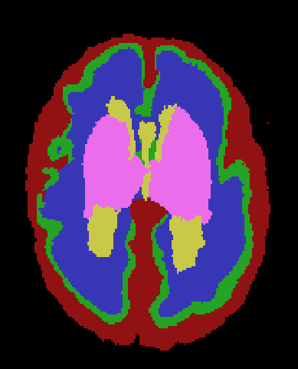
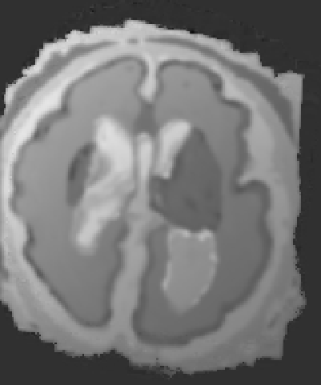
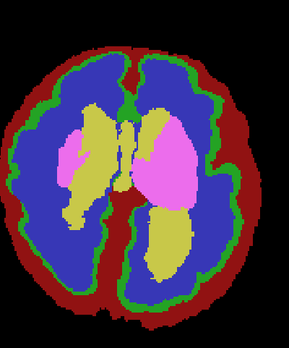
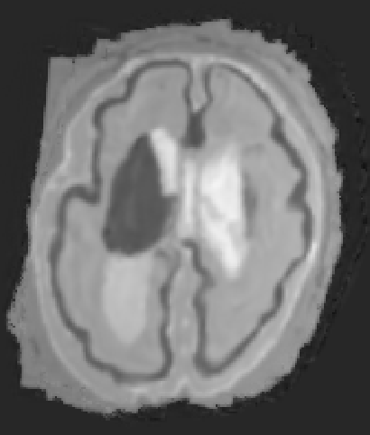
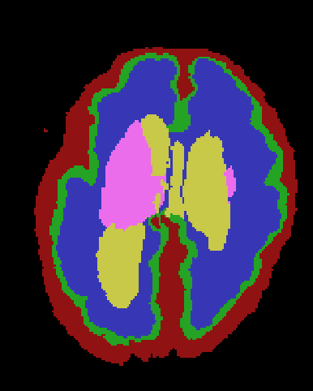
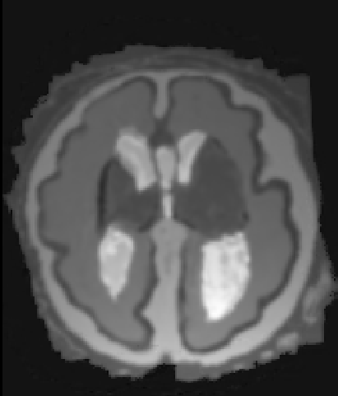
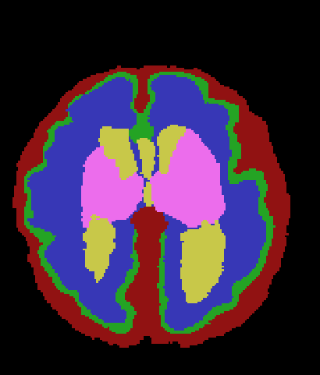
NIC-VICOROB Team: General pipeline
Training data
x5
Original T2w data
Synthetic T2w data
Segmentation mask with subregions
Deformed synthetic T2w images with corresponding tissue masks [1]
[1] Billot, Benjamin, et al. "SynthSeg: Segmentation of brain MRI scans of any contrast and resolution without retraining." Medical image analysis 86 (2023)
FeTA 2024 Challenge
MICCAI October 6-10, 2024 - Marrakesh/MOROCCO
2

Slide 9
NIC-VICOROB Team: General pipeline
Training data
Original T2w data
Synthetic T2w data
Segmentation mask with subregions
Deformed synthetic T2w images with corresponding tissue masks [1]
[1] Billot, Benjamin, et al. "SynthSeg: Segmentation of brain MRI scans of any contrast and resolution without retraining." Medical image analysis 86 (2023)
FeTA 2024 Challenge
MICCAI October 6-10, 2024 - Marrakesh/MOROCCO
2

Slide 10
NIC-VICOROB Team: General pipeline
Training data
Pretraining
Original T2w data
Synthetic T2w data
Fold 0
Fold 1
Fold 2
FeTA 2024 Challenge
MICCAI October 6-10, 2024 - Marrakesh/MOROCCO
3

Slide 11
NIC-VICOROB Team: General pipeline
Training data
Pretraining
Data preprocessing
& augmentation
Original T2w data
Synthetic T2w data
Fold 0
FeTA 2024 Challenge
MICCAI October 6-10, 2024 - Marrakesh/MOROCCO
3

Slide 12
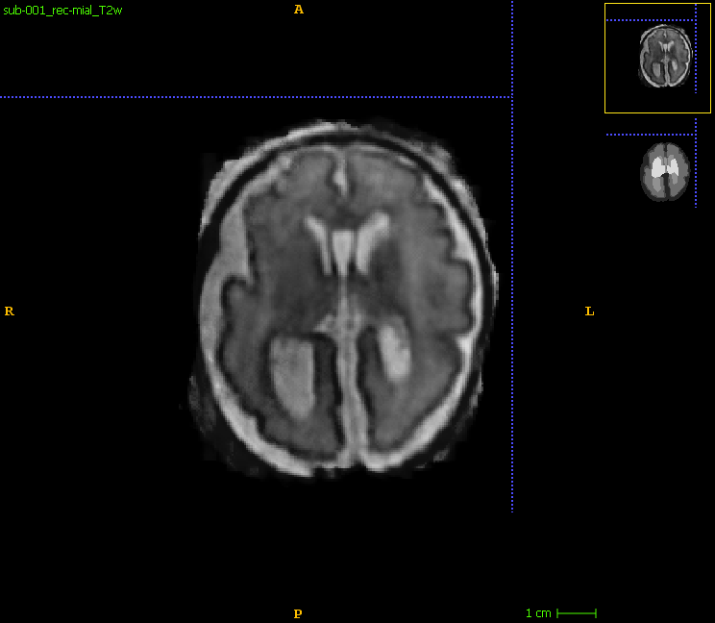
NIC-VICOROB Team: General pipeline
Training data
Pretraining
Data preprocessing
& augmentation
Original T2w data
Synthetic T2w data
Default nnUNet [2] preprocessing
Image resampling to 0.5x0.5x0.5
Random bias field and motion artifacts*
3D patches of 128x128x128
Fold 0
[2] Isensee, Fabian, et al. "nnU-Net: a self-configuring method for deep learning-based biomedical image segmentation." Nature methods 18.2 (2021)
* https://torchio.readthedocs.io/transforms/augmentation.html + https://torchio.readthedocs.io/transforms/augmentation.html
FeTA 2024 Challenge
MICCAI October 6-10, 2024 - Marrakesh/MOROCCO
3

Slide 13
NIC-VICOROB Team: General pipeline
Training data
Pretraining
Data preprocessing
& augmentation
3D nnUNet framework
(full_res)
Original T2w data
Synthetic T2w data
Default nnUNet [2] preprocessing
Image resampling to 0.5x0.5x0.5
Random bias field and motion artifacts*
3D patches of 128x128x128
Fold 0
[2] Isensee, Fabian, et al. "nnU-Net: a self-configuring method for deep learning-based biomedical image segmentation." Nature methods 18.2 (2021)
* https://torchio.readthedocs.io/transforms/augmentation.html + https://torchio.readthedocs.io/transforms/augmentation.html
FeTA 2024 Challenge
MICCAI October 6-10, 2024 - Marrakesh/MOROCCO
3

Slide 14
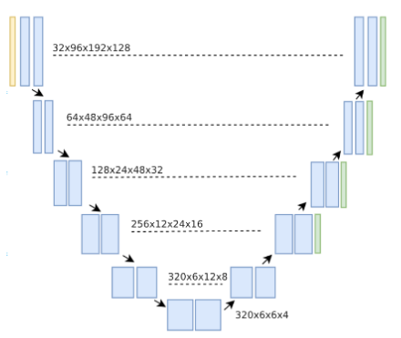
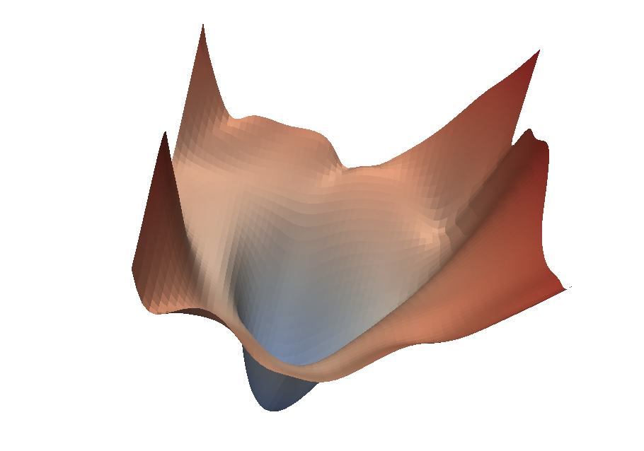
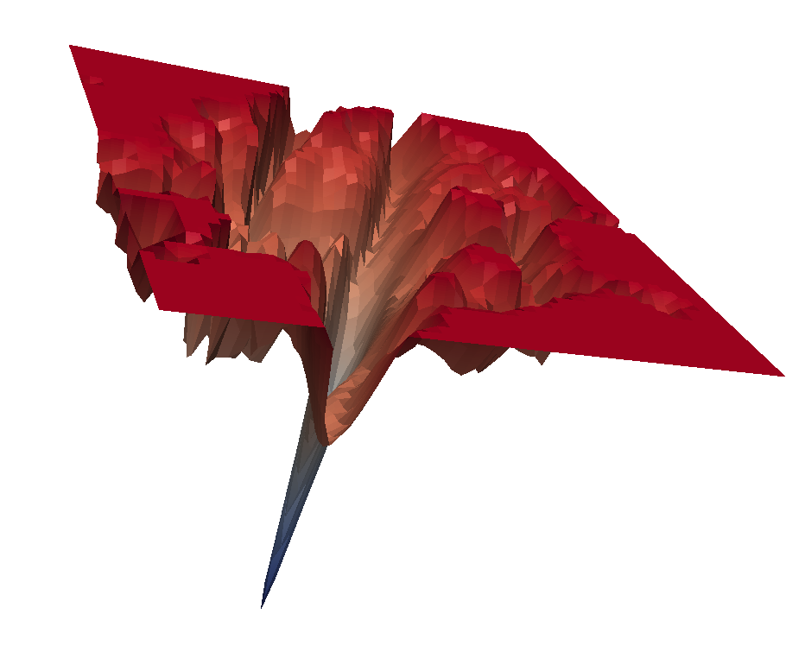
NIC-VICOROB Team: General pipeline
Training data
Pretraining
Data preprocessing
& augmentation
3D nnUNet framework
(full_res)
Original T2w data
Synthetic T2w data
Default nnUNet [2] preprocessing
Image resampling to 0.5x0.5x0.5
Random bias field and motion artifacts*
3D patches of 128x128x128
Default nnUNet configurations
Dice and CrossEntropy losses
SAM optimizer [3]
Fold 0
[2] Isensee, Fabian, et al. "nnU-Net: a self-configuring method for deep learning-based biomedical image segmentation." Nature methods 18.2 (2021)
[3] Foret, Pierre, et al. "Sharpness-aware minimization for efficiently improving generalization." arXiv preprint arXiv:2010.01412 (2020)
* https://torchio.readthedocs.io/transforms/augmentation.html + https://torchio.readthedocs.io/transforms/augmentation.html
FeTA 2024 Challenge
MICCAI October 6-10, 2024 - Marrakesh/MOROCCO
3

Slide 15

NIC-VICOROB Team: General pipeline
Training data
Pretraining
Data preprocessing
& augmentation
3D nnUNet framework
(full_res)
Training
Original T2w data
Synthetic T2w data
Default nnUNet [2] preprocessing
Image resampling to 0.5x0.5x0.5
Random bias field and motion artifacts*
3D patches of 128x128x128
Default nnUNet configurations
Dice and CrossEntropy losses
SAM optimizer [3]
1000 epochs
Fold 0
[2] Isensee, Fabian, et al. "nnU-Net: a self-configuring method for deep learning-based biomedical image segmentation." Nature methods 18.2 (2021)
[3] Foret, Pierre, et al. "Sharpness-aware minimization for efficiently improving generalization." arXiv preprint arXiv:2010.01412 (2020)
* https://torchio.readthedocs.io/transforms/augmentation.html + https://torchio.readthedocs.io/transforms/augmentation.html
FeTA 2024 Challenge
MICCAI October 6-10, 2024 - Marrakesh/MOROCCO
3

Slide 16
NIC-VICOROB Team: General pipeline
Finetuning data
FeTA 2024 Challenge
MICCAI October 6-10, 2024 - Marrakesh/MOROCCO
4

Slide 17
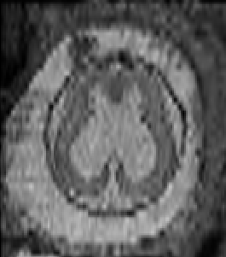
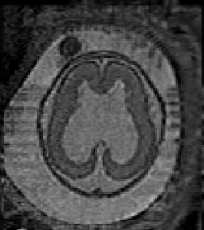
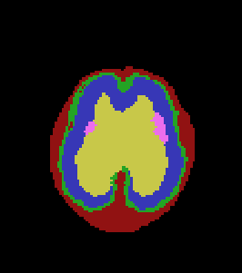
NIC-VICOROB Team: General pipeline
Finetuning data
Original T2w data
Synthetic T2w data
FeTA 2024 Challenge
MICCAI October 6-10, 2024 - Marrakesh/MOROCCO
4

Slide 18
NIC-VICOROB Team: General pipeline
Finetuning data
Original T2w data
Synthetic T2w data
Simulated LR T2w data
Using MONAI’s RandSimulateLowResolution*
+ Resampling to 0.8x0.8x0.8
* https://docs.monai.io/en/stable/transforms.html#randsimulatelowresolution
FeTA 2024 Challenge
MICCAI October 6-10, 2024 - Marrakesh/MOROCCO
4

Slide 19
NIC-VICOROB Team: General pipeline
Finetuning data
Original T2w data
Synthetic T2w data
Simulated LR T2w data
Fold 0
FeTA 2024 Challenge
MICCAI October 6-10, 2024 - Marrakesh/MOROCCO
5

Slide 20
NIC-VICOROB Team: General pipeline
Finetuning data
Finetuning
Original T2w data
Synthetic T2w data
Simulated LR T2w data
Data preprocessing
& augmentation
3D nnUNet framework
(full_res)
Training
Fold 0
200 epochs
FeTA 2024 Challenge
MICCAI October 6-10, 2024 - Marrakesh/MOROCCO
5

Slide 21
NIC-VICOROB Team: General pipeline
Finetuning data
Finetuning
Data preprocessing
& augmentation
3D nnUNet framework
(full_res)
Training
Original T2w data
Synthetic T2w data
Simulated LR T2w data
Postprocessing
FeTA 2024 Challenge
MICCAI October 6-10, 2024 - Marrakesh/MOROCCO
5

Slide 22
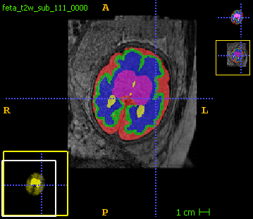
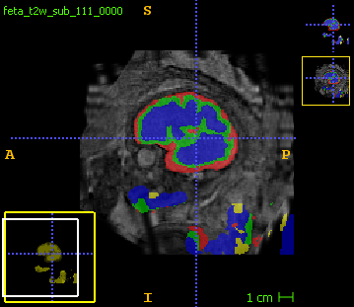
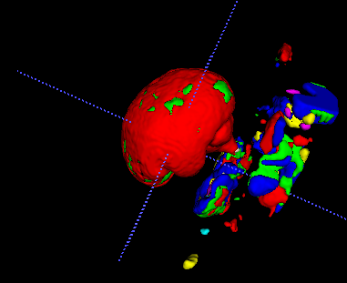
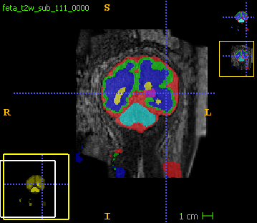
NIC-VICOROB Team: General pipeline
Finetuning data
Finetuning
Data preprocessing
& augmentation
3D nnUNet framework
(full_res)
Training
Original T2w data
Synthetic T2w data
Simulated LR T2w data
Postprocessing
FeTA 2024 Challenge
MICCAI October 6-10, 2024 - Marrakesh/MOROCCO
5

Slide 23
NIC-VICOROB Team: General pipeline
Finetuning data
Finetuning
Finetuning
Data preprocessing
& augmentation
3D nnUNet framework
(full_res)
Training
Original T2w data
Synthetic T2w data
Simulated LR T2w data
Postprocessing
FeTA 2024 Challenge
MICCAI October 6-10, 2024 - Marrakesh/MOROCCO
5

Slide 24
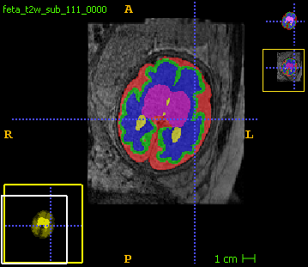
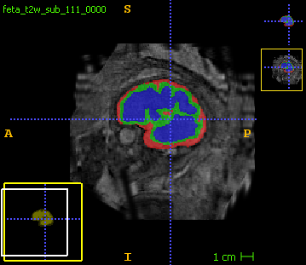
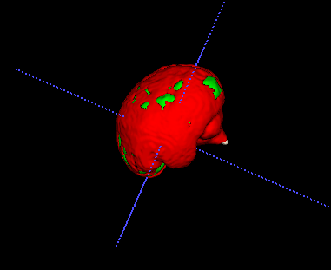
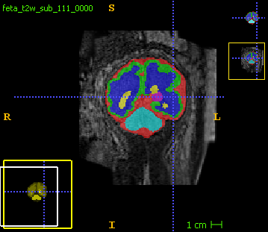
NIC-VICOROB Team: General pipeline
Finetuning data
Finetuning
Data preprocessing
& augmentation
3D nnUNet framework
(full_res)
Training
Original T2w data
Synthetic T2w data
Simulated LR T2w data
Postprocessing
Masking with the brain mask
Keeping only largest centred component
FeTA 2024 Challenge
MICCAI October 6-10, 2024 - Marrakesh/MOROCCO
5

Slide 25
NIC-VICOROB Team: General pipeline
Finetuning data
Finetuning
Data preprocessing
& augmentation
3D nnUNet framework
(full_res)
Training
Original T2w data
Synthetic T2w data
Simulated LR T2w data
Postprocessing
Masking with the brain mask
Keeping only largest centred component
Final prediction
FeTA 2024 Challenge
MICCAI October 6-10, 2024 - Marrakesh/MOROCCO
5

Slide 26
NIC-VICOROB Team: Fetal Tissue Annotation and Segmentation challenge (FeTA 2024)
Rachika E. Hamadache$^{1}$, Amina Bouzid$^{1}$, Ricardo Montoya$^{1}$, Marawan Elbatel$^{2}$,
Cansu Yalçın$^{1}$, Hadeel Awwad$^{1}$, Clara Lisazo$^{1}$, Valeriia Abramova$^{1}$,
Adrià Casamitjana$^{1}$, Arnau Oliver$^{1}$, Robert Martí$^{1}$, and Xavier Lladó$^{1}$
$^{1}$ Research Institute of Computer Vision and Robotics (ViCOROB), Universitat de Girona, Catalonia, Spain
$^{2}$ Hong Kong University of Science and Technology (HKUST)

