Slide 1
Category review: Chips
August 2026
Customer strategy and trial recommendations
Brand note: If client logo is not required, use alternate title page layout right click slide thumbnail > Layout > Title

Slide 2
Notes:
To view Privacy video explaining how important data privacy is to Quantium, please click here: https://www.youtube.com/watch?v=Zq1QDAkoRzU
or here Q:\Company Reference\Brand & Design\Brand videos\Q Privacy.mp4
At Quantium, we believe that data is the behavioural footprint of humanity and that it has to be treated with the utmost care and responsibility.
Histories, attitudes, indeed lives are stored within it in ways that aren’t always apparent – and that’s what makes its potential so powerful.
To work with it responsibly, sensitively, we set ourselves the highest data privacy protection and governance standards.
We have spent 17 years perfecting privacy-by-design and secure-by-design principles. Central to this is not holding any personally identifiable information about people –
we neither receive it, and put the necessary protections in place to be unable to decipher it.
Every aspect of handling data is safeguarded: from its de-identification, to its encryption – data security is paramount and of the highest grade.
We pride ourselves on gaining the trust of iconic organisations around the world through years of securely working with their data,
and in turn the trust that builds with their stakeholders.

Slide 3
Grow chips through targeted activation and selective trial rollout
Answer first: three actions for the next six months
01
02
03
Win the growth segment
Protect the volume base
Scale proven layouts
Target Mainstream young singles/couples with brand-led secondary displays. Prioritise Tyrrells and Twisties, with added visibility in the lead-up to Christmas.
Use value bundles for older and young families. Avoid blanket discounting: the target segment already pays a higher unit price.
Roll out the trial design in stores resembling 77 and 88. Investigate store 86 execution and pricing before another controlled test.

Slide 4
01
Category growth strategy

Slide 5
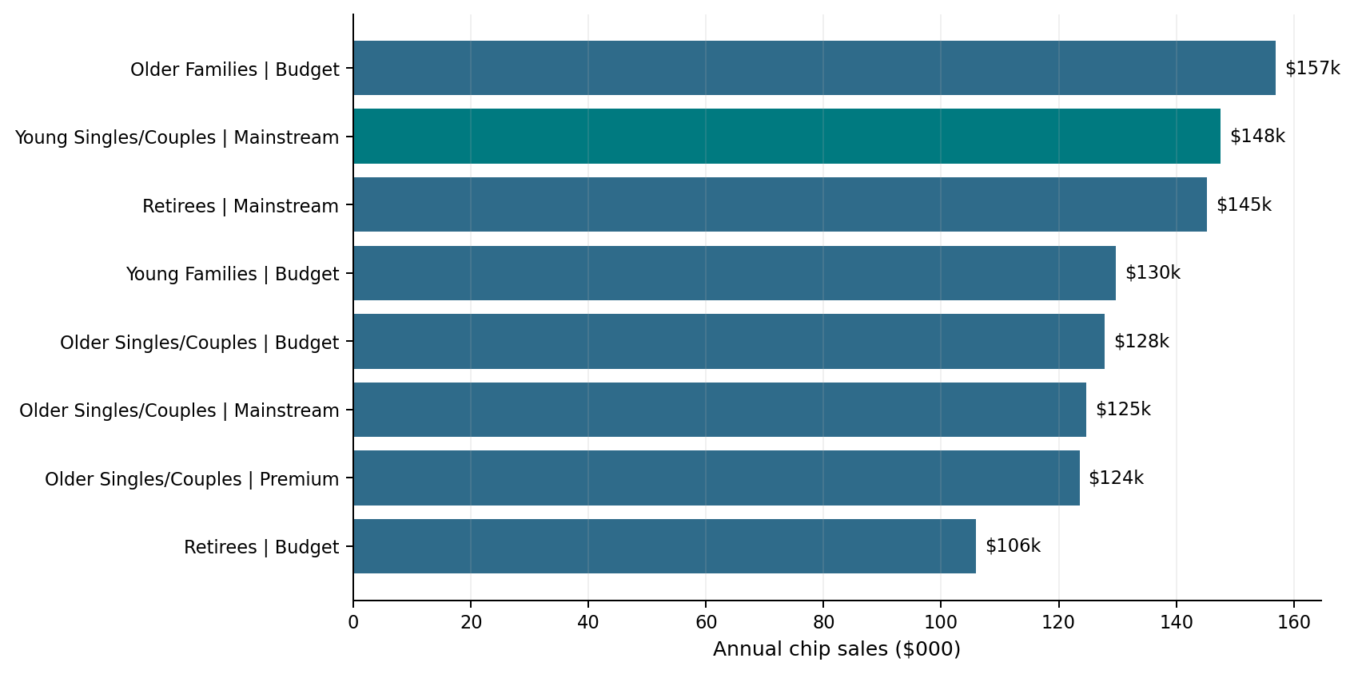
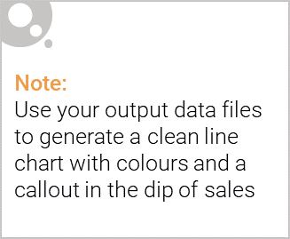
Three customer pools account for one-quarter of category sales
Budget older families lead sales; Mainstream young singles/couples are the clearest growth target
Largest sales pool
Budget older families: $157k, or 8.7% of annual chip sales.
Growth target
Mainstream young singles/couples: $148k and the largest buyer base.
Seasonal opportunity
Transactions rise before Christmas; use gondola ends or promotional displays ahead of the holiday closure.

Slide 6
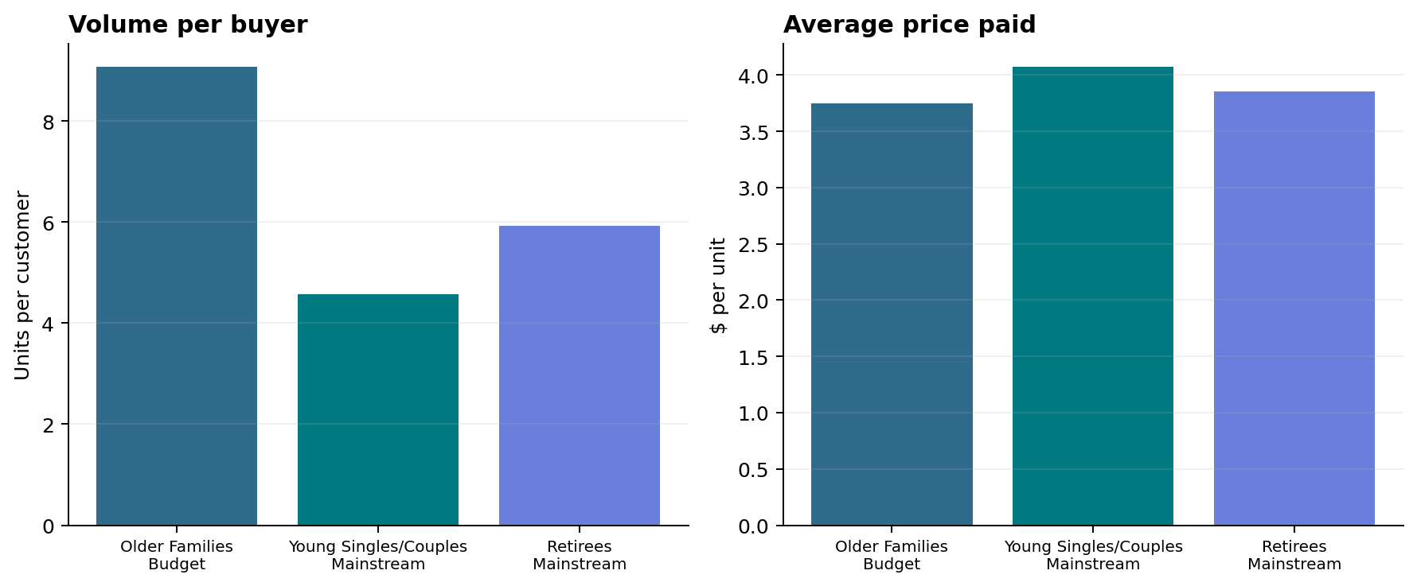
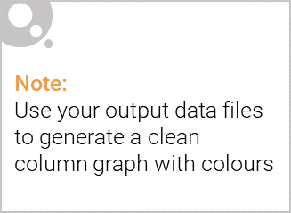
Family volume and young-mainstream pricing drive category spend
Sales = customers × units per customer × average price per unit
Family volume
Older and young families buy more units per customer—protect them with value and bundle mechanics.
Price resilience
Mainstream young and mid-age singles/couples pay significantly more per unit (p < 0.001).
Commercial implication: target offers by mission; do not use a category-wide price cut.

Slide 7
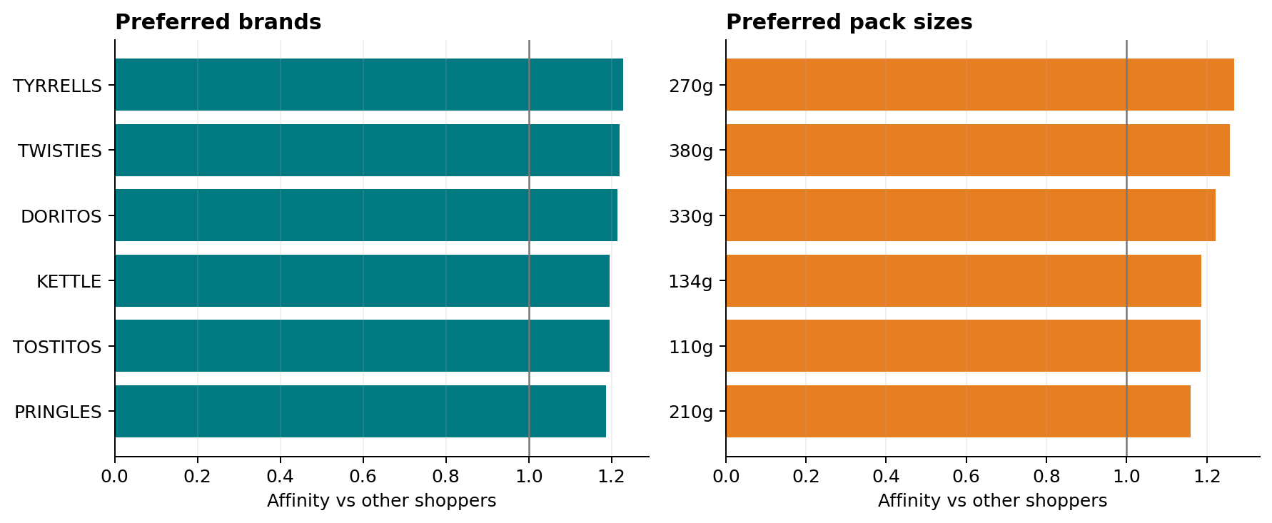
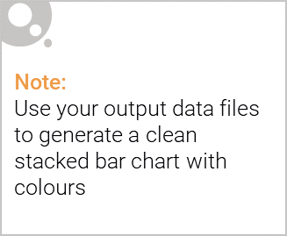
Tyrrells and Twisties are the strongest target-segment plays
Affinity compares the target segment’s unit mix with all other chip buyers
Brand activation
Off-locate Tyrrells and Twisties in high-traffic discretionary space; keep price architecture premium.
Pack-size caveat
270g leads pack affinity, but only Twisties sells this size—do not generalise the effect to other brands.
Measure incremental units, margin and repeat purchase against matched controls.

Slide 8
02
Trial store performance

Slide 9
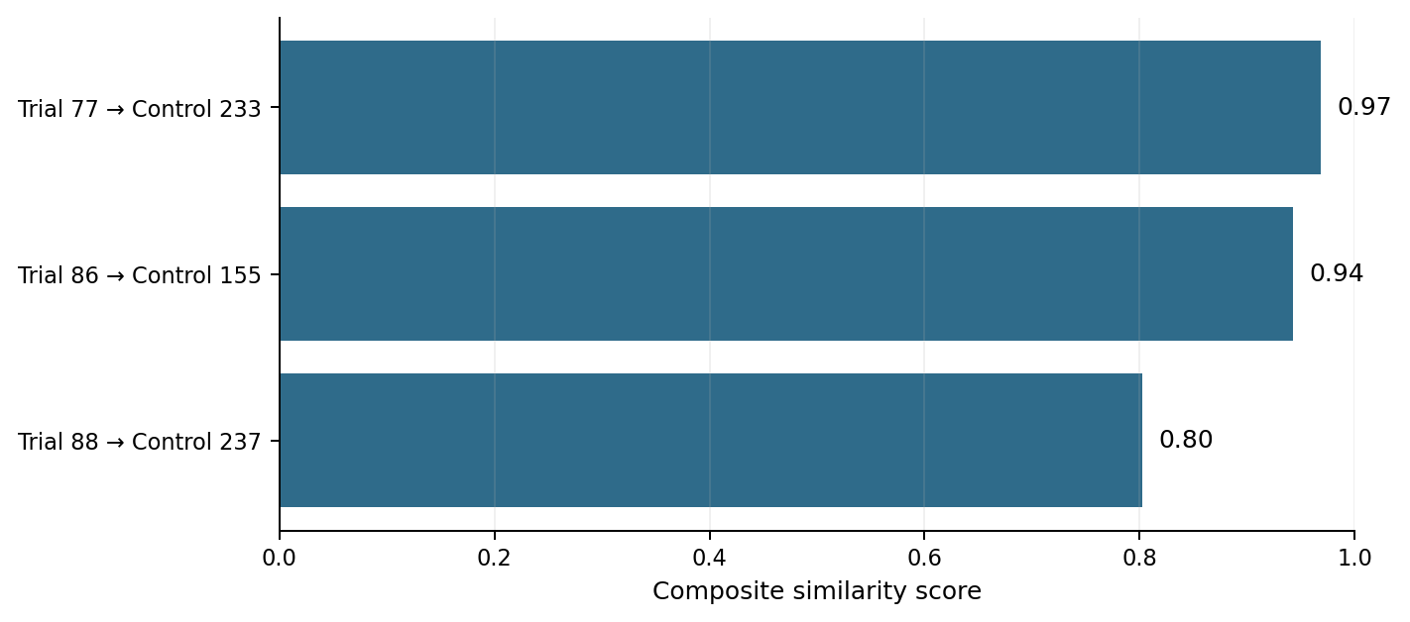
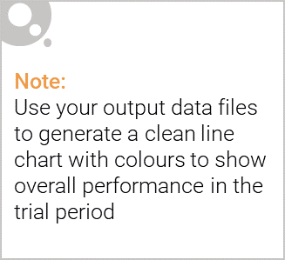
Matched controls isolate trial impact from normal variation
Controls were selected on seven pre-trial months of sales and customer trends and scale
77 → 233
Very strong match across sales and customer behaviour.
86 → 155
Strong match; suitable for diagnosing customer-versus-sales response.
88 → 237
Good match; remaining uncertainty is reflected in the rollout safeguards.
Method: equal-weight composite of Pearson correlation and month-normalised magnitude similarity.

Slide 10
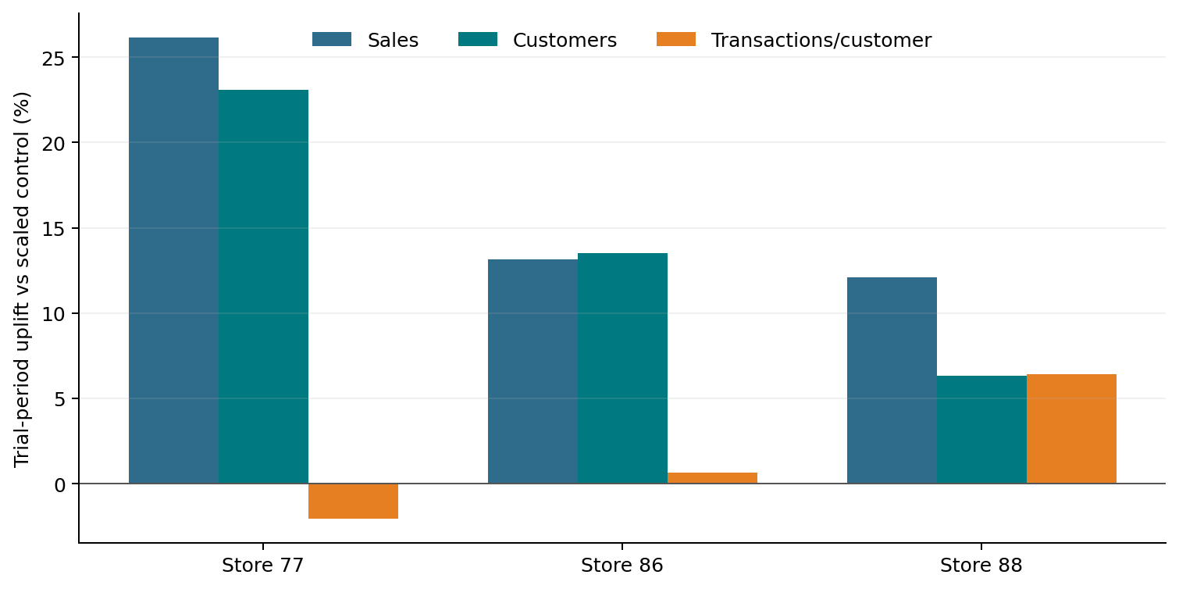
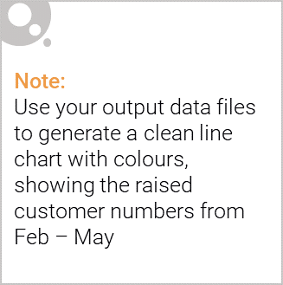
Roll out in stores like 77 and 88; investigate store 86 before retesting
A successful store cleared statistical and commercial thresholds in at least two of three trial months
Store 77 — ROLL OUT
Sales +26%; customers +23%. Growth came from reach, not more transactions per shopper.
Store 86 — INVESTIGATE
Customers +14% but sales were not consistently material. Check pricing, deals and execution.
Store 88 — ROLL OUT
Sales +12%; customers +6%; transactions/customer +6%. Scale to similar stores with monitoring.

